Slide 1
Sequences

Slide 2
Homework Review
Review Homework 07 with a partner.
Focus on:
7.4
7.6
7.7

Slide 3




Sequences
Ordered list of elements
Special function in which domain is a set of consecutive integers (e.g., 1, 2, 3, 4, ...)
Many different sequences used in discrete mathematics
We study them and try to find a way to express them
Examples:
0, 1, 4, 9, 16, 25, 36, ...
0, 1, 8, 27, 64, 125, ...
1, 2, 4, 8, 16, 32, 64, ...
1, 1, 2, 6, 24, 120, 720, ...
0, 1, 1, 2, 3, 5, 8, 13, ...
$$a_{n}^{2}$$
$$a_{n}^{3}$$
$$2^{n}$$
$$a_{n}!$$
$$a_{n}=a_{n−1}+a_{n−2}, for n>1 and a_{0}=0, a_{1}=1$$

Slide 4

Sequences
Arithmetic progression:
$a, a+d, a+d+d, a+d+d+d, …$
$a,a+d, a+2d, a+3d, …,a+nd$
In general, each term is of the form:
$a+nd$
We can also write it in terms of the previous term:
$a_{n+1}=a_{n}+d$
Geometric progression:
$a, ar, ar^{2},ar^{3},…, ar^{n}$
$ar^{n}$
$a_{n+1}=a_{n} ∗ r$

Slide 5
Two special types of sequence
Arithmetic progression
1, 3, 5, 7, 9, ...
0, 7, 14, 21, ...
Geometric progression
1, 2, 4, 8, 16, 32, ...
1, 5, 25, 125, 625, ...

Slide 6

Arithmetic progression
A sequence of numbers separated by a fixed common difference.
Interval = 1: 1, 2, 3, 4, 5, ...
Interval = 2: 1, 3, 5, 7, 9, ...
Interval = 5: 1, 6, 11, 16, 21, ...
Interval = 5: 0, 5, 10, 15, 20, ...
How would you do this in Python?
range(start, stop, step)
Example
$a_{n}=a_{0}+n⋅d, for n≥0$
Does this work if the common difference is not an integer?

Slide 7

Geometric progression
A sequence of numbers separated a common ratio.
Multiple = 1: 1, 1, 1, 1, 1, ...
Multiple = 2: 3, 6, 12, 24, ...
Multiple = 2: 1, 2, 4, 8, 16, 32, ...
Multiple = 3: 1, 3, 9, 27, 81, ...
Multiple = 3: 4, 12, 36, 108, 324, ...
Multiple = 5: 0, 5, 25, 125, 625, ...
How would you do this in Python?
[a_0 * r**n for n in range(0, end)]
$a_{n}=a_{0}⋅r^{n} for n≥0$
Example

Slide 8
Additional Exercises:
8.1.1 a, d, f, g (use python)
8.1.3 a-d (use python)

Slide 9
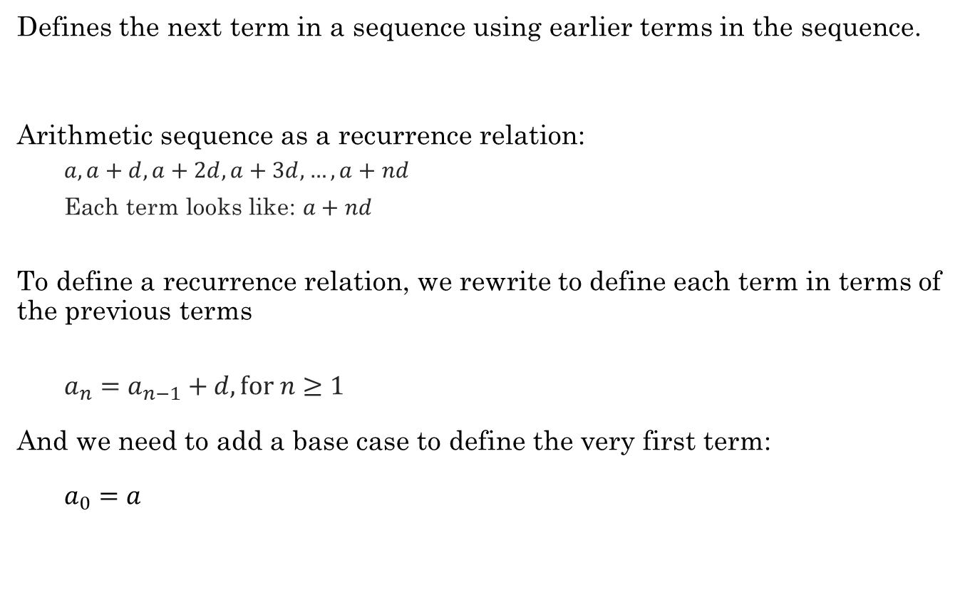
Recurrence Relations
Defines the next term in a sequence using earlier terms in the sequence.
Arithmetic sequence as a recurrence relation:
$a,a+d, a+2d, a+3d, …,a+nd$
Each term looks like: $a+nd$
To define a recurrence relation, we rewrite to define each term in terms of the previous terms
$a_{n}=a_{n−1}+d, for n≥1$
And we need to add a base case to define the very first term:
$a_{0}=a$

Slide 10

Recurrence Relations
Defines the next term in a sequence using earlier terms in the sequence.
Geometric sequence as a recurrence relation:
$a, ar, ar^{2},ar^{3},…, ar^{n}$
Each term looks like: $a⋅r$
To define a recurrence relation, we rewrite to define each term in terms of the previous terms
$a_{n}=a_{n−1}⋅r, for n≥1$
And we need to add a base case to define the very first term:
$a_{0}=a$

Slide 11
Python examples
Recurrence relations in Python

Slide 12
Additional Exercises:
8.2.1 a-c (use python)

