Slide 1
Python recurrence relation examples
Recurrence relations in Python

Slide 2
Additional Exercises:
8.2.1 a-c (use python)

Slide 3
Summations

Slide 4
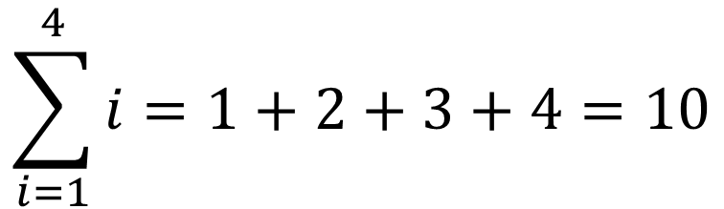
Summations
$$\sum_{i=1}^{4}{i}=1+2+3+4=10$$
In Python:
sum(range(1,5))
reduce(add, range(1,5))
reduce(lambda a,b: a+b, range(1,5))
Examples

Slide 5
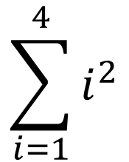
Summations
$$\sum_{i=1}^{4}{i^{2}}$$
sum([i**2 for i in range(1,5)])
or
reduce(add, map(lambda i: i**2, range(1,5)))

Slide 6
Additional Exercises:
8.3.1 a-e (use python)

Slide 7
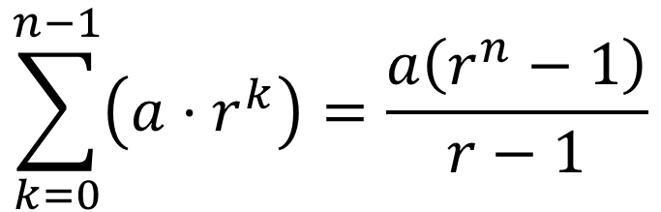
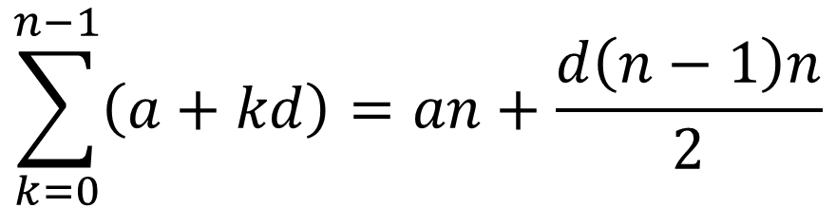
Summations – Closed Forms
Closed form arithmetic sequence:
$$\sum_{k=0}^{n−1}{\left(a+kd\right)=an+\frac{d\left(n−1\right)n}{2}}$$
Closed form geometric sequence:
$$\sum_{k=0}^{n−1}{\left(a⋅r^{k}\right)=\frac{a\left(r^{n}−1\right)}{r−1}}$$

Slide 8
Additional Exercises:
8.3.2 a-e
8.3.3 a-b
8.3.4 a-b
8.3.5

Slide 9
Additional Exercises:
8.3.1 a-e (use python)
8.3.2 a-e
8.3.3 a-b
8.3.4 a-b
8.3.5

