Slide 1
Number Theory
The study of integers

Slide 2
Homework Review
Review Homework 8 with a partner.

Slide 3
Important applications
Division and modular arithmetic
Generating pseudorandom numbers
Check digits
Encryption
Hashing
Assigning memory locations
Arithmetic with LARGE integers. (Too large to be represented easily in a computer)
Prime numbers
Modern cryptography
Rosen, Kenneth. Discrete Mathematics and Its Applications, 7th Edition. McGraw-Hill, 2012

Slide 4
True or False?
3 | 12
3 | 13
13 | 52
14 | 58
1 | n
n | n
n | 0
0 | n
Example
Neff, Rick, and Gopalakrishnan, Ganesh. First Three Odds Double Halve Divide Reciprocate. CRC Press, 2021

Slide 5

Division
If $a$ and $b$ are integers and $a≠0$, we say that $a$ divides $b$ if there is an integer $c$ such that $b=ac$.
In other words, $\frac{b}{a}$ is an integer. There is no remainder.
$a | b$ means $a$ divides $b$
$3 | 12$ is true because $\frac{12}{3}=4$ with no remainder.
$3 | 13$ is not true because $\frac{13}{3}=4 remainder 1 or 4.33\overline{3}$.

Slide 6
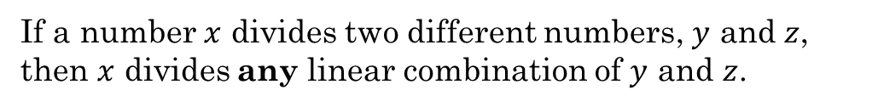
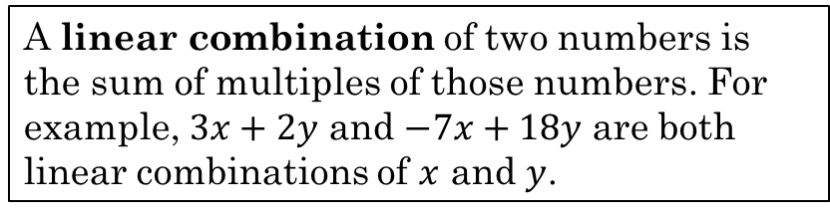
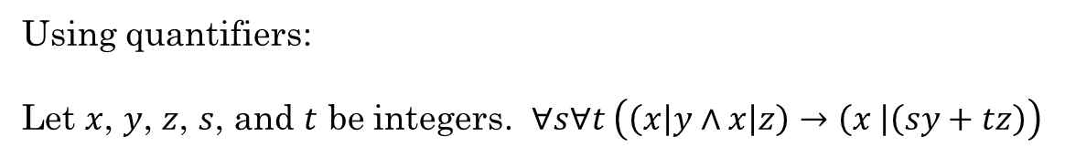
Linear Combinations
If a number $x$ divides two different numbers, $y$ and $z$, then $x$ divides any linear combination of $y$ and $z$.
A linear combination of two numbers is the sum of multiples of those numbers. For example, $3x+2y$ and $−7x+18y$ are both linear combinations of $x$ and $y$.
Let $x$, $y$, and $z$ be integers. If $x|y$ and $x|z$, then $x|(sy + tz)$for any integers $s$ and $t$.
Using quantifiers:
Let $x$, $y$, $z$, $s$, and $t$ be integers. $∀s∀t \left(\left(x\left|y∧x\right|z\right)→\left(x \right|\left(sy+tz\right)\right)$
Explore in Python

Slide 7
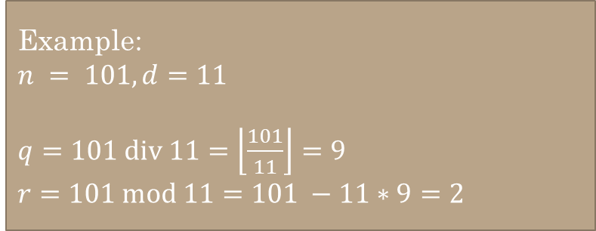



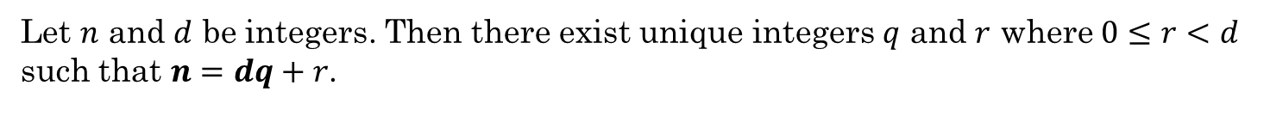
Division Theorem
Dividing an integer by a positive integer produces a quotient $q$ and remainder $r$.
Let $n$ and $d$ be integers. Then there exist unique integers $q$ and $r$ where $0≤r<d$ such that $n=dq+r$.
This is a fancy way of saying that if you divide one integer by another integer, there will be an integer quotient $q$ and a remainder $r$. ($r$ might be $0$)
$$q=n div d=\left\lfloor \frac{n}{d}\right\rfloor$$
$$r=n mod d=n−d\left\lfloor \frac{n}{d}\right\rfloor$$
Example:
$n = 101, d=11$
$q=101 div 11=\left\lfloor \frac{101}{11}\right\rfloor =9$
$r=101 mod 11=101 −11∗9=2$
Python:
q = n // d r = n % d
Rosen, Kenneth. Discrete Mathematics and Its Applications, 7th Edition. McGraw-Hill, 2012

Slide 8








Compute q and r algorithmically
Case 1: n ≥ 0. | Case 2: n < 0.
q := 0 r := n While ( r ≥ d ) q := q + 1 r := r - d End-While | q := 0 r := n While ( r < 0 ) q := q - 1 r := r + d End-While
Use these steps to compute $q$ and $r$ for the following:
$n=29, d=7$
$n=58, d=9$
$q=4, r=$1
$$q=6, r=4$$
$n=−29, d=7$
$n=−58, d=9$
$$q=−5, r=6$$
$$q=−7, r=5$$
Irani, Sandy. Discrete Mathematics, Zyante Inc. (zyBooks.com)

Slide 9
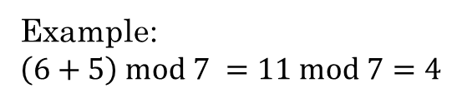
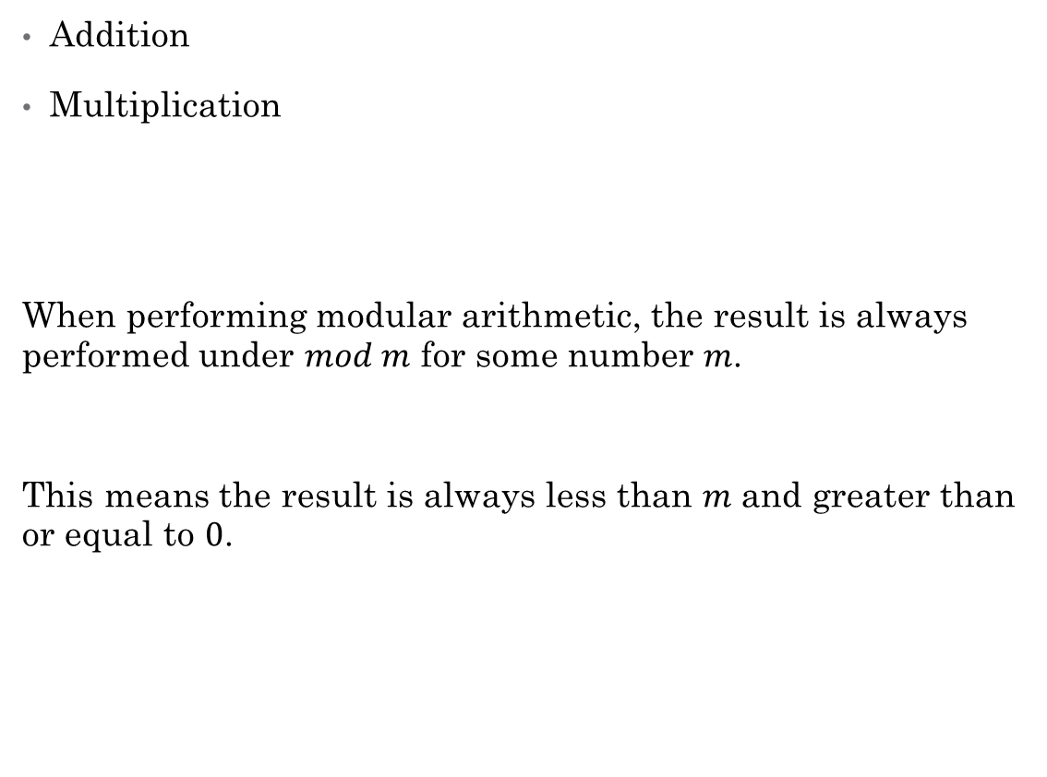
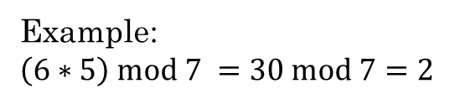
Modular arithmetic
Addition
Multiplication
When performing modular arithmetic, the result is always performed under $mod m$ for some number $m$.
This means the result is always less than $m$ and greater than or equal to $0$.
Example:
$\left(6+5\right) mod 7 =11 mod 7=4$
Example:
$\left(6∗5\right) mod 7 =30 mod 7=2$

Slide 10

Congruences
$a≡_{m}b$ $a$ is congruent modulo $m$ to $b$
$a≡b(mod m)$ $a$ is congruent modulo $m$ to $b$
Both $a$ and $b$ have the same remainder when divided by $m$.
Example:
14 and 21 are congruent modulo 7 because $14 mod 7=21 mod 7=0$
0, 5, 10, 15, 20 are all congruent modulo 5.
So are 1, 6, 11, 16, and 21.

Slide 11

Congruences
Another way to think about it:
$a mod m=b mod m$
0, 12, 24, 36, 48, … are all congruent mod 12
0, 7, 14, 21, 28, … are all congruent mod 7
1, 8, 15, 22, 29… are all congruent mod 7

Slide 12

Congruences
$a≡_{m}b$
$m | a−b$ $7 | 28−14$
$∃c\left(c∗m=a −b\right)$ $c ∗7=28 −14$, $c=2$
$∃k\left(a=k∗m+b\right)$ $28=k ∗7+14$, $k=2$
$\left(a−b\right) mod m=0$ $\left(28 −14\right) mod 7=0$
Python:
a % m == b % m
(a – b) % m == 0
Example

Slide 13
Equivalence Classes
${\left[a\right]}_{R}=\left\{s | \left(a,s\right)∈R\right\}$
Meaning: If we have an equivalence relation $R$ on set $A$, the set of all elements $s$ related to an element $a$ of $A$ is the equivalence class.
In other words, if we have $(a,b)$ as a pair in $R$, then the set of all $b$ for a given $a$ is the equivalence class of that $a$.
Rosen, Kenneth. Discrete Mathematics and Its Applications, 7th Edition. McGraw-Hill, 2012

Slide 14
Example:
Let $A$ be the set of all students in the class.
Let $R$ be the equivalence relation on $A$ represented by all pairs $(x,y)$ where $x$ and $y$ are at the same table.
List out the pairs $\left(x,y\right)$ for your table. $\{(bob,sam), (sam, bob), (bob, sue), (sue, bob),$
$$(sue, sam), (sam, sue), (bob, bob), (sam, sam), (sue, sue)\}$$
What is ${\left[bob\right]}_{R}$?
${\left[bob\right]}_{R}=\{bob, sam, sue\}$
This subset of $A$ consists of all students at the same table as bob. This is the set of all students equivalent to bob with respect to $R$. This subset is an equivalence class of the relation.

Slide 15

Example:
Let $R$ be the equivalence relation congruence modulo 4 where the domain is $ℤ$.
What is ${\left[0\right]}_{R}$?
${\left[0\right]}_{4}=\{…, −8, −4, 0, 4, 8, 12, …\}$
What is ${\left[1\right]}_{R}$?
${\left[1\right]}_{4}=\{…, −7, −3, 1, 5, 9, …\}$
Rosen, Kenneth. Discrete Mathematics and Its Applications, 7th Edition. McGraw-Hill, 2012

Slide 16

Example:
Let $R$ be the equivalence relation on $A$ for congruence modulo 5 where $A$is the set of integers defined by range(-20,21).
Use Python to generate the equivalence class ${\left[3\right]}_{5}$
Example
Rosen, Kenneth. Discrete Mathematics and Its Applications, 7th Edition. McGraw-Hill, 2012

Slide 17

Computing arithmetic operations mod m.
Let m be an integer larger than 1. Let x and y be any integers. Then,
$[(x mod m) + (y mod m)] mod m = [x + y] mod m$
$[(x mod m)(y mod m)] mod m = [xy] mod m$
Let's do Challenge 9.2.1

Slide 18

Computing exponents:
$4610 mod 7$
$= (46 mod 7)10 mod 7$
$= 410 mod 7$
$41 mod 7 = 4$
$42 mod 7 = 4^{1} ∗ 4^{1} mod 7 =4∗4 mod 7=16 mod 7 = 2$
$44 mod 7 = (42 mod 7) ∗ (42 mod 7) = 2 ∗ 2 mod 7 = 4 mod 7 = 4$
$48 mod 7 = (44 mod 7) ∗ (44 mod 7) = 4 ∗ 4 mod 7 = 16 mod 7 = 2$
$410 mod 7 = (48 mod 7) ∗ (42 mod 7) = 2 ∗ 2 mod 7 = 4 mod 7 = 4$
Since $410 mod 7 = 4$, then $4610 mod 7 = 4$

Slide 19
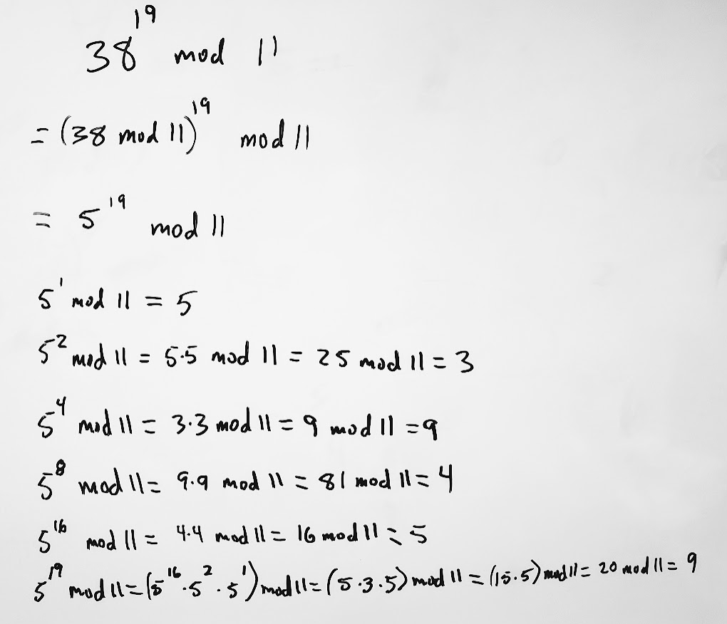
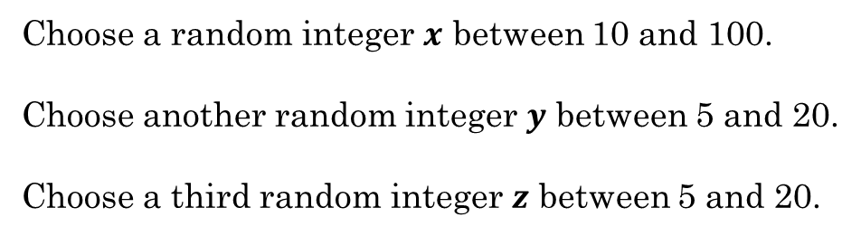
With a partner
Choose a random integer $x$ between 10 and 100.
Choose another random integer $y$ between 5 and 20.
Choose a third random integer $z$ between 5 and 20.
Write a problem on the whiteboard in the form $x^{y} mod n$
Shift one place to the left and solve the problem.

Slide 20
Additional Exercises:
9.1.3 a-d
9.1.4 a-d
9.2.1 a-d
9.2.3 b

Slide 21
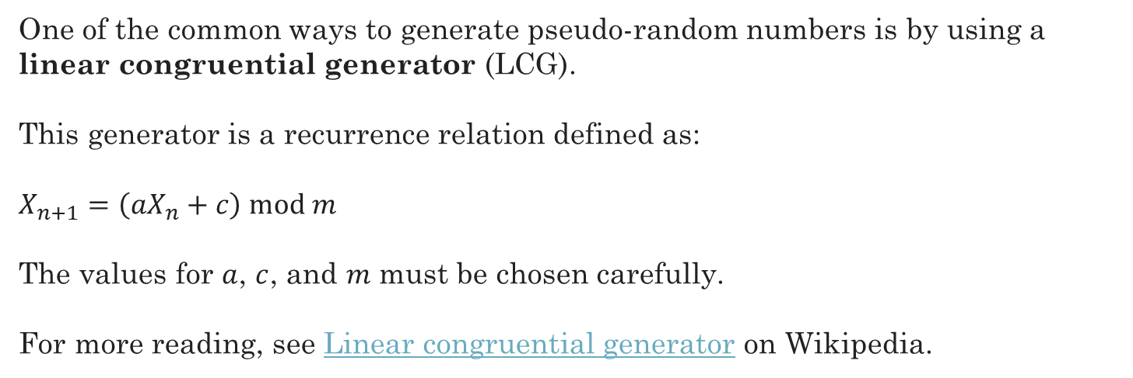
Pseudorandom Number Generators
One of the common ways to generate pseudo-random numbers is by using a linear congruential generator (LCG).
This generator is a recurrence relation defined as:
$X_{n+1}=\left(aX_{n}+c\right) mod m$
The values for $a$, $c$, and $m$ must be chosen carefully.
For more reading, see Linear congruential generator on Wikipedia.
See a LCG implemented in Python

