Slide 1
Prime Numbers

Slide 2

Recall
Computing arithmetic operations mod m.
Let m be an integer larger than 1. Let x and y be any integers. Then,
$[(x mod m) + (y mod m)] mod m = [x + y] mod m$
$[(x mod m)(y mod m)] mod m = [xy] mod m$

Slide 3

Computing exponents:
$4610 mod 7$
$= (46 mod 7)10 mod 7$
$= 410 mod 7$
$41 mod 7 = 4$
$42 mod 7 = 4^{1} ∗ 4^{1} mod 7 =4∗4 mod 7=16 mod 7 = 2$
$44 mod 7 = (42 mod 7) ∗ (42 mod 7) = 2 ∗ 2 mod 7 = 4 mod 7 = 4$
$48 mod 7 = (44 mod 7) ∗ (44 mod 7) = 4 ∗ 4 mod 7 = 16 mod 7 = 2$
$410 mod 7 = (48 mod 7) ∗ (42 mod 7) = 2 ∗ 2 mod 7 = 4 mod 7 = 4$
Since $410 mod 7 = 4$, then $4610 mod 7 = 4$

Slide 4
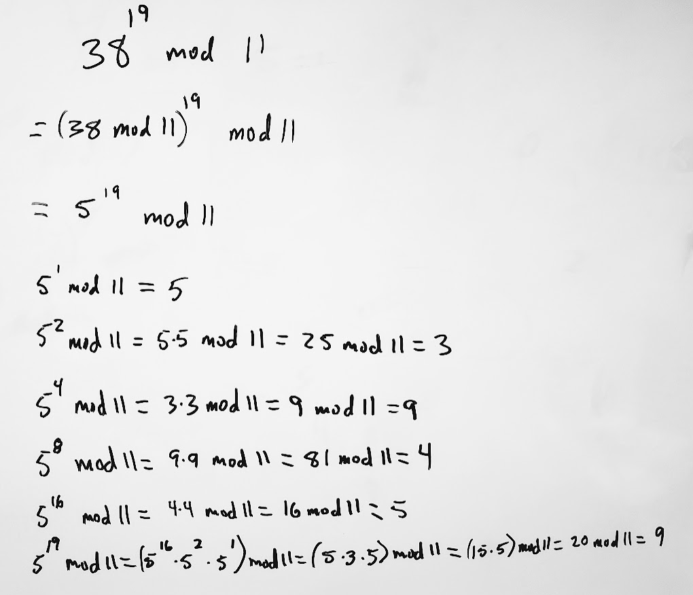
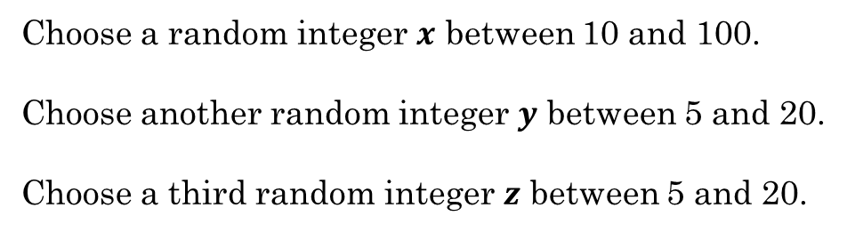
With a partner
Choose a random integer $x$ between 10 and 100.
Choose another random integer $y$ between 5 and 20.
Choose a third random integer $z$ between 5 and 20.
Write a problem on the whiteboard in the form $x^{y} mod z$
Shift one place to the left and solve the problem.

Slide 5
Additional Exercises:
9.1.3 a-d
9.1.4 a-d
9.2.1 a-d
9.2.3 b

Slide 6
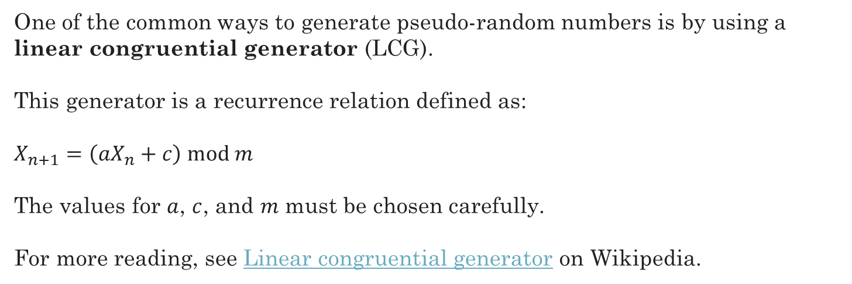
Pseudorandom Number Generators
One of the common ways to generate pseudo-random numbers is by using a linear congruential generator (LCG).
This generator is a recurrence relation defined as:
$X_{n+1}=\left(aX_{n}+c\right) mod m$
The values for $a$, $c$, and $m$ must be chosen carefully.
For more reading, see Linear congruential generator on Wikipedia.
See a LCG implemented in Python

Slide 7


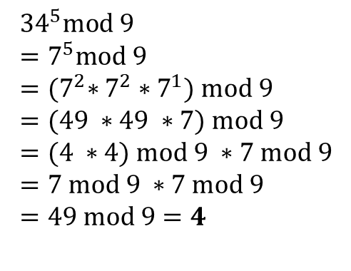
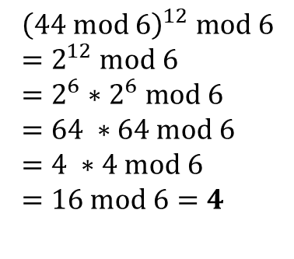
Review
Calculate the following, by hand:
${44}^{12} mod 6$
$${\left(44 mod 6\right)}^{12} mod 6 \\ =2^{12} mod 6 \\ =2^{6}∗2^{6} mod 6 \\ =64 ∗64 mod 6 \\ =4 ∗4 mod 6 \\ =16 mod 6=4$$
${34}^{5} mod 9$
$${34}^{5}mod 9 \\ =7^{5}mod 9 \\ ={(7}^{2}∗7^{2}∗7^{1}) mod 9 \\ =(49 ∗49 ∗7) mod 9 \\ =(4 ∗4) mod 9 ∗7 mod 9 \\ =7 mod 9 ∗7 mod 9 \\ =49 mod 9=4$$

Slide 8
Primes
What's so great about primes?
Building blocks of integers
Cryptology

Slide 9
Primes
What is a prime number?
Divisible only by 1 and itself
2,3,5,7,11,13,17,19...

Slide 10
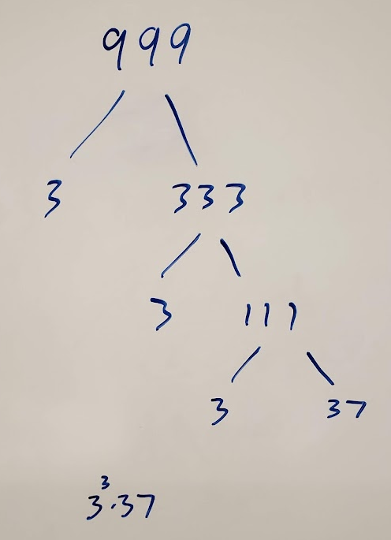
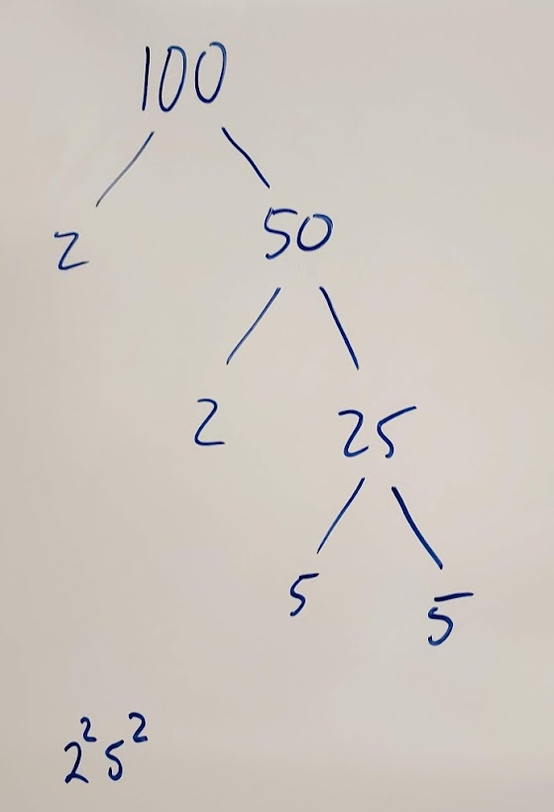
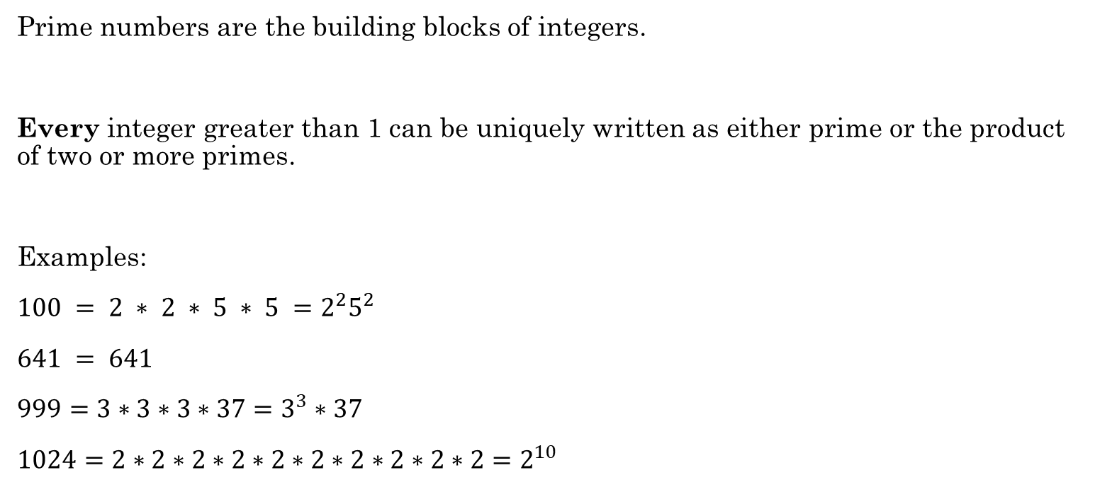
Fundamental Theorem of Arithmetic
Prime numbers are the building blocks of integers.
Every integer greater than 1 can be uniquely written as either prime or the product of two or more primes.
Examples:
$100 = 2 ∗ 2 ∗ 5 ∗ 5 =2^{2}5^{2}$
$641 = 641$
$999=3∗3∗3∗37=3^{3}∗37$
$1024=2∗2∗2∗2∗2∗2∗2∗2∗2∗2=2^{10}$
Use non-decreasing order and exponential notation.
641 is prime

Slide 11
Greatest Common Divisor (GCD)
Greatest Common Divisor – Largest integer that divides both numbers (i.e., the largest factor of both numbers)
What is the GCD of 24 and 36?
Factors of 24: 1, 24, 2, 12, 3, 8, 4, 6
Factors of 36: 1, 36, 2, 18, 3, 12, 4, 9, 6
Relatively Prime or Coprime means their GCD is 1
What is the GCD of 17 and 22?
Factors of 17: 1, 17
Factors of 22: 1, 22, 2, 11
Rosen, Kenneth. Discrete Mathematics and Its Applications, 7th Edition. McGraw-Hill, 2012

Slide 12
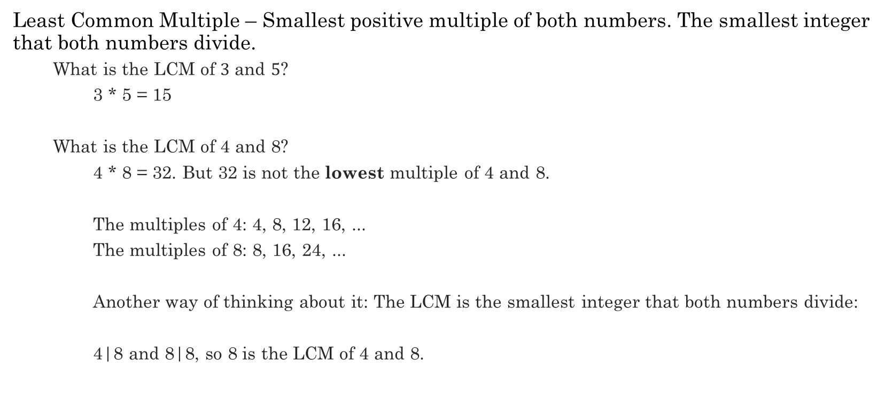
Least Common Multiple (LCM)
Least Common Multiple – Smallest positive multiple of both numbers. The smallest integer that both numbers divide.
What is the LCM of $3$ and $5$?
3 * 5 = 15
What is the LCM of 4 and 8?
4 * 8 = 32. But 32 is not the lowest multiple of 4 and 8.
The multiples of 4: 4, 8, 12, 16, ...
The multiples of 8: 8, 16, 24, ...
Another way of thinking about it: The LCM is the smallest integer that both numbers divide:
4|8 and 8|8, so 8 is the LCM of 4 and 8.
Multiples of 3: 3, 6, 9, 12, 15, 18, ...
Multiples of 5: 5, 10, 15, 20, ...
The smallest common multiple of both numbers is 8
Rosen, Kenneth. Discrete Mathematics and Its Applications, 7th Edition. McGraw-Hill, 2012

Slide 13


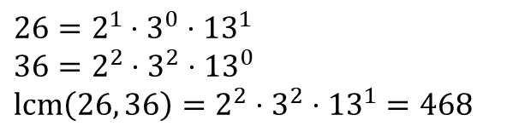
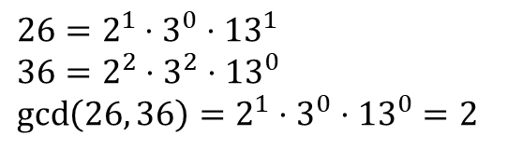

Finding GCD and LCM with Prime Factorization
What is the prime factorization of 26?
What is the prime factorization of 36?
What is gcd(26, 36)?
What is lcm(26,36)?
Given:
$x$ = $p_{1}^{a_{1}}⋅p_{2}^{a_{2}}⋅⋅⋅p_{r}^{a_{r}}$
$y=p_{1}^{b_{1}}⋅p_{2}^{b_{2}}⋅⋅⋅p_{r}^{b_{r}}$
Then:
$\gcd\left(x,y\right)=p_{1}^{\min\left\{a_{1}, b_{1}\right\}}⋅p_{2}^{\min\left\{a_{2},b_{2}\right\}}⋅⋅⋅p_{r}^{\min\left\{a_{r}, b_{r}\right\}}$
$\operatorname{lcm}\left(x,y\right)=p_{1}^{\max\left\{a_{1}, b_{1}\right\}}⋅p_{2}^{\max\left\{a_{2},b_{2}\right\}}⋅⋅⋅p_{r}^{\max\left\{a_{r}, b_{r}\right\}}$
$$2⋅13$$
$$2^{2}⋅3^{2}$$
$26=2^{1}⋅3^{0}⋅{13}^{1}$
$36=2^{2}⋅3^{2}⋅{13}^{0}$
$\gcd\left(26, 36\right)=2^{1}⋅3^{0}⋅{13}^{0}=2$
$26=2^{1}⋅3^{0}⋅{13}^{1}$
$36=2^{2}⋅3^{2}⋅{13}^{0}$
$\operatorname{lcm}\left(26, 36\right)=2^{2}⋅3^{2}⋅{13}^{1}=468$

Slide 14

Finding Primes
Trial Division (Brute Force)
Divide by each prime up to $\sqrt{n}$
Example: Is 421 prime?
Sieve of Eratosthenes
Whiteboard demo
Python demo
2 | 421 no
3 | 421 no
5 | 421 no
7 | 421 no
11 | 421 no
13 | 421 no
17 | 421 no
19 | 421 no
421 is prime
Can we use brute force to figure out if this number is prime?
35201546659608842026088328007565866231962578784643756647773109869245232364730066609837018108561065242031153677

Slide 15
Additional Exercises:
9.3.1 a-f
9.3.2 a-d

Slide 16
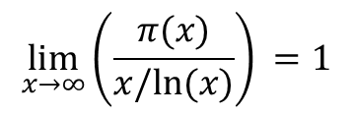



Prime Number Theorem
There are an infinite number of primes
The Prime Number Theorem:
Helps us estimate how many prime numbers are in the range 2 through x.
We define $π\left(x\right)$ as the number of primes from 2 to $x$.
Then,
The ratio of prime numbers between 2 and x to all numbers between 2 and x approaches 1/ln x as x approaches infinity.
$$\lim_{x→∞}{{\left(\frac{π(x)}{x/ln⁡(x)}\right)}^{ }=1}$$
$${{\left(\frac{π(x)}{x}\right)}^{ }≈\frac{1}{ln⁡(x)}}$$
$$π\left(x\right)≈\frac{x}{ln⁡(x)}$$

Slide 17






Prime Number Theorem
The ratio of primes to all numbers is approximately $1/ln⁡(x)$.
Example:
How many primes are there between 2 and 1000?
$$\frac{x}{\ln\left(x\right)}=\frac{1000}{ln⁡(1000)}≈145$$
$${{\left(\frac{π(x)}{x}\right)}^{ }≈\frac{1}{ln⁡(x)}}$$
As $x$ gets larger, the ratio gets smaller.
In other words, primes become more sparse the larger the range.
If we choose a random number between 2 and $x$, the likelihood that it is prime is $1/ln⁡(x)$.
$$π\left(x\right)≈\frac{x}{ln⁡(x)}$$
The number of primes in the range 2 through $x$ is approximately
In Python, $ln⁡(x)$ is math.log(x)
Python demo

Slide 18
Additional Exercises:
9.3.1 a-f
9.3.2 a-d
9.4.1 a-c
9.4.2 a-d

Slide 19

$2^{31}−1 = 2147483647$
(Prime or not? How do you tell, easily?)
2+1+4+7+4+8+3+6+4+7 = 45
4 + 5 = 9
Therefore, this number is divisible by both 3 and 9 and NOT prime

