Slide 1
Euclidean Algorithm

Slide 2
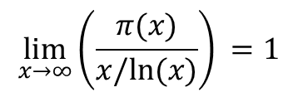



Prime Number Theorem
There are an infinite number of primes
The Prime Number Theorem:
Helps us estimate how many prime numbers are in the range 2 through x.
We define $π\left(x\right)$ as the number of primes from 2 to $x$.
Then,
The ratio of prime numbers between 2 and x to all numbers between 2 and x approaches 1/ln x as x approaches infinity.
$$\lim_{x→∞}{{\left(\frac{π(x)}{x/ln⁡(x)}\right)}^{ }=1}$$
$${{\left(\frac{π(x)}{x}\right)}^{ }≈\frac{1}{ln⁡(x)}}$$
$$π\left(x\right)≈\frac{x}{ln⁡(x)}$$

Slide 3






Prime Number Theorem
The ratio of primes to all numbers is approximately $1/ln⁡(x)$.
Example:
How many primes are there between 2 and 1000?
$$\frac{x}{\ln\left(x\right)}=\frac{1000}{ln⁡(1000)}≈145$$
$${{\left(\frac{π(x)}{x}\right)}^{ }≈\frac{1}{ln⁡(x)}}$$
As $x$ gets larger, the ratio gets smaller.
In other words, primes become more sparse the larger the range.
If we choose a random number between 2 and $x$, the likelihood that it is prime is $1/ln⁡(x)$.
$$π\left(x\right)≈\frac{x}{ln⁡(x)}$$
The number of primes in the range 2 through $x$ is approximately
In Python, $ln⁡(x)$ is math.log(x)
Python demo

Slide 4
Additional Exercises:
9.3.1 a-f
9.3.2 a-d
9.4.1 a-c
9.4.2 a-d

Slide 5




Greatest Common Divisor (GCD)
Greatest Common Divisor – Largest integer that divides both numbers (i.e., the largest factor of both numbers)
What is the GCD of 24 and 36?
Factors of 24: 1, 2, 3, 4, 6, 8, 12, 24
Factors of 36: 1, 2, 3, 4, 9, 12, 18, 36
What is the GCD of 6 and 32?
Factors of 6: 1, 2, 3, 6
Factors of 32: 1, 2, 4, 8, 16, 32
Using Prime Factorizations:
$24: 2^{3}3^{1}$
$36: 2^{2}3^{2}$
Smallest exponents: $2^{2}3^{1}=12$
Using Prime Factorizations:
$$6: { 2}^{1}3^{1}$$
$$32: 2^{5}3^{0}$$
Smallest exponents: $2^{1}3^{0}=2$
Rosen, Kenneth. Discrete Mathematics and Its Applications, 7th Edition. McGraw-Hill, 2012

Slide 6

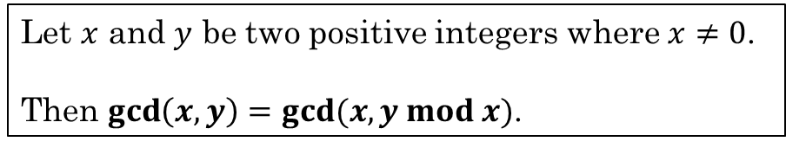

GCD Theorem
Computing GCD of two integers is computationally difficult for large numbers. Why?
Finding the prime factorization of a large number is difficult. We only know how to do it using brute force.
We have a shortcut!
We can reduce the problem of finding the GCD of large numbers by using mod.
Let $x$ and $y$ be two positive integers where $x≠0$.
Then $\gcd\left(x,y\right)=gcd⁡(x, y mod x)$.
Example:
$\gcd\left(6, 32\right)=2$
$\gcd\left(6, 32 mod 6\right)=\gcd\left(6, 2\right)=2$
In other words, the GCD of two integers is the same if we reduce one of those numbers using mod of the other number.
And we can keep going until one of the numbers is reduced to 0.
$\gcd\left(6 mod 2, 2\right)=\gcd\left(0, 2\right)=2$

Slide 7

Recall the Division Theorem
Dividing an integer by a positive integer produces a quotient $q$ and remainder $r$.
Let $n$ and $d$ be integers.
Then there exist unique integers $q$ and $r$ where $0≤r<d$ such that $n=qd+r$

Slide 8
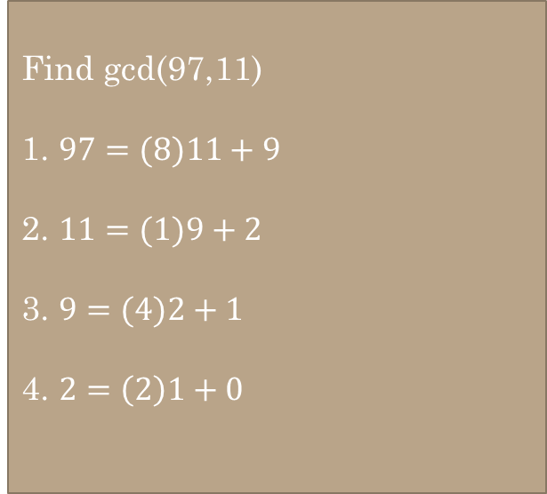
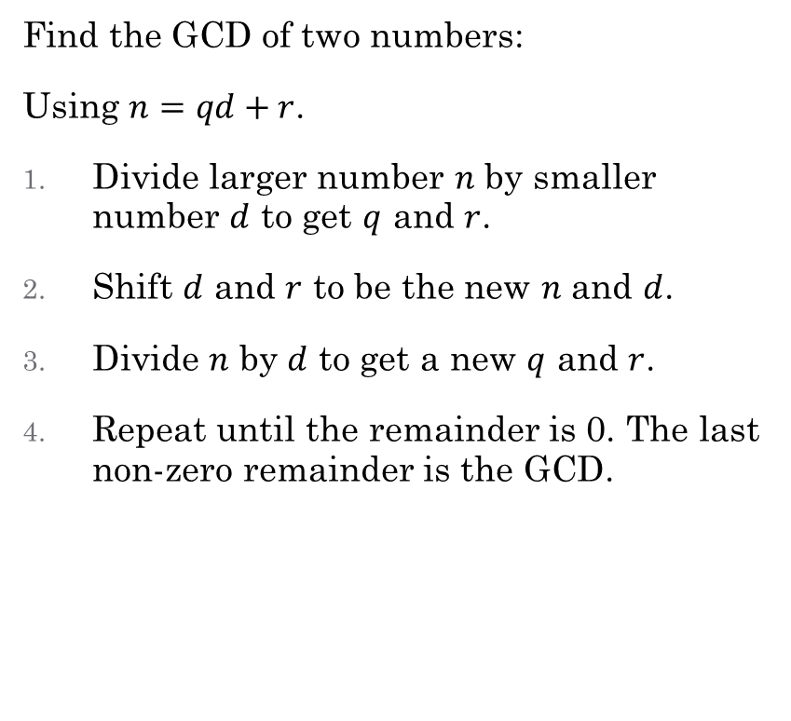
Euclidean GCD Algorithm
Find gcd(97,11)
Find the GCD of two numbers:
Using $n=qd+r$.
Divide larger number $n$ by smaller number $d$ to get $q$ and $r$.
Shift $d$ and $r$ to be the new $n$ and $d$.
Divide $n$ by $d$ to get a new $q$ and $r$.
Repeat until the remainder is 0. The last non-zero remainder is the GCD.
Find gcd(97,11)
1. $97=(8)11+9$
2. $11=(1)9+2$
3. $9=(4)2+1$
4. $2=\left(2\right)1+0$

Slide 9
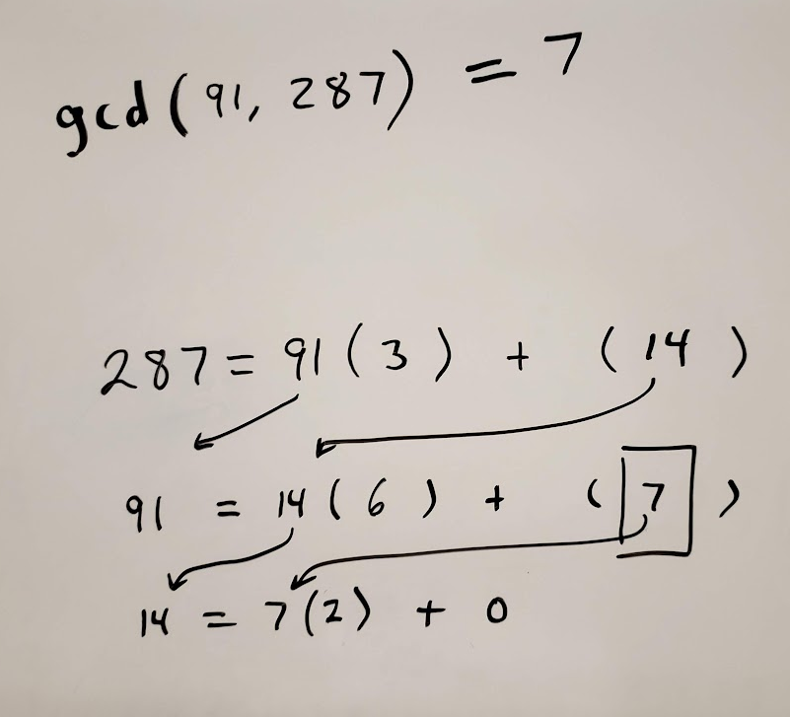

Find gcd(97,11)
1. $97=(8)11+9$
2. $11=(1)9+2$
3. $9=(4)2+1$
4. $2=\left(2\right)1+0$
Find the gcd(91, 287)

Slide 10
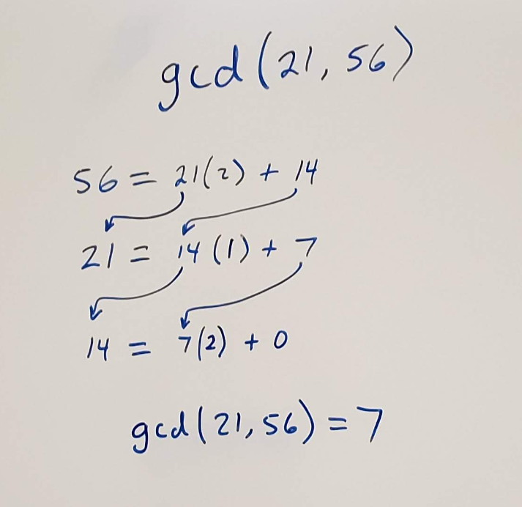
Find gcd(21, 56)

Slide 11


Extended Euclidean Algorithm
Recall Theorem 9.1.1:
If x|y and x|z, then x|(sy + tz) for any integers s and t.
The GCD of x and y can be expressed as a linear combination of x and y:
$\gcd\left(x, y\right)=sx+ty$ for some $s$ and $t$. By the GCD Theorem, $\gcd\left(x,y\right)=\gcd\left(x, y mod x\right)$.
$\gcd\left(44, 38\right)=\gcd\left(44 mod 38, 38\right)=\gcd\left(6, 38\right)=\gcd\left(38 mod 6, 6\right)=\gcd\left(2, 6\right)=\gcd\left(6 mod 2, 2\right)=\gcd\left(0,2\right)=2$
$\gcd\left(44, 38\right)=2$. We can express this as a linear combination, $2=s⋅44+t⋅38$.
$2=38 mod 6=38−\left(\right)⋅6=38−\left(6\right)⋅6$
$2=38 −6⋅6$
$6=44 mod 38=44 −\left(\right)⋅38=44−\left(1\right)⋅38$
$6=44 −1⋅38$
$2=38 −6⋅(44−1⋅38)$ substitute ($44−1⋅38$) for $6$
$2=38−6⋅44+6⋅38$ simplify
$2=−6⋅44+7⋅38$ We have our linear combination
$s=−6$
$t=7$

Slide 12
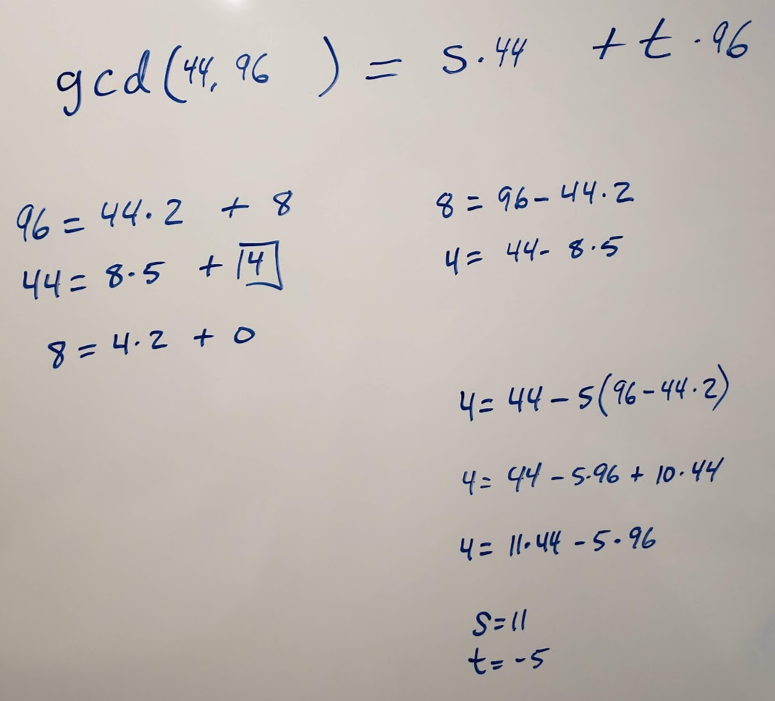

Demo
Find $s$ and $t$ such that $\gcd\left(44, 96\right)=s⋅44+t⋅96$

Slide 13
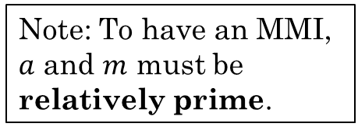
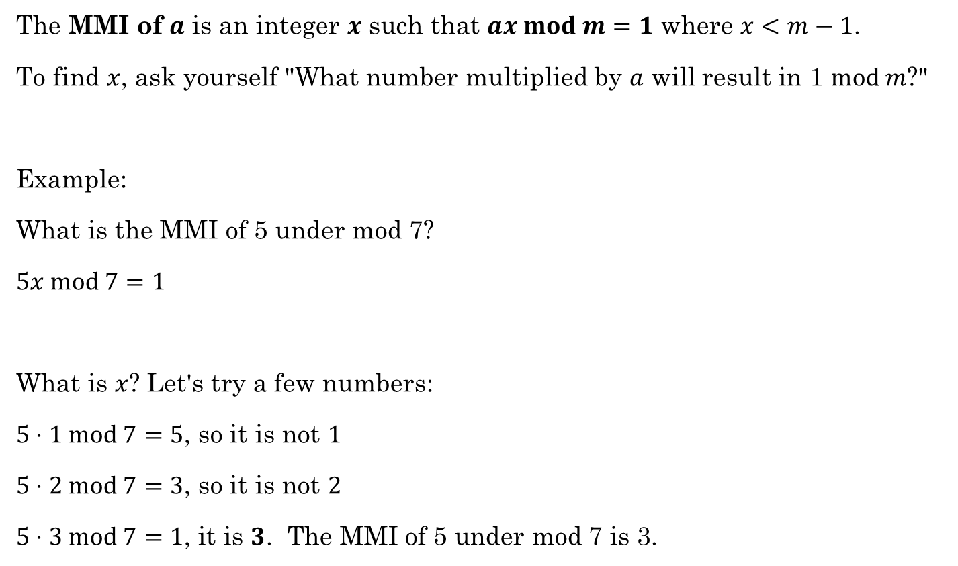
Multiplicative Inverse (MMI)
The MMI of $a$ is an integer $x$ such that $ax mod m=1$ where $x<m−1$.
To find $x$, ask yourself "What number multiplied by $a$ will result in 1 $mod m$?"
Example:
What is the MMI of 5 under mod 7?
$5x mod 7=1$
What is $x$? Let's try a few numbers:
$5⋅1 mod 7=5$, so it is not $1$
$5⋅2 mod 7=3$, so it is not $2$
$5⋅3 mod 7=1$, it is $3$. The MMI of 5 under mod 7 is 3.
Note: To have an MMI, $a$ and $m$ must be relatively prime.
0
6
1
5
2
4
3

Slide 14
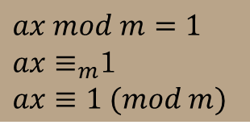

MMI
Modular Multiplicative Inverse or Inverse Mod m or Multiplicative Inverse Mod m
$2x≡1 (mod 17)$
$2x≡_{17}1$
What multiple of 2 is one more than a multiple of 17?
9
9 is an MMI of 2 under mod 17
The MMI exists only if $a$ and $m$ are coprime.
MMIs are used in cryptography, especially the RSA Algorithm
$ax mod m=1$
$ax≡_{m}$1
$ax≡1 (mod m)$

Slide 15

What is the MMI of:
$3 (mod 7)$ (What multiple of 3 is one more than a multiple of 7?)
$3⋅x≡_{7}1$
$x=5$, so $5$ is the MMI for $3 (mod 7)$.

Slide 16
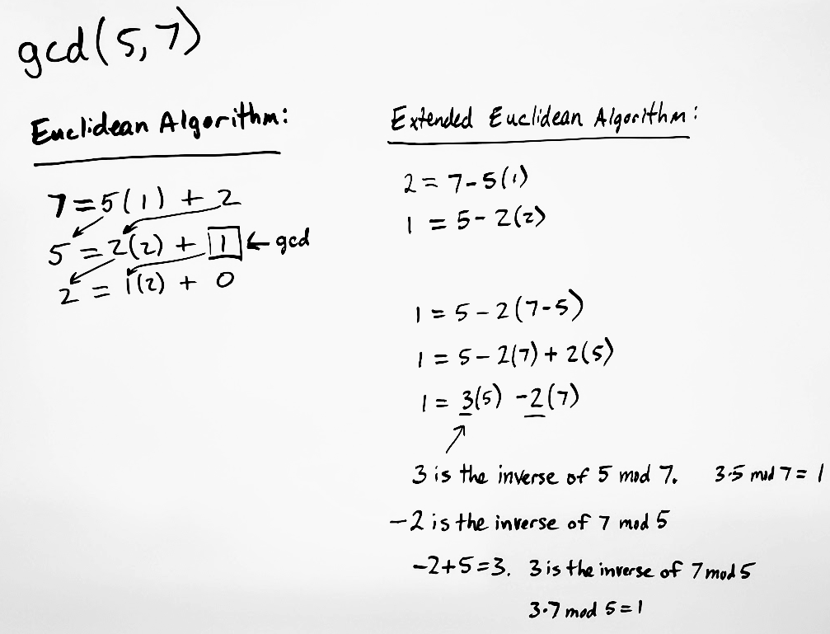

Use Extended Euclidean to find MMI
If $\gcd\left(x,n\right)≠1$, then there is no MMI.
If $x$ and $n$ are relatively prime, then $\gcd\left(x,n\right)=1$, so we can find a linear combination $1=sx+tn$.
$s$ is the MMI of $x$ under $mod n$ because $sx−1=−tn$, so $sx$ is 1 more than a multiple of $n$.
Example
Find gcd(5,7)

Slide 17
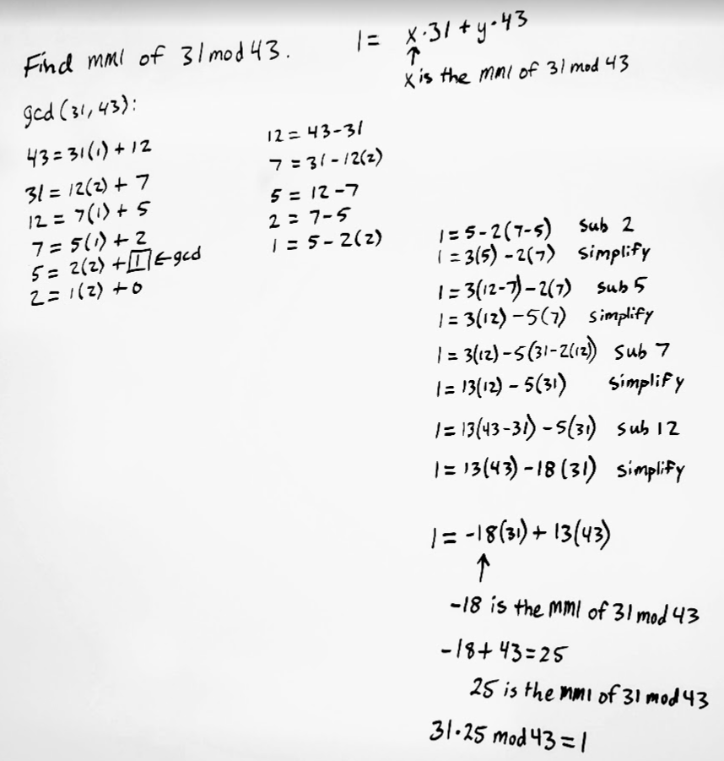

Use the Extended Euclidean Algorithm to find the MMI of $31 mod 43$.
Use Euclidean Algorithm to find gcd(31,43)
Use Extended Euclidean Algorithm to solve $1=31x + 43y$.
Now $x$ is the MMI of $31 mod 43$. (And $y$ is the MMI of $43 mod 31$)

Slide 18
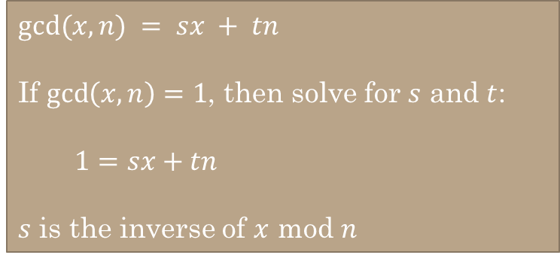
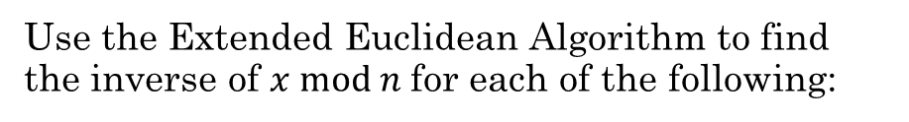
$gcd⁡(x,n) = sx + tn$
If $\gcd\left(x,n\right)=1$, then solve for $s$ and $t$:
$1=sx+tn$
$s$ is the inverse of $x$ mod $n$
Use the Extended Euclidean Algorithm to find the inverse of $x mod n$for each of the following:
x=35, n=48
11
x=25, n=84
37

Slide 19
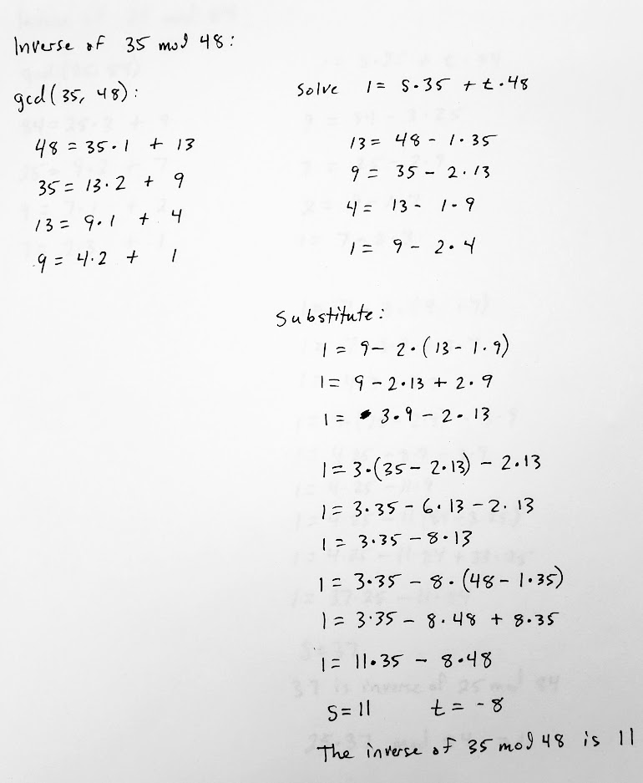
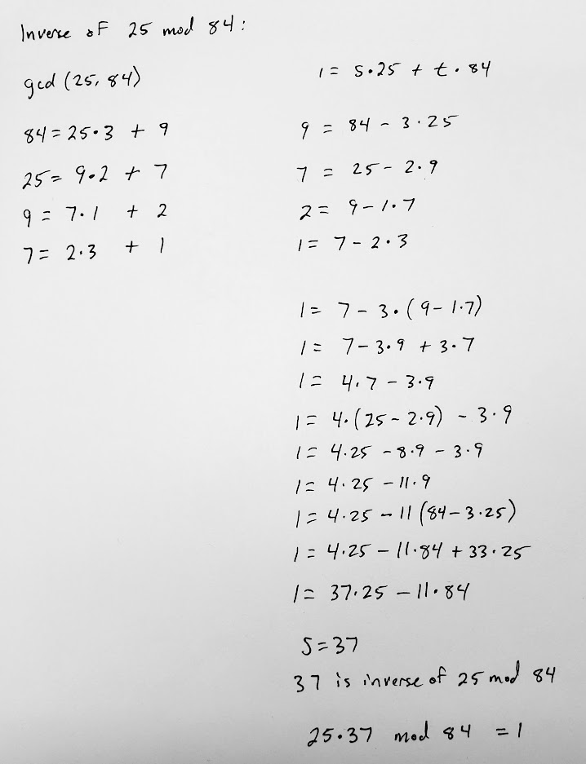

Slide 20
More Practice
Additional Exercises:
9.5.1 (a-d)
9.5.2 (a-d)

Slide 21



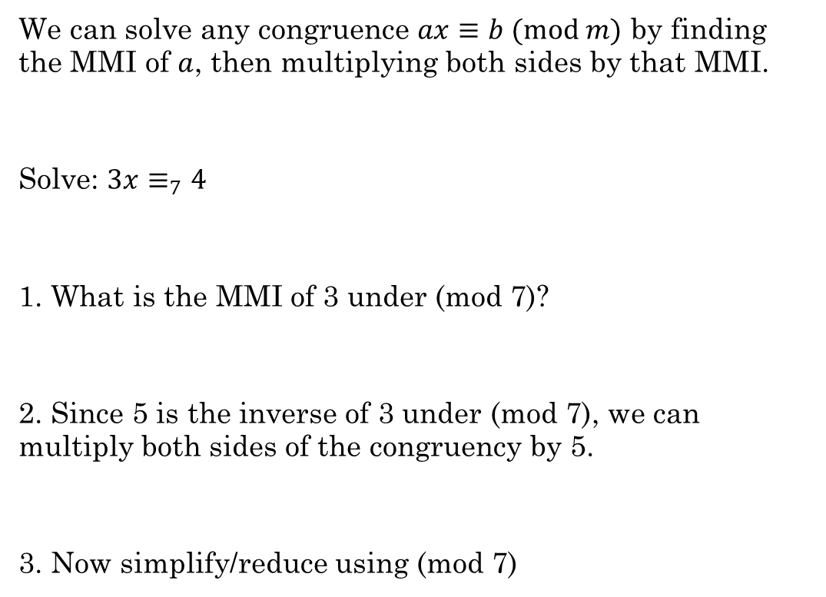




Why is the MMI important?
We can solve any congruence $ax≡b (mod m)$ by finding the MMI of $a$, then multiplying both sides by that MMI.
Solve: $3x≡_{7}4$
1. What is the MMI of 3 under (mod 7)?
2. Since 5 is the inverse of 3 under (mod 7), we can multiply both sides of the congruency by 5.
3. Now simplify/reduce using (mod 7)
$$3x≡_{7}4$$
$3x≡_{7}1$
$x=5$
$3\left(5\right)x≡_{7}4(5)$
$15x≡_{7}20$
$1x≡_{7}6$
$x=6$
Rosen, Kenneth. Discrete Mathematics and Its Applications, 7th Edition. McGraw-Hill, 2012

