Slide 1
Base-b & Fast Exponentiation

Slide 2
Review Homework
Review last week's homework with a partner

Slide 3
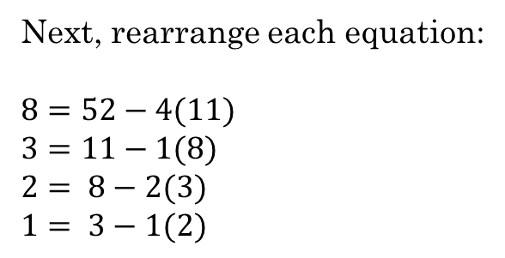
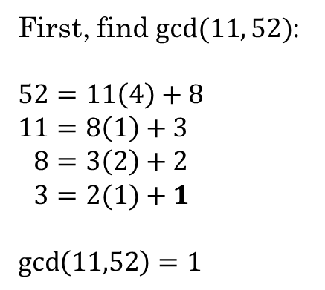
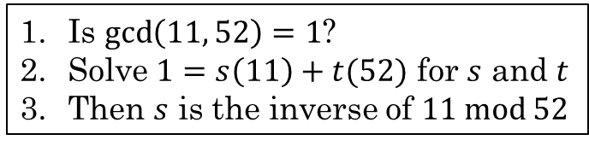
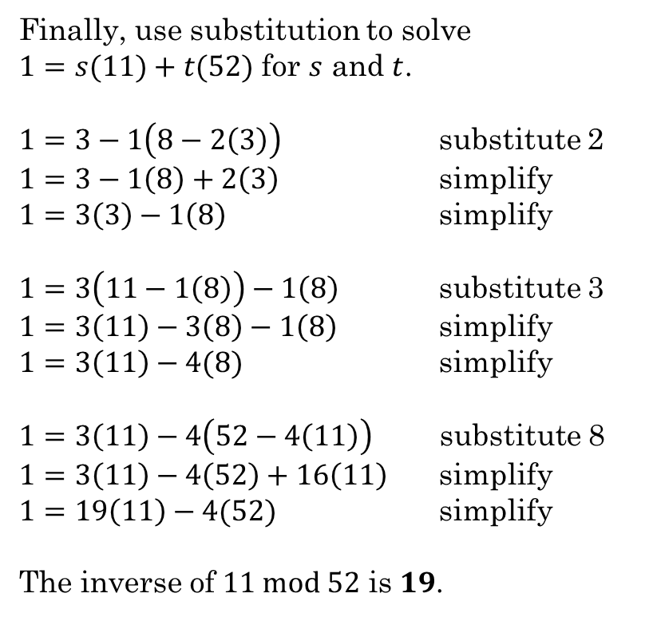
Review
Is $\gcd\left(11, 52\right)=1$?
Solve $1=s\left(11\right)+t(52)$ for $s$ and $t$
Then $s$ is the inverse of $11 mod 52$
Let's review the Extended Euclidean Algorithm
Find the inverse of 11 mod 52
First, find $gcd⁡(11, 52)$:
$$52=11\left(4\right)+8 \\ 11=8\left(1\right)+3 \\ 8=3\left(2\right)+2 \\ 3=2(1)+1$$
$\gcd\left(11,52\right)=1$
Next, rearrange each equation:
$8=52−4(11)$ $3=11−1(8)$ $2= 8−2(3)$ $1= 3−1(2)$
Finally, use substitution to solve
$1=s(11)+t(52)$ for $s$ and $t$.
$1=3−1\left(8−2\left(3\right)\right)$ substitute 2 $1=3−1\left(8\right)+2\left(3\right)$ simplify $1=3\left(3\right)−1\left(8\right)$ simplify
$1=3\left(11−1\left(8\right)\right)−1\left(8\right)$ substitute 3 $1=3\left(11\right)−3\left(8\right)−1\left(8\right)$ simplify $1=3\left(11\right)−4(8)$ simplify
$1=3\left(11\right)−4\left(52−4\left(11\right)\right)$ substitute 8 $1=3\left(11\right)−4\left(52\right)+16\left(11\right)$ simplify $1=19\left(11\right)−4(52)$ simplify
The inverse of $11 mod 52$ is $19$.

Slide 4




Base-b
We can express any integer $n$ using any base-$b$ where $b > 1$
$n=a_{k}b^{k}+a_{k−1}b^{k−1}+…+a_{1}b^{1}+a_{0}b^{0}$
$$523=5⋅{10}^{2}+2⋅{10}^{1}+3⋅{10}^{0}$$
${\left(a_{k}a_{k−1}…a_{1}a_{0}\right)}_{b}$
base $b$ expansion of $n$
$${523}_{10}$$
Binary: ${\left(10110100\right)}_{2}={1∙2}^{7}+0∙2^{6}+1∙2^{5}+1∙2^{4}+0∙2^{3}+1∙2^{2}+0∙2+0=180$ (decimal)
Octal: ${\left(264\right)}_{8}=2⋅8^{2}+6⋅8^{1}+4=180$ (decimal)
Hexadecimal: ${\left(B4\right)}_{16}=B⋅{16}^{1}+4=11⋅16+4=176+4=180$ (decimal)

Slide 5



Hexadecimal Numbers
Decimal | Hex | Binary
0 | 0 | 0000
1 | 1 | 0001
2 | 2 | 0010
3 | 3 | 0011
4 | 4 | 0100
5 | 5 | 0101
6 | 6 | 0110
7 | 7 | 0111
8 | 8 | 1000
9 | 9 | 1001
10 | A | 1010
11 | B | 1011
12 | C | 1100
13 | D | 1101
14 | E | 1110
15 | F | 1111
Base-16 is called Hexadecimal or Hex
Hexadecimal uses 16 "digits" or symbols
Each hex digit corresponds to a unique sequence of 4 binary bits.
Two hex digits represent 8 binary bits, a byte.
$$10110111 = B7$$
$$10110111 = B7=11⋅16+7={183}_{10}$$
$$10110111=1⋅2^{7}+1⋅2^{5}+1⋅2^{4}++1⋅2^{2}+1⋅2^{1}+1⋅2^{0}={183}_{10}$$
What is 3F?
Binary:
$$00111111$$
Decimal:
$$3⋅16+15={63}_{10}$$

Slide 6
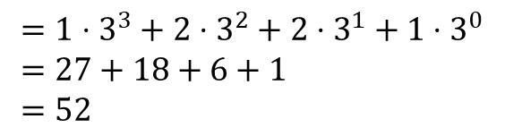

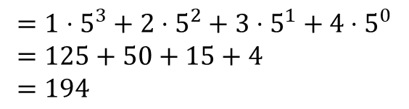

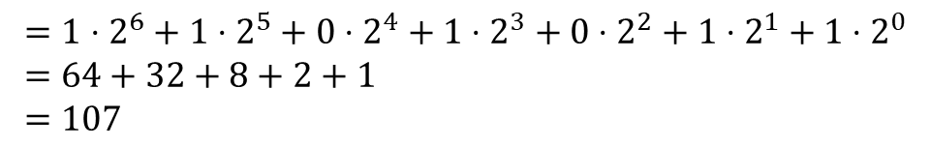

Convert base-b to n
$n=a_{k}b^{k}+a_{k−1}b^{k−1}+…+a_{1}b^{1}+a_{0}b^{0}$
Convert each of the following to base-10 (without using a calculator):
$${1101011}_{2}$$
$$=1⋅2^{6}+1⋅2^{5}+0⋅2^{4}+1⋅2^{3}+0⋅2^{2}+1⋅2^{1}+1⋅2^{0} \\ =64+32+8+2+1 \\ =107$$
$${1234}_{5}$$
$$=1⋅5^{3}+2⋅5^{2}+3⋅5^{1}+4⋅5^{0} \\ =125+50+15+4 \\ =194$$
$${1221}_{3}$$
$$=1⋅3^{3}+2⋅3^{2}+2⋅3^{1}+1⋅3^{0} \\ =27+18+6+1 \\ =52$$

Slide 7



Convert $n$ to $base_{b}$
Example:
${97}_{10}$ to base₃
$$97=3⋅\left(32\right)+\left(1\right)$$
$$32=3⋅\left(10\right)+\left(2\right)$$
$$10=3⋅\left( 3\right)+\left(1\right)$$
$$3 =3⋅\left( 1\right)+\left(0\right)$$
$$1 =3⋅\left( 0\right)+\left(1\right)$$
Divide $n$ by $b$ to get a quotient $q$and remainder $a_{0}$:
$n=bq_{0}+a_{0}$
The remainder is the rightmost "digit" in the base$_b$ expansion of $n$
Divide the quotient $q_{0}$ by $b$ to obtain a new quotient $q_{1}$ and remainder $a_{1}$.
$q_{0}=bq_{1}+a_{1}$
The remainder $a_{1}$ is the next rightmost "digit".
Continue the process until the quotient is $0$.
21
1
121
0121
10121
10121₃
Rosen, Kenneth. Discrete Mathematics and Its Applications, 7th Edition. McGraw-Hill, 2012

Slide 8




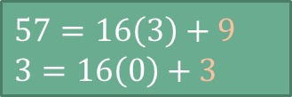

Try it!
Convert ${215}_{10}$ to base-5
Convert 57₁₀ to base-16
$215=5\left(43\right)+0$
$43=5\left(8\right)+3$
$8=5\left(1\right)+3$
$1=5\left(0\right)+1$
Example:
${97}_{10}$ to base₃
$$97=3⋅\left(32\right)+\left(1\right)$$
$$32=3⋅\left(10\right)+\left(2\right)$$
$$10=3⋅\left(3\right)+\left(1\right)$$
$$3 =3⋅\left( 1\right)+\left(0\right)$$
$$1 =3⋅\left( 0\right)+\left(1\right)$$
$$10121$$
$$1330$$
$57=16\left(3\right)+9$
$3=16\left(0\right)+3$
$$39$$

Slide 9
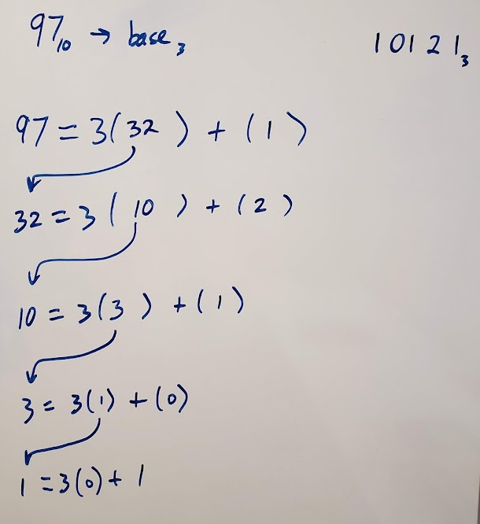
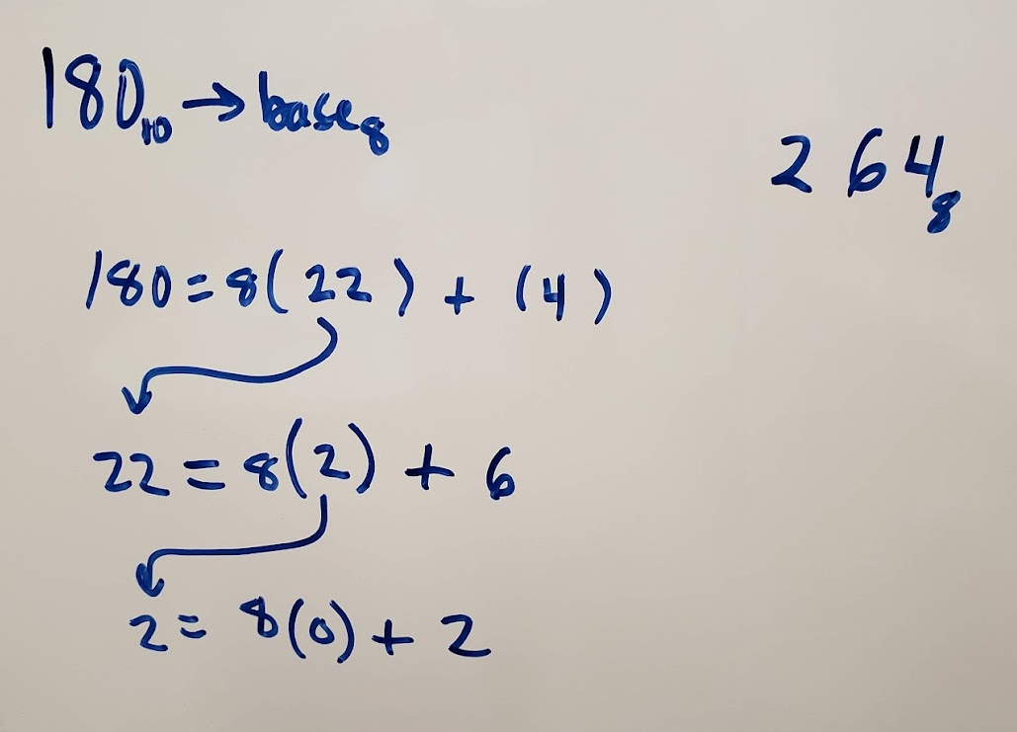
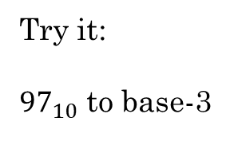
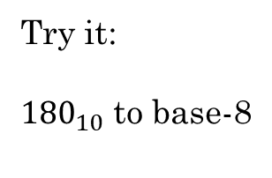
Try it:
${180}_{10}$ to base-8
Try it:
${97}_{10}$ to base-3

Slide 10
Additional Exercises:
9.6.1 (a-d)
9.6.2 (a-d)

Slide 11
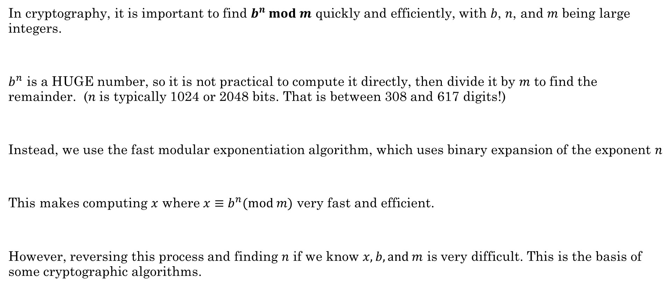
Fast Modular Exponentiation
In cryptography, it is important to find $b^{n} mod m$ quickly and efficiently, with $b$, $n$, and $m$ being large integers.
$b^{n}$ is a HUGE number, so it is not practical to compute it directly, then divide it by $m$ to find the remainder. ($n$ is typically 1024 or 2048 bits. That is between 308 and 617 digits!)
Instead, we use the fast modular exponentiation algorithm, which uses binary expansion of the exponent $n$
This makes computing $x$ where $x≡b^{n}(mod m)$ very fast and efficient.
However, reversing this process and finding $n$ if we know $x, b, and m$ is very difficult. This is the basis of some cryptographic algorithms.
Rosen, Kenneth. Discrete Mathematics and Its Applications, 7th Edition. McGraw-Hill, 2012

Slide 12
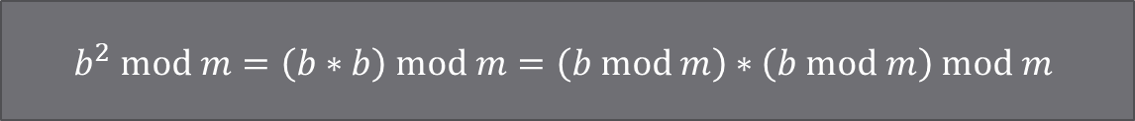

Modular exponentiation
We can quickly compute $b^{n} mod m$ if $n$ is a power of 2 because:
Compute $7^{256}\left(mod 13\right)$:
$7 mod 13=7$
$7^{2} mod 13=\left(7∗7\right) mod 13=49 mod 13=10$
$7^{4} mod 13=\left(7^{2}∗7^{2}\right) mod 13=\left(7^{2}mod 13 ∗7^{2}mod 13\right) mod 13=\left(10∗10\right) mod 13=9$
$7^{8} mod 13=\left(7^{4}∗7^{4}\right) mod 13=\left(9∗9\right) mod 13=81 mod 13=3$
$7^{16} mod 13=\left(7^{8}∗7^{8}\right) mod 13=\left(3∗3\right) mod 13=9 mod 13=9$
$7^{32} mod 13=\left(7^{16}∗7^{16}\right) mod 13=\left(9∗9\right) mod 13=3$
$7^{64} mod 13=\left(7^{32}∗7^{32}\right) mod 13=\left(3∗3\right) mod 13=9$
$7^{128} mod 13=\left(7^{64}∗7^{64}\right) mod 13=\left(9∗9\right) mod 13=3$
$7^{256} mod 13=\left(7^{128}∗7^{128}\right) mod 13=\left(3∗3\right) mod 13=9$
$$b^{2} mod m=\left(b∗b\right) mod m=\left(b mod m\right)∗\left(b mod m\right) mod m$$
https://www.khanacademy.org/computing/computer-science/cryptography/modarithmetic/a/fast-modular-exponentiation

Slide 13

If $n$ is not a power of 2, we convert it into multiples of powers of 2:
$$b^{n}=b^{{a_{k−1}∗2}^{k−1}+a_{k−2}∗2^{k−2}+ …+a_{1}2^{1}+a_{0}}=b^{{a_{k−1}∗2}^{k−1}}∗…∗b^{a_{1}∗2}∗b^{a_{0}}$$
Example:
$b^{117}$
$117={1 1 1 0 1 0 1}_{2}$
$117=64+32+16+4+1$
$b^{117}=b^{(64+32+16+4+1) }=b^{64}∗b^{32}∗b^{16}∗b^{4}∗b$
Now we can find something like $5^{117} mod 19$
64
32
16
4
1
Rosen, Kenneth. Discrete Mathematics and Its Applications, 7th Edition. McGraw-Hill, 2012
https://www.khanacademy.org/computing/computer-science/cryptography/modarithmetic/a/fast-modular-exponentiation

Slide 14
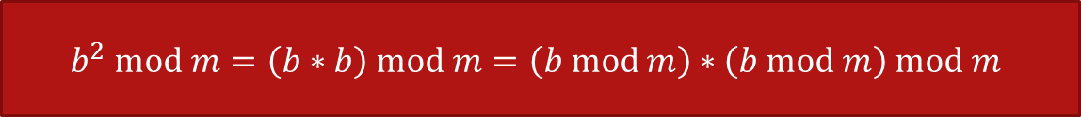


$$b^{2} mod m=\left(b∗b\right) mod m=\left(b mod m\right)∗\left(b mod m\right) mod m$$
$5^{117} mod 19$
$5^{117} mod 19=5^{64+32+16+4+1} mod 19=5^{64}∗5^{32}∗5^{16}∗5^{4}∗5^{1} mod 19$
$5^{1} mod 19=5$
$5^{2} mod 19=\left(5∗5\right) mod 19=25 mod 19=6$
$5^{4} mod 19=\left(5^{2}∗5^{2}\right) mod 19=\left(6∗6\right) mod 19=36 mod 19=17$
$5^{8} mod 19=\left(5^{4}∗5^{4}\right) mod 19=\left(17∗17\right) mod 19=289 mod 19=4$
$5^{16} mod 19=\left(5^{8}∗5^{8}\right) mod 19= \left(4∗4\right) mod 19=16 mod 19=16$
$5^{32} mod 19=\left(16 ∗16\right) mod 19=256 mod 19=9$
$5^{64} mod 19=\left(9 ∗9\right) mod 19=81 mod 19=5$
$5^{117} mod 19=\left(5∗9∗16∗17∗5\right) mod 19=61200 mod 19=1$
$$\left(5∗9\right) mod 19 =7 \\ \left(7∗16\right) mod 19=17 \\ \left(17∗17\right) mod 19=4 \\ \left(4∗5\right) mod 19=1$$
https://www.khanacademy.org/computing/computer-science/cryptography/modarithmetic/a/fast-modular-exponentiation

Slide 15
Practice
Compute the following using fast modular exponentiation:
5³⁵ mod 11
5⁶⁸ mod 7
53²⁷ mod 12
46³⁹ mod 11
See additional exercises 9.7.2 a-d for sample solutions.

