Slide 1

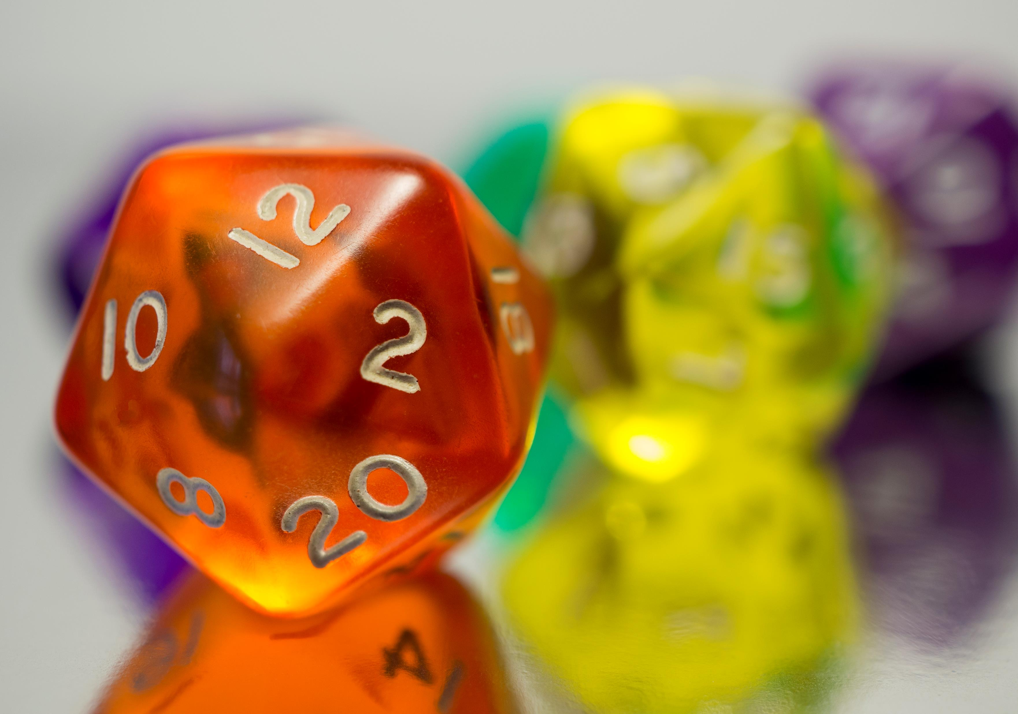


Counting

Slide 2
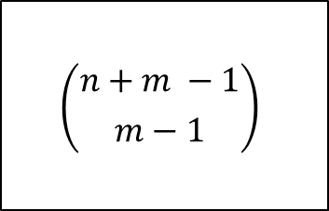

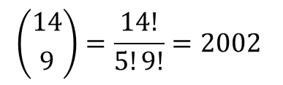
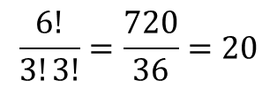
Review
Permutations with repetition
How many ways can you rearrange this binary string 000111?
$$\frac{n!}{n_{1}!n_{2}!⋯n_{k}!}$$
$$\frac{6!}{3!3!}=\frac{720}{36}=20$$
Multisets
How many ways can you select five pieces of candy from a bowl with 10 different kinds?
$$\left({n+m −1 \atop m−1}\right)$$
$$\left({14 \atop 9}\right)=\frac{14!}{5!9!}=2002$$

Slide 3
Group Work
Work on the following Additional Exercises with a partner:
10.6.3
10.7.1
10.7.3
10.8.2
10.9.1
10.9.2

Slide 4
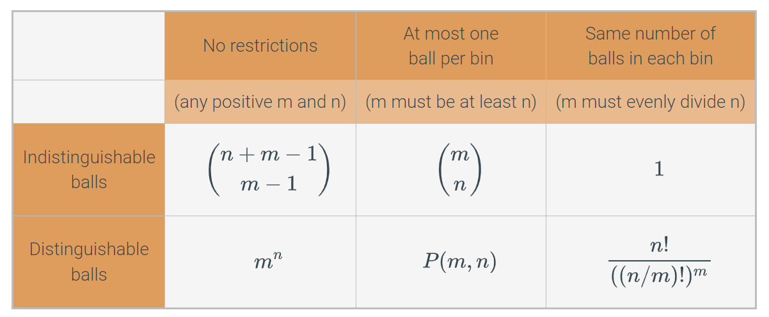
Balls in bins
Six different types of counting problems, with six different ways to count

Slide 5


Inclusion-exclusion Principle (2 sets)
Let $A$ and $B$ be two finite sets. Then $\left|A∪B\right|=\left|A\right|+\left|B\right|−|A∩B|$
$$\left|A∪B\right|=\left|A\right|+\left|B\right|−|A∩B|$$

Slide 6


Inclusion-exclusion Principle (3 sets)
Let $A, B, C$ be finite sets. Then $\left|A∪B∪C\right|=\left|A\right|+\left|B\right|+\left|C\right|−\left|A∩B\right|−\left|B∩C\right|−\left|A∩C\right|+|A∩B∩C|$
$$\left|A∪B∪C\right|=\left|A\right|+\left|B\right|+\left|C\right|−\left|A∩B\right|−\left|B∩C\right|−\left|A∩C\right|+|A∩B∩C|$$

Slide 7
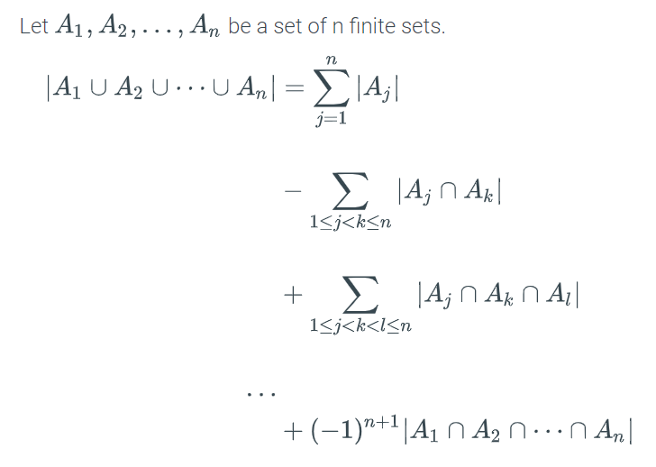
General Inclusion-exclusion Principle

Slide 8
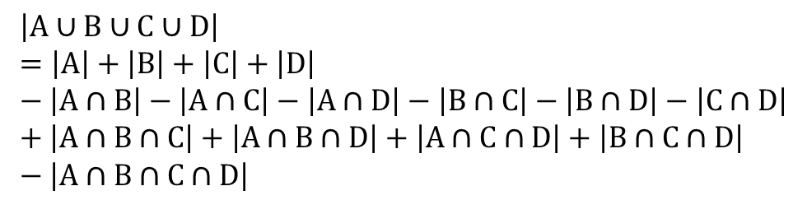
General Inclusion-exclusion Principle
For 4 sets, A, B, C, D:
$$\left|A∪B∪C∪D\right| \\ =\left|A\right|+\left|B\right|+\left|C\right|+\left|D\right| \\ − \left|A∩B\right|−\left|A∩C\right|−\left|A∩D\right|−\left|B∩C\right|−\left|B∩D\right|−\left|C∩D\right| \\ + \left|A∩B∩C\right|+\left|A∩B∩D\right|+\left|A∩C∩D\right|+\left|B∩C∩D\right| \\ − \left|A∩B∩C∩D\right|$$
If all 4 sets are the same size:
$$\left|A∪B∪C∪D\right|=4∗\left|A\right|−\left({4 \atop 2}\right)\left|A∩B\right|+\left({4 \atop 3}\right) \left|A∩B∩C\right|− \left|A∩B∩C∩D\right|$$

Slide 9
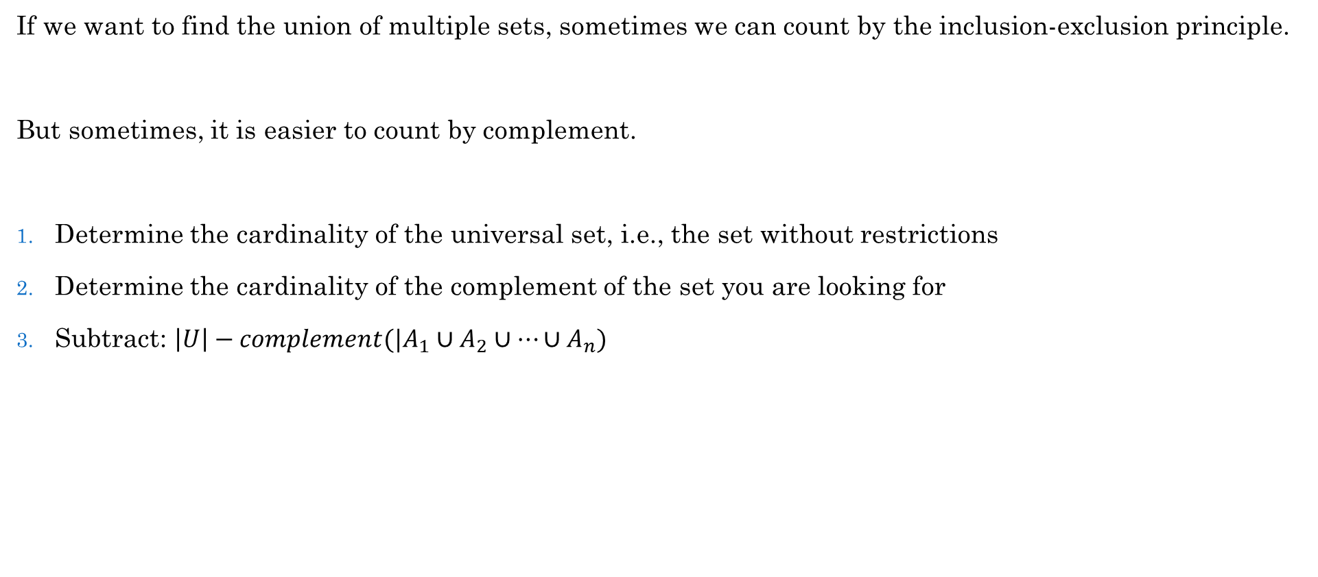
Cardinality of Union by Complement
If we want to find the union of multiple sets, sometimes we can count by the inclusion-exclusion principle.
But sometimes, it is easier to count by complement.
Determine the cardinality of the universal set, i.e., the set without restrictions
Determine the cardinality of the complement of the set you are looking for
Subtract: $\left|U\right|−complement(|A_{1}∪A_{2}∪⋯∪A_{n})$

Slide 10
Let's play a Kahoot!

Slide 11
Group Work
Work on the following additional exercises with a partner:
10.10.1
10.10.2
10.11.1

