Slide 1

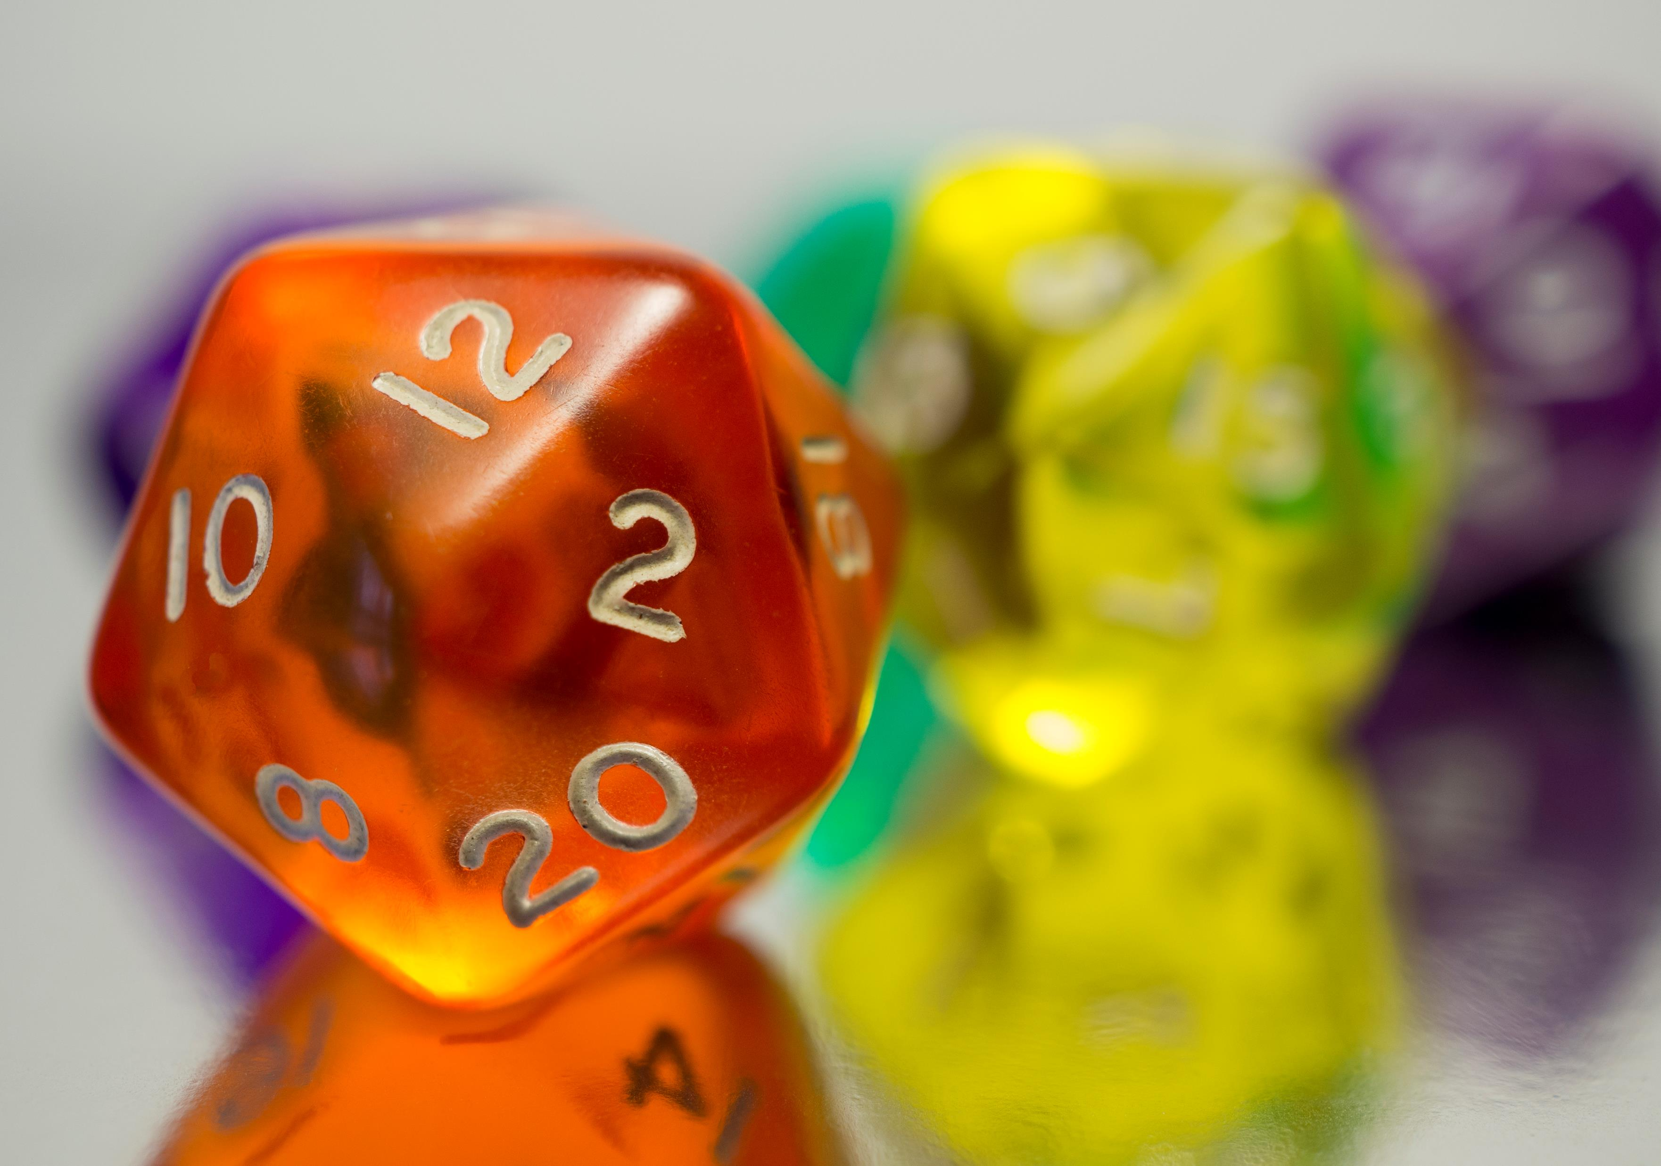


Counting

Slide 2
Exam Review
Review Exam #2 and discuss any you have questions about

Slide 3
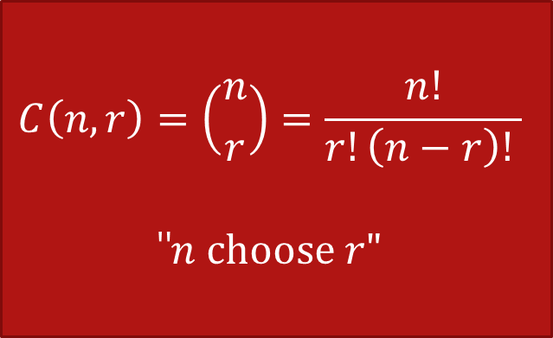
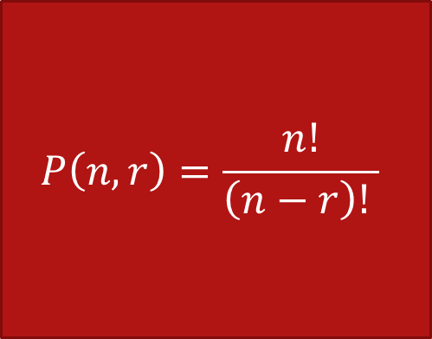
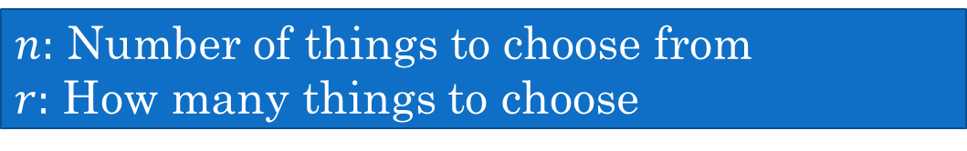
Review: r-Permutations vs r-Combinations (Subsets)
$n:$ Number of things to choose from
$r:$ How many things to choose
Order matters
Order does not matter
$$P\left(n,r\right)=\frac{n!}{\left(n−r\right)! }$$
$$C\left(n,r\right)=\left({n \atop r}\right)=\frac{n!}{r!\left(n−r\right)! }$$
"$n choose r"$
Think sequence or arrangement
Think sets

Slide 4






Dealing with large factorials
$$11$$
$$16$$
$$\frac{33!}{30!3!}$$
$$= \frac{33∗32∗31 ∗30!}{30!∗3!}$$
$$= \frac{33∗32∗31}{3∗2}$$
$$=11∗16∗31=5456$$
Much simpler!

Slide 5
Additional Exercises:
10.3.4
10.4.2
10.4.3
10.5.3

Slide 6



Counting by Complement
How many 8-bit strings do not begin with 01?
1. How many 8-bit strings are there with no restrictions?
$$2^{8}$$
2. How many 8-bit strings DO begin with 01?
01_ _ _ _ _ _ $2^{6}$
3. Subtract
$2^{8}−2^{6}=192$

Slide 7
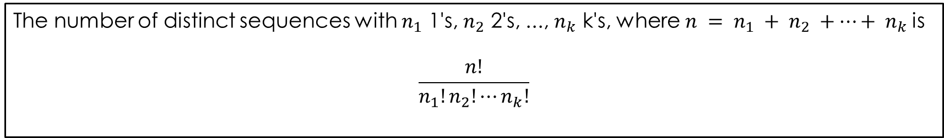
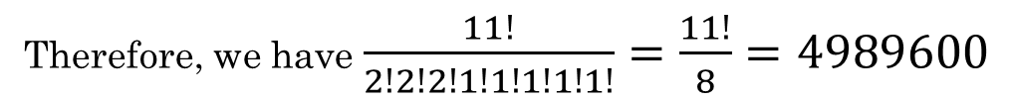
Permutations with repetitions
How many ways can you order the letters in the word MATHEMATICS?
Note there are 2 M's, 2 A's, and 2 T's. There are 11 letters total.
The number of distinct sequences with $n_{1}$ 1's, $n_{2}$ 2's, ..., $n_{k}$ k's, where $n = n_{1} + n_{2} +…+ n_{k}$is
$$\frac{n!}{n_{1}!n_{2}!⋯n_{k}!}$$
Therefore, we have $\frac{11!}{2!2!2!1!1!1!1!1!}=\frac{11!}{8}=4989600$

Slide 8





Permutations with repetitions
$$\frac{n!}{n_{1!}n_{2!}⋯n_{k}!}$$
How many bit strings with three 0's and five 1's?
00011111
$$\frac{8!}{5!3!}=$$
$$\frac{8⋅7⋅6⋅5!}{5!3!}$$
$$=\frac{8⋅7⋅6}{3⋅2⋅1}$$
$$=8⋅7=56$$

Slide 9


Multisets / Multichoosing
Subsets with repetition allowed. Order does not matter.
$S=\{a,b,c,d,e\}$
Some of the ways to choose a subset of three elements:
$\left\{a,b,c\right\}$
$\left\{a,a,a\right\}$
$\left\{a,b,b\right\}$
$\left\{c,e,e\right\}$
$$\left(\left({n \atop r}\right)\right)=C\left(n−1+r, r\right)=\frac{\left(n−1+r\right)!}{r!\left(n−1\right)!}$$
"$n$ multichoose $r$"

Slide 10
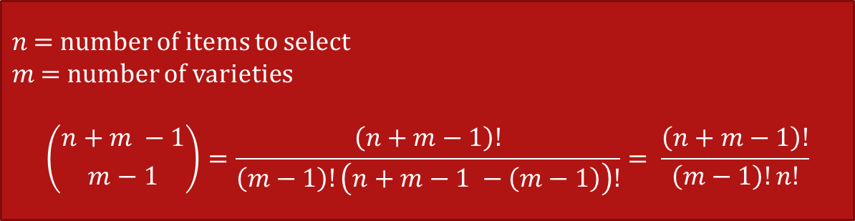


Multisets / Multichoosing
Subsets with repetition allowed. Order does not matter.
$S=\{a,b,c,d,e\}$
Some of the ways to choose a subset of three elements:
$\left\{a,b,c\right\}$
$\left\{a,a,a\right\}$
$\left\{a,b,b\right\}$
$\left\{c,e,e\right\}$
$$Note:$$
$$\left({n+m −1 \atop m−1}\right)= \left({n+m −1 \atop n}\right)$$
$n$ = number of items to select
$m$ = number of varieties
$$\left({n+m −1 \atop m−1}\right)=\frac{\left(n+m−1\right)!}{\left(m−1\right)!\left(n+m−1 −\left(m−1\right)\right)!}= \frac{\left(n+m−1\right)!}{\left(m−1\right)!n!}$$

Slide 11
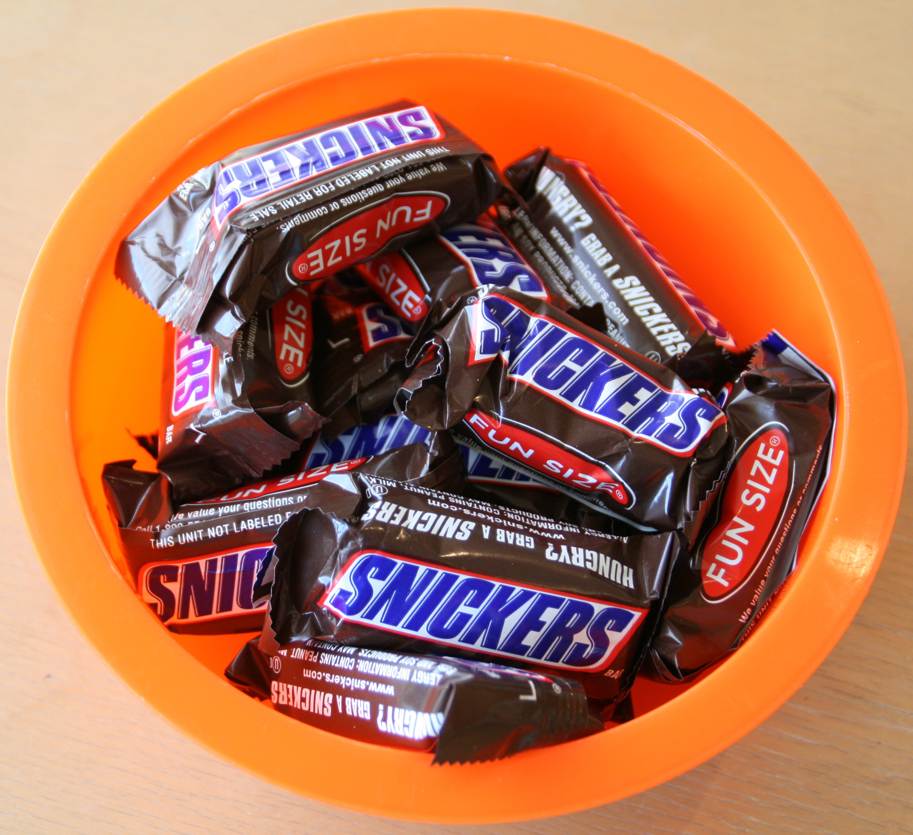




Snack time!
$$\left(\left({n \atop r}\right)\right)=\frac{\left(n−1+r\right)!}{r!\left(n−1\right)!}$$
How many ways can we select four candy bars from a bowl containing Snickers, Twix, and Butterfingers? Assume order does not matter and repetition is allowed. There are at least 4 of each type of candy bar in the bowl.
$$\left(\left({n \atop k}\right)\right)$$
$$\left(\left({3 \atop 4}\right)\right)$$
$$\left({6 \atop 4}\right)= \frac{6!}{4!2!}= \frac{6∗5}{2}=15$$
Rosen, Kenneth. Discrete Mathematics and Its Applications, 7th Edition. McGraw-Hill, 2012

Slide 12

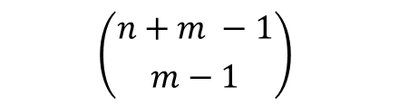


Snack time!
$$\left({n+m −1 \atop m−1}\right)$$
How many ways can we select 4 candy bars from a bowl containing Snickers, Twix, and Butterfingers? Assume order does not matter and repetition is allowed. There are at least 4 of each type of candy bar in the bowl.
$n$ = number of items to select
$m$ = number of varieties
$n=4$ (selecting four candy bars)
$m=3$ (there are three kinds to choose from)
$$\left({n+m−1 \atop m−1}\right)= \left({6 \atop 2}\right)$$
$$\left({6 \atop 2}\right)= \frac{6!}{2!4!}= \frac{6∗5}{2}=15$$
Rosen, Kenneth. Discrete Mathematics and Its Applications, 7th Edition. McGraw-Hill, 2012

Slide 13
Stars and Bars / 0s and 1s
Whiteboard

Slide 14




Number of Solutions to a Fixed Sum
Count the number of solutions to the equation
$x_{1}+x_{2}+x_{3}=4$ where $x_{1},$ $x_{2}$, $x_{3}$ are integers.
This is the same problem as selecting 4 items from 3 varieties, where we have $x_{1}$ of the first variety, $x_{2}$ of the second variety, and $x_{3}$ of the third variety. This is the same problem as the candy bar problem.
$n=4$
$m=3$
$$\left({4+3 −1 \atop 3−1}\right)= \left({6 \atop 2}\right)$$
$$\left({6 \atop 2}\right)= \frac{6!}{2!4!}= \frac{6∗5}{2}=15$$

Slide 15




Try it
Count the number of solutions to the equation
$x_{1}+x_{2}+x_{3}=15$
Now we are selecting 15 items from 3 varieties, where we have $x_{1}$ of the first variety, $x_{2}$ of the second variety, and $x_{3}$ of the third variety.
$n=15$
$m=3$
$$\left({15+3 −1 \atop 3−1}\right)= \left({17 \atop 2}\right)$$
$$\frac{17!}{2!15!}= \frac{17∗16}{2}=136$$

Slide 16


Handshakes
There are 110 people at a meeting. They each shake hands with everyone else. How many handshakes were there? Is it a permutation or subset, and how many options are there?
Each handshake consists of 2 people.
How many subsets of 2 people are there? This is the number of handshakes that takes place.
This is a subset problem.
$$\left({110 \atop 2}\right)=5995$$

Slide 17
Additional Exercises:
10.6.3
10.6.4
10.7.1
10.7.3
10.8.1
10.8.2
10.9.1
10.9.2

Slide 18
Let's play a Kahoot!

Slide 19
Stars and bars example
Ice cream or money

Slide 20
Python Practice
Write a function to calculate combinations (e.g., "n choose k")
example

