Slide 1

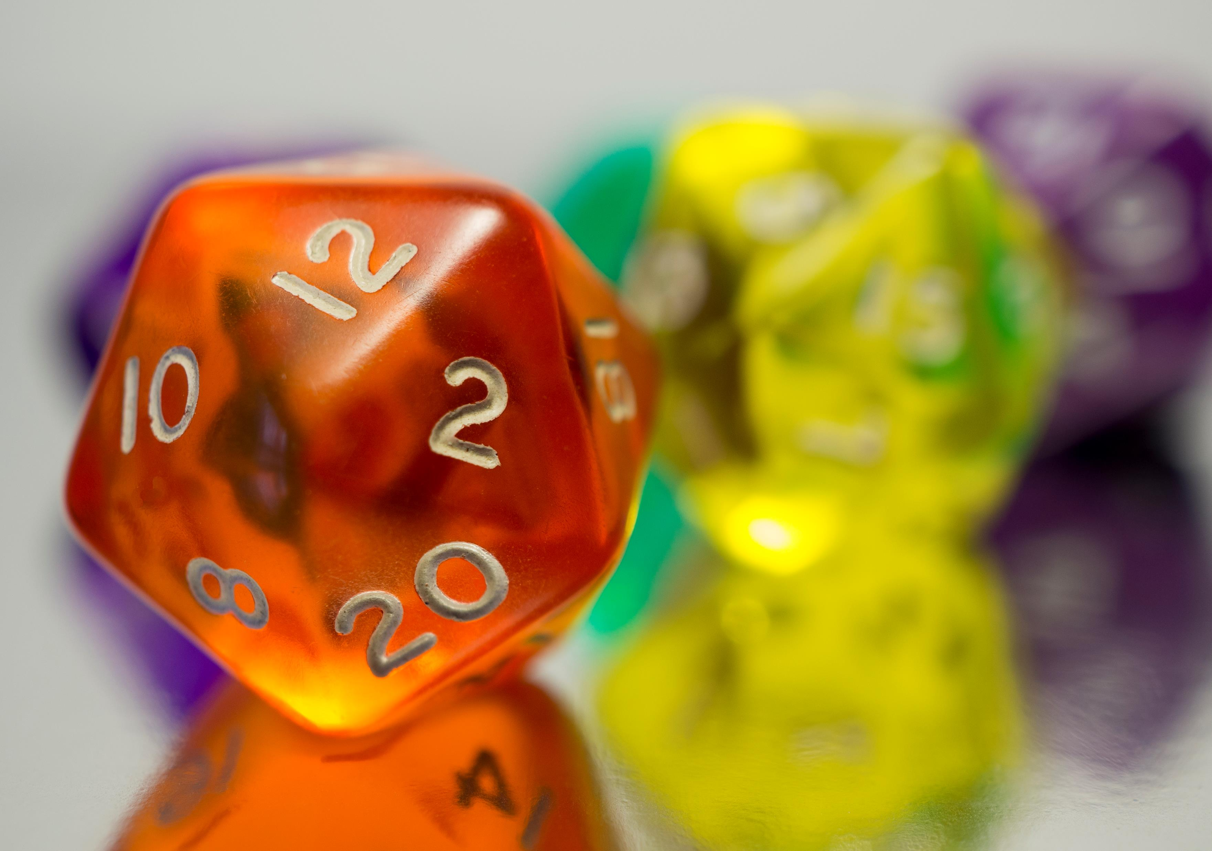


Generating Permutations and Combinations

Slide 2
Homework Review
Take a few moments to share your solutions to homework 11

Slide 3
Review
What is the difference between a permutation and a subset/combination?

Slide 4
Generating Permutations
Last week, we learned to count the number of permutations of a set.
Sometimes, we want to list or generate all the permutations of a set, not just count them.
What are some reasons we might want to do this?
Finding a Hamiltonian Cycle in a graph
Planning a road trip to visit every state capital. What are the possible routes?
Traveling Salesman problem. What is the optimal way to visit every city on the route and get back home?
Delivering packages. What is the best order to deliver them in to minimize the total distance traveled by the driver?

Slide 5
Lexicographical Order
How many permutations are there for the set {a,b,c,d}?
4! = 24
How many of them start with the letter "a"?
3! = 6
List them all in lexicographical order:
Lexicographic order is a way of ordering n-tuples in which two n-tuples are compared according to the first entry where they differ. This is called "alphabetical order" when using letters/words.
abcd
abdc
acbd
acdb
adcb
adbc

Slide 6

Generating permutations
Finding the next permutation in lexicographical order:
Search the list from right to left and find the first item that is smaller than the previous item. Call this item $x$.
Swap $x$ with the smallest item that is greater than $x$ in the part of the list that comes after $x$.
Reorder the rest of the list in increasing order by reversing this part of the list.
What comes after this permutation?
abdec
abdec
Step 1:
x = d
abedc
Step 2: Swap d and e
abdec
abecd
abedc
Step 3: Reverse the rest of the list

Slide 7
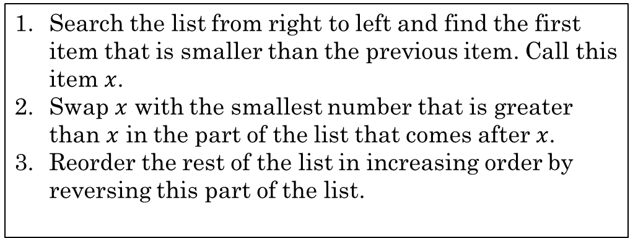
Lexicographical Order
List the first 10 permutations of the set {1,2,3,4,5} in lexicographical order, then compare with a partner.
12345
12354
12435
12453
12534
12543
13245
13254
13425
13452
Search the list from right to left and find the first item that is smaller than the previous item. Call this item $x$.
Swap $x$ with the smallest number that is greater than $x$ in the part of the list that comes after $x$.
Reorder the rest of the list in increasing order by reversing this part of the list.
How many total permutations are there?
$5!=120$

Slide 8
Additional Exercises
With a partner, complete the following from the Additional Exercises.
11.1.1
11.1.2
11.1.3

Slide 9
Binomial Theorem
Whiteboard discussion

Slide 10
Pascal's Triangle
Take a moment to create Pascal's Triangle up to the 7th row.
Now use Pascal's Triangle to answer these questions:
How many ways can you choose 2 elements from a set of 7 things?
21
How many ways can you choose 3 elements from a set of 7 things?
35
How many ways can you choose 4 elements from a set of 5 things?
5

Slide 11
Additional Exercises
With a partner, complete the following additional exercises:
11.2.1 a-d
First using a calculator. Then do it again by writing a Python function to compute it for you given the exponents and coefficients.
11.2.2
11.2.3

Slide 12
Pigeonhole Principle
If a function has a domain of size $n+1$ or more, and a codomain of size $n$ or less, then there are two elements in the domain that map to the same element in the codomain.
Rephrased:
If $n$ is a positive integer and $n+1$ or more objects are placed into $n$ boxes, then there is at least one box with more than two of the objects.
Rosen, Kenneth. Discrete Mathematics and Its Applications, 7th Edition. McGraw-Hill, 2012

Slide 13

Pigeonhole Principle
If you have 10 pigeons and 9 boxes, at least one box will have more than one pigeon.
Image by Freepik

Slide 14
Pigeonhole Principle
Among any set of 13 people, there are at least two people who have a birthday in the same month.
Person 1
January
Person 1
January
Person 2
February
Person 2
February
Person 3
March
Person 3
March
Person 4
April
Person 4
April
Person 5
May
Person 5
May
Person 6
June
Person 6
June
Person 7
July
Person 7
July
Person 8
August
Person 8
August
Person 9
September
Person 9
September
Person 10
October
Person 10
October
Person 11
November
Person 11
November
Person 12
December
Person 12
December
Person 13
Person 13

Slide 15
Pigeonhole Principle
Among any set of 367 people, how many of them must have the same birthday?
At least two people must have the same birthday because there are only 366 possible birthdays.
Rosen, Kenneth. Discrete Mathematics and Its Applications, 7th Edition. McGraw-Hill, 2012

Slide 16
Pigeonhole Principle
How many students must be in a class to guarantee that at least two students receive the same score on a quiz, if the quiz has possible scores from 0 to 30?
How many possible scores are there?
31
How many students must be in the class to guarantee that two receive the same score?
32
Rosen, Kenneth. Discrete Mathematics and Its Applications, 7th Edition. McGraw-Hill, 2012

Slide 17
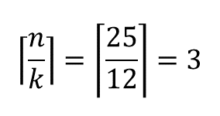
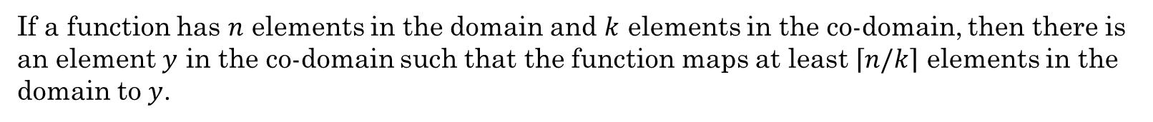
Generalized Pigeonhole Principle
If a function has $n$ elements in the domain and $k$ elements in the co-domain, then there is an element $y$ in the co-domain such that the function maps at least $\left\lceil n/k\right\rceil$ elements in the domain to $y$.
Example:
Among a group of 25 people, there are at least 3 whose birthday falls in the same month.
Jan
Feb
Mar
Apr
May
Jun
Jul
Aug
Sep
Oct
Nov
Dec
$$\left\lceil \frac{n}{k}\right\rceil =\left\lceil \frac{25}{12}\right\rceil =3$$
1
2
3
4
5
6
7
8
9
10
11
12
13
14
15
16
17
18
19
20
21
22
23
24
25

Slide 18
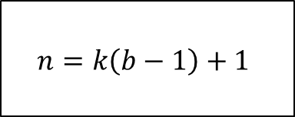
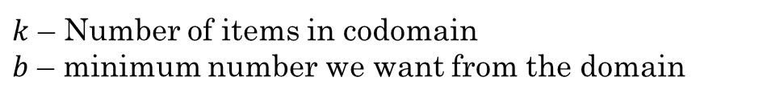
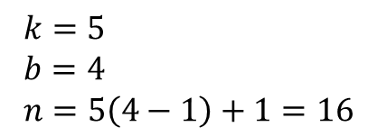

Generalized Pigeonhole Principle
What if we want to guarantee a minimum number of items?
$$n=k\left(b−1\right)+1$$
$k$ – Number of items in codomain
$b$ – minimum number we want from the domain
Example:
How many gumballs must we choose from a gumball machine with 5 colors of gumballs to guarantee we get at least 4 gumballs of the same color?
$$n=k\left(b−1\right)+1$$
red
blue
green
purple
pink
1
2
3
4
5
6
7
8
9
10
11
12
13
14
15
$$k=5 \\ b=4 \\ n=5\left(4−1\right)+1=16$$
16
Notes:
mapping from gumballs to colors.
k – This is the number of items in the target/codomain. 5 colors
b – This is the minimum number we want from the domain. 4 gumballs of same color
n – This is the size the domain must be to get b items mapping to k items. Number of gumballs we must pick. This is the worst case, where each gumball comes up a different color. It's also possible to get four in a row that are the same color. But we are talking about the minimum to guarantee a certain number of the same color.

Slide 19

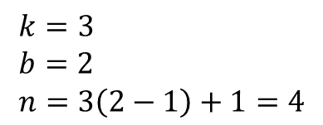
Generalized Pigeonhole Principle
Example:
How many socks must we choose from a drawer with 3 colors of socks to guarantee we get at least 2 socks of the same color?
black
blue
grey
$$n=k\left(b−1\right)+1$$
1
2
3
4
$$k=3 \\ b=2 \\ n=3\left(2−1\right)+1=4$$
Notes:
mapping from sock picks to colors.
k - Target is number of colors, which is 3.
b – at least 2 socks of same color
n – minimum number in domain to achieve b

Slide 20

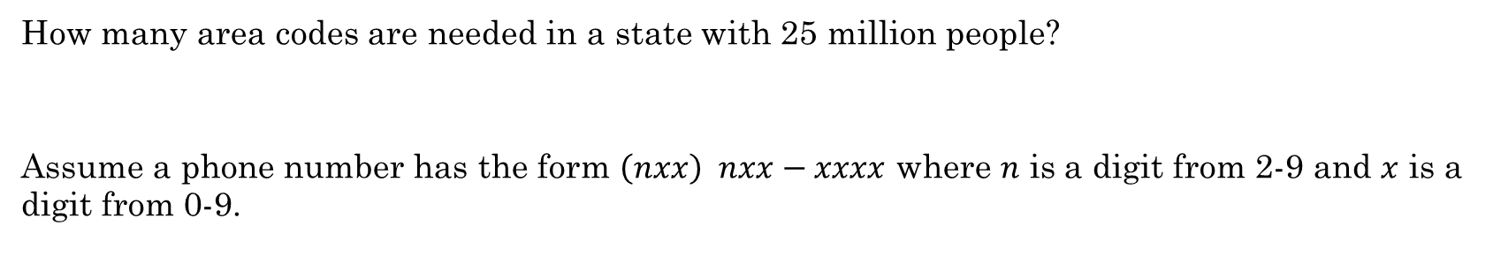
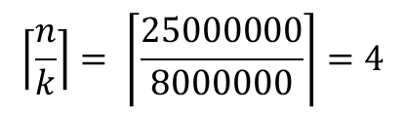
Practice – Area Codes
How many area codes are needed in a state with 25 million people?
Assume a phone number has the form $\left(nxx\right) nxx−xxxx$ where $n$ is a digit from 2-9 and $x$ is a digit from 0-9.
How many 7-digit phone numbers are possible?
$$8∗{10}^{6}=8,000,000$$
$$\left\lceil \frac{n}{k}\right\rceil = \left\lceil \frac{25000000}{8000000}\right\rceil =4$$
How many area codes do we need?

Slide 21
Additional Exercises
With a partner, complete the following additional exercises.
11.3.1
11.3.2
11.3.3

