Slide 1

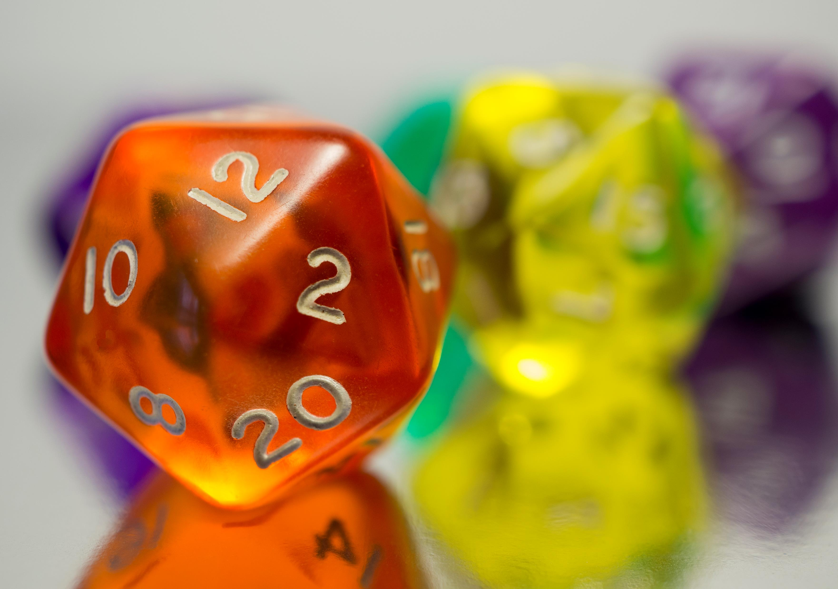


Conditional Probability & Bayes' Theorem

Slide 2
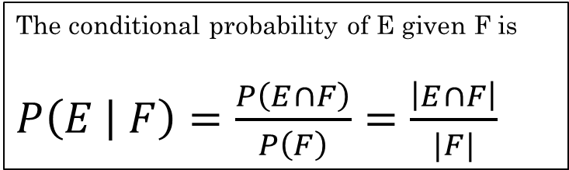

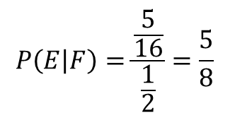
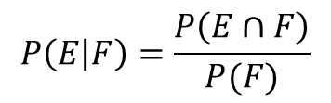
Conditional Probability
The conditional probability of E given F is
$P\left(E | F\right)=\frac{P\left(E∩F\right)}{P\left(F\right)}=\frac{\left|E∩F\right|}{|F|}$
Randomly generate a bit string of length four. Each outcome is equally likely.
What is the probability that it contains at least two consecutive 0's?
What if we know the first bit is a 0? Does that change the probability?
Now we are looking for the probability of two consecutive 0's given the first bit is a 0.
We have a different sample space. Now our possible outcomes only include those that start with a 0.
*As long as the distribution is uniform
$S=\{0000, 0001, 0010,…, 1111\}$ $\left|S\right|=16$
$E=\{0000, 0001, 0010, 0011, 0100, 1000, 1001, 1100\}$ $\left|E\right|=$ 8
$F=$ first bit is a 0, $\left|F\right|=8$
$P\left(E\right)=\frac{8}{16}=\frac{1}{2}$
$$P\left(E | F\right)=\frac{P\left(E∩F\right)}{P(F)}$$
$$P\left(E | F\right)=\frac{\frac{5}{16}}{\frac{1}{2}}=\frac{5}{8}$$

Slide 3
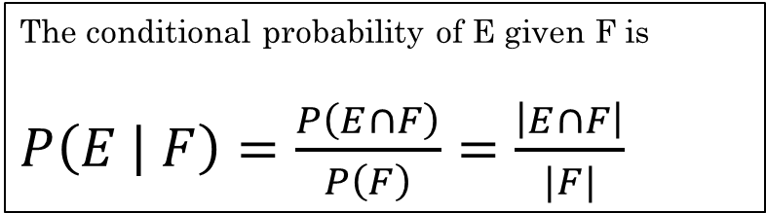
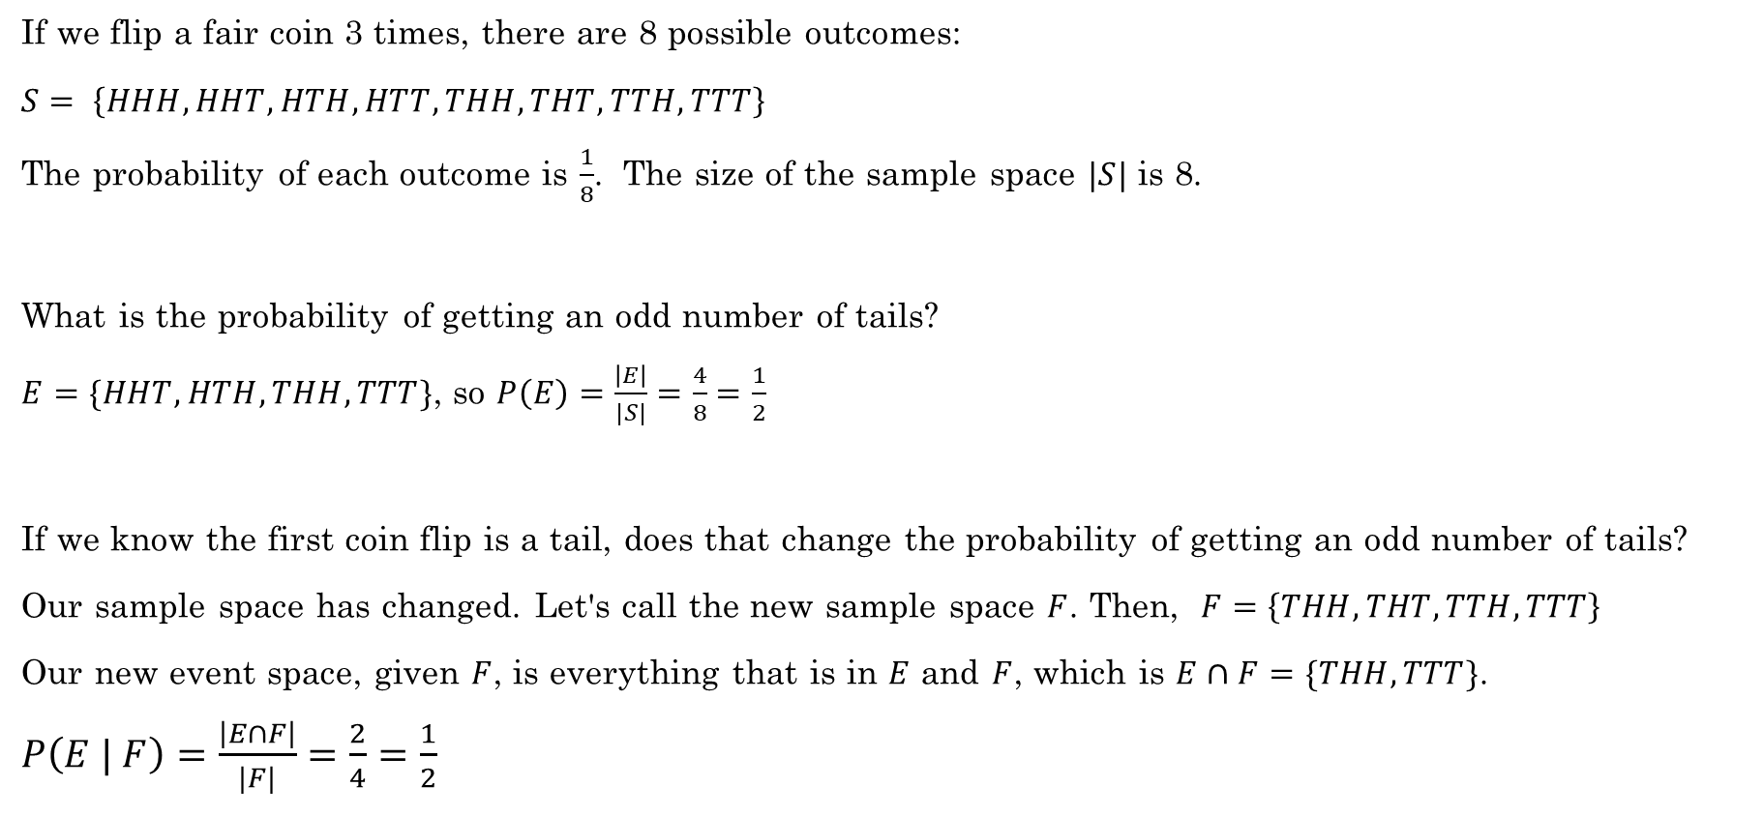
Conditional Probability
The conditional probability of E given F is
$P\left(E | F\right)=\frac{P\left(E∩F\right)}{P\left(F\right)}=\frac{\left|E∩F\right|}{|F|}$
If we flip a fair coin 3 times, there are 8 possible outcomes:
$S= \left\{HHH, HHT, HTH, HTT, THH, THT, TTH, TTT\right\}$
The probability of each outcome is $\frac{1}{8}$. The size of the sample space $|S|$ is 8.
What is the probability of getting an odd number of tails?
$E=\{HHT, HTH, THH, TTT\}$, so $P\left(E\right)=\frac{\left|E\right|}{|S|}=\frac{4}{8}=\frac{1}{2}$
If we know the first coin flip is a tail, does that change the probability of getting an odd number of tails?
Our sample space has changed. Let's call the new sample space $F$. Then, $F=\left\{THH, THT, TTH, TTT\right\}$
Our new event space, given $F$, is everything that is in $E$ and $F$, which is $E∩F=\{THH, TTT\}$.
$P\left(E | F\right)=\frac{\left|E∩F\right|}{|F|}=\frac{2}{4}=\frac{1}{2}$
The probability did not change. Why not?

Slide 4
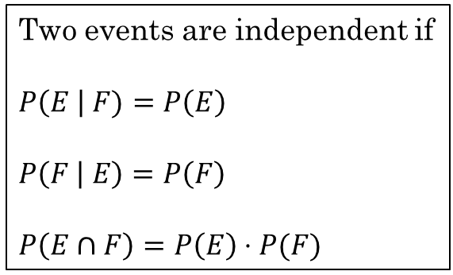
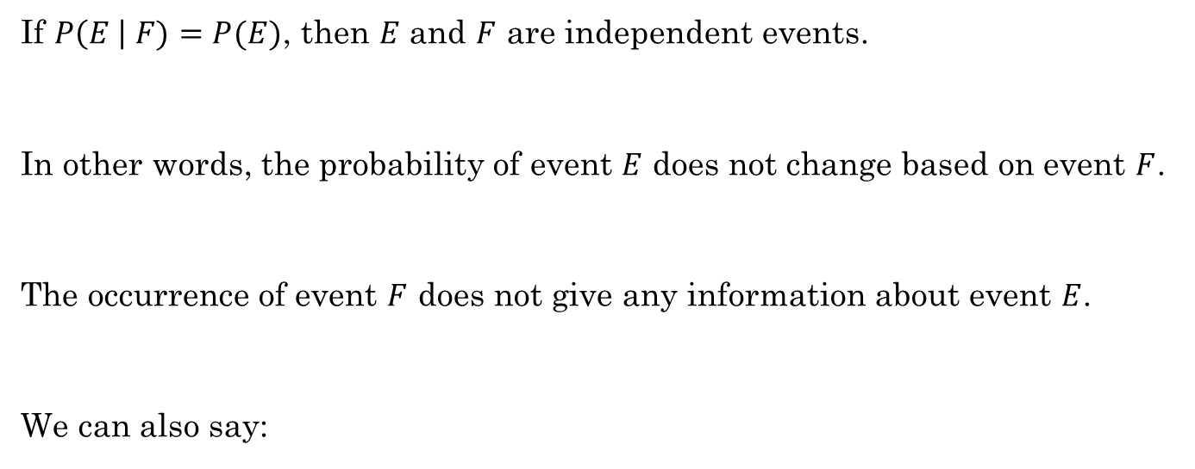
Independent Events
If $P\left(E \right| F)=P(E)$, then $E$ and $F$ are independent events.
In other words, the probability of event $E$ does not change based on event $F$.
The occurrence of event $F$ does not give any information about event $E$.
We can also say:
Two events are independent if
$P\left(E \right| F)=P\left(E\right)$
$P\left(F | E\right)=P\left(F\right)$
$P\left(E∩F\right)=P\left(E\right)⋅P(F)$
These three conditions are all equivalent.

Slide 5
As a class
Additional Exercises
12.3.1 – Whiteboard
12.3.2 – Using Python

Slide 6
Additional Exercises
12.3.3
12.3.4
12.3.6

Slide 7

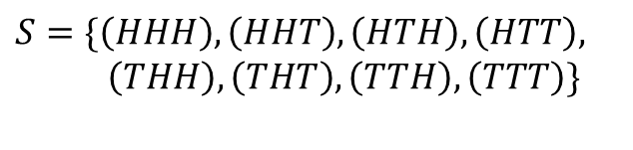



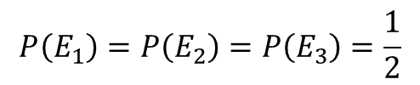
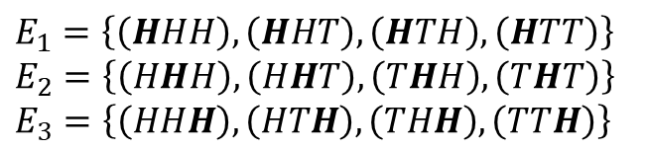

Mutual independence
$P\left(E_{1}∩E_{2}∩…∩E_{n}\right)=P\left(E_{1}\right)⋅P\left(E_{2}\right)⋯P\left(E_{n}\right)$
Example:
$n$ throws of a die where each event $E_{i}$ depends only on the outcome of the $i^{th}$ throw.
Flip a coin three times. $E_{i}$ is the event that the $i^{th}$ throw is a Head.
$S=\{\left(HHH\right),\left(HHT\right), \left(HTH\right), \left(HTT\right),$ $\left(THH\right), \left(THT\right), \left(TTH\right), \left(TTT\right)\}$
$E_{1}=\left\{\left(HHH\right), \left(HHT\right), \left(HTH\right), \left(HTT\right)\right\}$
$E_{2}=\left\{\left(HHH\right), \left(HHT\right), \left(THH\right),\left(THT\right)\right\}$
$E_{3}=\left\{\left(HHH\right), \left(HTH\right), \left(THH\right), \left(TTH\right)\right\}$
$E_{1}∩E_{2}∩E_{3}=\left\{\left(HHH\right)\right\}$
These events are mutually independent because a successful outcome in one event does not depend on the other events.
$P\left(E_{1}∩E_{2}∩E_{3}\right)=\frac{1}{8}$
$$P\left(E_{1}\right)=P\left(E_{2}\right)=P\left(E_{3}\right)=\frac{1}{2}$$
$P(E_{1})⋅P(E_{2})⋅P(E_{3})=\frac{1}{8}$
$$P\left(E_{1}∩E_{2}∩E_{3}\right)=P(E_{1})⋅P(E_{2})⋅P(E_{3})$$

Slide 8
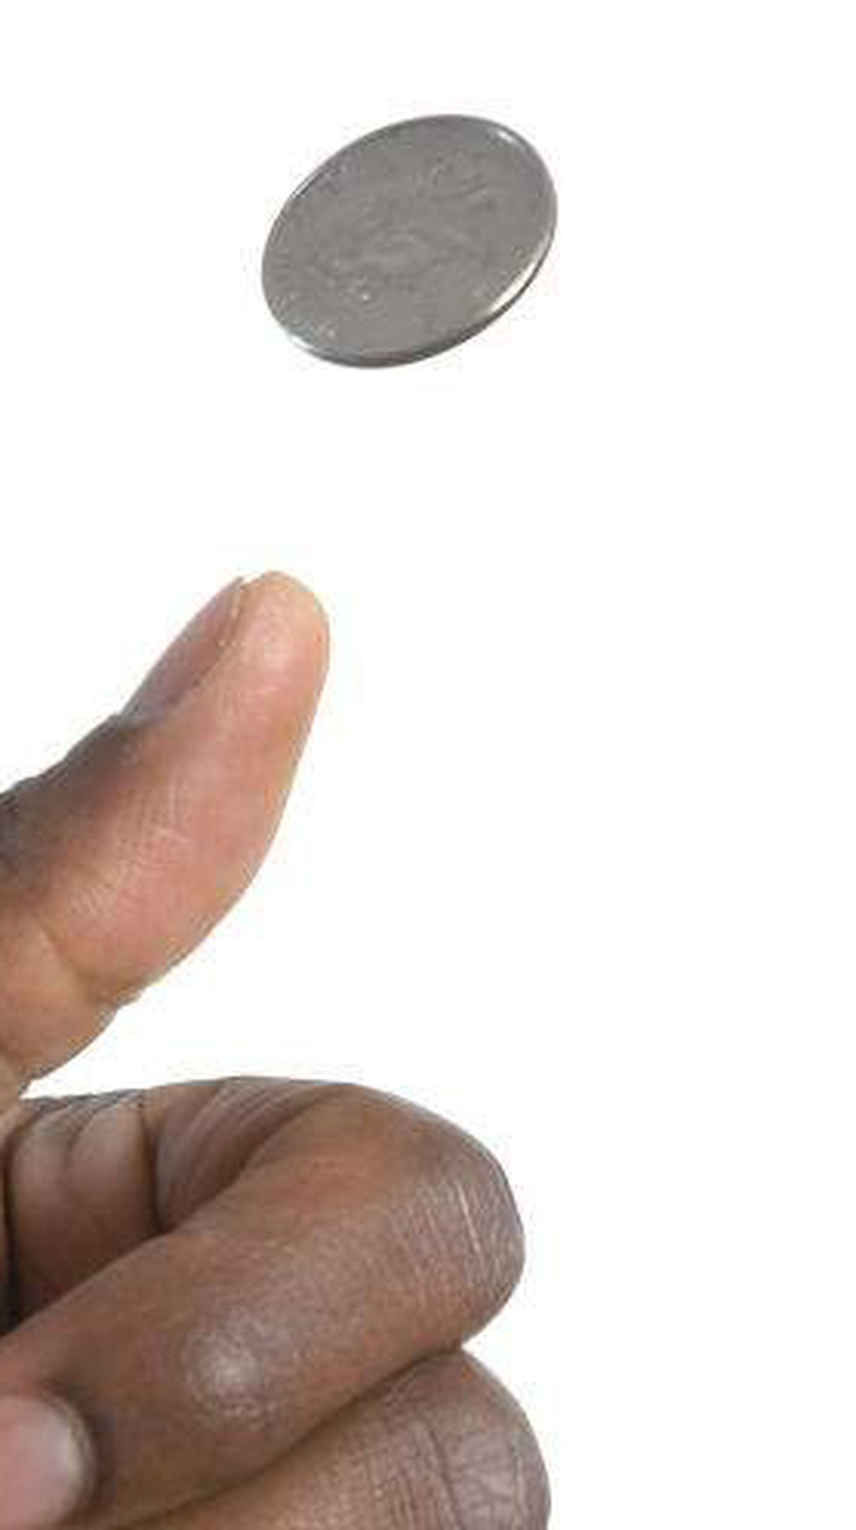
Rolling dice – Does order matter?
Let's talk about flipping coins:
If order doesn't matter, then here is our sample space when flipping two coins:
{HH, HT, TT}
The probability of getting one H and one T would be 1/3. This is clearly incorrect.
It's not so much that order matters, but that we need to distinguish the outcomes of two different variables. Coin #1 and Coin #2. We need to treat them as if order does matter.
{HH, HT, TH, TT}
Now the probability of getting one H and one T is 2/4 = 1/2, which is correct.
https://math.stackexchange.com/questions/2428759/why-does-order-matter-when-two-dice-are-rolled

Slide 9
Rolling Dice – Does order matter?
Just like flipping coins, if we roll five dice, we have five different variables. We need to treat the problem as if order matters so we can easily distinguish between the five dice.
If not, then our sample space does not equally represent all possible rolls.
(1,1,1,1,1) is not as likely as (1,2,3,4,5) because (1,1,1,1,1) can only happen one way, but (1,2,3,4,5) can happen 5!=120 ways.
Show with Python

