Slide 1

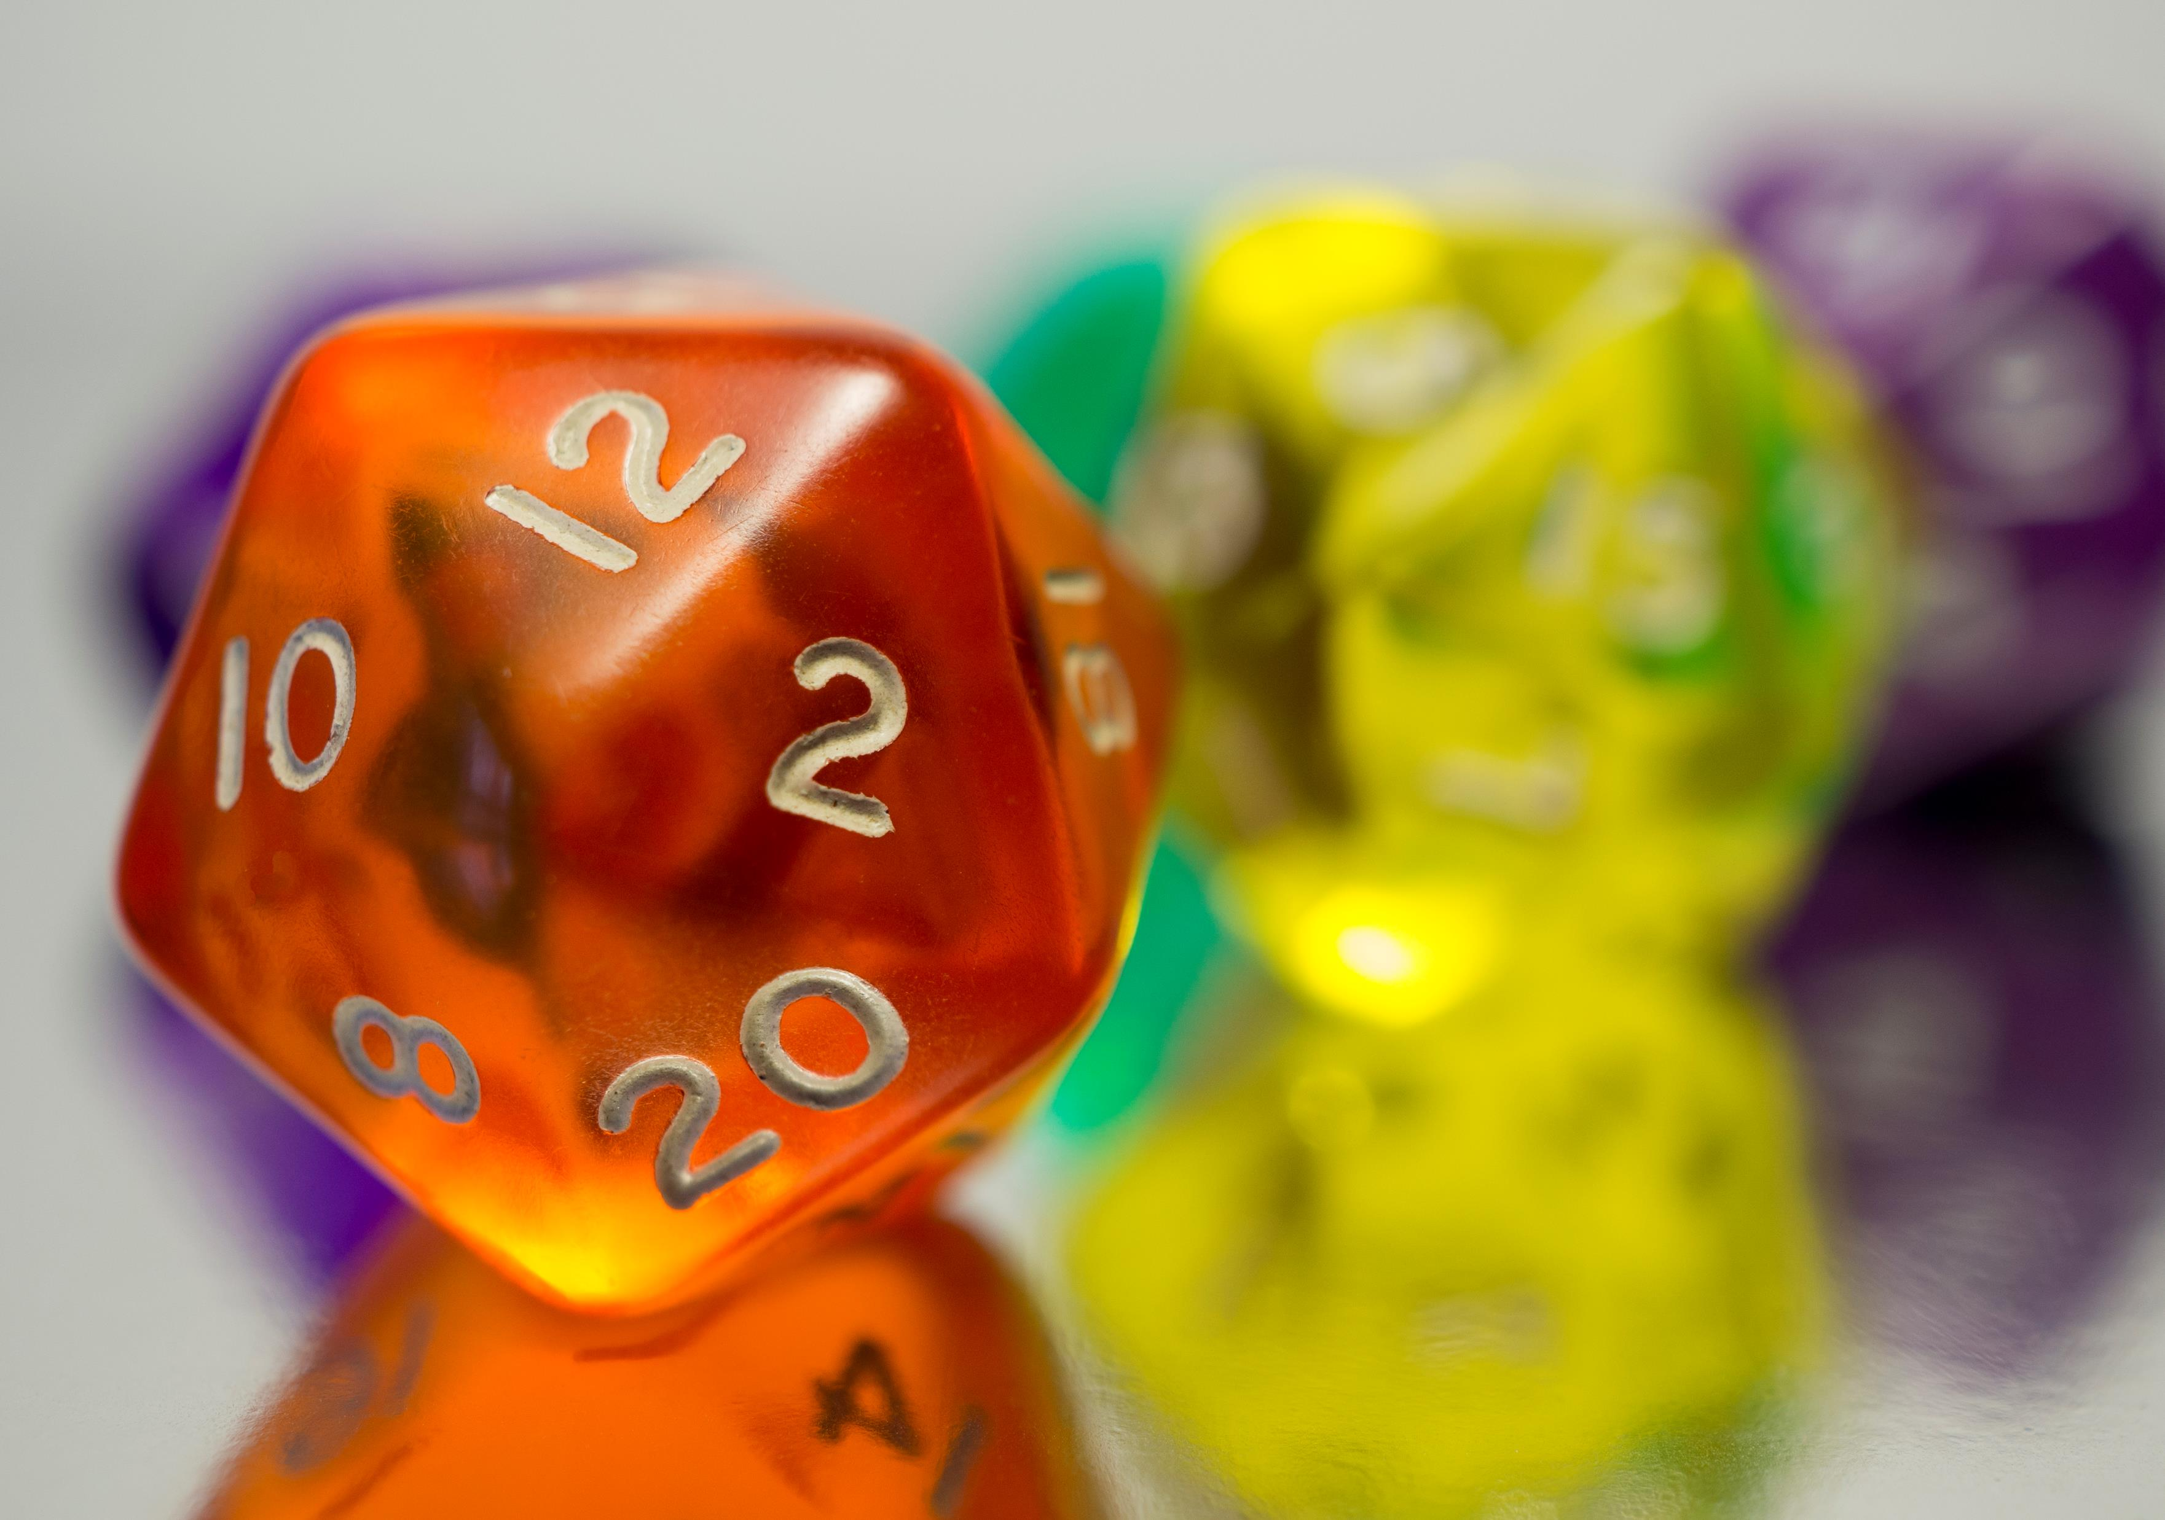


Bayes' Theorem

Slide 2
Bayes' Theorem
Helps us find the probability of an event based on partial information.
Used extensively in machine learning and other areas. Spam filters, classifying text, images, etc.
Suppose we have two jars of skittles, Jar A and Jar B. We can't see inside and don't know which is which.
Jar A contains two green skittles and seven red skittles. Jar B contains four green skittles and three red skittles.
You randomly choose a skittle from one of the jars. If the skittle is red, what is the probability you selected from Jar A?

Slide 3
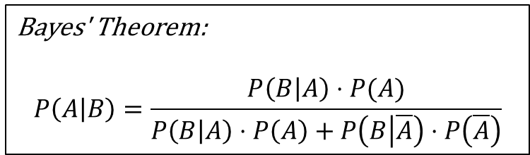
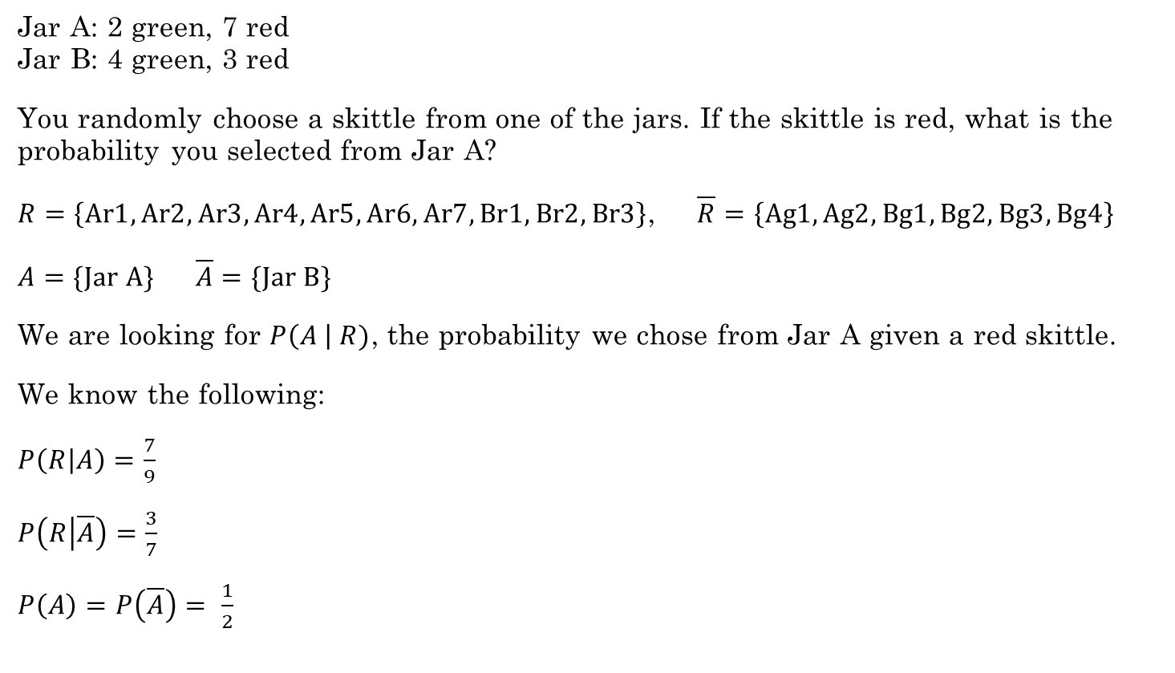

Bayes' Theorem
Bayes' Theorem:
$$P\left(A | B\right)=\frac{P\left(B | A\right)⋅P(A)}{P\left(B | A\right)⋅P\left(A\right)+P\left(B | \overline{A}\right)⋅P\left(\overline{A}\right)}$$
Jar A: 2 green, 7 red Jar B: 4 green, 3 red
You randomly choose a skittle from one of the jars. If the skittle is red, what is the probability you selected from Jar A?
$R=\left\{Ar1, Ar2, Ar3, Ar4, Ar5, Ar6, Ar7, Br1, Br2, Br3\right\}$, $\overline{R}=\left\{Ag1, Ag2, Bg1, Bg2, Bg3, Bg4\right\}$
$A=\{Jar A\}$ $\overline{A}=\{Jar B\}$
We are looking for $P\left(A \right| R)$, the probability we chose from Jar A given a red skittle.
We know the following:
$P\left(R | A\right)=\frac{7}{9}$
$P\left(R | \overline{A}\right)=\frac{3}{7}$
$P\left(A\right)=P\left(\overline{A}\right)= \frac{1}{2}$
Apply Bayes' Theorem:
$$P\left(A | R\right)=\frac{\frac{7}{9}⋅\frac{1}{2}}{\frac{7}{9}⋅\frac{1}{2}+\frac{3}{7}⋅\frac{1}{2}}=\frac{\frac{7}{9}}{\frac{7}{9}+\frac{3}{7}}≈0.645$$
Before choosing a red skittle, we assumed the probability that we selected Jar A was 50%. But with the extra information of choosing a red skittle, that probability increased to 64.5%.
Rosen, Kenneth. Discrete Mathematics and Its Applications, 7th Edition. McGraw-Hill, 2012

Slide 4
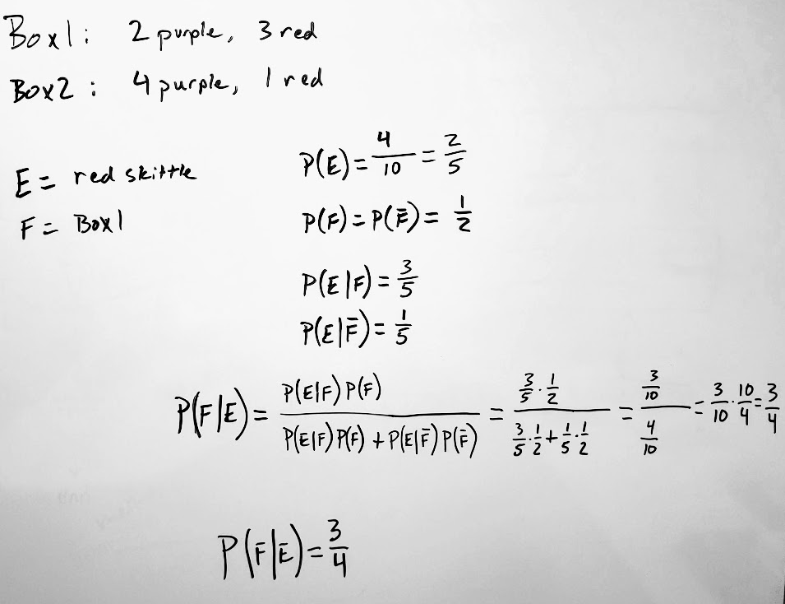

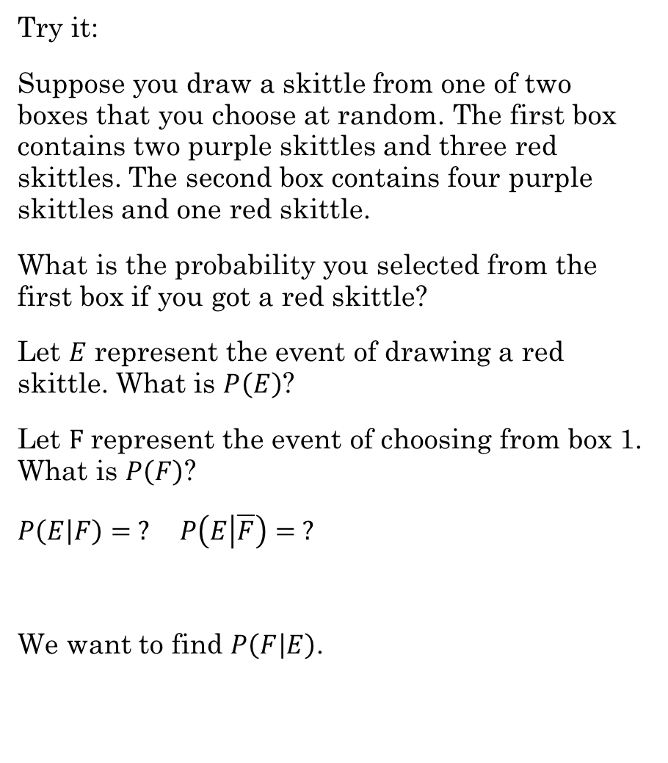
Try it:
Suppose you draw a skittle from one of two boxes that you choose at random. The first box contains two purple skittles and three red skittles. The second box contains four purple skittles and one red skittle.
What is the probability you selected from the first box if you got a red skittle?
Let $E$ represent the event of drawing a red skittle. What is $P\left(E\right)$?
Let $F$ represent the event of choosing from box 1. What is $P\left(F\right)$?
$P\left(E | F\right)= ?$ $P\left(E | \overline{F}\right)= ?$
We want to find $P\left(F | E\right)$.
$P\left(F | E\right)=\frac{3}{4}$

Slide 5
As a Class
Challenge 12.4.1

Slide 6
With a partner
Additional Exercises
12.3.6
12.4.1
12.4.4

Slide 7


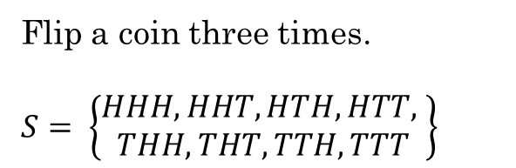
Random Variables
Not random
Not a variable
It is a function that maps from a sample space $S$ to the real numbers $ℝ$.
$X\left(s\right): S→ ℝ$
A random variable is a function that assigns a real number to each possible outcome.
Example:
Flip a coin three times.
$S= \left\{\begin{aligned}HHH, HHT, HTH, HTT, \\ THH, THT, TTH, TTT\end{aligned}\right\}$
Let $X(s)$ be the random variable that equals the number of heads that appear in the outcome $s$. Then,
$X\left(HHH\right)=3$
$X\left(HHT\right)=X\left(HTH\right)=X\left(THH\right)=2$
$X\left(HTT\right)=X\left(THT\right)=X\left(TTH\right)=1$
$X\left(TTT\right)=0$
Rosen, Kenneth. Discrete Mathematics and Its Applications, 7th Edition. McGraw-Hill, 2012

Slide 8

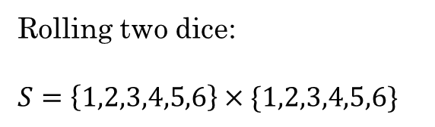
Random Variables
Example:
Rolling two dice:
$S=\left\{1,2,3,4,5,6\right\}×\{1,2,3,4,5,6\}$
Let $X(s)$ be the random variable that equals the sum of the two dice. Then,
$X\left(1,1\right)=2$
$X\left(1,2\right)=X\left(2,1\right)=3$
$X\left(1,3\right)=X\left(2,2\right)=X\left(3,1\right)=4$
$X\left(1,4\right)=X\left(2,3\right)=X\left(3,2\right)=X\left(4,1\right)=5$
$X\left(1,5\right)=X\left(2,4\right)=X\left(3,3\right)=X\left(4,2\right)=X\left(5,1\right)=6$
$X\left(1,6\right)=X\left(2,5\right)=X\left(3,4\right)=X\left(4,3\right)=X\left(5,2\right)=X\left(6,1\right)=7$
$X\left(2,6\right)=X\left(3,5\right)=X\left(4,4\right)=X\left(5,3\right)=X\left(6,2\right)=8$
$X\left(3,6\right)=X\left(4,5\right)=X\left(5,4\right)=X\left(6,3\right)=9$
$X\left(4,6\right)=X\left(5,5\right)=X\left(6,4\right)=10$
$X\left(5,6\right)=X\left(6,5\right)=11$
$X\left(6,6\right)=12$
Rosen, Kenneth. Discrete Mathematics and Its Applications, 7th Edition. McGraw-Hill, 2012

Slide 9



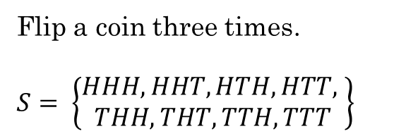
Distribution over a Random Variable
A distribution of a random variable $X$ on sample space $S$ is the set of pairs $\left(r, p\left(X=r\right)\right)$ for all $r∈X(S)$ where $p(X=r)$ is the probability that $X$ has the value $r$.
Example:
Flip a coin three times.
$S= \left\{\begin{aligned}HHH, HHT, HTH, HTT, \\ THH, THT, TTH, TTT\end{aligned}\right\}$
If $X(s)$ is the random variable that equals the number of heads that appear in the outcome $s$. Then,
$X\left(HHH\right)=3$
$X\left(HHT\right)=X\left(HTH\right)=X\left(THH\right)=2$
$X\left(HTT\right)=X\left(THT\right)=X\left(TTH\right)=1$
$X\left(TTT\right)=0$
What is the probability of each outcome?
1/8
The distribution of the random variable $X$ is the set of pairs:
$$\left\{\left(3,\frac{1}{8}\right), \left(2,\frac{3}{8}\right), \left(1,\frac{3}{8}\right), \left(0,\frac{1}{8}\right)\right\}$$
Rosen, Kenneth. Discrete Mathematics and Its Applications, 7th Edition. McGraw-Hill, 2012

Slide 10


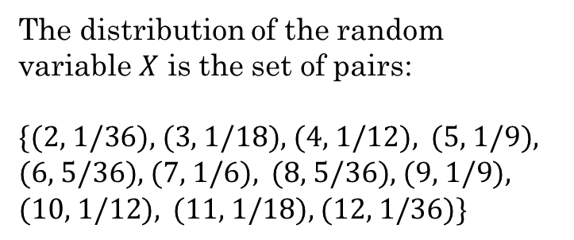
Distribution over a Random Variable
What is the distribution of X?
Rolling two dice:
$S=\left\{1,2,3,4,5,6\right\}×\{1,2,3,4,5,6\}$
$$\left(r, p\left(X=r\right)\right)$$
$X(s)$ is the random variable that equals the sum of the two dice.
$X\left(1,1\right)=2$
$X\left(1,2\right)=X\left(2,1\right)=3$
$X\left(1,3\right)=X\left(2,2\right)=X\left(3,1\right)=4$
$X\left(1,4\right)=X\left(2,3\right)=X\left(3,2\right)=X\left(4,1\right)=5$
$X\left(1,5\right)=X\left(2,4\right)=X\left(3,3\right)=X\left(4,2\right)=X\left(5,1\right)=6$
$X\left(1,6\right)=X\left(2,5\right)=X\left(3,4\right)=X\left(4,3\right)=X\left(5,2\right)=X\left(6,1\right)=7$
$X\left(2,6\right)=X\left(3,5\right)=X\left(4,4\right)=X\left(5,3\right)=X\left(6,2\right)=8$
$X\left(3,6\right)=X\left(4,5\right)=X\left(5,4\right)=X\left(6,3\right)=9$
$X\left(4,6\right)=X\left(5,5\right)=X\left(6,4\right)=10$
$X\left(5,6\right)=X\left(6,5\right)=11$
$X\left(6,6\right)=12$
The distribution of the random variable $X$ is the set of pairs:
$\text{\{(2, 1/36), (3, 1/18), (4, 1/12), }$ $\text{(5, 1/9), (}\text{6, 5/36), (7, 1/6), }$ $\text{(8, 5/3}\text{6}\text{), (9, 1/9), (10, 1/12), }$ $\text{(11, 1/18), (12, 1/36)}\text{\}}$
* The sum of all these probabilities must be 1
Rosen, Kenneth. Discrete Mathematics and Its Applications, 7th Edition. McGraw-Hill, 2012

Slide 11
Additional Exercises
12.5.1 – As a class
12.5.3
12.5.4

Slide 12
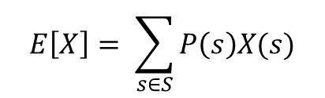
Expected Value of Random Variable
The expected value of a random variable is the sum over all the elements of the product of the probability of the element and the value of the random variable for this element
$$E\left[X\right]= \sum_{s∈S}{P\left(s\right)X(s)}$$
The expected value is a weighted average of the values of the random variable.
This is useful for solving many problems, such as computing the average-case complexity of algorithms.
It is also called the expectation or mean of the random variable.
It can even show the expected winnings from purchasing a lottery ticket...
It is a center point for the distribution of values for this random variable.
Example 12.6.1
Rosen, Kenneth. Discrete Mathematics and Its Applications, 7th Edition. McGraw-Hill, 2012

Slide 13
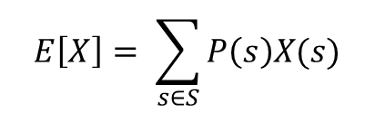
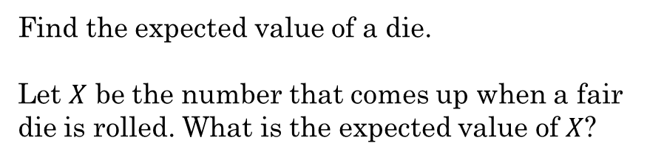
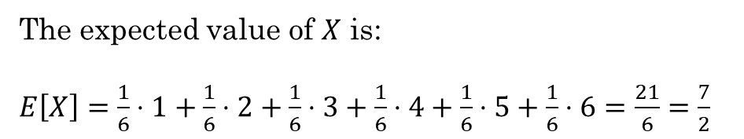
Expected Value of Random Variable
$$E\left[X\right]= \sum_{s∈S}{P\left(s\right)X(s)}$$
Example:
We can answer such questions as:
Find the expected value of a die.
Let $X$ be the number that comes up when a fair die is rolled. What is the expected value of $X$?
How many heads would we expect to get if we flip a coin 100 times?
The random variable $X$ has the values 1, 2, 3, 4, 5, 6
What is the expected number of comparisons needed to find an element in a list using a linear search?
Each value has a probability of $\frac{1}{6}$
The expected value of $X$ is:
$E\left[X\right]=\frac{1}{6}⋅1+\frac{1}{6}⋅2+\frac{1}{6}⋅3+\frac{1}{6}⋅4+\frac{1}{6}⋅5+\frac{1}{6}⋅6=\frac{21}{6}=\frac{7}{2}$
Rosen, Kenneth. Discrete Mathematics and Its Applications, 7th Edition. McGraw-Hill, 2012

Slide 14
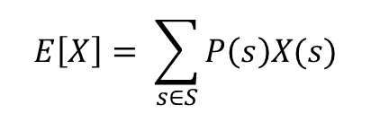

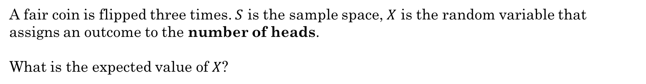

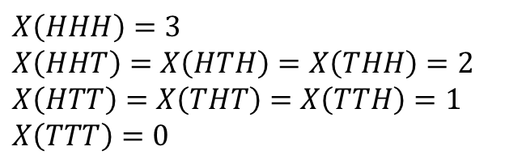
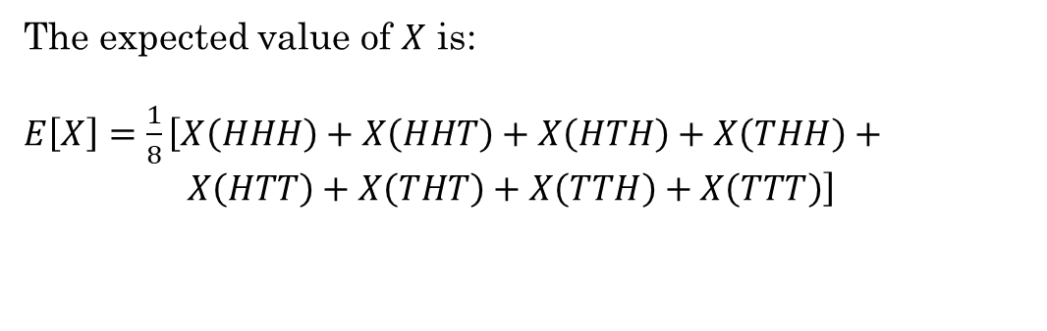
Expected Value of Random Variable
$$E\left[X\right]= \sum_{s∈S}{P\left(s\right)X(s)}$$
Example:
A fair coin is flipped three times. $S$ is the sample space, $X$ is the random variable that assigns an outcome to the number of heads.
What is the expected value of $X$?
It is a fair coin, so what is the probability of each outcome?
1/8
$S= \left\{\begin{aligned}HHH, HHT, HTH, HTT, \\ THH, THT, TTH, TTT\end{aligned}\right\}$
The expected value of $X$ is:
$E\left[X\right]=\frac{1}{8}\left[X\left(HHH\right)+X\left(HHT\right)+X\left(HTH\right)+X\left(THH\right)+ X\left(HTT\right)+X\left(THT\right)+X\left(TTH\right)+X\left(TTT\right)\right]$
$X\left(HHH\right)=3$
$X\left(HHT\right)=X\left(HTH\right)=X\left(THH\right)=2$
$X\left(HTT\right)=X\left(THT\right)=X\left(TTH\right)=1$
$X\left(TTT\right)=0$
$=\frac{1}{8}(3+2+2+2+1+1+1+0)=\frac{12}{8}$
$=\frac{3}{2}$
The expected or average number of heads is $\frac{3}{2}$ or 1.5
Rosen, Kenneth. Discrete Mathematics and Its Applications, 7th Edition. McGraw-Hill, 2012

Slide 15
Try it

Slide 16
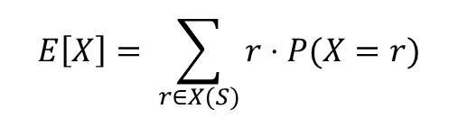
Expected Value of Random Variable
$$E\left[X\right]= \sum_{s∈S}{P\left(s\right)X(s)}$$
If there are only a few outcomes, i.e., the sample space is small, we can compute this easily.
Instead, we can compute the expected value by grouping together the outcomes assigned the same value by the random variable:
$$E\left[X\right]= \sum_{r∈X(S)}{r⋅P(X=r)}$$
If there are a lot of outcomes, this is more difficult.
where $X\left(S\right)$ is the range of $X$
Rosen, Kenneth. Discrete Mathematics and Its Applications, 7th Edition. McGraw-Hill, 2012

Slide 17
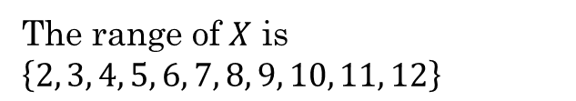


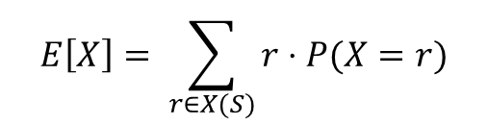
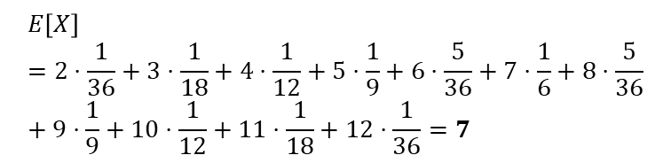

Expected Value of Random Variable
$$E\left[X\right]= \sum_{r∈X(S)}{r⋅P(X=r)}$$
Example:
What is the expected value of the sum of the numbers that appear when rolling two fair dice?
$S= \left\{\left(1,1\right), \left(1,2\right), …, \left(6,6\right)\right\}$
The range of $X$ is $\left\{2, 3, 4, 5, 6, 7, 8, 9, 10, 11, 12\right\}$
$X(s)$ is the random variable that equals the sum of the two dice.
$X\left(1,1\right)=2$
$X\left(1,2\right)=X\left(2,1\right)=3$
$X\left(1,3\right)=X\left(2,2\right)=X\left(3,1\right)=4$
$X\left(1,4\right)=X\left(2,3\right)=X\left(3,2\right)=X\left(4,1\right)=5$
$X\left(1,5\right)=X\left(2,4\right)=X\left(3,3\right)=X\left(4,2\right)=X\left(5,1\right)=6$
$X\left(1,6\right)=X\left(2,5\right)=X\left(3,4\right)=X\left(4,3\right)=X\left(5,2\right)=X\left(6,1\right)=7$
$X\left(2,6\right)=X\left(3,5\right)=X\left(4,4\right)=X\left(5,3\right)=X\left(6,2\right)=8$
$X\left(3,6\right)=X\left(4,5\right)=X\left(5,4\right)=X\left(6,3\right)=9$
$X\left(4,6\right)=X\left(5,5\right)=X\left(6,4\right)=10$
$X\left(5,6\right)=X\left(6,5\right)=11$
$X\left(6,6\right)=12$
$P\left(2\right)=P\left(12\right)= \frac{1}{36}$ $P\left(3\right)=P\left(11\right)= \frac{1}{18}$
$P\left(4\right)=P\left(10\right)= \frac{1}{12}$ $P\left(5\right)=P\left(9\right)= \frac{1}{9}$
$P\left(6\right)=P\left(8\right)= \frac{5}{36}$ $P\left(7\right)=\frac{1}{6}$
$$E\left[X\right]=2⋅\frac{1}{36}+3⋅\frac{1}{18}+4⋅\frac{1}{12}+5⋅\frac{1}{9}+6⋅\frac{5}{36}+7⋅\frac{1}{6}+8⋅\frac{5}{36}+9⋅\frac{1}{9}+10⋅\frac{1}{12}+11⋅\frac{1}{18}+12⋅\frac{1}{36}=7$$
The expected or average value is 7
Rosen, Kenneth. Discrete Mathematics and Its Applications, 7th Edition. McGraw-Hill, 2012

Slide 18

Expected Value of Random Variable
$$E\left[X\right]= \sum_{r∈X(S)}{r⋅P(X=r)}$$
Example:
What is the expected value of the sum of the numbers that appear when rolling two fair dice?
$S= \left\{\left(1,1\right), \left(1,2\right), …, \left(6,6\right)\right\}$
$X(s)$ is the random variable that equals the sum of the two dice.
$X\left(1,1\right)=2$
$X\left(1,2\right)=X\left(2,1\right)=3$
$X\left(1,3\right)=X\left(2,2\right)=X\left(3,1\right)=4$
$X\left(1,4\right)=X\left(2,3\right)=X\left(3,2\right)=X\left(4,1\right)=5$
$X\left(1,5\right)=X\left(2,4\right)=X\left(3,3\right)=X\left(4,2\right)=X\left(5,1\right)=6$
$X\left(1,6\right)=X\left(2,5\right)=X\left(3,4\right)=X\left(4,3\right)=X\left(5,2\right)=X\left(6,1\right)=7$
$X\left(2,6\right)=X\left(3,5\right)=X\left(4,4\right)=X\left(5,3\right)=X\left(6,2\right)=8$
$X\left(3,6\right)=X\left(4,5\right)=X\left(5,4\right)=X\left(6,3\right)=9$
$X\left(4,6\right)=X\left(5,5\right)=X\left(6,4\right)=10$
$X\left(5,6\right)=X\left(6,5\right)=11$
$X\left(6,6\right)=12$
The other way, we would have had to sum each outcome in $S$.
$$E[X]=\frac{1}{36}[2+3+3+4+4+4+5+5+5+5+6+6+6+6+6+7+7+7+7+7+7+8+8+8+8+8+9+9+9+9+10+10+10+11+11+12=7$$
Same result, but more lengthy calculation.
The expected or average value is 7
Using Python
Rosen, Kenneth. Discrete Mathematics and Its Applications, 7th Edition. McGraw-Hill, 2012

Slide 19
Additional Exercises:
12.6.1
12.6.2

Slide 20

Linearity of Expectations
The expected value of the sum of random variables is the sum of their expected values.
$$E\left[X_{1}+X_{2}+…+X_{n}\right]=E[X_{1}]+E[X_{2}] +…+E[X_{n}]$$
$$E\left[aX\right]=aE[X]$$
Used to simplify calculating expectations.
Does NOT require the random variables to be independent.

Slide 21
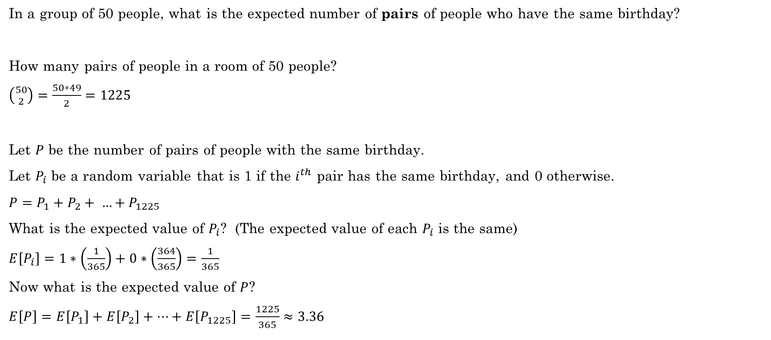
Linearity of Expectations
In a group of 50 people, what is the expected number of pairs of people who have the same birthday?
How many pairs of people in a room of 50 people?
$\left({50 \atop 2}\right)=\frac{50∗49}{2}=1225$
Let $P$ be the number of pairs of people with the same birthday.
Let $P_{i}$ be a random variable that is 1 if the $i^{th}$ pair has the same birthday, and 0 otherwise.
$P=P_{1}+P_{2}+ …+P_{1225}$
What is the expected value of $P_{i}$? (The expected value of each $P_{i}$ is the same)
$E\left[P_{i}\right]=1∗\left(\frac{1}{365}\right)+0∗\left(\frac{364}{365}\right)=\frac{1}{365}$
Now what is the expected value of $P$?
$E\left[P\right]=E\left[P_{1}\right]+E\left[P_{2}\right]+…+E\left[P_{1225}\right]=\frac{1225}{365}≈3.36$
In a room of 50 people, we would expect about 3.36 pairs have the same birthday.

Slide 22
Additional Exercises:
12.7.1

Slide 23
Class Activity
Calculate the probability of rolling each pattern in Yahtzee.

Slide 24
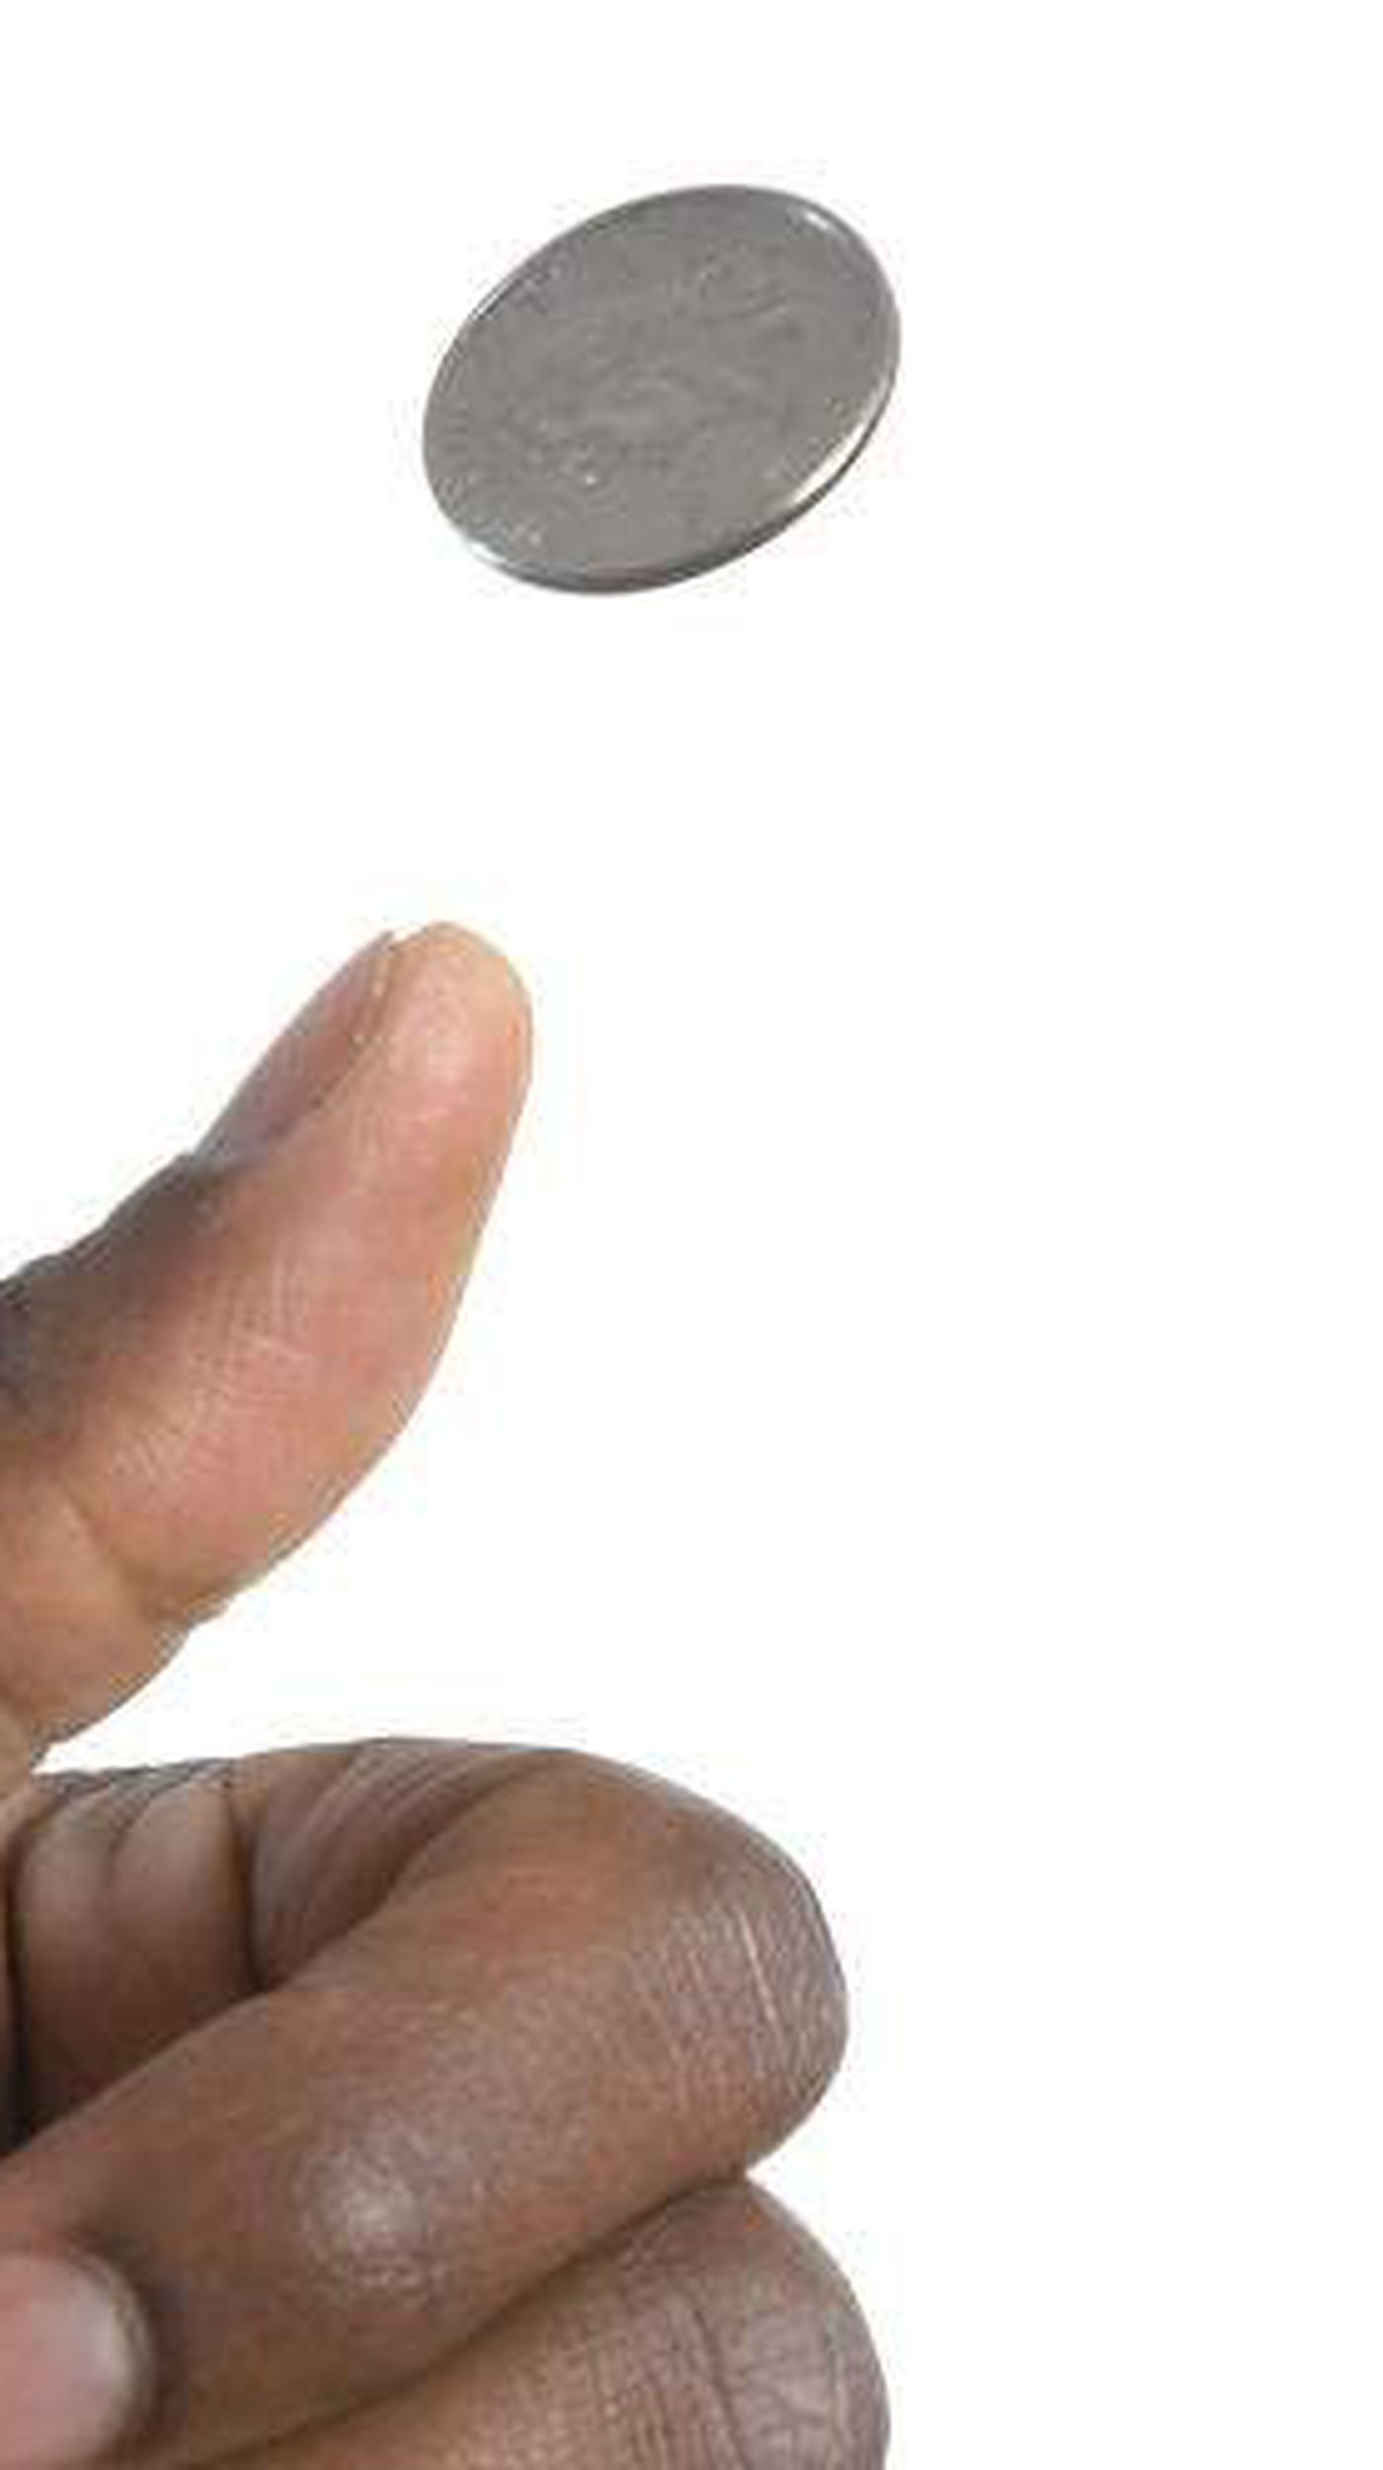
Rolling dice – Does order matter?
Let's talk about flipping coins:
If order doesn't matter, then here is our sample space when flipping two coins:
{HH, HT, TT}
The probability of getting one H and one T would be 1/3. This is clearly incorrect.
It's not so much that order matters, but that we need to distinguish the outcomes of two different variables. Coin #1 and Coin #2. We need to treat them as if order does matter.
{HH, HT, TH, TT}
Now the probability of getting one H and one T is 2/4 = 1/2, which is correct.
https://math.stackexchange.com/questions/2428759/why-does-order-matter-when-two-dice-are-rolled

Slide 25
Rolling Dice – Does order matter?
Just like flipping coins, if we roll five dice, we have five different variables. We need to treat the problem as if order matters so we can easily distinguish between the five dice.
If not, then our sample space does not equally represent all possible rolls.
(1,1,1,1,1) is not as likely as (1,2,3,4,5) because (1,1,1,1,1) can only happen one way, but (1,2,3,4,5) can happen 5!=120 ways.
Show with Python

