Slide 1
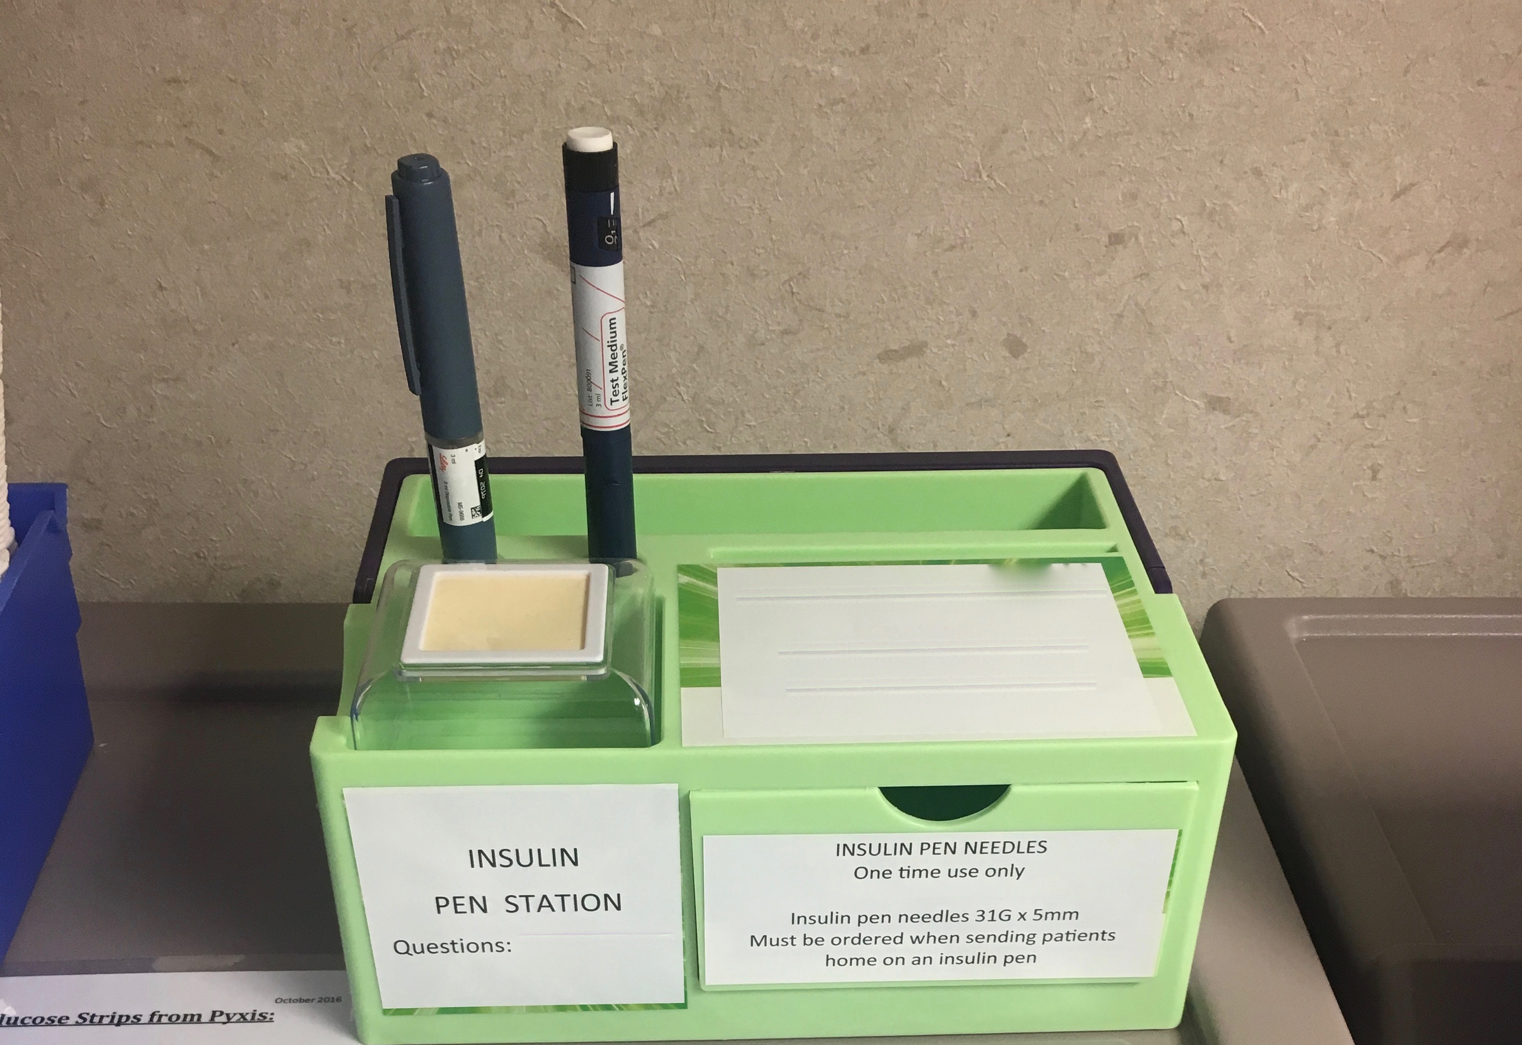
Examining the Impact of Education on Diabetes Rates
Mackenzie Bogiages
University of North Carolina- Department of Economics
Gathering and Cleaning the Data
30.3 million U.S. residents live with diabetes (about 70 million more live with prediabetes)
About $245 billion is spent on diabetes care in the U.S. per year
Diabetes is a disease in which the body's ability to produce or respond to insulin is impaired, resulting in abnormal metabolism of carbohydrates and elevated levels of glucose
Medical Expenditure Panel Survey
Variables include: diabetes diagnosis, US region, age, sex, race, ethnicity, student status, level of English, blood pressure status, heart disease status, heart attacks, strokes, high cholesterol status
Impact of Race
Typically race has a large and statistically significant impact on diabetes rates. In this study, it can be seen that African Americans have diabetes rates close to 14%, while other race assignments have rates of only 10% as can be seen below.
Impact of Education
To reduce diabetes rates as well as national healthcare expenditure, a target population needs to be identified for preventative care, and education level will help identify that key population.
A multivariate model was used to estimate the impact of education on diabetes (many other factors were controlled for)
11.8% of patients with no degree have diabetes
12.1% of patients with a GED have diabetes
11.2% of patients with high school diplomas have diabetes
8.3% of patients with bachelor’s degrees have diabetes
8.4% of patients with master’s degrees have diabetes
5.6% of patients with Doctorate degrees have diabetes
The main difference in diabetes rates based on education stems from obtaining a bachelor’s degree. After assigning each patient to a binary category (0 = no bachelor’s degree obtained, 1 = bachelor’s degree obtained), the following results were yielded:
Those with bachelor’s degrees are .4578 times less likely to get diabetes when compared to the population without bachelor’s degrees
Conclusions
The objective of this paper is to quantify the effect that education has on diabetes rates so that target populations for preventative care can be identified.
Target Population
Patients not on the “college-bound track”
Offer diabetes preventative education in public schools at a young age, before students are legally old enough to drop out and miss this critical information, and before they are old enough to be responsible for their own health via diet and exercise regime
Offer community outreach programs teaching diabetes education and care in areas with low rates of bachelor’s degree per capita
Further Analysis
If this study were to be recreated or built off of, a few changes could yield more information:
Whether or not a student was on the “college-bound track” should be recorded in elementary, middle, and high school
Analyze the impacts of physical education classes in grade school and the impact of any health requirements in colleges
Race should be recorded more thoroughly rather than just listing “mixed race”
Analyze the results of trade school and other alternative degrees
Recommendations
To reduce diabetes rates (as well as the national expenditure on diabetes), we should invest more in the health education of those without bachelor’s degrees and those not projected to go to college and teach them about the importance of diabetes prevention and care.
Acknowledgements
The author would like to thank David Guilkey for his continued assistance and Carol Anne Benson for her photographs.

