Slide 1
Durham County Crimes
Mackenzie Bogiages, Kevin Chen,
Austin Dunn, Tony Lieu, Alicia Ar

Slide 2
Durham Crimes Dataset
Original dataset:
Latitude and longitude coordinates
Year, month, day, hour, minute reported
Year, month, day, hour, minute occurred
Day of the week
Crime reported as, charged as
District, big zone
What we added:
Area
American Tobacco Campus
City Center
Duke University
Durham Technical Community College
North Carolina Central University
Downtown
0 – Not in downtown
1 – Located in downtown

Slide 3
Overview
Goal: To learn more about criminal behavior patterns through analysis of location and time
“Predictive Policing”
Challenges: Cleaning dataset, 120+ different types of crimes

Slide 4
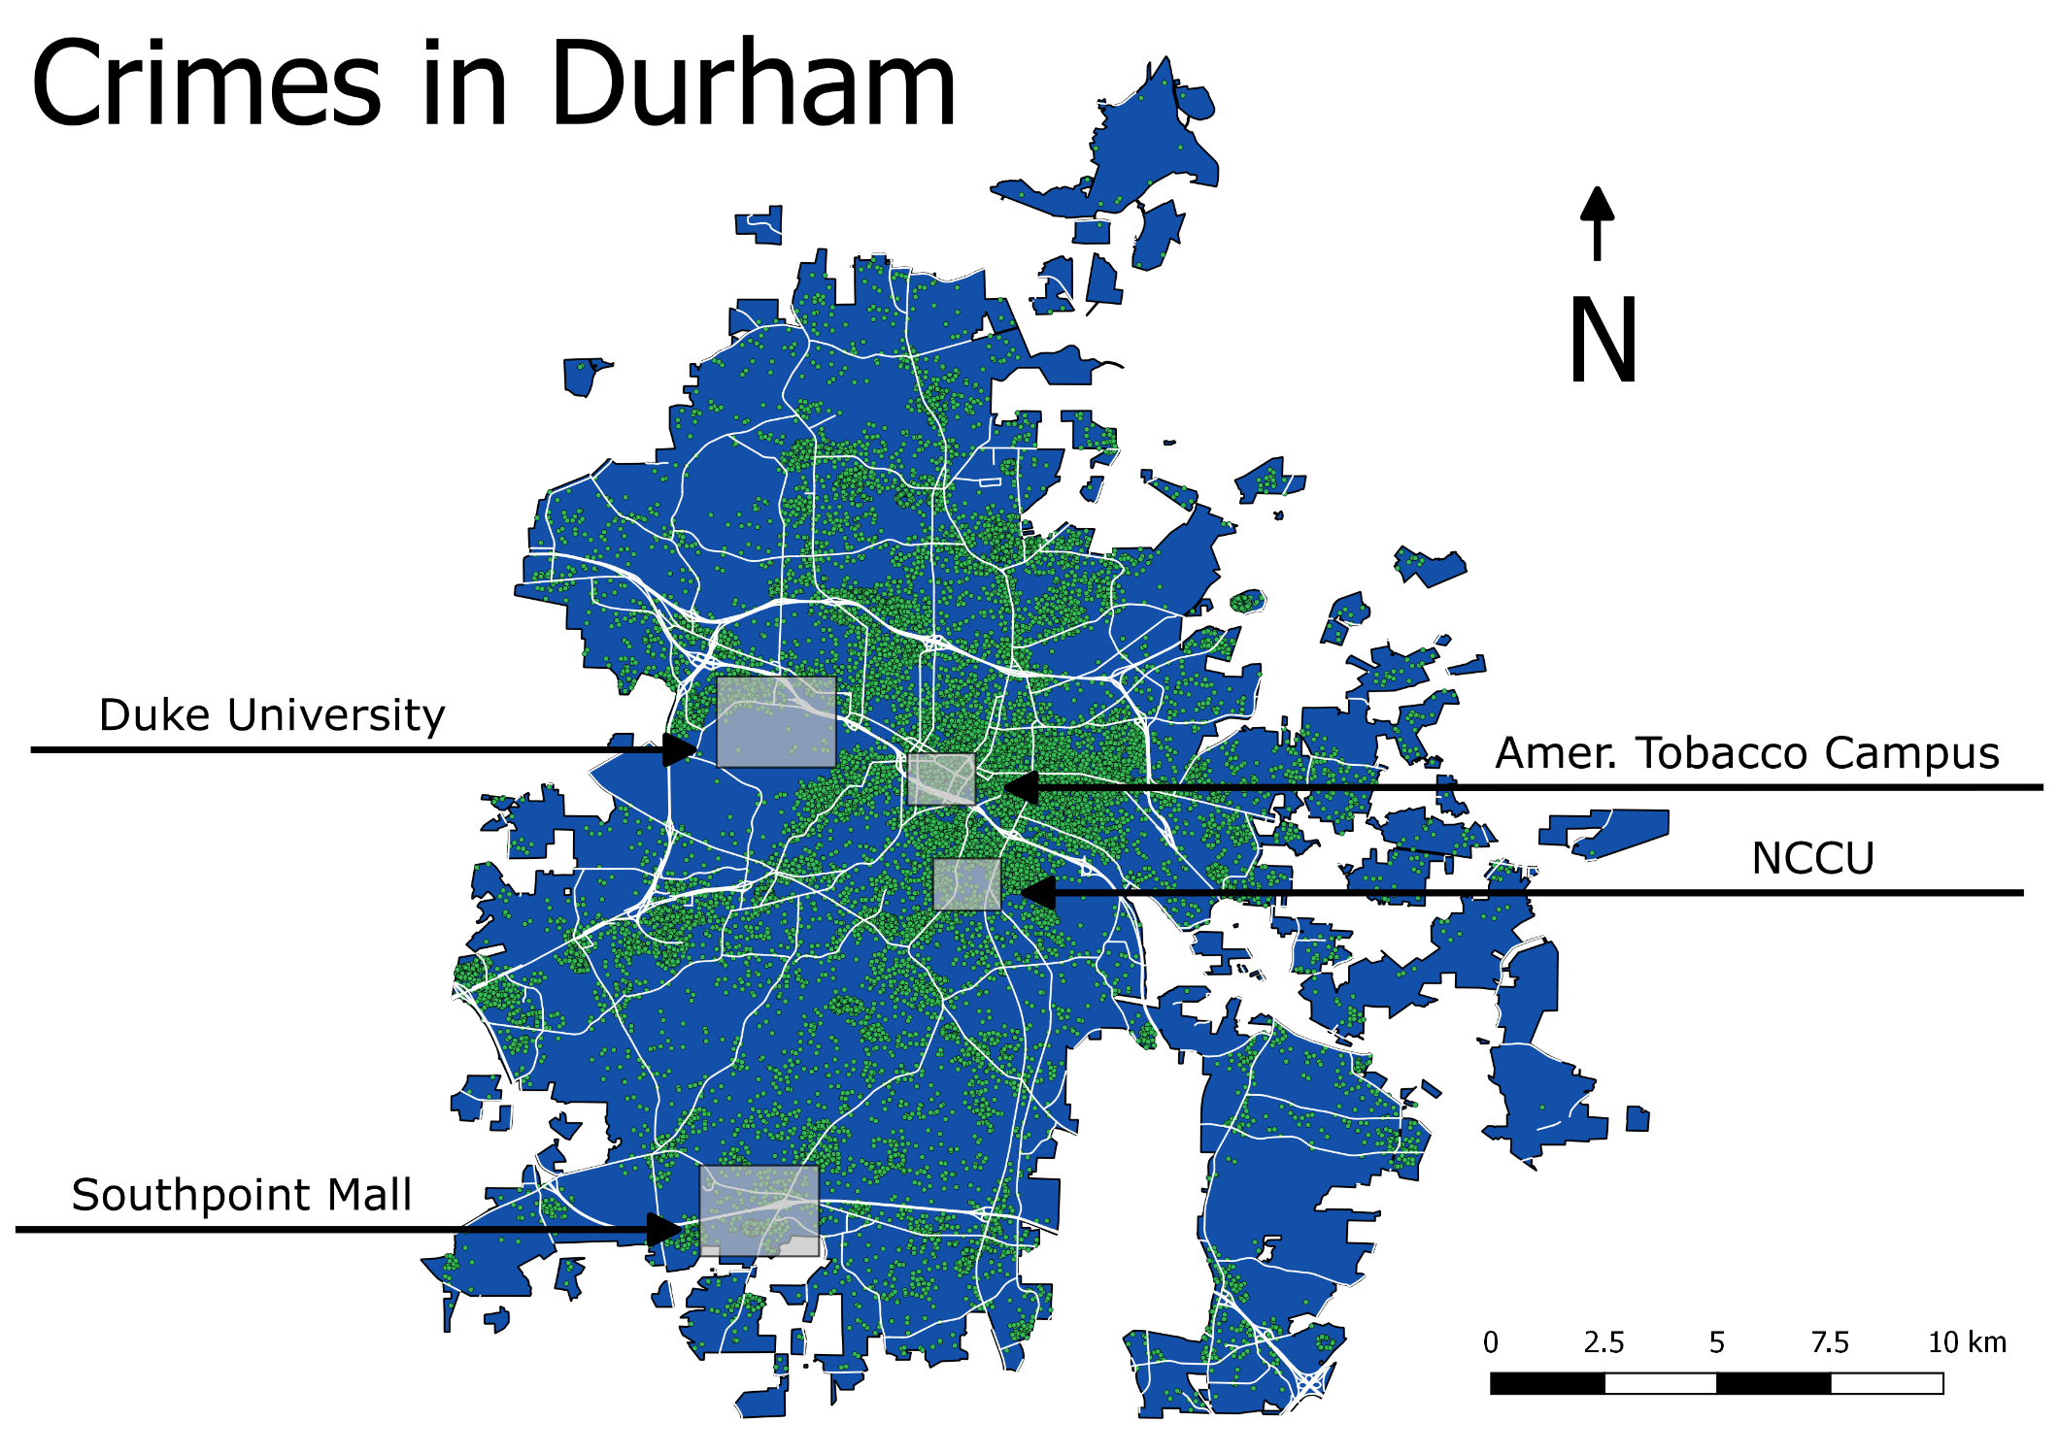

Slide 5
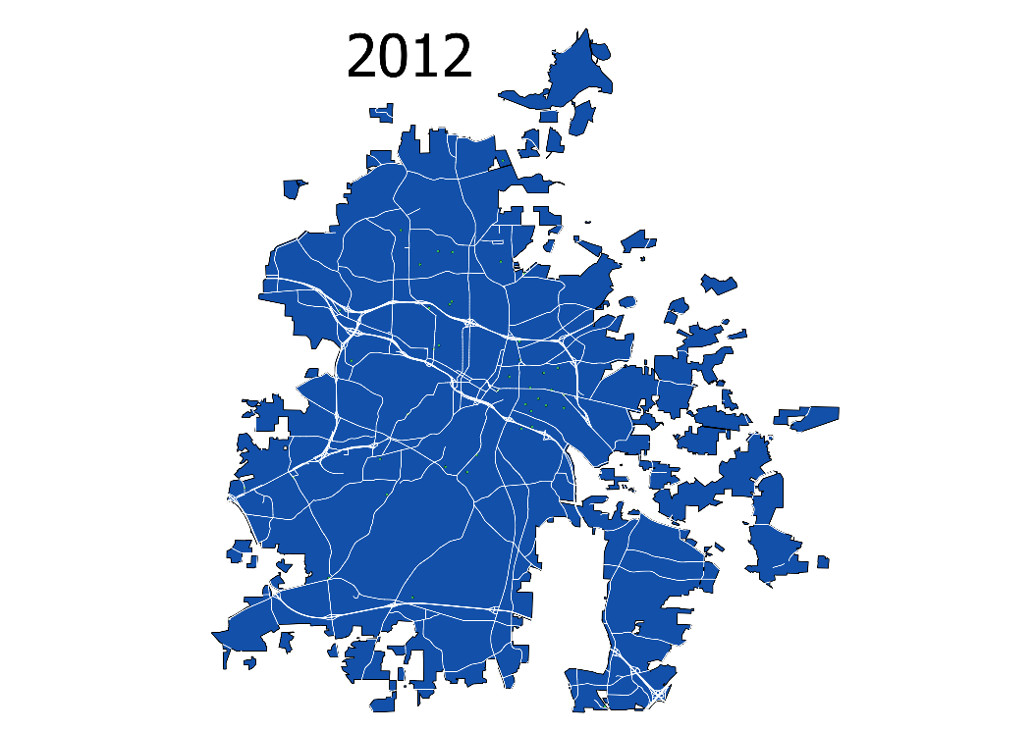
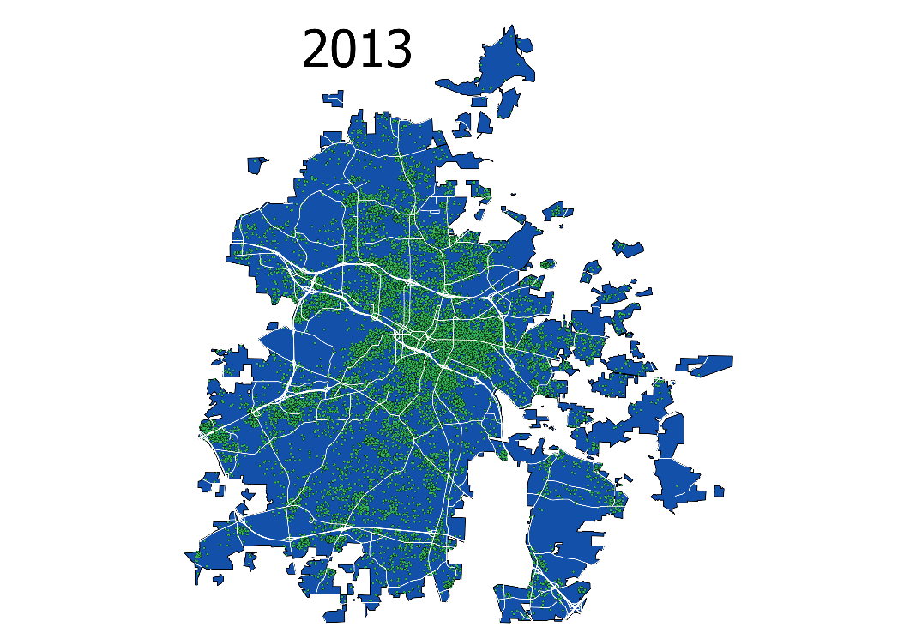
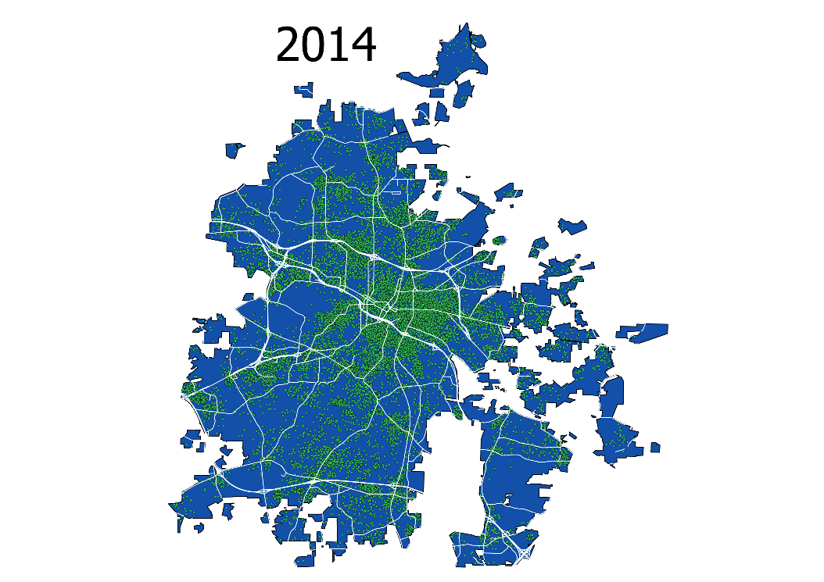


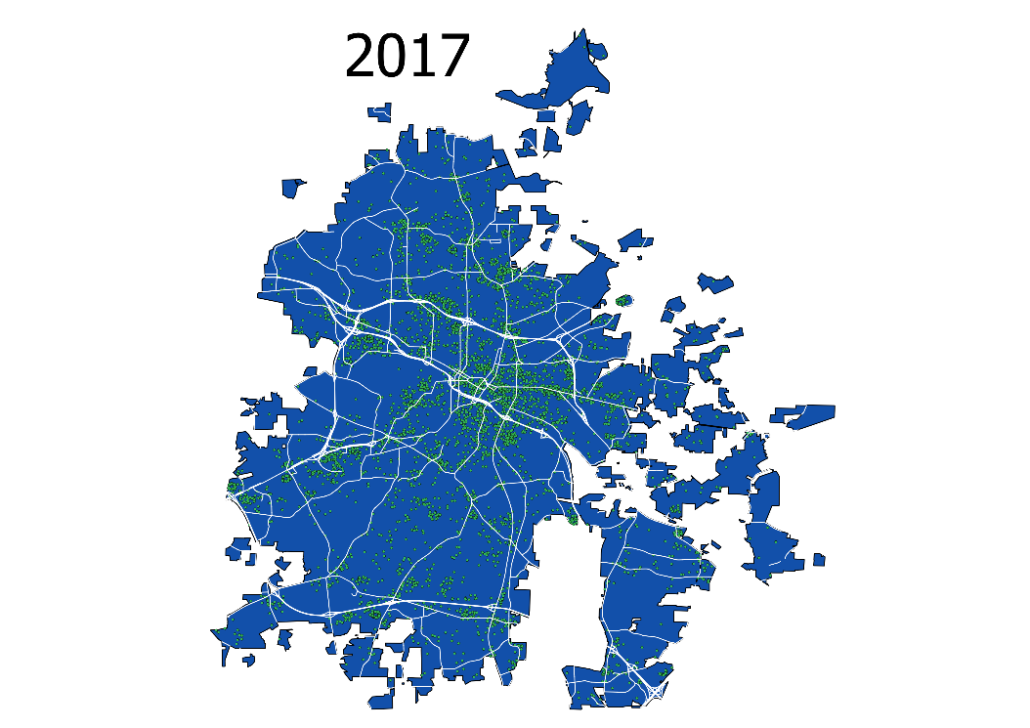

Slide 6
Methodology
C
C
C
C
Clustering: K-Means and Hierarchical to group certain types of crimes together

Slide 7
Clustering
2 variables:
Reported as
Grouped data by “reported as” then calculated summary statistics: counts, mean latitude, mean longitude, mean hour occurred (only counts >150)
Charged as
Grouped data by “charged as” then calculate mean latitude and mean longitude

Slide 8
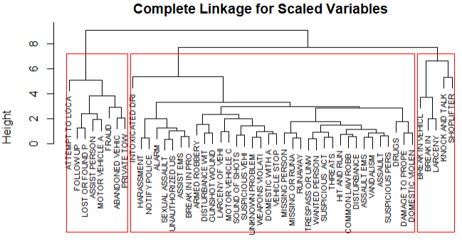
Clustering: Reported as
Hierarchical Clustering
Intuitive pair findings:
Home break-in and vehicle break-in
Abandoned vehicle and private towing
Missing person and runaway
Interesting pairs:
Damage to property and domestic violence
Sound of shots and suspicious vehicles

Slide 9
Clustering: Reported as
K-Means Clustering
Same exact pairs, except “knock and talk” moves from group 3 to 2
48/49 crimes were classified into same cluster as hierarchical!
98% similarity

Slide 10
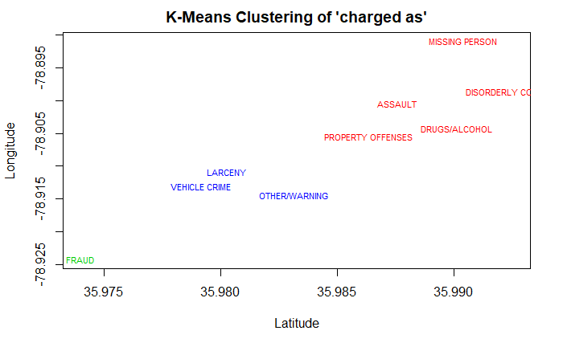
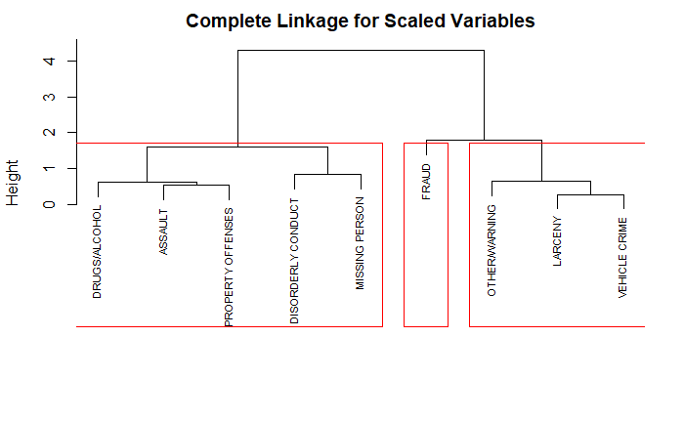
Clustering: Charged as

Slide 11
Future Recommendations

