Slide 1
Durham County Crimes
MACKENZIE BOGIAGES, KEVIN CHEN,
AUSTIN DUNN, TONY LIEU, ALICIA AR
Notes:
Hello, we are Group One

Slide 2
Durham Crimes Dataset
Original dataset:
Latitude and longitude coordinates
Year, month, day, hour, minute reported
Year, month, day, hour, minute occurred
Day of the week
Crime reported as, charged as
District, big zone
What we added:
Area
American Tobacco Campus
City Center
Duke University
Durham Technical Community College
North Carolina Central University
Downtown
0 – Not in downtown
1 – Located in downtown
Notes:
Our original dataset consists of un-tidydata. The predictors that were included were generally about time and location which are on the left.
We added binary variables such as downtown to determine if most of the crimes happen in a more dense area.

Slide 3
Overview
Goal: To learn more about criminal behavior patterns through analysis of location and time
“Predictive Policing”
Challenges: Cleaning dataset, 120+ different types of crimes, 70k+ observations

Slide 4
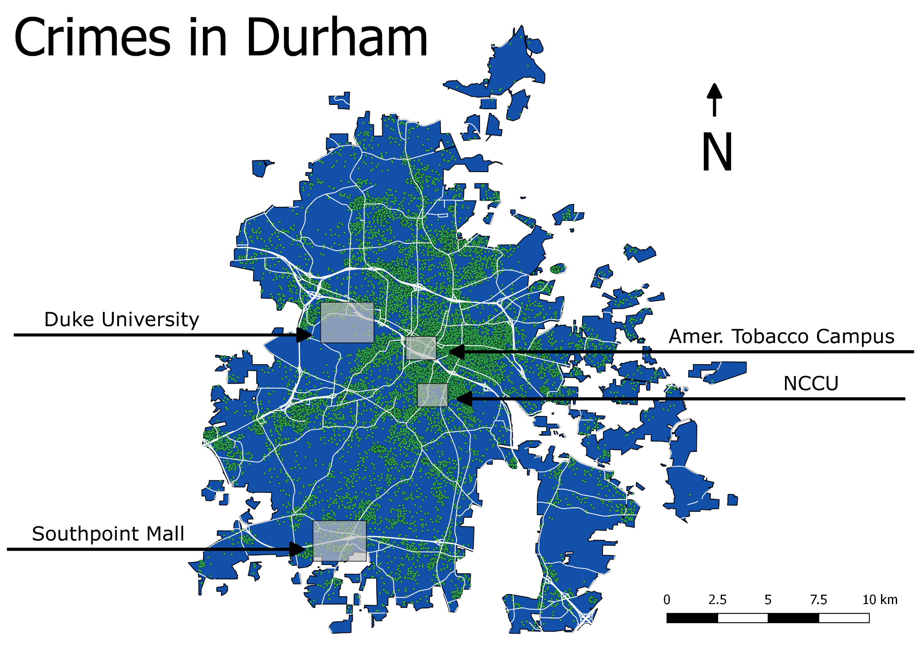
Notes:
We made a map that shows Durham county and all of the crimes that were recorded. We also labeled many major areas of interest in Durham.
Most crimes cluster in this area maybe due to highly populated areas.

Slide 5
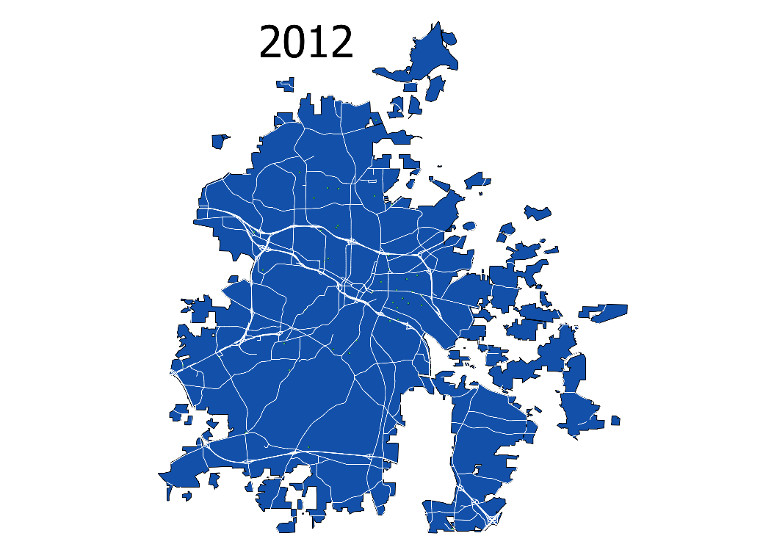
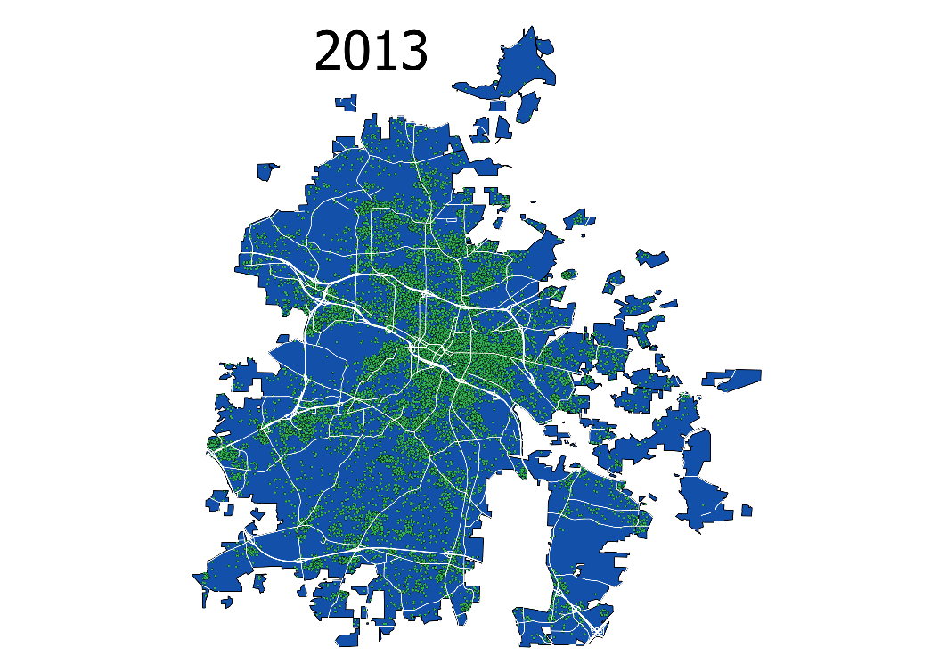
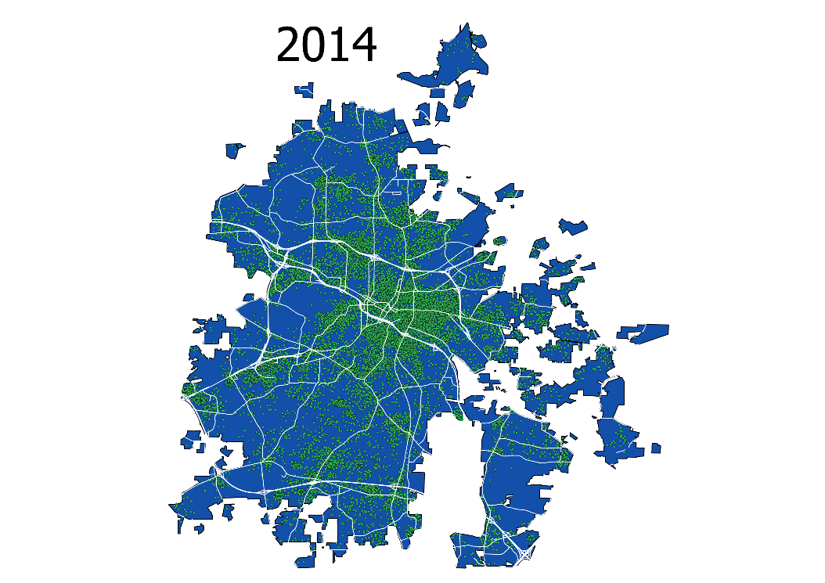


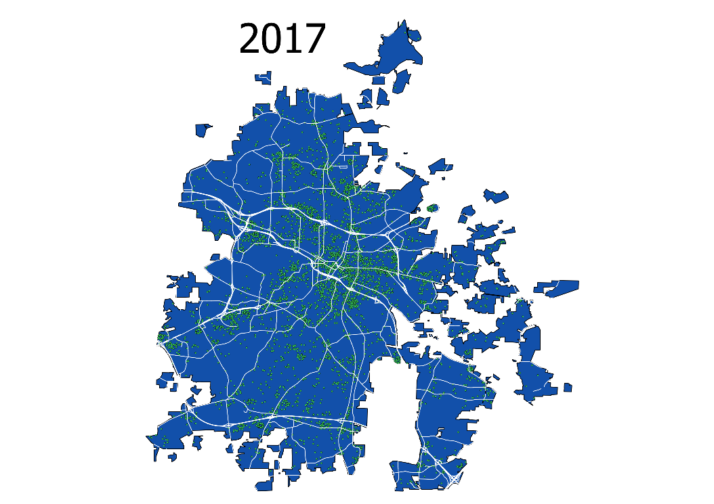
Notes:
We did not have many crimes recorded for 2012 and 2017.

Slide 6
Methodology
Linear Models and Forward Selection to model crime distribution by time
Logistic Regression, LDA, and QDA to classify and predict if a crime will occur during the day or at night
Classification Trees: Bagging, Random Forest, and C5.0 to classify and predict types of crimes
Clustering: K-Means and Hierarchical to group certain types of crimes together
Notes:
Why we chose them?
Clustering -- we chose clustering to see if there are patterns that were unnoticeable because there are different types of crimes
c5.0 -- the trees that we used in class only allow for binary splits; c5.0 allows you to have more than two splits so that we can predict all nine types of crimes
Linear Models -- the data set was low dimensional

Slide 7
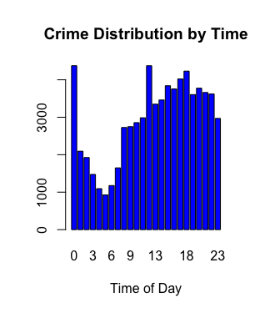
Notes:
This is a histogram of the number of crimes for each hour. We see that there is a dip in the number of crimes from 2-7am. This is reasonable because many people are still sleeping. Criminals have to sleep too.

Slide 8
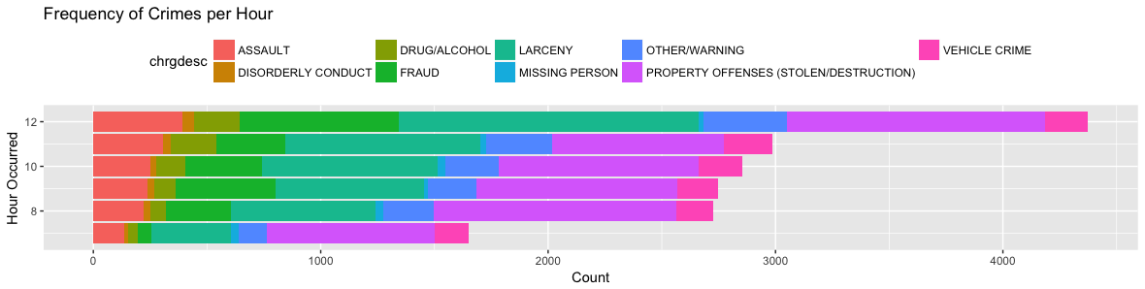
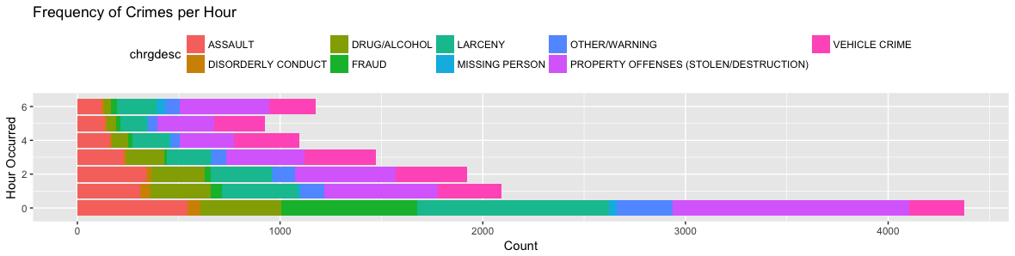
Notes:
For these plots, we took the information from the previous histogram and broke it further down. With these plots we can see what types of crimes happened at every hour.
Notes:
Fraud (green) happens most often at 12am and 12pm
Vehicle crime (Pink) (inlcudes breaking into cars) happens more frequently when the sun is down

Slide 9
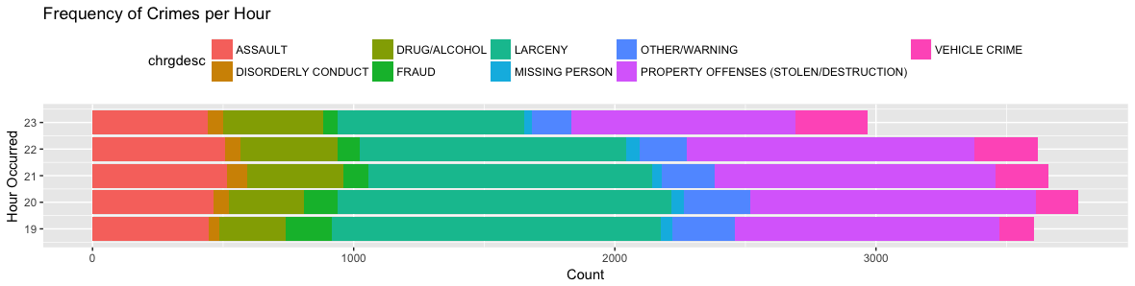
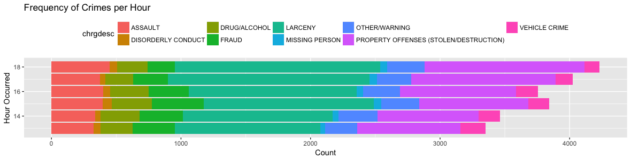
Notes:
Notes:
Larceny happens most often at 5-8pm
Assault happens generally around 9pm -12am
This graph is bimodal with peaks at 12am and 6pm

Slide 10
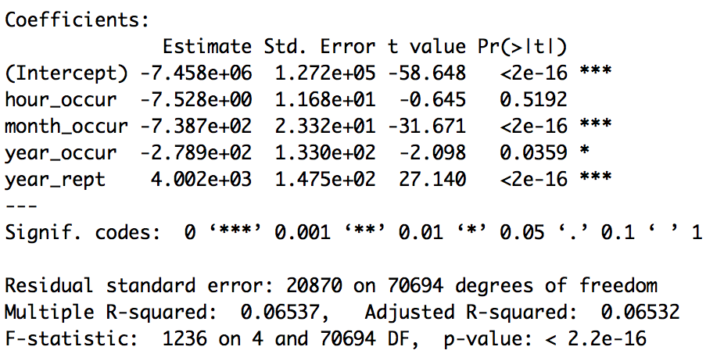
Linear Model
n > p, so the data set is low-dimensional
Forward selection used to find the optimal model
Adjusted R² shows the model only explains 6.5% of variation
Notes:
-the number of data points is greater than the number of varibales used, so the data set is low dimensional
-we used forward selection to find the optimal linear model
-adjuster R^2 for optimal linear model still does not explain as much of the variation as we would like, so the linear model doen’t do as good of a job as we would like on this data set

Slide 11
Logistic Regression, LDA, and QDA
Add a binary variable to determine if a crime occurred during day or night
Night defined as 8pm - 6am
Day otherwise
Data randomly split into test and training sets with ratio 3:1
Goal: Predict when a crime occurs based on the type of crime and location
Are certain crimes more likely to occur at night when it is dark?
Are some areas more prone to crime at certain times?

Slide 12
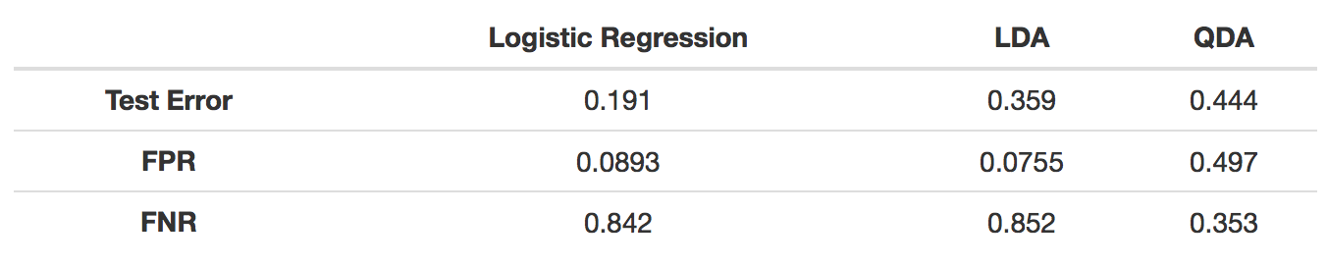
Logistic Regression, LDA, and QDA
Results
Logistic regression gives a much lower test error
FPR and FNR are unbalanced for all methods, but logistic and LDA are much worse
Limited by having a low number of classifiers

Slide 13
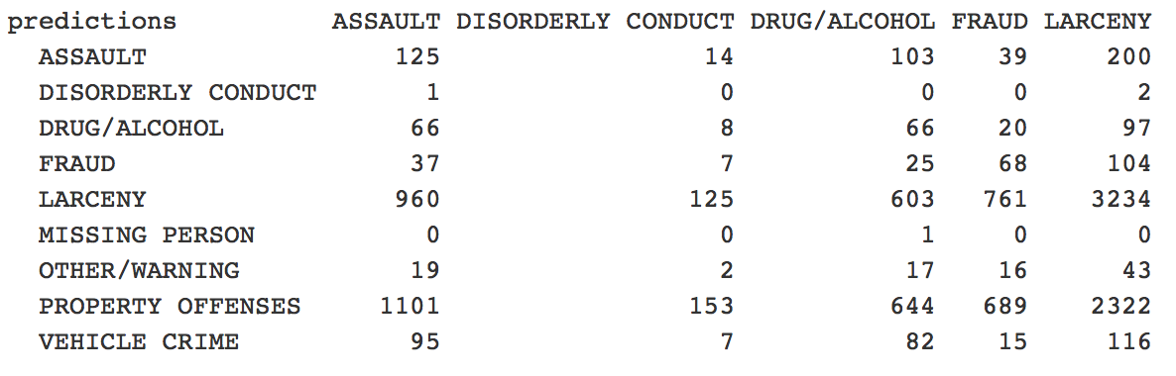
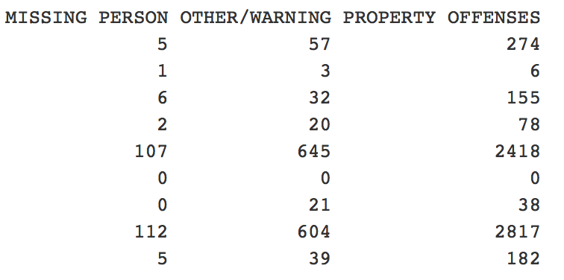
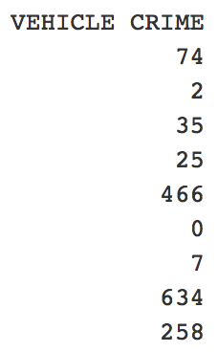
Bagging
Classified by “charged as” using bagging with 25 bootstrap replications
Out-of-bag estimate of misclassification error: 0.4467
Notes:
Misclassified cases are classified into similar categories
Larceny cases misclassified as property offenses
Property offenses misclassified as larceny
Vehicle crimes misclassified as larceny/property offenses

Slide 14
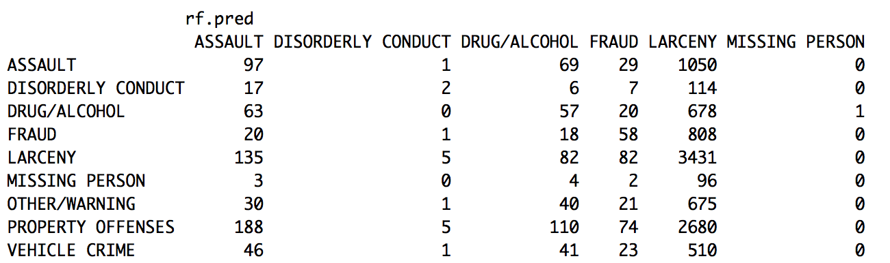
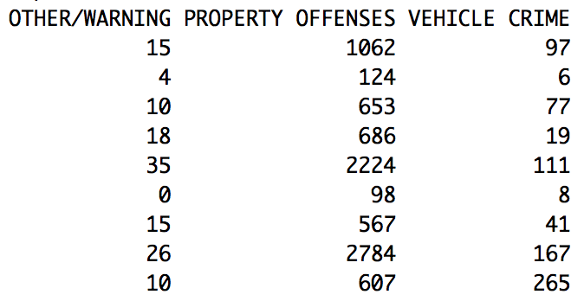
Random Forest
Classified by “charged as”, using random forest
Misclassification error on test set: 0.6825
Notes:
Tends to misclassify as larceny and property offenses regardless of true classification
2376 cases of assault in the test set, 1050 classified as larceny and 1062 classified as property offenses

Slide 15
C5.0: Overview
Improved version of C4.5, an alternative decision tree implementation developed by Dr. Ross Quinlan
Various differences from CART, including:
Picks features with greatest information gain as nodes
As opposed to Gini impurity for CART (homogeneity or “purity” of nodes)
Allows for non-binary trees
Notes:
C5.0 Intro
Based off a different splitting algorithm
CART measures Gini impurity while C5.0 chooses features that provide the greatest information gain
Non-binary splits allowed, letting us classify for our 9 charge categories

Slide 16
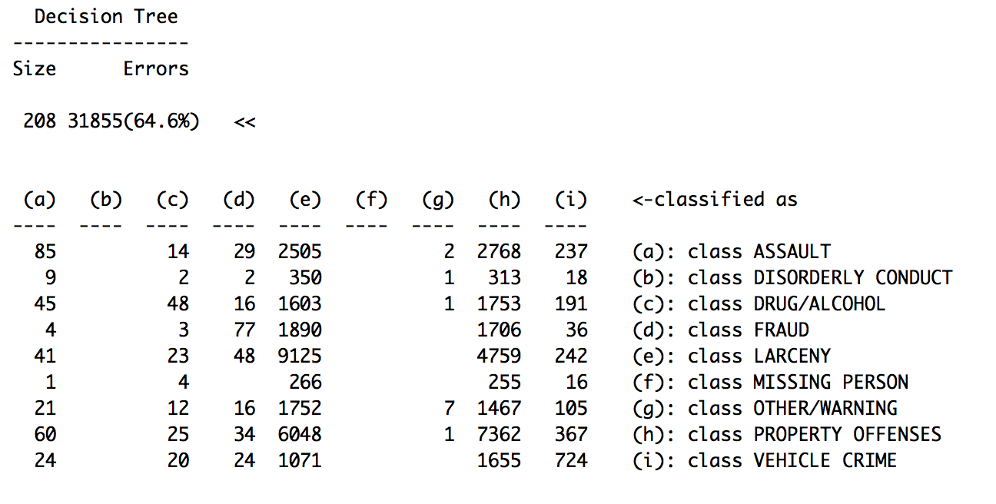
C5.0: Results
As in previous tree models, there is a high number of larceny charges misclassified as property offenses, and vice versa
None classified as disorderly conduct or missing person
High misclassification error
Notes:
Disorderly conduct and missing person - 2 smallest categories

Slide 17
Trees: Additional Comments
Predicting “downtown” and “district”
Whether a crime occurred downtown or in a certain district
Limited classifiers such as area, zone, latitude, longitude
Trees do not grow past one node
Remaining independent variables do not provide enough information for the algorithm to grow the tree
Notes:
Issues
Limitations in predictors (not enough variety and not enough in general)
Differences in size of categories (14,000 for larceny and 500 for missing persons)

Slide 18
Clustering
2 variables:
Reported as
Grouped data by “reported as” then calculated summary statistics: counts, mean latitude, mean longitude, mean hour occurred (only counts >150)
Charged as
Grouped data by “charged as” then calculate mean latitude and mean longitude
Notes:
-k means and hierarchical for both
-reported as only used counts greater than 150 because so many crimes
-charged as used all

Slide 19
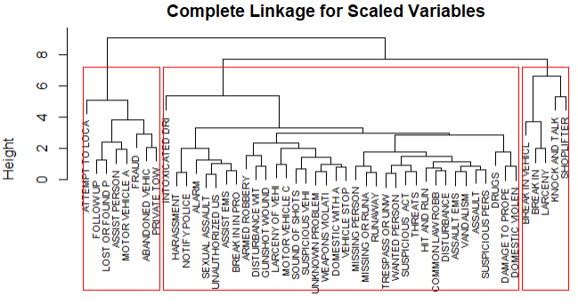
Clustering: Reported as
Hierarchical Clustering
Intuitive pair findings:
Home break-in and vehicle break-in
Abandoned vehicle and private towing
Missing person and runaway
Interesting pairs:
Damage to property and domestic violence
Sound of shots and suspicious vehicles
Notes:
-dendragram for hierarchical clustering
-used complete linkage because observations were spherical
-intereesting pairs: could be domestic violence involving property and complaining neighboers/neighborhood moms

Slide 20
Clustering: Reported as
K-Means Clustering
Same exact pairs, except “knock and talk” moves from group 3 to 2
48/49 crimes were classified into same cluster as hierarchical!
98% similarity
Notes:
-same thing but for k means
-only difference was knock and talk moved
-means there is prob a pattern

Slide 21
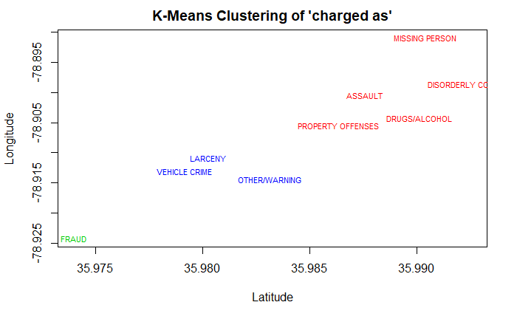
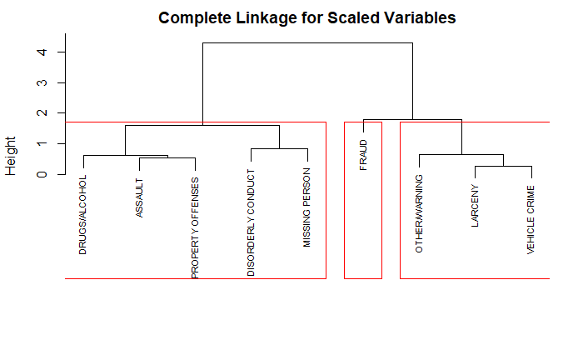
Clustering: Charged as
Notes:
-same thing but for charged as k-means vs hierarchical
-dendrgarm and cluster have same results

Slide 22
Summary
Limitations:
Not enough meaningful variables in the data set
Many were used to describe the time and location
Could use data on offender’s age, sex, prior offenses, income, education level, marital status, etc. to improve predictions
Fewer observations from earlier years compared to recent years
Clustering seems to work the best for us

