Slide 1
Voice Recognition Model using Python.
Presented by Govind Nair, Mohit Kumar Gupta, Vicky Maddheshiya, Satyendra Pal Singh.

Slide 2
Introduction :
A voice assistant or voice recognition model is a software agent that can perform tasks or services for an individual based on verbal commands i.e. by interpreting human speech and respond via synthesized voices.
The U.I of the application is self-explanatory and minimal.
The application works same like Cortana/ Siri/ Google Assistant etc.

Slide 3
Objective:
Study of NLP(Natural Language Processing)
Study of various machine learning Algorithm.
Study of various Data Science concepts.
Working and understanding the various algorithms.

Slide 4
Literature Review :
Voice assistant use in 2019 is up 9.5% over last year. By comparison, the use of voice assistants grey 27% in 2018 and 24% in 2017.
It’s estimated that 111.8 million people in the US will use a voice assistant at least monthly this year. That represents 39.4% of US internet users and 33.8% of the overall population.
By 2021 it’s expected that the number of US voice assistant users will reach 122.7 million, which represents 36.6% of the US population.
The study says 32% of people own a smart speaker, and 71% of those people use voice commands every day.

Slide 5
Tools used for implementation :
Python Programming Language.
Python IDLE
Pycharm IDE
Anaconda IDE
Google Text to Speech, and many more as needful.

Slide 6
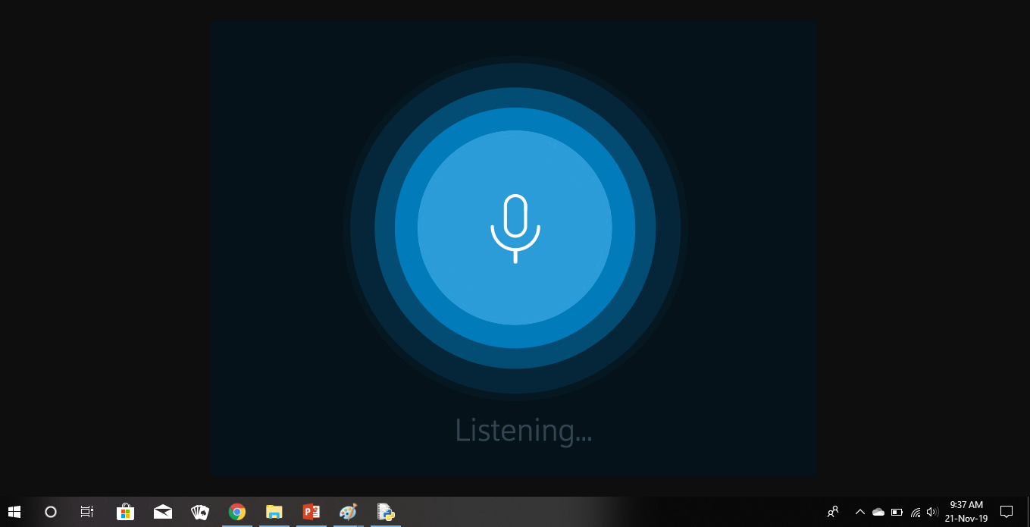
Methodology :
1.Listening Phase :- Commands are passed through verbal communication
(The actual representation may vary with the given representation depending on GUI technology)

Slide 7
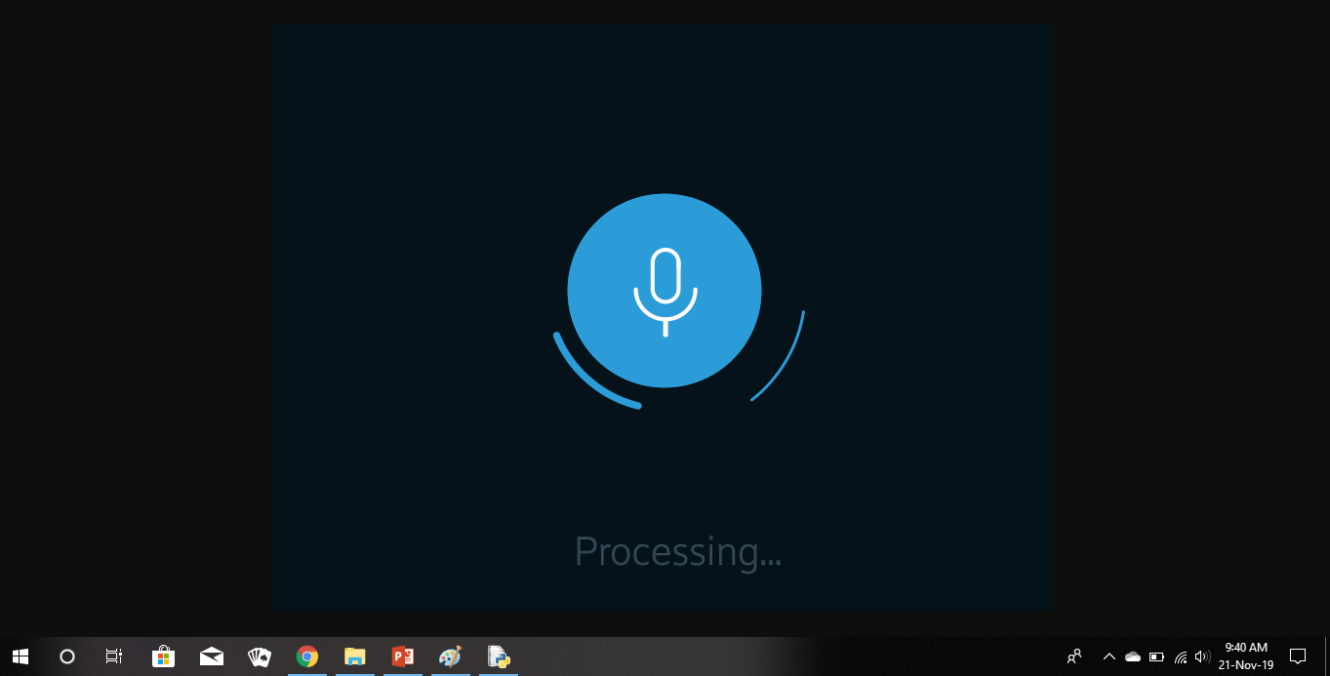
2.Processing phase :- System process voice commands
(The actual representation may vary with the given representation depending on GUI technology)

Slide 8
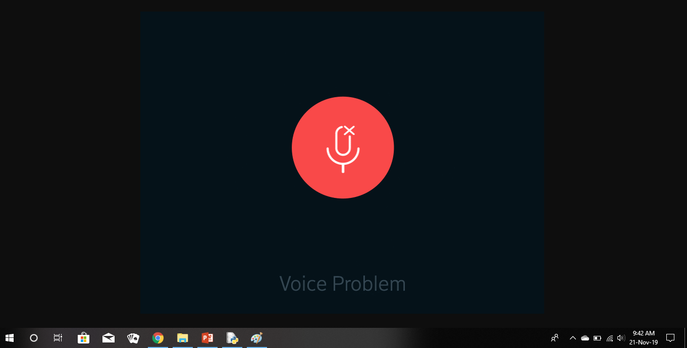
3.Process Execution on successful voice recognition
Else - Failure indication:
(The actual representation may vary with the given representation depending on GUI technology)

Slide 9
Functions implemented:
Greetings.
Normal Chat
Playing music from your playlist.
Browsing on web.
Weather Reports gathering.
Clicking a Photo from your device camera .
Various multimedia operations.
And opening system applications .
Mailing facility.
Opening Youtube.

Slide 10
Application of Voice Assistant:
Voice Forecasting Data for eg:-weather reports.
Voice navigation throughout the system.
Easy execution of various task on voice commands.
Voice assistants are the tool easing the work force of user.
Reminding for certain tasks

Slide 11
Results:
Voice assistants has reached to different levels ,hence competing with various models is difficult.
Building an efficient voice assistant is quiet an ambiguous task to perform.
Including various functions of the system as per system specification.
Development of an efficient voice recognition model.

Slide 12
Conclusion:
Voice assistant devices provides a way to communicate with machine via voice and can provide different services like Food delivery, Request Taxi, Weather, News, Wikipedia, Traffic, Music etc. And also due to introduction of IoT (Internet of Things), we can control our home appliances such as electric Bulb, television, vehicles, And almost every electrical devices. So it can be used anywhere in home, offices

Slide 13
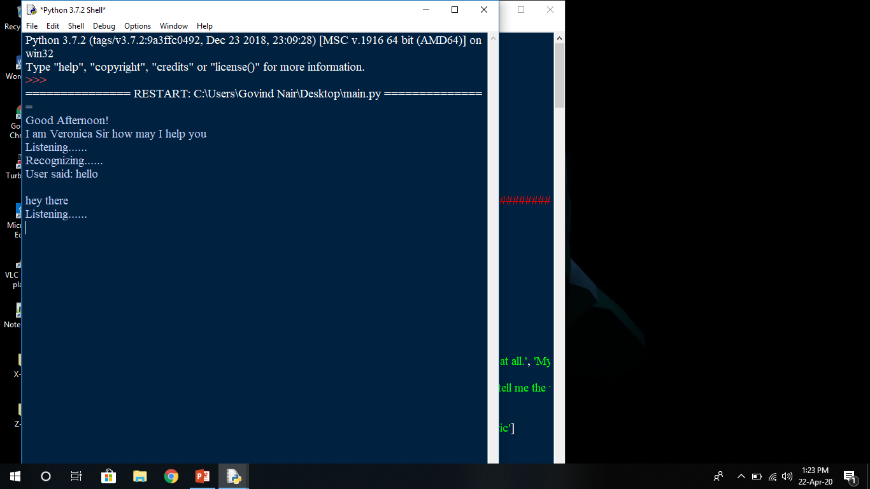
Snapshots of the project implementation:

Slide 14
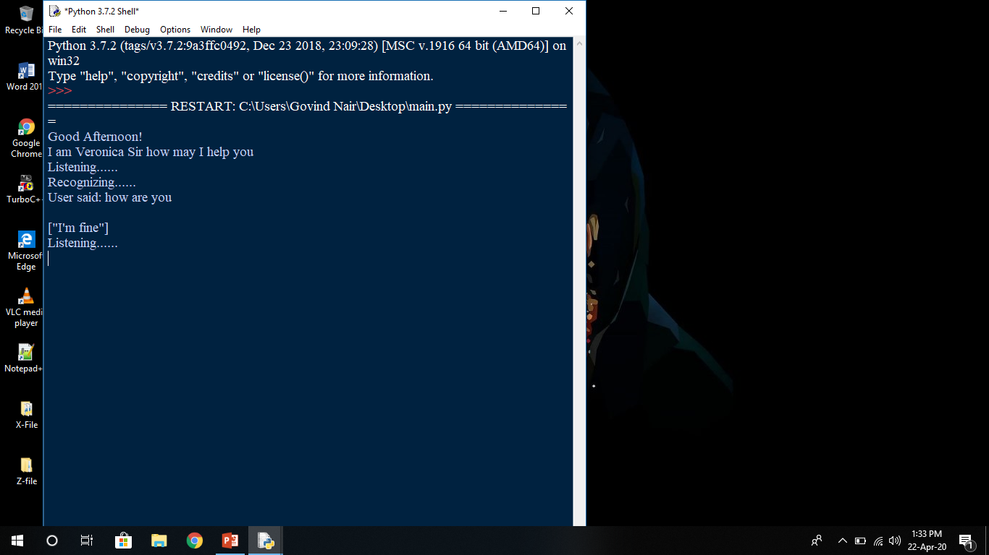
Snapshots of the project implementation :

Slide 15
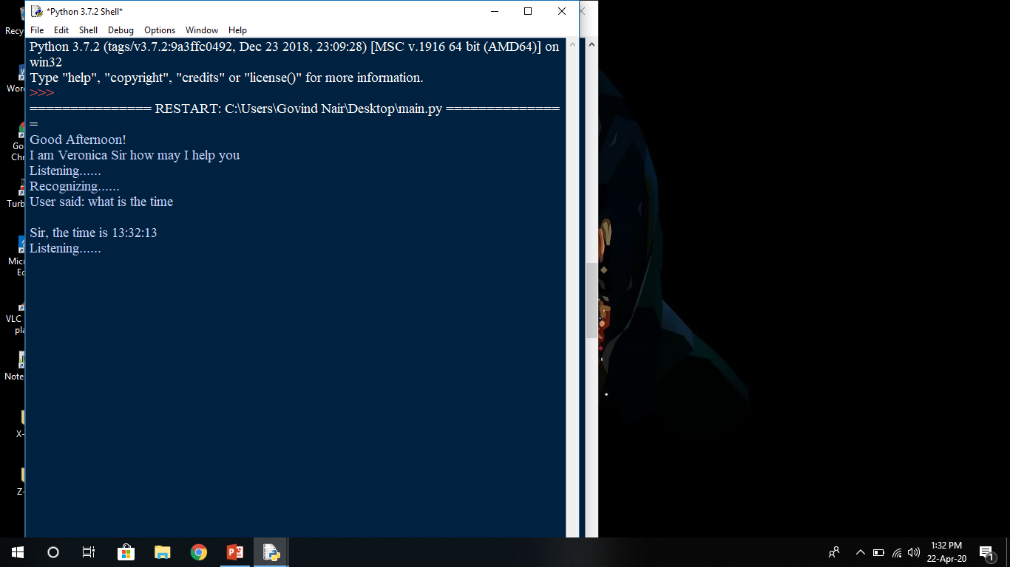
Snapshots of the project implementation:

Slide 16
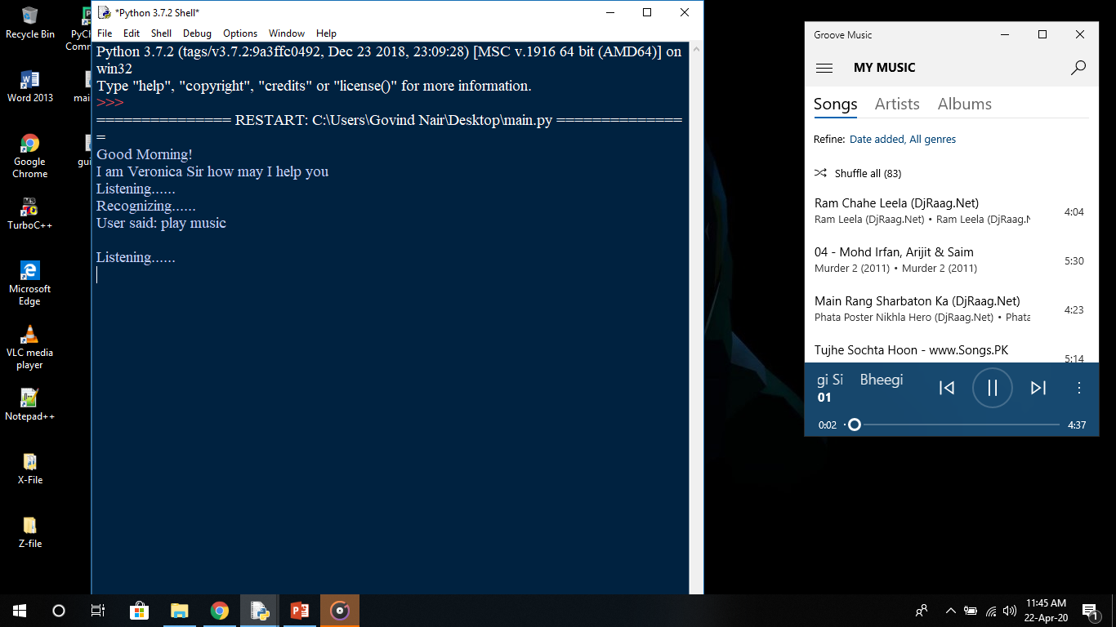
Snapshots of the project implementation :

Slide 17
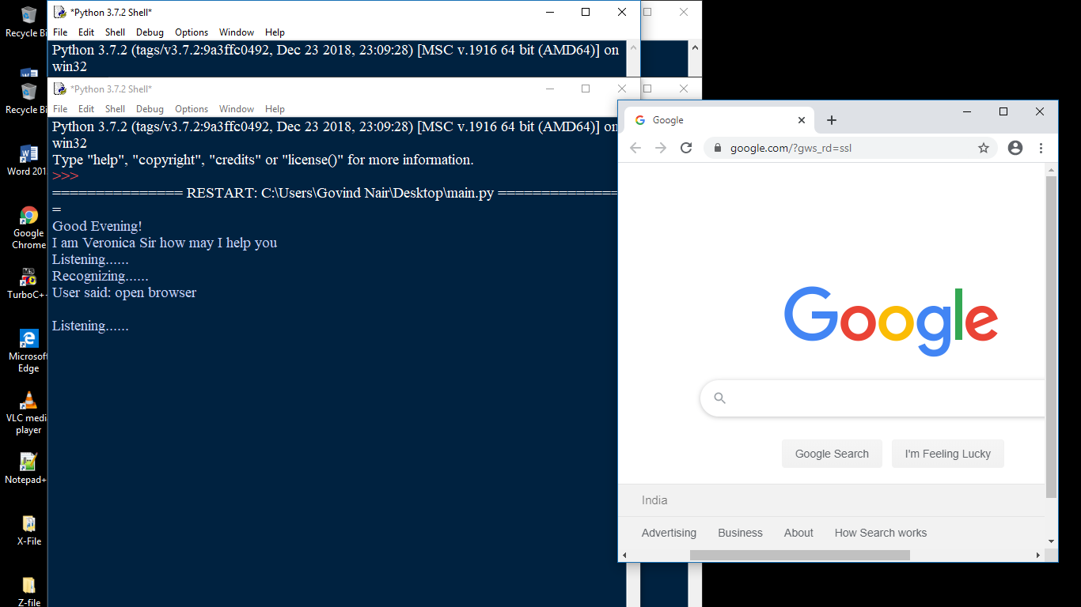
Snapshots of the project implementation :

Slide 18
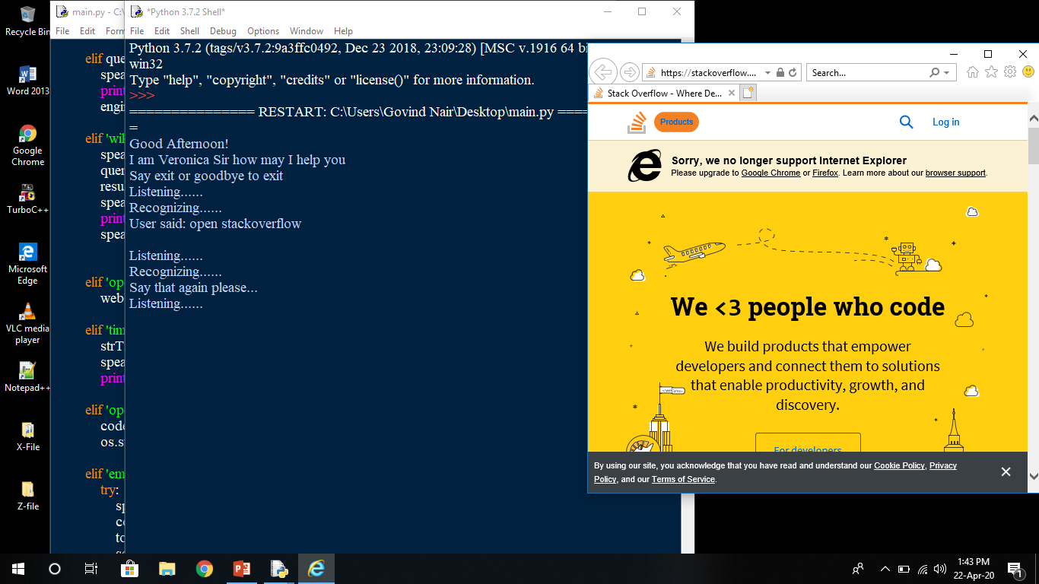
Snapshots of the project implementation:

Slide 19
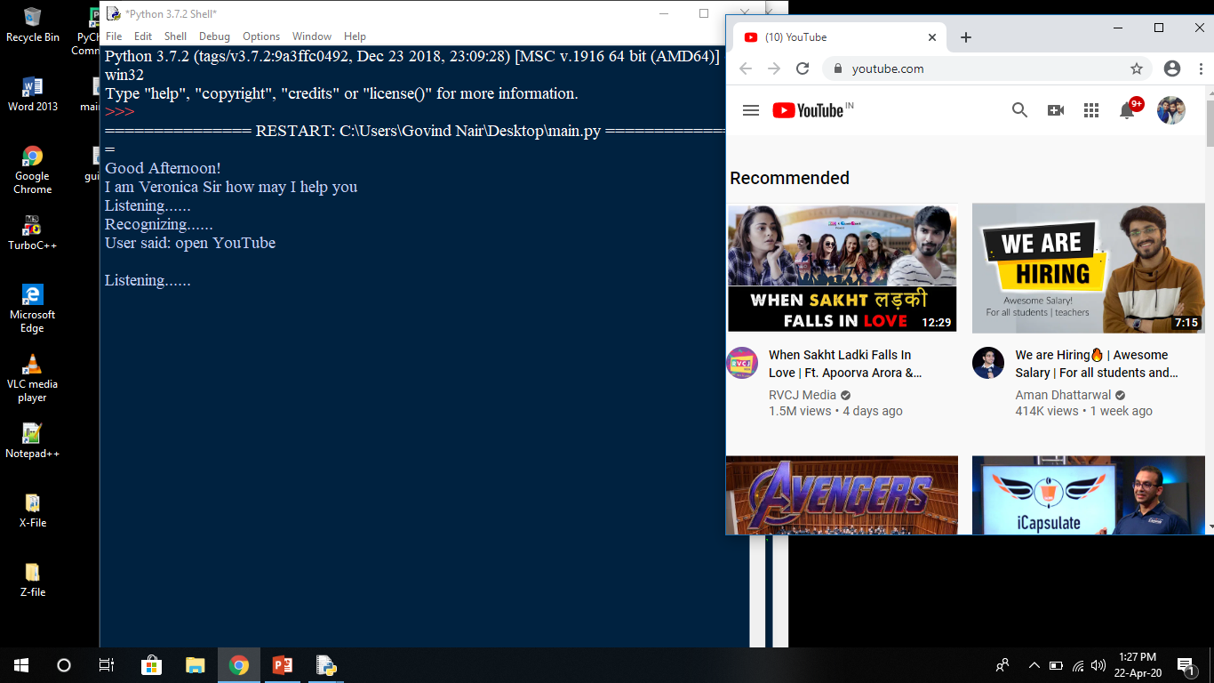
Snapshots of the project implementation :

Slide 20
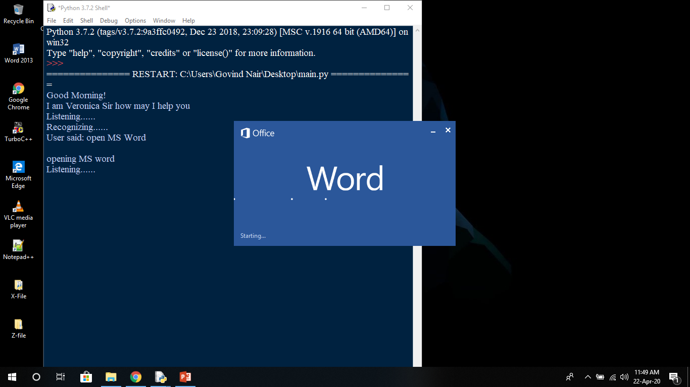
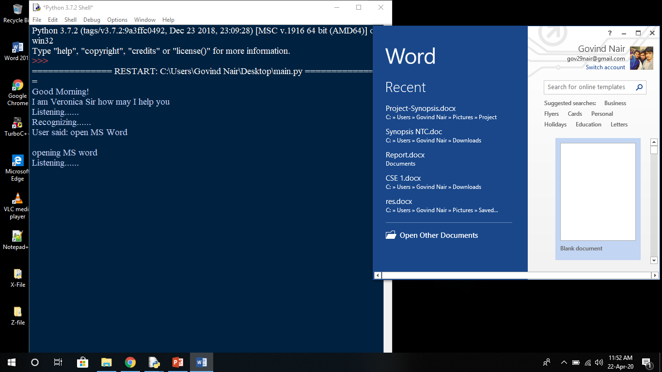
Snapshots of the project implementation:

Slide 21
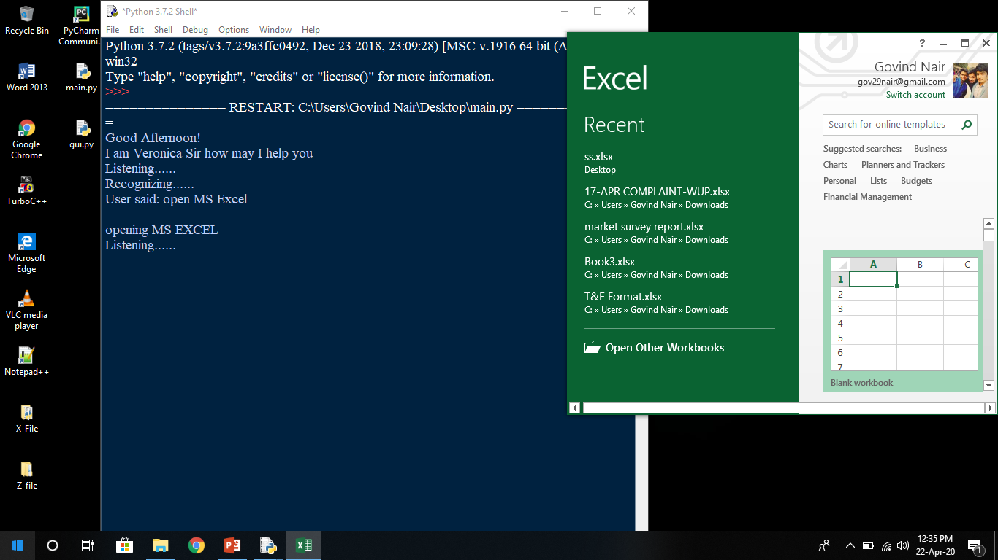
Snapshots of the project implementation:

Slide 22
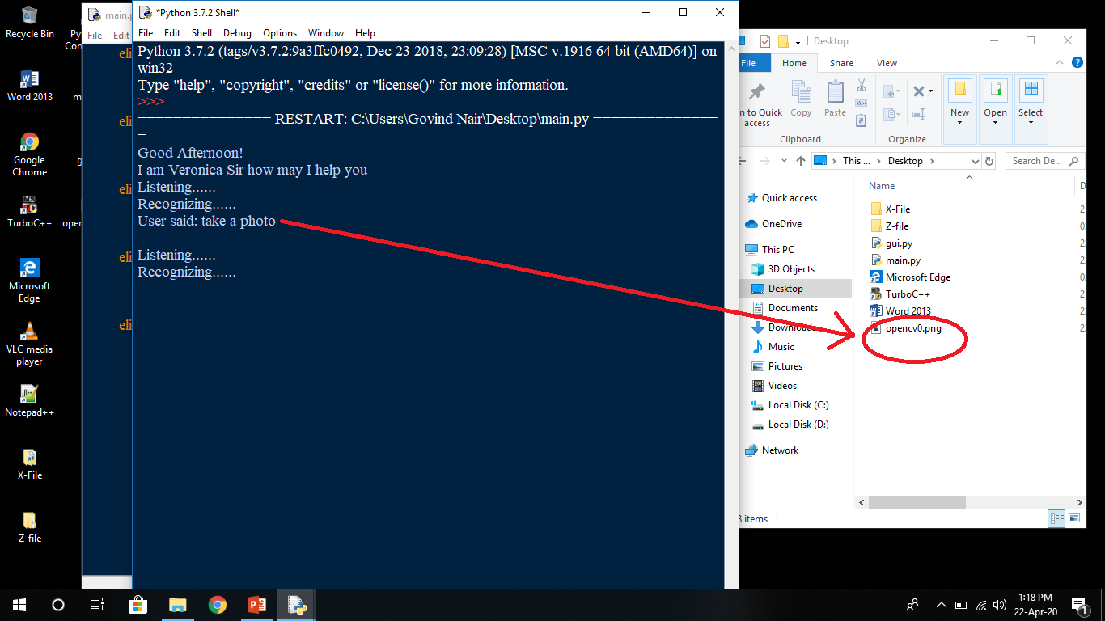
Snapshots of the project implementation:

Slide 23
References:
Various websites such as :
www.searchenginejournal.com, https://wiki.python.org/moin
Wikipedia : https://www.wikipedia.org/
Books:
Learning Python-Book (by David Ascher),
Think Python: An Introduction to Software Design (by Allen B. Downey)
YouTube : https://www.youtube.com/

Slide 24
