Slide 1
Automated detection and classification of events in the time series of hydraulic sensors
Alexander Mačejovský, Štěpán Pardubický

Slide 2
Task
Assigned by DHI, a water management company
Automated detection and correction of errors
in time series of waste-water measurements
Constraints given by the client: no targets, univariate
Output: practically usable Python library

Slide 3
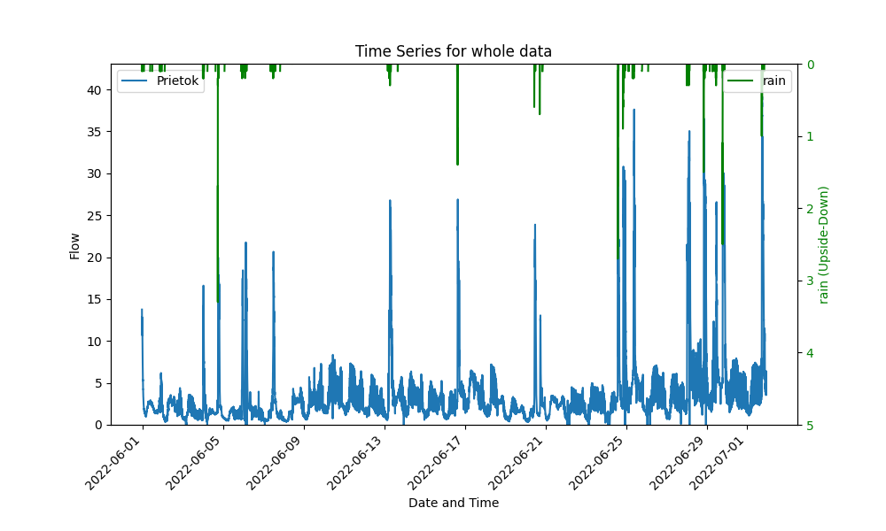
Data
8 time series, each 1 to 3 months long
Natural daily cyclicity, big impact of rain

Slide 4
Detection of events
Machine learning methods
Kmeans clustering, Autoencoder
Visual inspection and heurisitcal methods

Slide 5
Types of errors
Zero and constant values
Outliers and prolonged drops
Heightened volatility

Slide 6
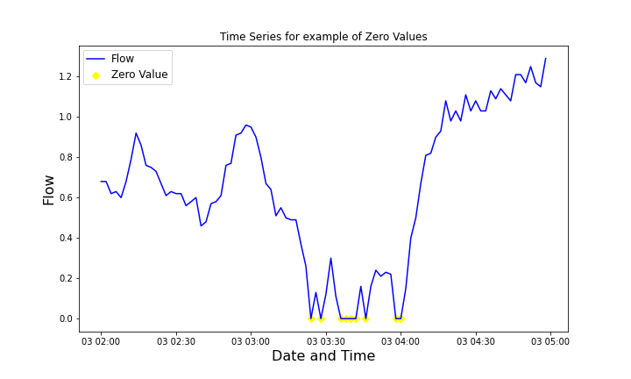
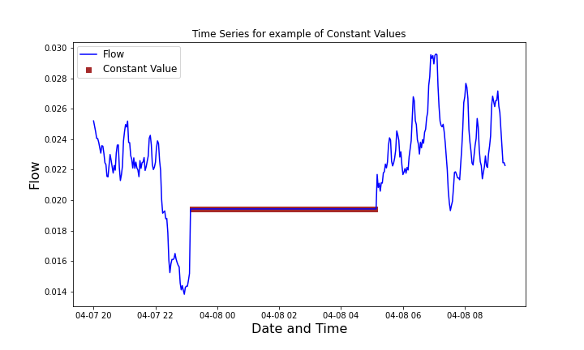
Zero and constant values
Straightforward, easy to identify

Slide 7
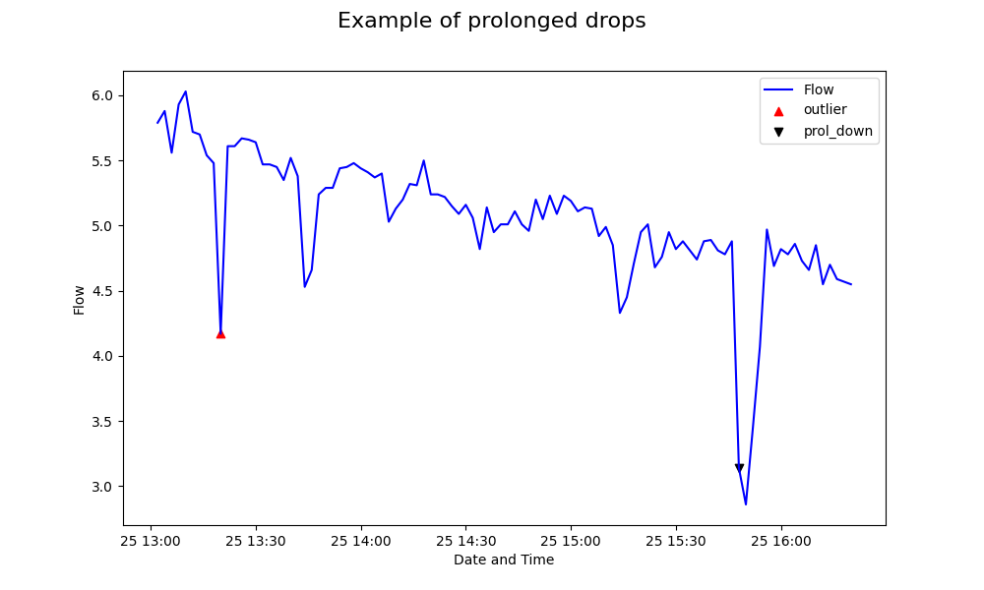
Outliers
Large jump there and back again

Slide 8
Prolonged drops
Measurements are hindered for a longer time

Slide 9
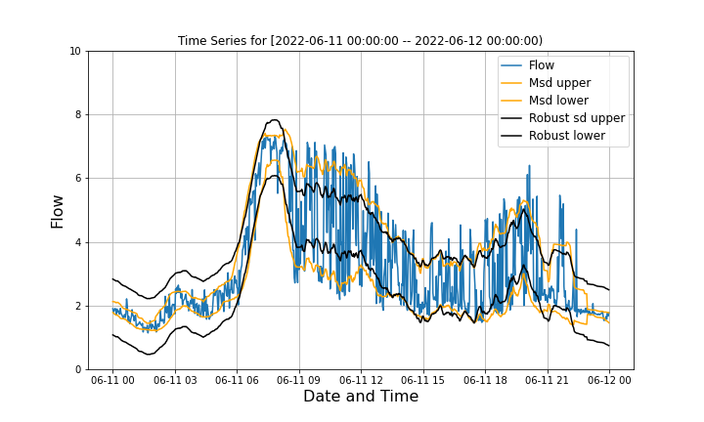
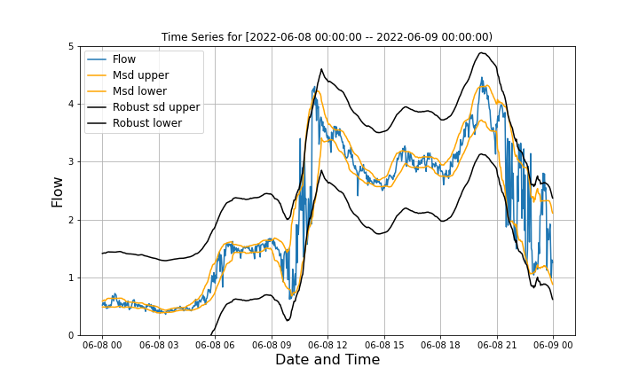
Heightened volatility
Suspiciously high volatility when compared to similar times of day on different days

Slide 10
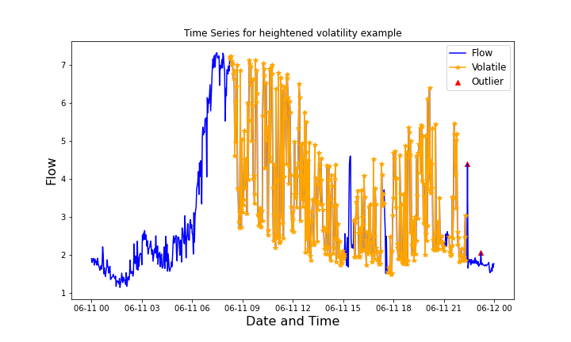
Heightened volatility
Identified by large moving standard deviation of the first differences

Slide 11
Corrections
Depend on the length of sensor’s malfunction:
Short-term errors (<8 periods)
Medium-term errors (8-60 periods)
Long-term errors (>60 periods)

Slide 12
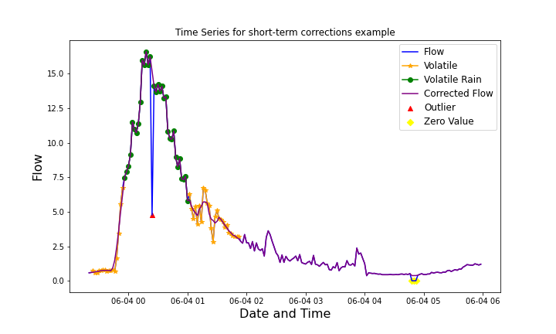
Short-term corrections
Simple smoothing, sufficient in practice

Slide 13
Medium-term corrections
Predictions from ARIMA models, by default ARIMA(3,1,2), based on 200 prior observations
Not fully implemented

Slide 14
Long-term corrections
Takes advantage of underlying cyclicity in the data
Not yet fully implemented

Slide 15
Python library
Graphical tools
Automated detection and corrections
Option for changing parameters for individual time series or even individual groups of errors

Slide 16
Conclusion
Managed to create multi-functional library which can be easily used for automatized detection and partially also for correction of errors
Functions are highly customizable

Slide 17
Thank you for your attention!

