Slide 1
Automatized detection and classication of events in the time series of hydraulic sensors
Alexander Mačejovský, Štěpán Pardubický

Slide 2
Task
Assigned by DHI, a water management company
Automated detection and correction of errors
in time series of waste-water measurements
Constraints given by the client –no targets, univariate
Output: practically usable Python library

Slide 3
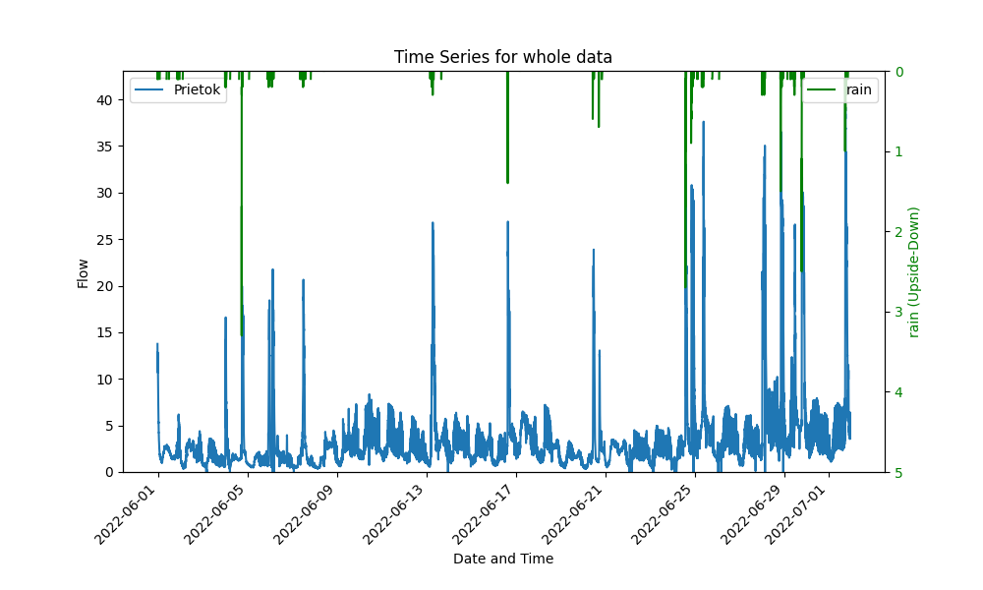
Data
8 time series, each several moths long
Noisy, rain has large impact
Stepan

Slide 4
Detection of events
Machine learning methods
Visual inspection and heurisitcal methods
Stepan

Slide 5
Types of errors
Zero and constant values
Outliers and prolonged drops
Heightened volatility

Slide 6
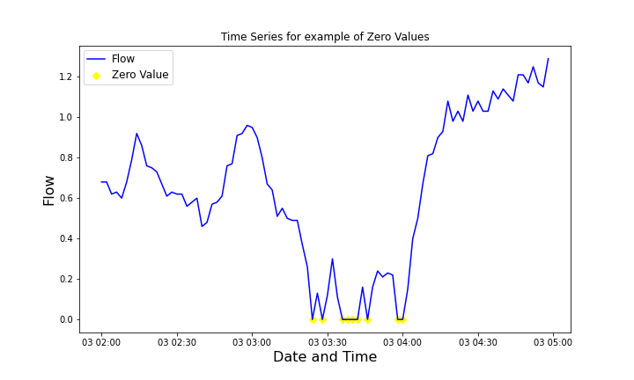
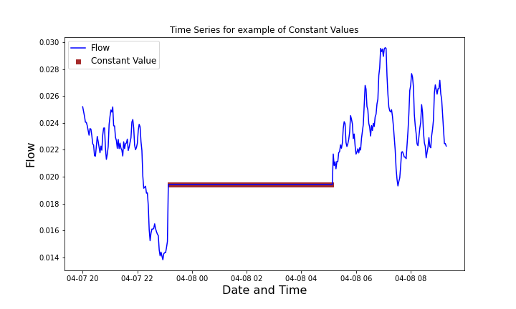
Zero and constant values
Straightforward, easy to identify

Slide 7
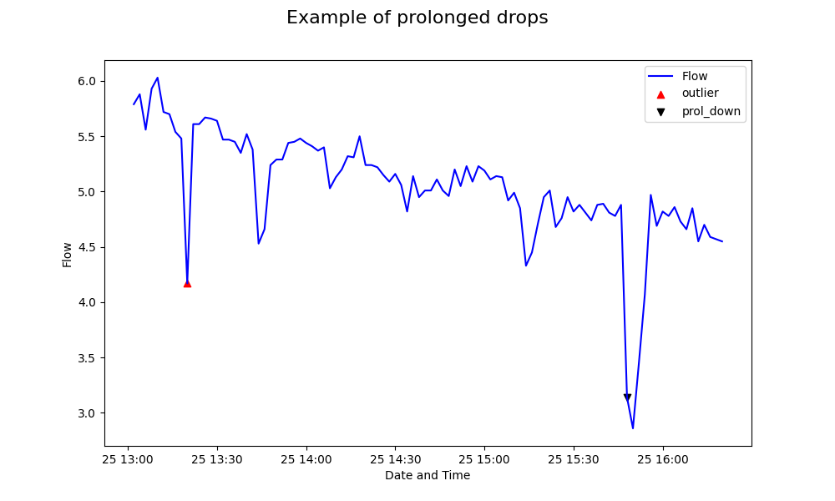
Outliers
Large jump there and back again

Slide 8
Prolonged drops
Measurements are hindered for some longer time
Stepan

Slide 9
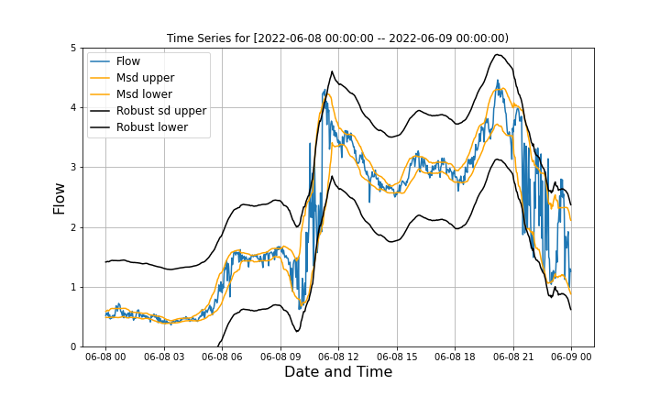
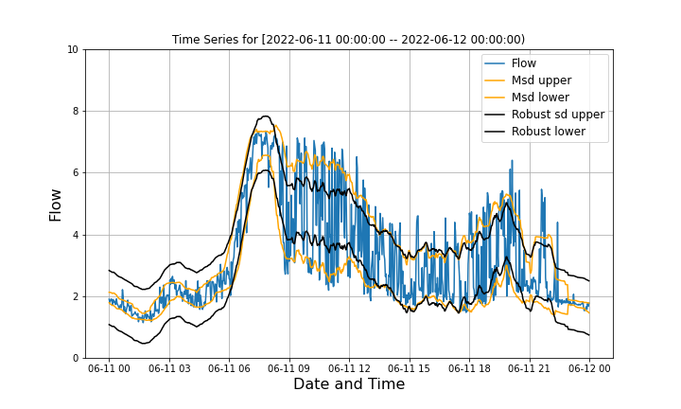
Heightened volatility
Suspiciously high volatility of first differences when compared to similar times of day on different days

Slide 10
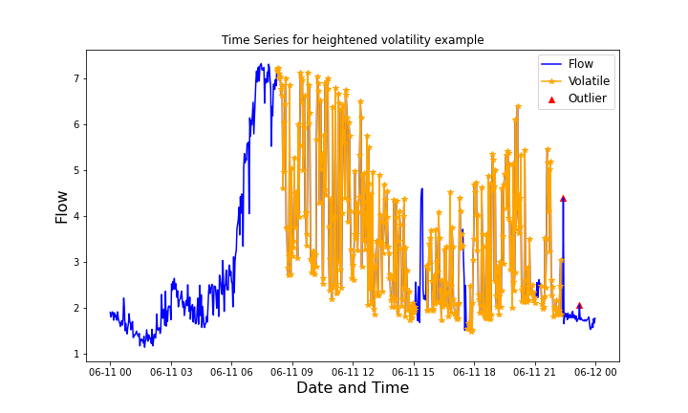
Heightened volatility
Suspiciously high volatility of first differences when compared to similar times of day on different days

Slide 11
Corrections
Depend on the length of sensor’s malfunction:
Short-term errors (<8 periods)
Medium-term errors (8-60 periods)
Long-term errors (>60 periods)

Slide 12
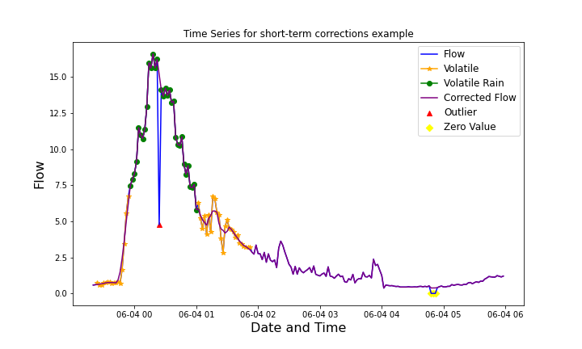
Short-term corrections
Simple smoothing, practically enough
Stepan

Slide 13
Medium-term corrections
Predictions from statistical models, namely ARIMA
Not fully implemented
Alex

Slide 14
Long-term corrections
Take advantage of cyclicity
Not yet implemented
Stepan

Slide 15
Python library
Graphical tools
Automated detection and corrections
Option for changing parameters for individual time series or even individual groups of errors

Slide 16
Conclusion
Managed to create quite multi-functional library which can be easily used for automatized detection and partially also for correction of errors
Stepan

Slide 17
Thank you for your attention!

