Slide 1
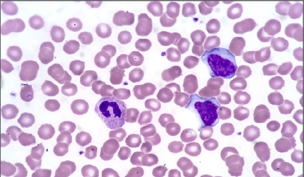
Virotherapy
By Zoë Liang & Macey Love

Slide 2
Overview
Slide 1: Title
Slide 2: Overview
Slide 3: History
Slide 4: Plan and Implementation
Slide 5: Plan and Implementation Visual
Slide 6: Pros of Advancement
Slide 7: Downsides of Advancement
Slide 8: Summary
Slide 9: Summary Opinion on Advancement
Slide 10: Sources

Slide 3

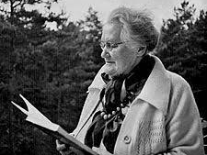
History
Lativan scientist Professor Aina Muceniece discovered it in the early 19th century, used culture-passaged viruses.
First trials, unsuccessful or successful with side effect of morbidity
1950s/1960s rodent trials- evolution of viruses to focus on tumors
Genetically engineered oncolytic virus discovered in the 1990s.
Discovery of Riga Virus led to development of virotherapy medication Rigvir
Notes:
Since the turn of the nineteenth century, when their existence was first recognized, viruses have attracted considerable interest as possible agents of tumor destruction. Early case reports emphasized regression of cancers during naturally acquired virus infections, providing the basis for clinical trials where body fluids containing human or animal viruses were used to transmit infections to cancer patients. Most often the viruses were arrested by the host immune system and failed to impact tumor growth, but sometimes, in immunosuppressed patients, infection persisted and tumors regressed, although morbidity as a result of the infection of normal tissues was unacceptable. With the advent of rodent models and new methods for virus propagation, there were numerous attempts through the 1950s and 1960s to force the evolution of viruses with greater tumor specificity, but success was limited and many researchers abandoned the field.
Clinical research of oncolytic virus began in the sixties of the 20th century under the guidance of Professor Aina Muceniece, the outstanding Latvian scientist, at the Latvian Institute of Microbiology and Virology. A decades-long research led to the development of oncolytic virus ECHO-7 medication – Rigvir.

Slide 4


Plan and Implementation
2017-2018: investment in research, Johnson and Johnson buy Benevir for $140 million
Clinical trials in the treatment of melanoma, breast cancer, prostate cancer, and brain cancer
Clinical trials, funding/investment, and FDA approval
T-VEC first approved in 2015
Other virotherapy treatments following in 2016 onward
Increased use expected in the near future
Notes:
On 2015, October 27th, the US Food and Drug Administration (FDA) has officially approved talimogene laherparepvec (T-VEC, also known as OncoVEXGM-CSF) for use in melanoma patients with injectable but non-resectable lesions in the skin and lymph nodes. T-VEC (which is commercialized by Amgen, Inc. under the name of Imlygic®) becomes therefore the first oncolytic virus approved for cancer therapy in the US. - National Library of Medicine
How hopeful is oncolytic virotherapy? How about millions of dollars hopeful. Within the past year, large amounts of money have been contributed towards continued research, implementing strategies, and FDA approval. In April of this year, Johnson & Johnson purchased private pre-clinical stage BeneVir with an upfront payment of $140 Million and is expected to complete payment in excess of 900 Million. Other major news in the hunt to lead the Oncolytic Virotherapy industry includes Merck acquiring the Australian company, Viralytics.
Why are pharma-giants partnering with OV development leaders? Pharma companies recognize the potential of oncolytic viruses. What is known about OV’s is that genetic modification of common viruses allows for lysing of cancer cells in advanced staged cancers. The treatment is also well tolerated and thus far has shown in clinical studies increased efficacy when used in solo treatments as well as in conjunction with other traditional treatments. A popular digital publication published an interview with Vyriad Founder, Dr. Russell. He revealed in the 2016 interview the “hope” that the viro-platform offers as the continued treatment studies of genetically engineered viruses expand. - virotherapy.com (see sources slide)

Slide 5
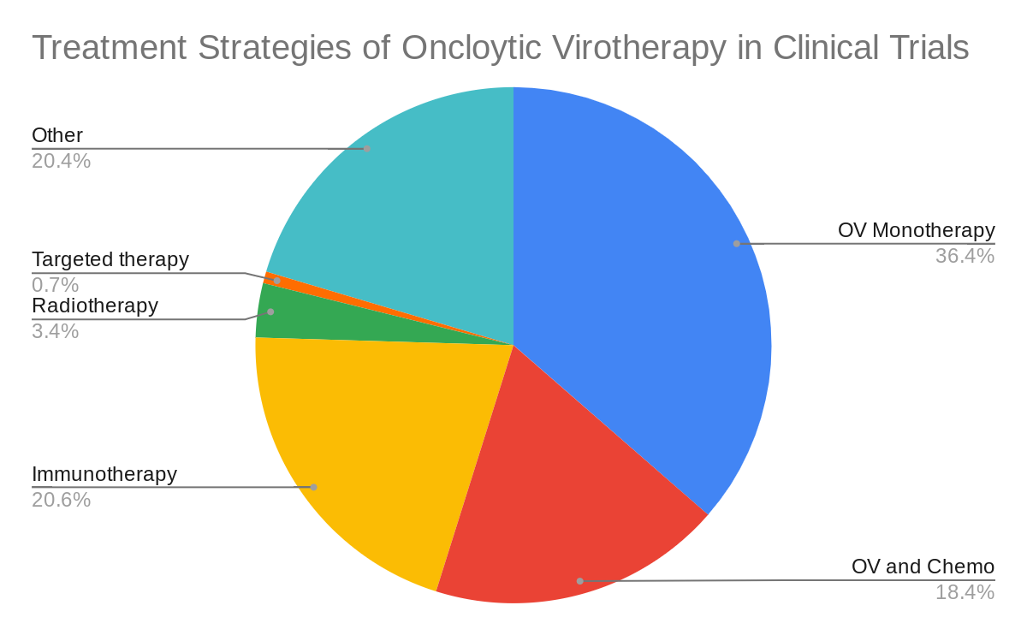
Plan and Implementation Visual
This excel pie chart shows the current clinical trials treatment strategies. Notice the high amount of OV and chemotherapy. The ability of virotherapy to work with other treatments is a large factor in this percentage.
Notes:
https://docs.google.com/spreadsheets/d/1bxUADGlL2ffTQisvHIyCJiq8RF9IfqEPASUUOFyzgjY/edit?usp=sharing

Slide 6
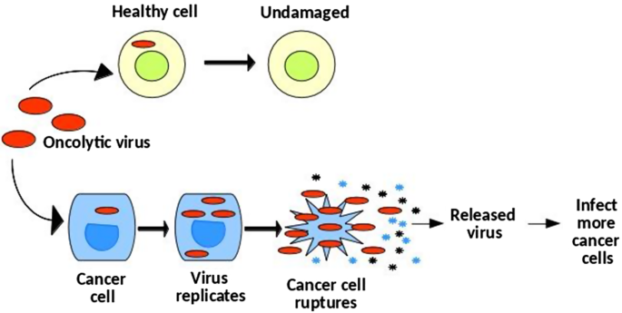
Pros of Advancement
Virotherapy doesn’t slow down or stop other treatments (ex. chemotherapy), allowing them all to work at the same time
It directly affects the tumor cells, and doesn’t interact with healthy cells, keeping the patient as healthy as possible.
Virotherapy has much less severe, if any, side effects compared to other cancer treatments.
Notes:
Some viruses prefer to attack cancerous tissues rather than healthy ones, and oncolytic virotherapy takes advantage of this fact. Anticancer viruses not only kill off tumor cells but also alert the host immune system to a cancer's presence.

Slide 7

Downsides of Advancement
Virotherapy purposefully causes illness to kickstart the immune system, but these illnesses may cause additional harm to the patient.
Virotherapy only has a complete remission rate of 25%, which is much lower than chemotherapy, depending on the type of cancer.
Most cancers are very difficult to reach, and because virotherapy is an injection this treatment won’t work for everyone.
Virotherapy cannot work alone, and therefore must be used alongside other treatments such as chemo or radiation.
Notes:
The most severe side effect is typically an inflammatory response to the treatment. Other possible side effects of virotherapy include flu-like symptoms such as fever, chills, nausea, and muscle aches. Some virotherapies can be injected directly into a tumor bed, making delivery a breeze. But many cancers are difficult to reach with a needle, or they might be scattered throughout the body. "This delivery problem is a major challenge. But virotherapy is not a cure on its own. Research suggests that virotherapies will serve to supplement chemotherapy, radiation therapy or immunotherapy.

Slide 8
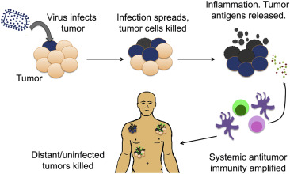
Summary
Virotherapy is when a cancer patient is injected with a low-risk virus. The injection is directly at the cancer site, and it kickstarts the immune system and helps it recognize that there is cancer there. It positively doesn’t affect healthy cells, but it has to be used with other treatments, which do affect them.
It was first discovered in the early 19th century, but only started gaining more traction in the late 1900s/early 2000s.

Slide 9
Summary Opinion on Advancement
Due to the low risk and high reward properties of virotherapy, I am for the advancement of this medical technology and so are many major medical companies and committees. Virotherapy research and implementation is being funded by major companies like Johnson and Johnson and is approved in many countries throughout Europe. WIth the clinical trials and research to back virotherapy, I believe that the continuous advancement of this cancer treatment could in the future save lives globally.

Slide 10
Sources
https://pubmed.ncbi.nlm.nih.gov/17299401/
https://www.virotherapy.com/history.php
https://www.ncbi.nlm.nih.gov/pmc/articles/PMC4142919/
https://www.mesotheliomahope.com/treatment/virotherapy/
https://www.ncbi.nlm.nih.gov/pmc/articles/PMC4760283/
https://www.virotherapy.com/blog/oncolytic-viruses-gain-traction-medical-community/
https://www.mesotheliomahope.com/treatment/virotherapy/#:~:text=Virotherapy%20has%20been%20praised%20as,%2C%20nausea%2C%20and%20muscle%20ache
https://www.livescience.com/64121-virotherapy.html
http://www.virotherapyfoundation.org/en/prof-aina-muceniece-2/

