Slide 1
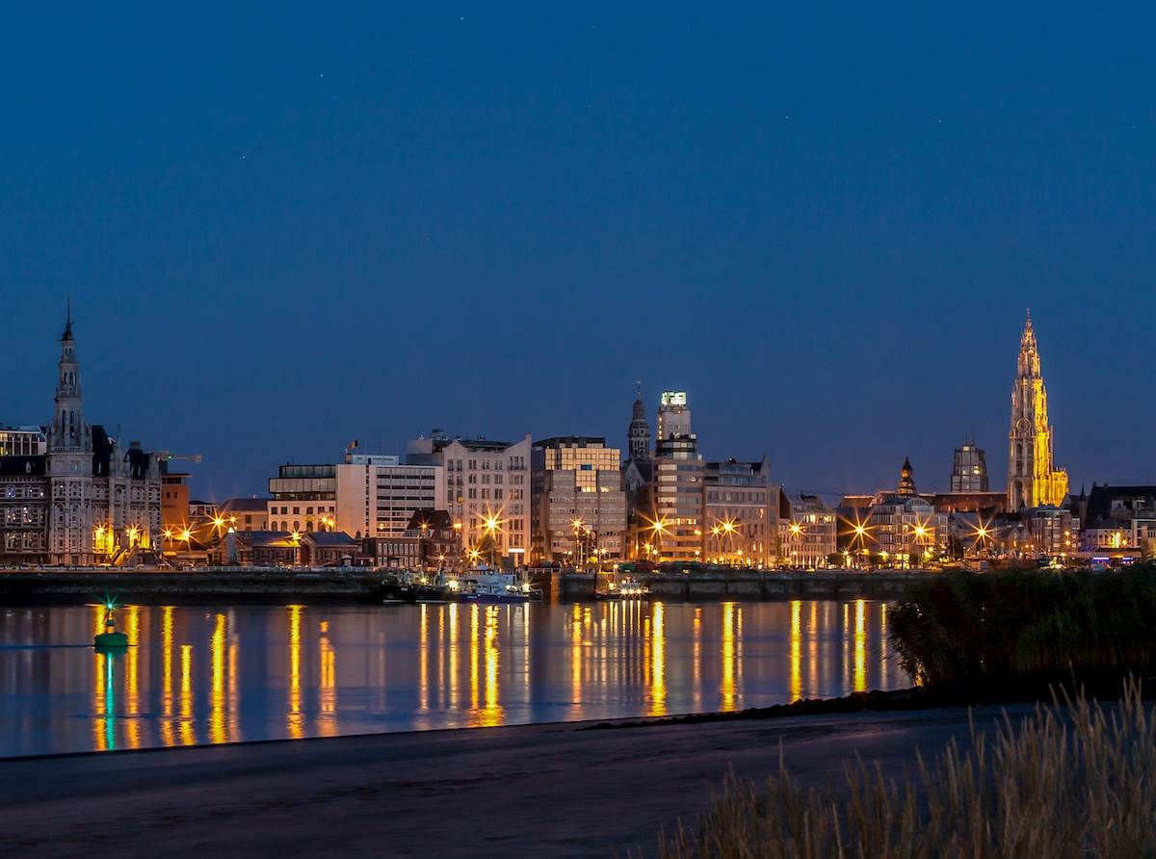
Smart environment tracker
Ruben Joosen, Jolanta Tadla, Hanna Grüning, Jan Machálek

Slide 2
Main Idea
Locate people in dangerous places via Bleutooth
Measure the quality of the environment
Notify the server if nessecary
Localization determination based on configuration data

Slide 3
Sensors
CO2 sensor
Temperature sensor
Humidity sensor
(Light sensor)
→ calculate the environment quality

Slide 4
Localization (+ bluetooth tracking)
Indoor localization of the device
(bluetooth sensing for active devices)
Outdoor localization based on configuration data

Slide 5
Wireless communication
The server gets an update if device is in danger
Device updates the server if the environment quality changes each x minutes/hours.

Slide 6
Bluetooth configuration
Set different thresholds for the sensors
Configure different modes (basic mode, sleepmode, send data to server, emergency mode…)
Set context configuration

Slide 7
Visualization & Application
Map Data
Temerature: 23°C
CO2 level: low
Humidity: 45%
Light level: light
Device mode: basic
Location: Indoor
PERSON NEARBY: YES
X
X

