Slide 1
Agentic B2B
Order Intake
Email
EDI Drop Folder
PDF
CSV / XLSX
A vendor-neutral, open-source reference prototype
aligned to the MACH Alliance Open Data Model.
X12 850 EDI

Slide 2
Purchase orders arrive in every format imaginable
Plain text emails
THE RESULT
Unstructured, inconsistent — every sender has their own format.
Every order is handled one at a time
PDF attachments
By a person, from reading to re-keying.
Machine-readable or scanned — you never know which until you open it.
Possibility of errors enter at every re-keying step
CSV / XLSX spreadsheets
Each handoff from inbox to ERP introduces risk.
Column names differ by buyer. Rows are missing. Totals don't add up.
Clarification emails delay everything
X12 850 EDI files
Back and forth before anything can move forward.
Technically structured — but every trading partner maps fields differently.
Phone calls & faxes
Staff time goes to intake
Still happening. Every one goes through a human, start to finish.
Not to customers. Not to growth.

Slide 3
One pipeline. Every channel. Every format.
INTAKE
EXTRACTION
VALIDATION
ROUTING
Submit to ERP
Seek Clarification
Normalises every
channel & format
Reads & structures
order data via AI
Business rules,
SKU, customer, stock
Decides the outcome
with a reason
Human Review
Reject
Claude does the reasoning. LangGraph manages the flow.
Inbound channels: Email · EDI Drop Folder · (extensible to WhatsApp, Webform, API)
Content types: Plain text · PDF · CSV · XLSX · X12 850 EDI
LangGraph is MIT licensed. The pipeline uses the open-source library only, not LangGraph Platform.

Slide 4




Every order gets an answer
Submit to ERP
Seek Clarification
All fields present. Customer and SKUs resolved. Confidence above threshold.
Order submitted to ERP as a draft — automatically, without human intervention.
Required fields are missing, or the buyer's SKU doesn't match any catalogue entry.
Reply sent to the buyer listing exactly what's needed — including catalogue suggestions.
Hand Off for Human Review
Reject
The agent has identified the order but can't fully resolve a key field — customer identity, SKU, or stock availability.
Operator sees the candidates and makes the call.
Spam, phishing, duplicate PO, or an order the agent cannot relate to a known buyer after a full lookup cascade.
Logged to the audit trail. No reply sent.
The agent decides and explains. Operators supervise — they don't process.

Slide 5
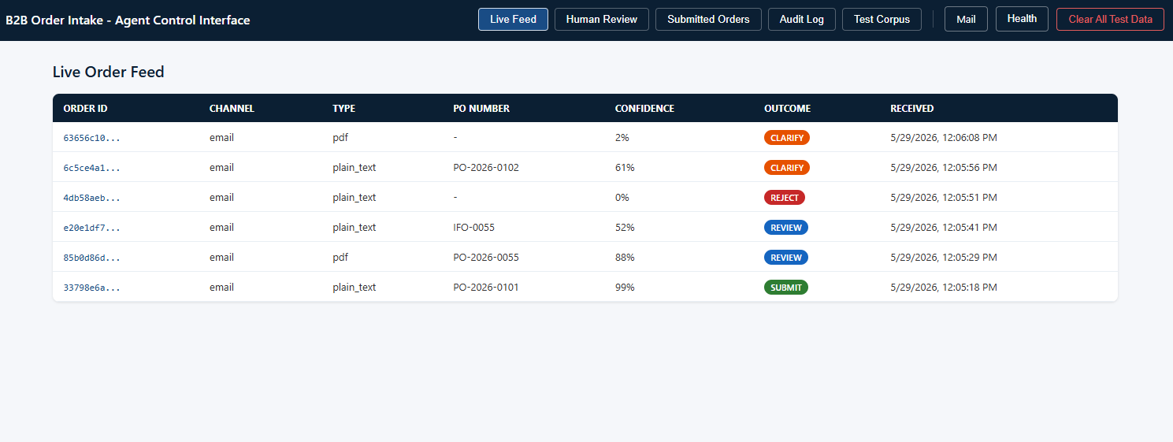
Operators observe — they don't process

Slide 6
Every component is swappable
Component
Default (demo)
Swap for production
.env variable
ERP System
Stub (local)
SAP · NetSuite · Dynamics 365 · Oracle
ERP_ADAPTER
AI Extraction
Claude (Anthropic)
Any LLM via LangChain (GPT-4, Gemini...)
EXTRACTION_PROVIDER
Customer Lookup
JSON file
Salesforce · HubSpot · any CRM or database
CUSTOMER_LOOKUP
Email Delivery
Mailpit (local)
SendGrid · AWS SES · Postmark
EMAIL_PROVIDER
Logging & Audit
PostgreSQL
Datadog · CloudWatch · Splunk
LOGGING_ADAPTER
The pipeline never changes. Only the adapters.

Slide 7
Clone it. Run it. Own it.
MIT Licensed
30–60
Code is free to use, modify, and distribute.
No lock-in. No royalties.
CC BY 4.0
minutes to a
running demo
All sample data and non-code assets.
Attributed, shareable, remixable.
What you need:
Docker Desktop or Docker Engine
MACH Alliance
Open Data Model
An Anthropic API key
Order, Customer, Inventory, Address entities
aligned to the MACH ODM standard.
git clone → docker compose up

Slide 8
The prototype is the foundation
Every capability below is a new adapter on the same pipeline — not a rewrite.
Near-term additions
Strategic roadmap
Order Acknowledgement
Multi-Language Support
Auto-confirm to buyer on ERP submission
Claude handles French, Spanish, German orders natively
Price Validation
WhatsApp / SMS Channel
Flag orders where submitted price differs from contract pricing
New channel adapter — same pipeline, new inbound path
Minimum Order Quantities
API Channel
Validate line quantities against per-SKU MOQ rules
REST endpoint for ERP-to-ERP direct order submission
Preferred Substitutions
Real-Time Inventory Sync
Suggest replacement SKUs when items are inactive or out of stock
Live inventory adapter replaces the static seed data
Partial Fulfillment
Historical Order Learning
Suggest shipping available stock, backorder the rest
Confirmed operator decisions improve future AI resolution
Customer Credit Check
Outbound Webhooks
Verify credit status before submitting to ERP
Notify downstream systems on every terminal outcome
Order Splitting
Analytics Dashboard
Submit passing lines now; hold problem lines for review
Order confidence trends, resolution accuracy, volume

Slide 9
Get started
github.com/machalliance/solution-studio-b2b-order-intake
1
2
3
Clone the repo
Add your API key
docker compose up
git clone the repository to
your local machine or server.
Copy .env.example to .env
and add your Anthropic API key.
All five services start.
Browse to localhost:3000.
Try first: drop corpus/edi/order-001-valid.csv into edi-inbox/ and watch the Live Feed.

