Slide 1
ENGINEERING CAPSTONE PROJECT – 1 | A.Y. 2026-27
EduPilot
AI-Powered Student Productivity Assistant
Adaptive task prioritization, smart planning and personalized study guidance
Team
Yarlagadda Yaswanth Prasad (2420090106)
Vittala Srisubramanya Sriram (2420090126)
Macharam Sathwik Kumar Goud (2420090078)
Guide
Dr J Kavitha Reddy
Department of CSE, KLH University, Hyderabad

Slide 2
The Problem
Why students need smarter task management
Students juggle multiple assignments, deadlines and personal commitments at once
Static to-do lists and calendars do not tell you what to do first
Poor prioritization leads to procrastination, last-minute stress and reduced performance
Effort is routinely misjudged, so plans break down and are never corrected
Stress
Deadline pile-ups
Procrastination
No clear starting point
Fixed logic
Tools that never adapt

Slide 3
Objectives & Proposed Solution
Objectives
EduPilot
• Rank tasks intelligently using deadlines, effort, priority and past behavior
• Generate an optimal order and schedule for completion
• Reduce procrastination and improve time management
• Provide analytics and personalized suggestions that improve over time
An AI-driven, web-based assistant built on adaptive software engineering principles.
It continuously learns from user interactions and adjusts its recommendations dynamically, so it evolves with the student's habits and workload instead of relying on fixed, static logic.
Scalable and personalized to each student.

Slide 4
Key Features
Five integrated modules in one dashboard
Tasks & Matrix
Smart Planner
Focus Pomodoro
Priority-scored tasks (Critical / High / Medium), subtasks, one-click decompose
Automated multi-day study schedule with deadline-aware session blocks
Timer tied to a chosen task, with a 5-minute procrastination rule
Productivity Analytics
AI Study Copilot
Adaptive Buffer
Focus streak, study hours, completion rate and effort accuracy charts
Chat assistant that explains priorities and breaks projects into steps
Learns estimate vs actual effort and scales future time estimates

Slide 5
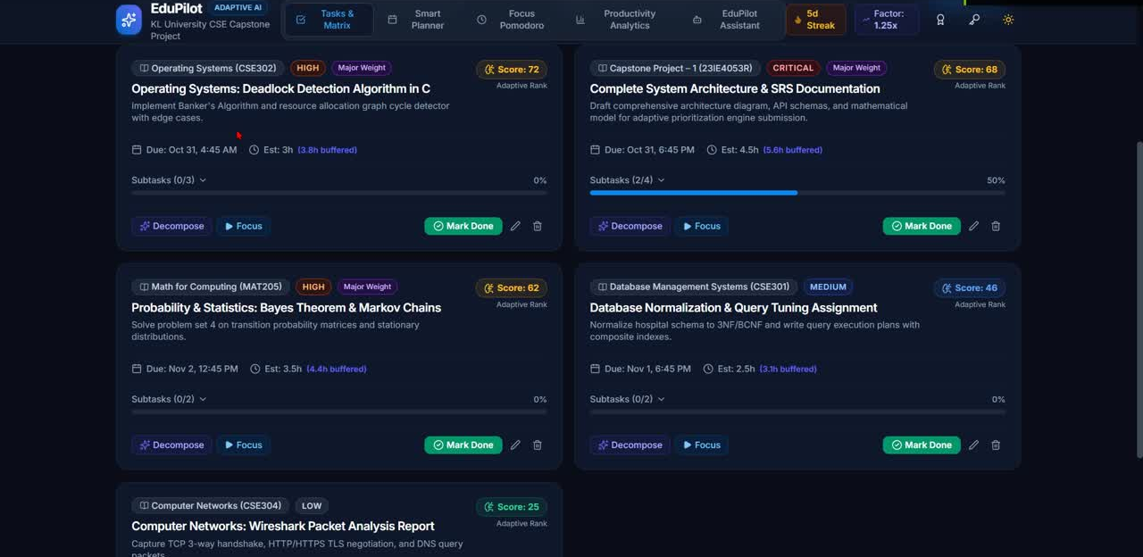
Implementation: Task Prioritization
Tasks ranked by an adaptive priority score
Each task carries priority, deadline, estimated effort and an adaptive score
Buffered deadlines account for the learned effort multiplier
Subtask progress tracking and one-click Decompose
Focus and Mark Done actions on every card
Task board with priority scores and deadlines

Slide 6
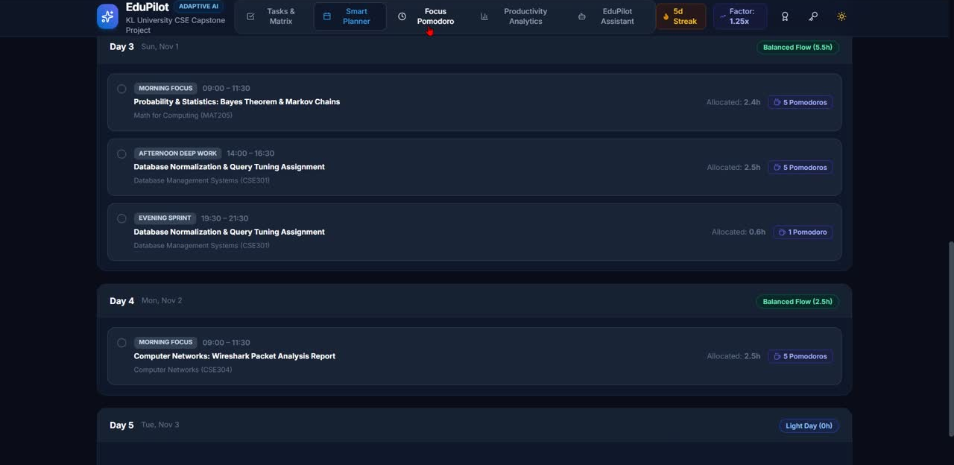
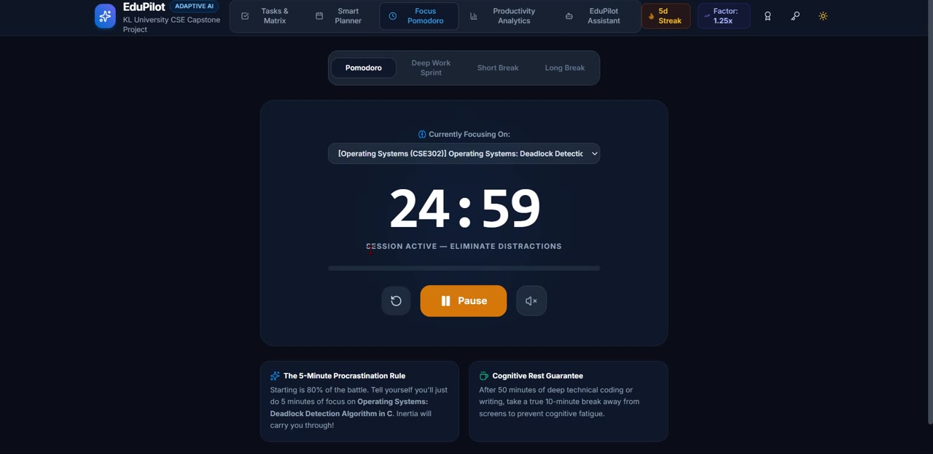
Implementation: Smart Planner & Focus Mode
Smart Planner: day-wise study sessions
Focus Pomodoro: 25-minute sessions per task
Planner distributes tasks across days by urgency and effort
Pomodoro timer links study time directly to the selected task
Built-in 5-minute start rule helps beat procrastination

Slide 7
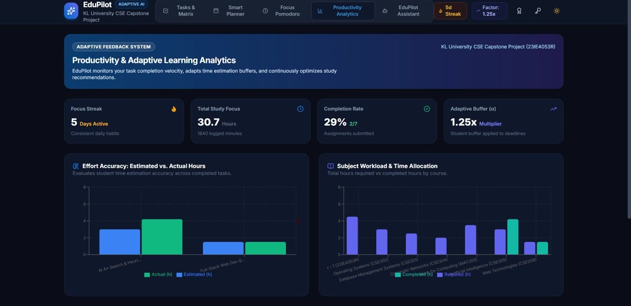
Implementation: Productivity Analytics
Learning from what the student actually does
Tracks focus streak, total study hours and completion rate
Effort accuracy chart compares estimates with real time spent
Adaptive buffer multiplier (e.g. 1.25x) updates from this history
Adaptive learning history explains every adjustment made
Estimated vs actual hours and subject workload

Slide 8
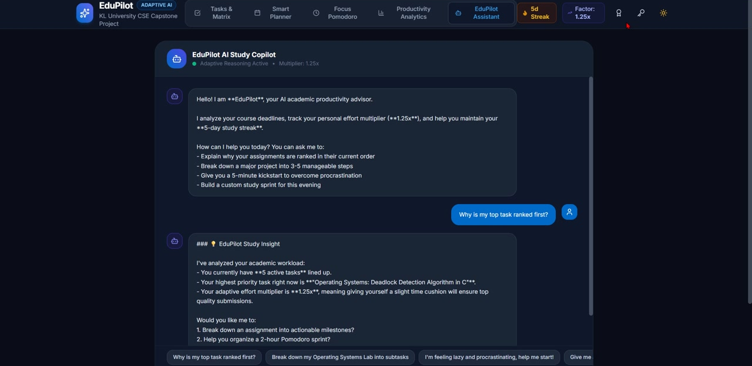
Implementation: AI Study Copilot
Conversational guidance grounded in the student's own tasks
Explains why assignments are ranked in a given order
Breaks large projects into 3-5 manageable steps
Offers 5-minute kickstarts and a custom study sprint for the evening
Quick-prompt chips for common questions
Copilot answering "What is my top priority task?"

Slide 9
Adaptive Software Engineering in Action
A feedback loop instead of fixed rules
1
2
3
4
5
Capture
Score & Rank
Execute
Learn
Adjust
Task attributes: deadline, effort, priority
AI computes priority and suggests an order
Focus sessions and task completion logged
Compare estimate vs actual effort
Update buffer multiplier and recommendations
The loop repeats continuously, so recommendations improve as the student's habits and workload change.

Slide 10
Technology Stack
Full-stack JavaScript web application
Frontend
Backend
AI Layer
React with Vite
Responsive dark-theme dashboard
Interactive charts
Node.js + Express server
REST API for tasks, planner and analytics
Adaptive engine logic
Task scoring and ranking
Study Copilot assistant
Learning from user behavior
Runs locally (localhost) with a client / server project structure and npm scripts to start both together.

Slide 11
Conclusion & Future Scope
Conclusion
Future Scope
• EduPilot turns scattered deadlines into a clear, prioritized plan
• Learns from real behavior, so estimates and suggestions keep improving
• Combines planning, focus tools, analytics and an AI copilot in one place
• Shows how adaptive, AI-driven approaches solve real student productivity problems
• Calendar and LMS integration
• Mobile app and push deadline reminders
• Collaborative group-project planning
• Deeper personalization with richer behavior models

Slide 12
Thank You
Questions?
EduPilot | Guide: Dr J Kavitha Reddy | Dept of CSE, KLH University

