Slide 1
AI Models for Sustainable Forest Management
CNN for Forest Monitoring and LSTM for Sentiment Analysis

Slide 2
Introduction
This presentation covers the application of AI models in sustainable forest management, focusing on CNN for forest monitoring and LSTM for sentiment analysis of environmental news.

Slide 3
Business Objectives
- Improve forest monitoring and management practices
- Enhance data-driven decision making for sustainable forest use
- Understand public sentiment on environmental issues
- Support the achievement of SDG 15: Life on Land

Slide 4
Business Understanding
- Forests are crucial for maintaining ecological balance and supporting biodiversity.
- Effective forest monitoring helps in preventing illegal logging, managing forest resources, and protecting wildlife.
- Public sentiment analysis on environmental issues aids in understanding public concerns and guiding policy decisions.

Slide 5
CNN for Forest Monitoring - Overview
The Convolutional Neural Network (CNN) model is used for monitoring forest cover and changes using Sentinel-2 satellite imagery. The model helps in identifying areas of deforestation and forest degradation.

Slide 6
CNN Model Summary
- Model Architecture:
- Conv2D Layer: 32 filters, 3x3 kernel, ReLU activation
- MaxPooling2D Layer: 2x2 pool size
- Conv2D Layer: 64 filters, 3x3 kernel, ReLU activation
- MaxPooling2D Layer: 2x2 pool size
- Flatten Layer
- Dense Layer: 128 units, ReLU activation
- Dense Layer: 1 unit, Sigmoid activation
- Training and validation accuracy were measured over 10 epochs.

Slide 7
LSTM for Sentiment Analysis - Overview
The Long Short-Term Memory (LSTM) model is used for sentiment analysis of environmental news articles. It helps in understanding public sentiment and guiding environmental policies.

Slide 8
LSTM Model Summary
- Model Architecture:
- Embedding Layer: 10,000 words, 128 dimensions
- LSTM Layer: 128 units, 0.2 dropout
- Dense Layer: 1 unit, Sigmoid activation
- Training and validation accuracy were measured over 5 epochs.

Slide 9
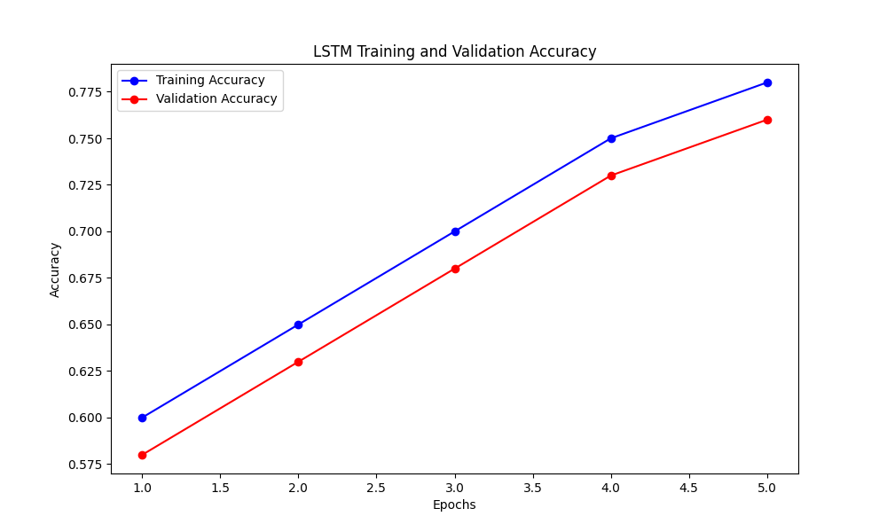
LSTM Training and Validation Accuracy

Slide 10
Conclusion
- The CNN model effectively monitors forest cover using Sentinel-2 imagery.
- The LSTM model provides insights into public sentiment on environmental issues through news articles.
- Both models contribute to SDG 15: Life on Land, enhancing forest sustainability.

