Slide 1


Slide 2





Meet the team
TEAM
2
Five owners across one CRISP-DM workflow.
Nicole Barmao
Arnold Kirwa
Johnson Mwau
Malvin Kiprop
Joseph Macharia
Business Understanding
Data Understanding
Modeling
Evaluation
Deployment
Team Member
Scrum Master
Team Member
Team Member
Project Manager
1
2
3
4
5
PLANT HEALTH AI • MAIZE DISEASE CLASSIFICATION

Slide 3
CRISP-DM process
PROCESS
3
A complete six-step journey from the business need to a deployable decision-support system.
1
2
3
4
5
6
Business
Understanding
Data
Understanding
Data
Preparation
Modeling
Evaluation
Deployment
BU
DU
DP
ML
EV
DEP
Define the problem,
objectives and value.
Inspect images,
classes and quality.
Standardize, split,
normalize and balance.
Train and compare
candidate models.
Measure performance,
errors and uncertainty.
Integrate the model
into a usable workflow.
PLANT HEALTH AI • MAIZE DISEASE CLASSIFICATION

Slide 4
Business Understanding
BUSINESS
4
Why the project matters, what it will deliver, and who benefits.
PROBLEM STATEMENT
MAIN OBJECTIVE
BUSINESS OBJECTIVES
Maize diseases can look visually similar. Lighting, leaf condition, image quality and disease severity can make identification difficult, delaying informed crop-management decisions.
Develop and evaluate an image-based ML system that classifies maize leaf images into defined disease and healthy categories and supports useful plant-health information.
1. Enable faster image-based screening.
2. Provide confidence-aware decision support and relevant plant-health information.
SOLUTION
PLANT IMPACT
PRODUCTION & FARMER IMPACT
A four-class image classifier using MobileNetV2 transfer learning, paired with confidence handling and a structured knowledge component.
Earlier recognition can help identify symptomatic leaves sooner, supporting timely attention before disease pressure becomes harder to manage.
Better-informed field decisions can support crop monitoring, reduce avoidable inspection delays and give farmers an accessible second source of information.
PLANT HEALTH AI • MAIZE DISEASE CLASSIFICATION

Slide 5
From leaf symptoms to farm decisions
BUSINESS
5
The intended value chain is decision support—not a replacement for professional diagnosis.
1 PLANT
2 PRODUCTION
3 FARMERS
Disease symptoms can reduce healthy leaf area and affect the plant's ability to sustain photosynthesis and grain filling.
The system focuses on early image-based screening within four supported classes.
Earlier visibility of potential disease can support more timely scouting, prioritization and follow-up.
The model's outputs should be interpreted alongside field context and uncertainty.
A simple image workflow can make preliminary screening more accessible where expert support is not immediately available.
Outputs are decision-support signals, not guaranteed diagnoses.
VALUE CHAIN
Photo
Classification
Confidence
Information
Action / follow-up
PLANT HEALTH AI • MAIZE DISEASE CLASSIFICATION

Slide 6
Data Understanding
DATA
6
Source, scale and structure of the verified working dataset.
4,184
4
628
628
2,928
verified / usable images
classes
validation images
test images
training images
DATASET SOURCE
FOUR CLASSES
GitHub: smaranjitghose/corn_pathology_ai
Project / dataset reference dates to around 2020 (~6 years ago).
The repository describes analysis of deep-learning architectures for corn leaf disease detection.
Blight • Common Rust • Gray Leaf Spot • Healthy
The project uses a single-label multiclass classification setup. Gray Leaf Spot is the smallest class in the training set, motivating class-weighting during model training.
github.com/smaranjitghose/corn_pathology_ai
Working split used throughout model experiments: 2,928 train • 628 validation • 628 test • stratified by class
PLANT HEALTH AI • MAIZE DISEASE CLASSIFICATION

Slide 7
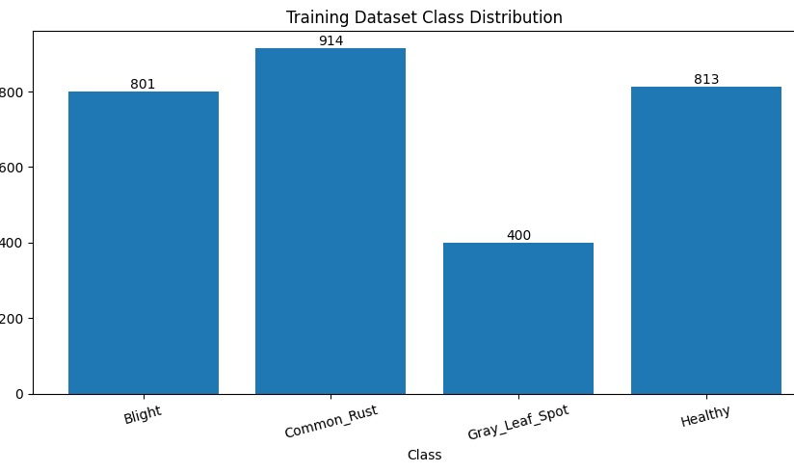
Data Understanding — class distribution
DATA
7
The four classes are visible at a glance; the imbalance is important for modeling.
BLIGHT
1,144 images in the cleaned dataset
COMMON RUST
1,306 images — largest class
GRAY LEAF SPOT
572 images — smallest class
HEALTHY
INSIGHT • Common Rust is the largest class, while Gray Leaf Spot is the smallest. The imbalance is carried into stratified splits and addressed during training with class weights.
1,162 images
PLANT HEALTH AI • MAIZE DISEASE CLASSIFICATION

Slide 8
Data Preparation
DATA
8
Exact preparation figures from the notebook, kept inside the blocks for quick reading.
STANDARDIZE
RGB
NORMALIZE
256 × 256
4,184
[0,1]
Custom CNN input
320 × 320 for Tuned CNN + MobileNetV2
4,179 RGB • 4 RGBA • 1 CMYK
→ all standardized to RGB
Custom CNNs: pixel / 255
MobileNetV2: approximately [−1,1]
AUGMENT
SPLIT
BALANCE
TRAIN ONLY
2,928 / 628 / 628
Gray Leaf Spot
Flip • rotation 0.08 • zoom 0.10
contrast 0.10
Train / validation / test
stratified and held-out
400 training images • 13.66%
class weight = 1.830000
Leakage control: split first → augment training only → keep validation and test unchanged.
PLANT HEALTH AI • MAIZE DISEASE CLASSIFICATION

Slide 9
Modeling
MODEL
9
Three controlled experiments were compared using the same held-out test set.
01 CUSTOM CNN
02 TUNED CUSTOM CNN
03 MOBILENETV2
256×256 RGB
Training augmentation + class weights
Purpose: establish a reference.
320×320 RGB
Moderate augmentation + class weights
Purpose: test controlled refinement.
320×320 RGB
ImageNet-pretrained + fine-tuning
Purpose: test transfer learning.
Experiment logic → Baseline → controlled refinement → transfer learning → fine-tuning. All models use the same authoritative 628-image test set.
PLANT HEALTH AI • MAIZE DISEASE CLASSIFICATION

Slide 10
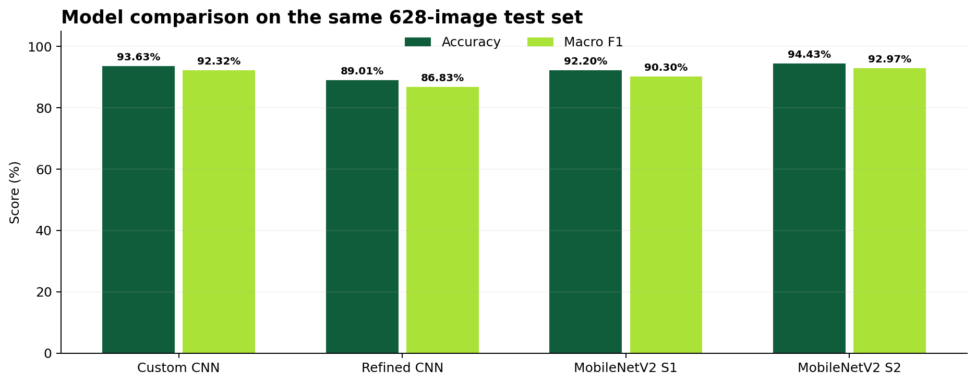
Model comparison — visual summary
MODEL
10
Accuracy and macro F1 on the same held-out test set.
STRONGEST OVERALL
MobileNetV2 Stage 2
94.43% accuracy • 92.97% macro F1
NEGATIVE EXPERIMENT
Tuned CNN fell to 89.01%
vs 93.63% baseline accuracy
READING THE VIZ
Fine-tuning improved the pretrained model from Stage 1 to Stage 2.
Interpretation • The final selection was based on overall performance plus class-level behavior and the difficult Blight ↔ Gray Leaf Spot boundary.
PLANT HEALTH AI • MAIZE DISEASE CLASSIFICATION

Slide 11
Custom CNN baseline
MODEL
11
The reference model establishes the starting point for later experiments.
93.63%
92.32%
588 / 628
28
test accuracy
macro F1
correct
Blight ↔ Gray errors
WHAT WORKED
WHERE IT STRUGGLED
Common Rust and Healthy were particularly strong in the baseline evaluation.
20 Blight images were predicted as Gray Leaf Spot and 8 Gray Leaf Spot images were predicted as Blight — 28 combined boundary errors.
Interpretation • A strong baseline, but the Blight ↔ Gray Leaf Spot boundary became the key area to improve.
PLANT HEALTH AI • MAIZE DISEASE CLASSIFICATION

Slide 12
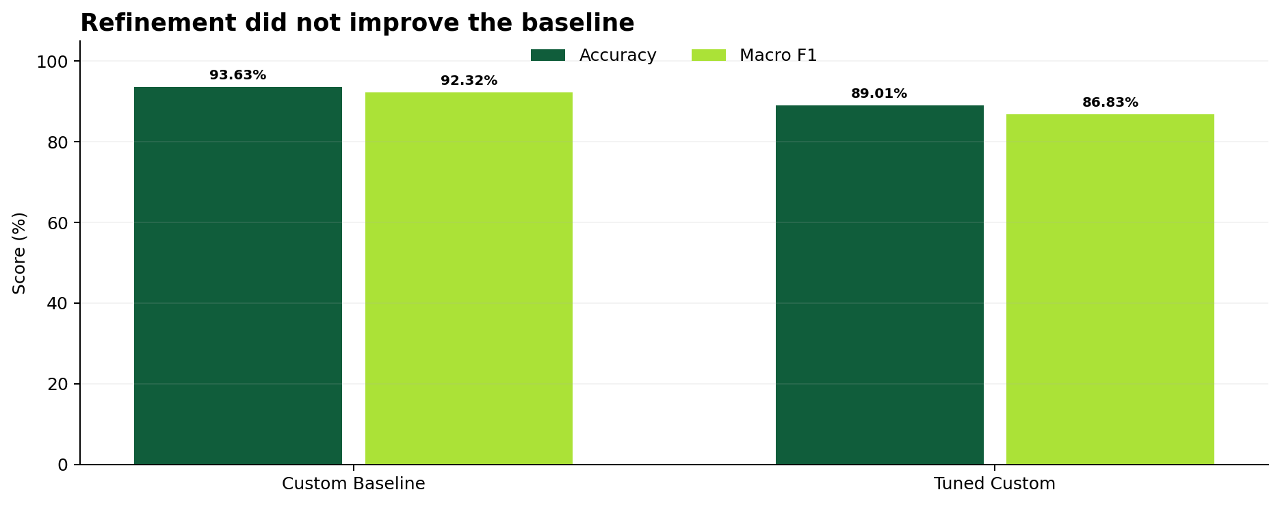
Refined CNN — a useful negative experiment
MODEL
12
The refinement tested higher resolution and moderate augmentation.
89.01%
86.83%
accuracy
macro F1
WHAT CHANGED
Input size 256×256 → 320×320, with moderate augmentation.
INTERPRETATION
Accuracy fell 4.62 pp and Blight ↔ Gray errors increased from 28 to 47. The experiment informed the move toward transfer learning.
PLANT HEALTH AI • MAIZE DISEASE CLASSIFICATION

Slide 13
Transfer learning + fine-tuning
MODEL
13
The pretrained MobileNetV2 backbone was tested in two stages.
STAGE 1 — FROZEN
STAGE 2 — FINE-TUNED
ImageNet-pretrained MobileNetV2 backbone kept frozen.
92.20% test accuracy
90.30% macro F1
Competitive, but below the Custom CNN baseline.
Selected later layers unfrozen at a lower learning rate; BatchNorm remained frozen.
94.43% test accuracy
92.97% macro F1
593 / 628 correct; 35 misclassified.
Key change • Fine-tuning improved accuracy by 2.23 percentage points from Stage 1 and reduced the principal Blight ↔ Gray boundary to 23 errors.
PLANT HEALTH AI • MAIZE DISEASE CLASSIFICATION

Slide 14
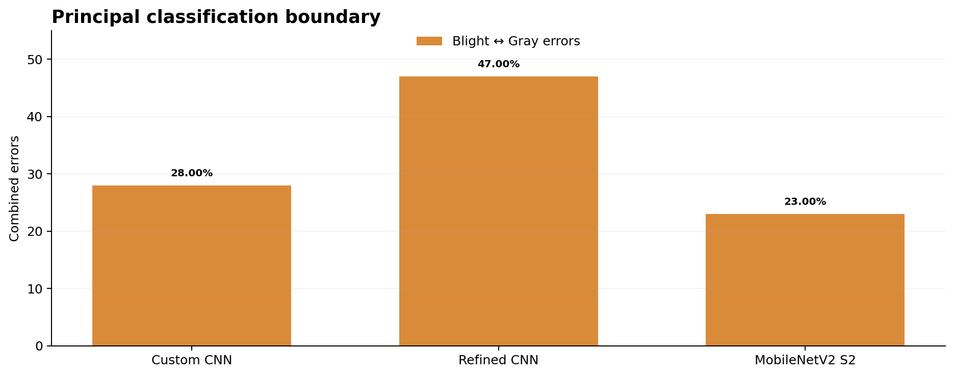
The main error boundary — Blight ↔ Gray Leaf Spot
EVALUATION
14
The same difficult pair appears across the experiments.
28
47
baseline
refined
23
MobileNetV2 Stage 2
INTERPRETATION
Stage 2 reduced the combined boundary from 28 to 23 errors — five fewer than the baseline — but visual overlap remains.
PLANT HEALTH AI • MAIZE DISEASE CLASSIFICATION

Slide 15
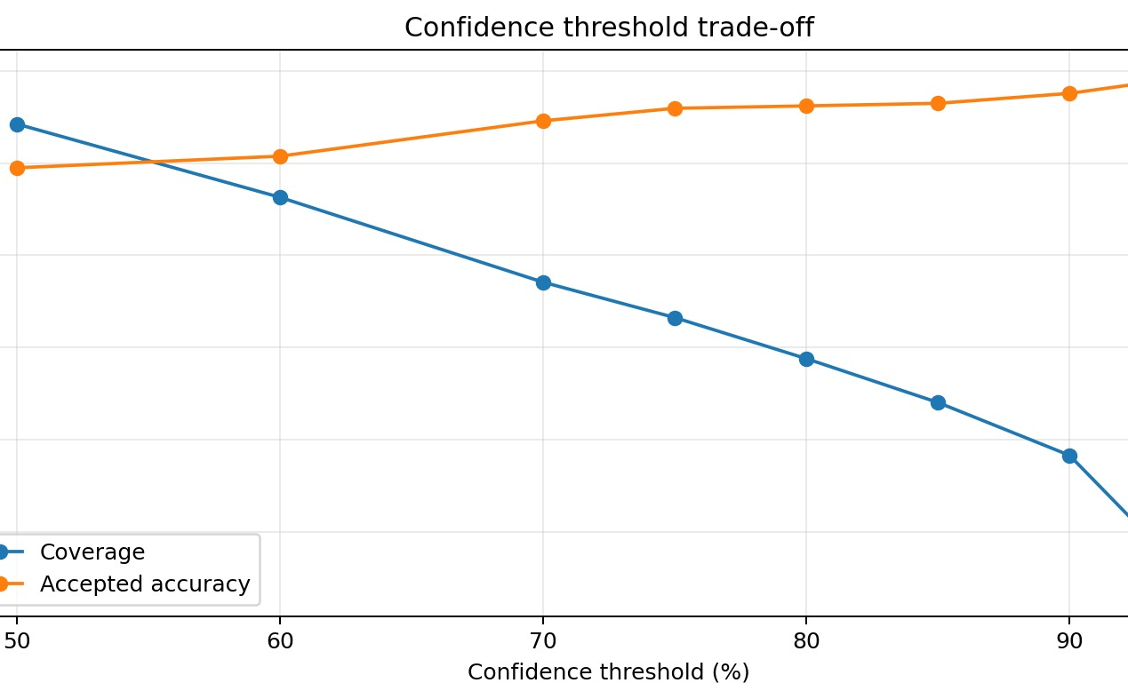
Confidence & uncertainty
EVALUATION
15
A good classifier should know when not to sound certain.
70%
88.54%
threshold
coverage
97.30%
72
accepted accuracy
uncertain
INTERPRETATION
At 70%, 556/628 predictions are accepted and 72 are treated as uncertain. Higher thresholds improve accepted accuracy but reduce coverage.
PLANT HEALTH AI • MAIZE DISEASE CLASSIFICATION

Slide 16
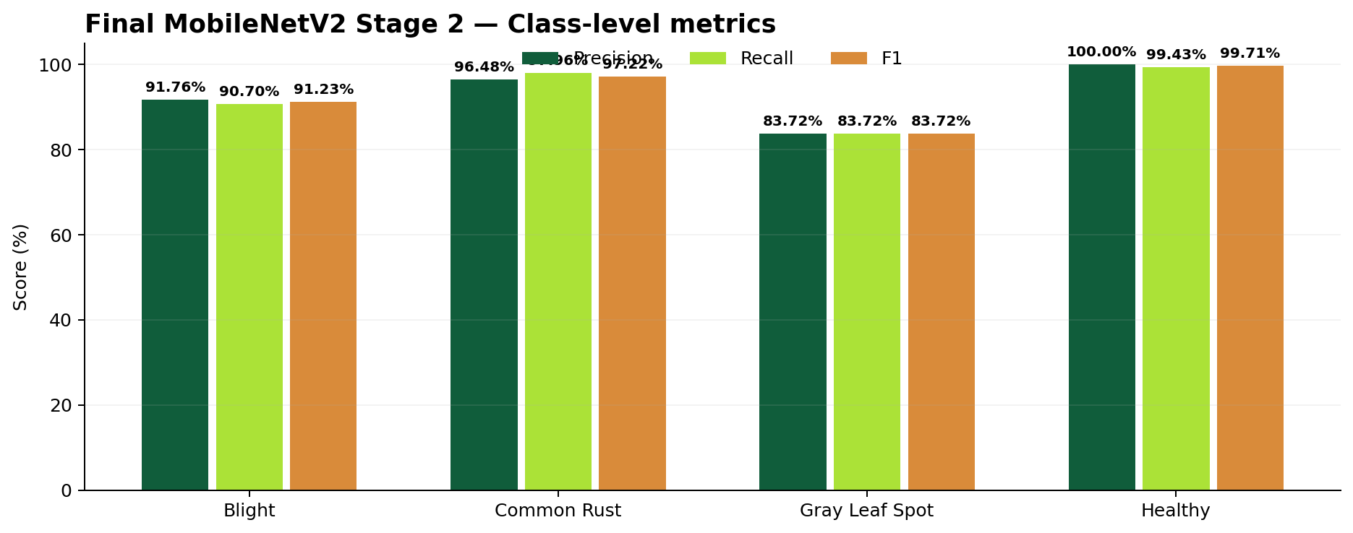
Final model — class-level evaluation
EVALUATION
16
Precision, recall and F1 reveal differences hidden by overall accuracy.
HEALTHY
100.00% precision
99.43% recall • 99.71% F1
COMMON RUST
96.48% precision
97.96% recall • 97.22% F1
GRAY LEAF SPOT
83.72% across all three metrics — weakest class
Viz summary • Healthy and Common Rust are highly consistent; Gray Leaf Spot remains the main class-level weakness.
PLANT HEALTH AI • MAIZE DISEASE CLASSIFICATION

Slide 17
Model Evaluation — final model performance
EVALUATION
17
MobileNetV2 Transfer Learning Stage 2 on 628 previously unseen test images.
94.43%
92.97%
94.42%
593 / 628
35
accuracy
macro F1
weighted F1
correct
misclassified
Class
Precision
Recall
F1
EVALUATION SUMMARY
Blight
91.76%
90.70%
91.23%
• Strong overall performance on the held-out test set.
• Healthy and Common Rust are strongest.
• Gray Leaf Spot is weakest by F1.
• Blight recall is 90.70%.
• The remaining errors reinforce the need for confidence-aware use.
Common Rust
96.48%
97.96%
97.22%
Gray Leaf Spot
83.72%
83.72%
83.72%
Healthy
100.00%
99.43%
99.71%
Interpretation • Overall accuracy is high, but class-level metrics identify where additional data and targeted analysis are still needed.
PLANT HEALTH AI • MAIZE DISEASE CLASSIFICATION

Slide 18
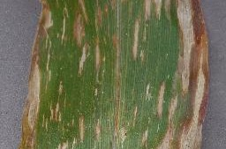
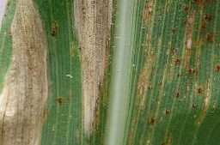
Sample disease images — visual distinction
DATA / EVALUATION
18
Two visually similar disease classes that matter for model interpretation.
GRAY LEAF SPOT
COMMON RUST
Elongated tan / gray lesions can overlap visually with other leaf damage.
Reddish-brown rust pustules create a different visual pattern on the leaf.
PLANT HEALTH AI • MAIZE DISEASE CLASSIFICATION

Slide 19
Structured plant-health knowledge
DEPLOYMENT
19
The classifier is paired with structured information so predictions can be followed by useful context.
KNOWLEDGE BASE
WHY A DATABASE?
SYSTEM FLOW
Disease
Symptoms
Conditions
Pathogens
Management
Transmission
Sources
Keeps plant-health information separate from chatbot logic.
Records can be updated and reused consistently across the application.
Prediction → confidence check → structured information → chatbot response.
Database connection details are supplied through environment variables rather than hard-coded credentials.
Role of the knowledge component • add context to the classification while keeping the model output distinct from supporting information.
PLANT HEALTH AI • MAIZE DISEASE CLASSIFICATION

Slide 20
Deployment
DEPLOYMENT
20
The deployment path connects image input, inference, uncertainty handling and plant-health information.
IMAGE
MODEL
SAFETY
KNOWLEDGE
INTERACTION
Upload / camera
MobileNetV2 Stage 2
Confidence check
PostgreSQL
Chatbot
APPLICATION
PUBLIC TESTING
DEPLOYMENT STATUS
FastAPI application
CNN-based maize disease classification
Image upload + camera capture
Local application testing completed.
Temporary Cloudflare Quick Tunnel used for public testing.
Core deployment path is in place; production hardening and broader validation remain.
System behavior • four-class probabilities → confidence gate → accepted prediction → structured plant-health information → user interaction.
PLANT HEALTH AI • MAIZE DISEASE CLASSIFICATION

Slide 21
Recommendations
NEXT STEPS
21
Actionable priorities based on the notebook's evaluation and deployment findings.
01
Strengthen the Blight ↔ Gray Leaf Spot boundary
02
Expand the dataset
Add representative images and continue targeted error analysis.
Collect diverse field images across lighting, backgrounds, cameras and disease stages.
03
Keep uncertainty handling
04
Validate in the field
Retain confidence thresholds so low-confidence outputs are surfaced as uncertain.
Test beyond the held-out dataset and monitor performance after deployment.
05
Improve explainability
Explore tools such as Grad-CAM to show which leaf regions influence predictions.
PLANT HEALTH AI • MAIZE DISEASE CLASSIFICATION

Slide 22
Q&A
Plant Health AI • Maize Disease Classification
Earlier identification • Better-informed decisions

