Slide 1


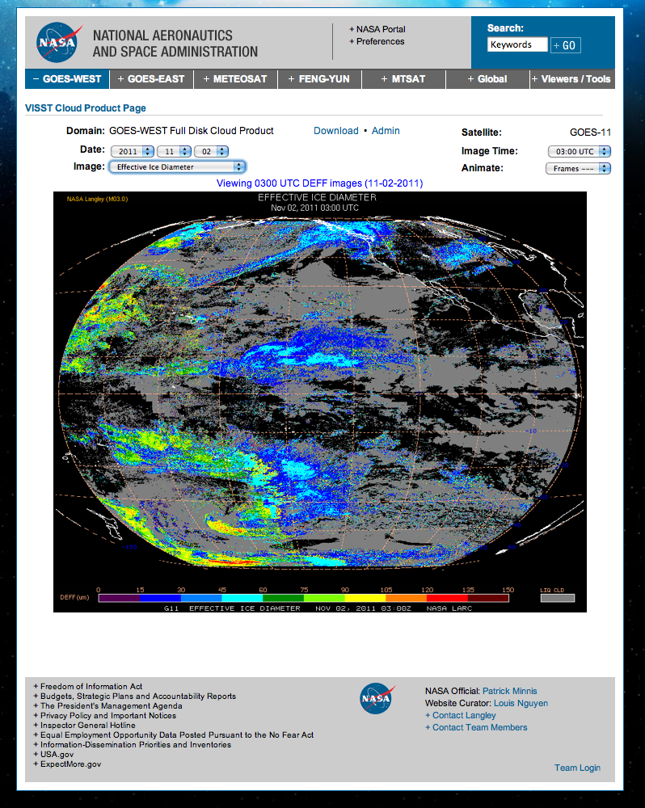
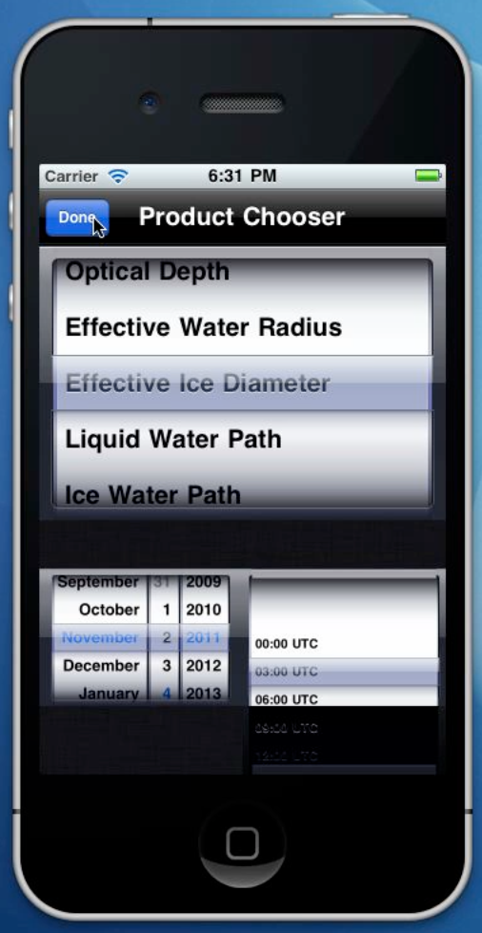
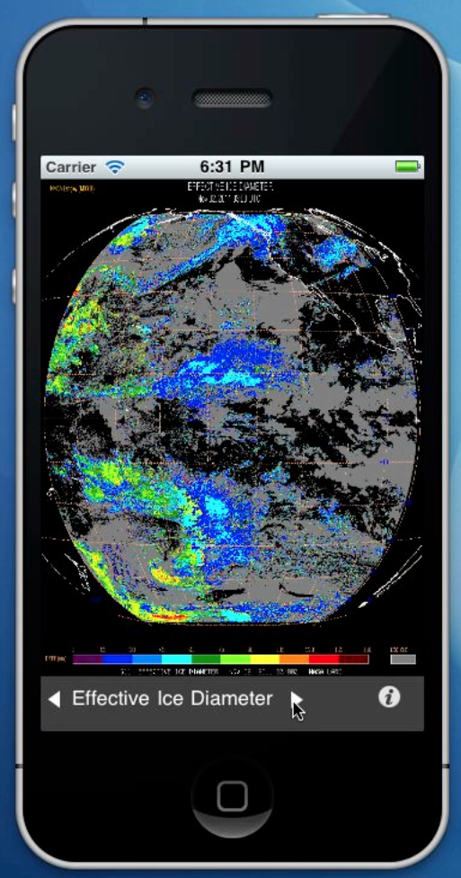
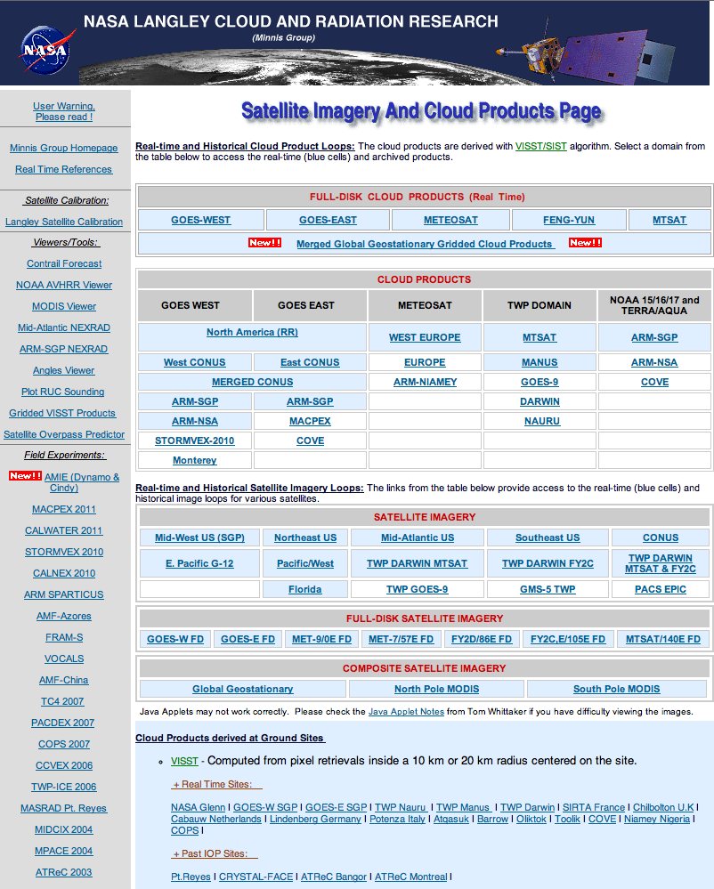
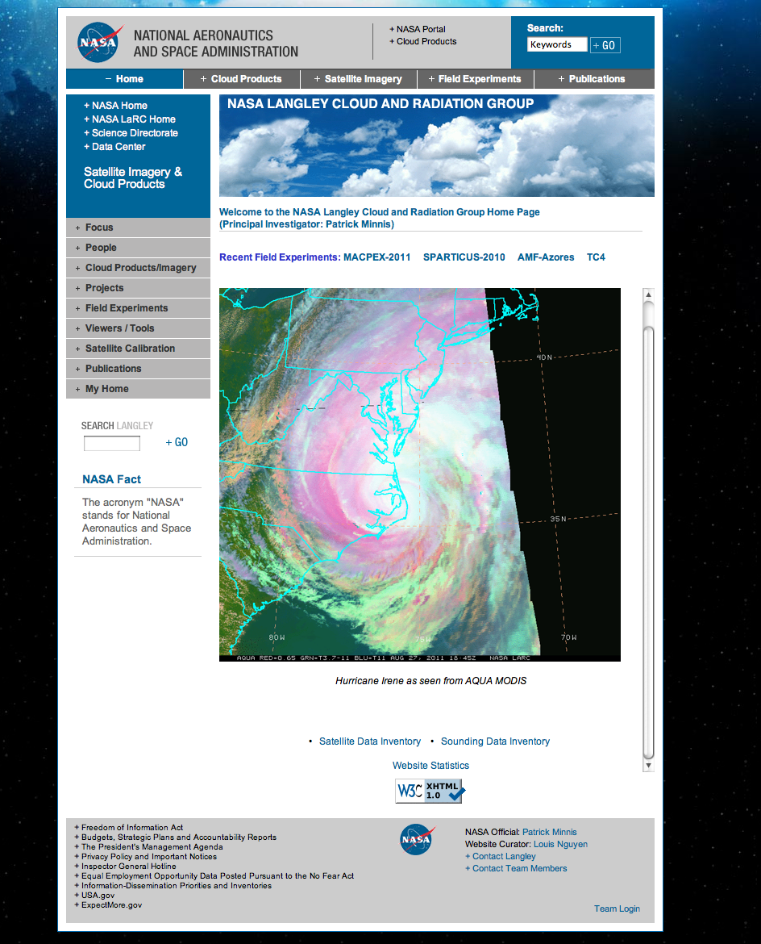
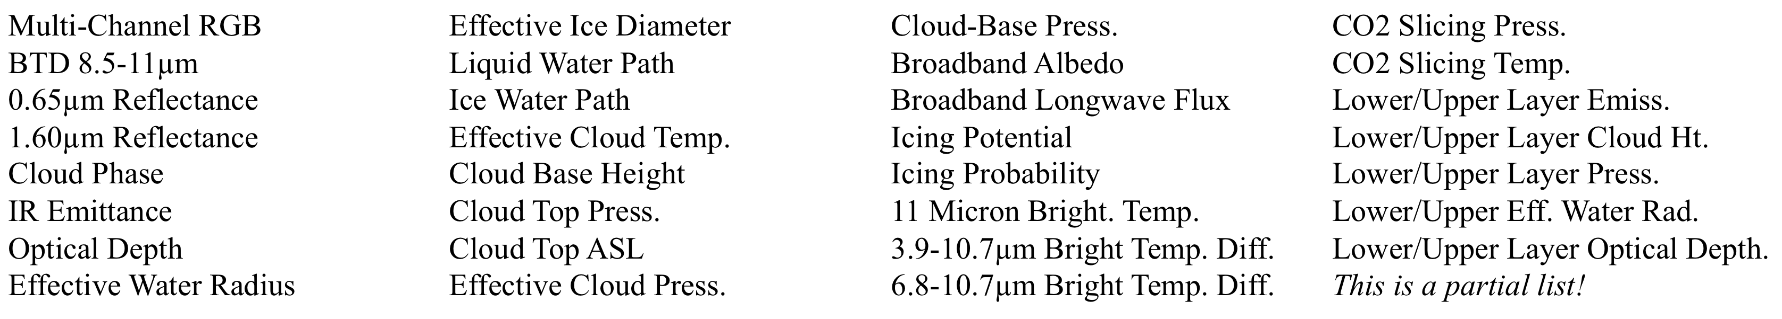


Access to Real-time and Historical Satellite Products
from a Mobile Application
Thad Chee¹, Matthew Kelly¹, Louis Nguyen², Patrick Minnis², Rabindra Palikonda¹, Douglas A. Spangenberg¹, J. Kirk Ayers¹
¹Science Systems & Applications, Inc., Hampton, VA, ²NASA-Langley Research Center, Hampton, VA,
Paper Number: IN11B-1293
Langley Cloud App
Langley Cloud App: Accessing Satellite Products
Web-Based Version
Motivation
The Clouds and Radiation Group has watched with great interest as mobile applications have entered the mainstream of social consciousness. One key mission the group has is to make our products available to all interested parties.
The revolution in mobile computing is seen as a new channel for our products to find even wider usage and this presents a great opportunity for us to make our information available to an even wider audience in the hope that it will find new applications that we have not yet imagined.
To move toward this goal, our team has put together an example application that remotely accesses satellite derived cloud products and satellite imagery. Mobile platforms have characteristics that set them apart from traditional platforms. Limited memory, processing power and storage relative to workstations are traded off against high mobility, accessibility and availability to a wide audience.
Design Goal
One important design goal was to provide a method for other developers to be able to discover and build applications that use our information. The application forms the basis for future development as well as exposing an API for developers to be able to build new applications that leverage our products.
Application Programming Interface (API)
The application needed to be able to access information stored within databases in our cloud processing and satellite retrieval system. To make this possible, an API was designed to provide access to necessary meta data. The publicly available API is described in this poster.
How The App Works
To the right, the user is selecting the particular cloud product that they would like to see a visualization of. In addition to a particular cloud product, the user is also required to enter the date and the particular satellite orbit time.
Once the user has entered her selection criteria, the application then acquires and displays a graphic plot overlain on the globe of the desired information. The image to the left shows a sample of what the effective Ice Diameter plot looks like for November 2, 2011 at 3:00 UTC.
The application also allows the user to easily change products by pressing on the left and right arrows. Accessibility to cognitively “nearby” information is optimized in the application.
Finally, as can be seen on the web based version to the far right, the imagery for that same date and time is shown in larger format. What is also readily apparent is that the web version offers a very similar experience
Future Directions
We are currently developing these systems and applications to add to the usefulness of this app. We plan to add in the near future the ability to animate temporally the visualization and also the ability to access the information by using a satellite ground track “prediction” based interface.
Cloud Products and Data Site:
http://www-angler.larc.nasa.gov
Application Programming Interface
Group Website and References:
www-pm.larc.nasa.gov
The API for accessing the internal metadata is described below:
HTTP request: http://www-pm.larc.nasa.gov/cgi-bin/site/showdoc
Generic Parameters: docid This is the application ID code. For this API, it should always be 22
c This is the command parameter (described below)
Functions: List Domains – this allows an external program to determine all available domains of data that can be accessed.
  Command: ajax-list-domains
  Example: http://www-pm.larc.nasa.gov/cgi-bin/site/showdoc?docid=22&c=ajax-list-domains
  Returns: An XML list of domains along with attributes
  Attributes: domain-id: Unique numeric ID for domain. Other attributes indicate image sizes, source satellite, imagery locations for direct access
List Channels – This allows an external program to determine all available channels or products that are available for a given domain.
Command: ajax-list-channels
Domain: Use a domain ID returned from the List Domains call.
Example: http://www-pm.larc.nasa.gov/cgi-bin/site/showdoc?docid=22&domain-id=4&c=ajax-list-channels
Returns: An XML list of channels and descriptive names for the channels
Sample Cloud Product List
Corresponding author email: Thad.L.Chee@nasa.gov

