Slide 1

Archive Facebook
Matthew Kelly
Department of Computer Science Old Dominion University
Norfolk, Virginia

Slide 2

What is it?
Add-on for Mozilla Firefox
Allows you to grab a stand- alone archive of the content of your Facebook account
Utilizes browser’s viewport, so result is WYSIWYG
Archive Facebook http://bit.ly/archivefb

Slide 3

Current Methods
“Doesn’t Facebook already allow you to do this?”
Yes! But the look-and-feel is lost, removing the familiarity of traversing one’s FB content
Facebook controls what you are able to download (e.g. not friends’ profile pictures)
Archive Facebook http://bit.ly/archivefb

Slide 4
Why is this important?
Archive Facebook provides a more true-to-original archive by preserving look-and-feel
Archive integrity
What gets downloaded with FB’s method is of their choosing
What gets downloaded with ArchiveFB’s method is of your choosing [as supported]
Archive Facebook http://bit.ly/archivefb

Slide 5

Why is this important?
Bad Things Can Happen to Your Information
FB can delete account at their discretion
Account may be compromised and data lost forever
Archive Facebook http://bit.ly/archivefb

Slide 6
Why is this important?
Information is frozen-in-time (a true snapshot), so will be preserved even if comments are deleted, posts are modified, etc.
Even if my account is up and functioning, I can look at the past, but I will be looking at the past with today’s filter, i.e. FB history is not a true archive of the past
Archive Facebook http://bit.ly/archivefb

Slide 7

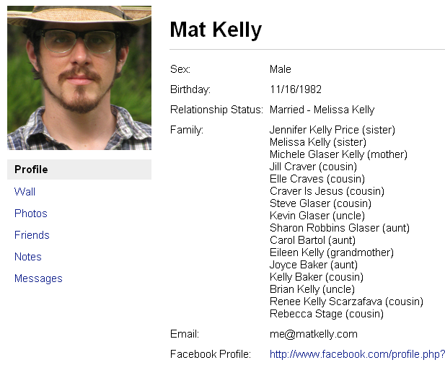
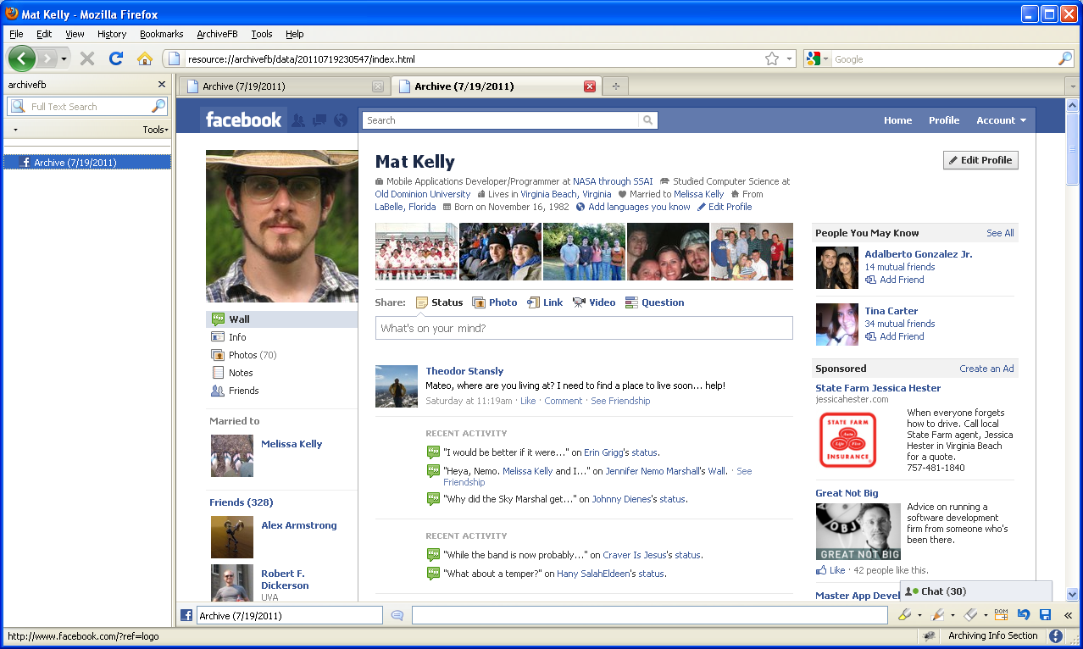
Content Dump versus WYSIWYG
Facebook Native Profile Download
Archive Facebook Archiving Session Result
Archive Facebook http://bit.ly/archivefb

Slide 8
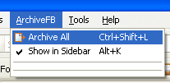


How Does it Work
Minimal UI provides navigation ease – only one menu item selection to get started
Pick and choose what you want archived based on a list of supported media type
Can choose defaults and archive all
Very few clicks produce significant results
Archive Facebook http://bit.ly/archivefb

Slide 9
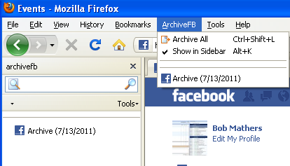
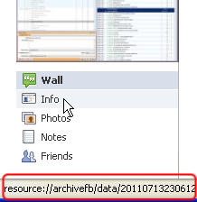
How do I access my archive?
New menu item added
Restoring is as simple as clicking the dated archive’s name
Archived files are stored locally and can be backed up to alternative medium, viewed by other applications and treated as normal files on the system
Archive Facebook http://bit.ly/archivefb

Slide 10
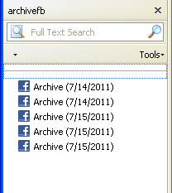
What it Doesn’t Do (Yet)
Chain together various archiving sessions – each session is independent from all others.
Allow you to archive anything beyond your own information
This would violate FB’s TOS, has been implemented but the functionality is hidden
Maintain robustness through FB’s redesigns
Archive Facebook http://bit.ly/archivefb

Slide 11
Complications in Developing the Add-On
No prior experience in Add-On Dev Domain
FB occasionally changed their URI scheme and data storage method, which breaks ArchiveFB
They do this often, so it’s a matter of cat & mouse
Archiving can take awhile (inherent to the problem)
Archive Facebook http://bit.ly/archivefb

Slide 12


Further Suggested Improvements
Appeal code to social media sites other than FB (e.g. G+, MySpace)
Allow for automatic archiving based on a user-defined period
Give an option to store archives in a user-defined location
Allow archiving of group/fan pages, friends’ FB pages, etc
Archive Facebook http://bit.ly/archivefb

Slide 13

Where can I get it?
https://addons.mozilla.org/en-US/firefox/addon/archivefacebook/
or -
http://bit.ly/archivefb
Archive Facebook http://bit.ly/archivefb

