Slide 1

WARCreate Create Wayback-Consumable WARC Files from Any Webpage
Mat Kelly, Michele C. Weigle, Michael L. Nelson
{mkelly,mweigle,mln}@cs.odu.edu
Old Dominion University; Norfolk, VA
Notes:
Introduce
Software project – WARCreate- Chrome extension
Allows create WARC file from any webpage you can view in your browser.

Slide 2

What is WARCreate?
Google Chrome extension
Creates WARC files
Enables preservation by users from their browser
First steps in bringing Institutional Archiving facilities to the PC
Notes:
WARC format prev inaccessible directly to users
Using tool, users utilize format.
Bringing WARC format to user is signif b/c
first step in porting practices, tools and facilities from conventnl web archiving to casual archivist or anyone wants to preserve content in a standard way.

Slide 3
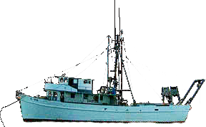






Target Content
Unreachable by web crawlers
Behind authentication
Not listed in search engines (Deep Web)
Private
We don’t want our bank statements in Wayback
Non-pertinent to public
Others have little interest in our Facebook comments
Notes:
If vistd WB Mach, noticed lg part of web not preserved
Content | auth & data inacces crawlers IS NOT ARCHIVED
Maybe this is good, not arcving bank statmts
Dontwant Crawlers != auth w/ bank & archive spending habits but what if I wanted to archive them?
Instead bank st, wanted to preserve FB acct content or priv Twitt feed?
No facil exist that allow me to archi this → WARC format.

Slide 4
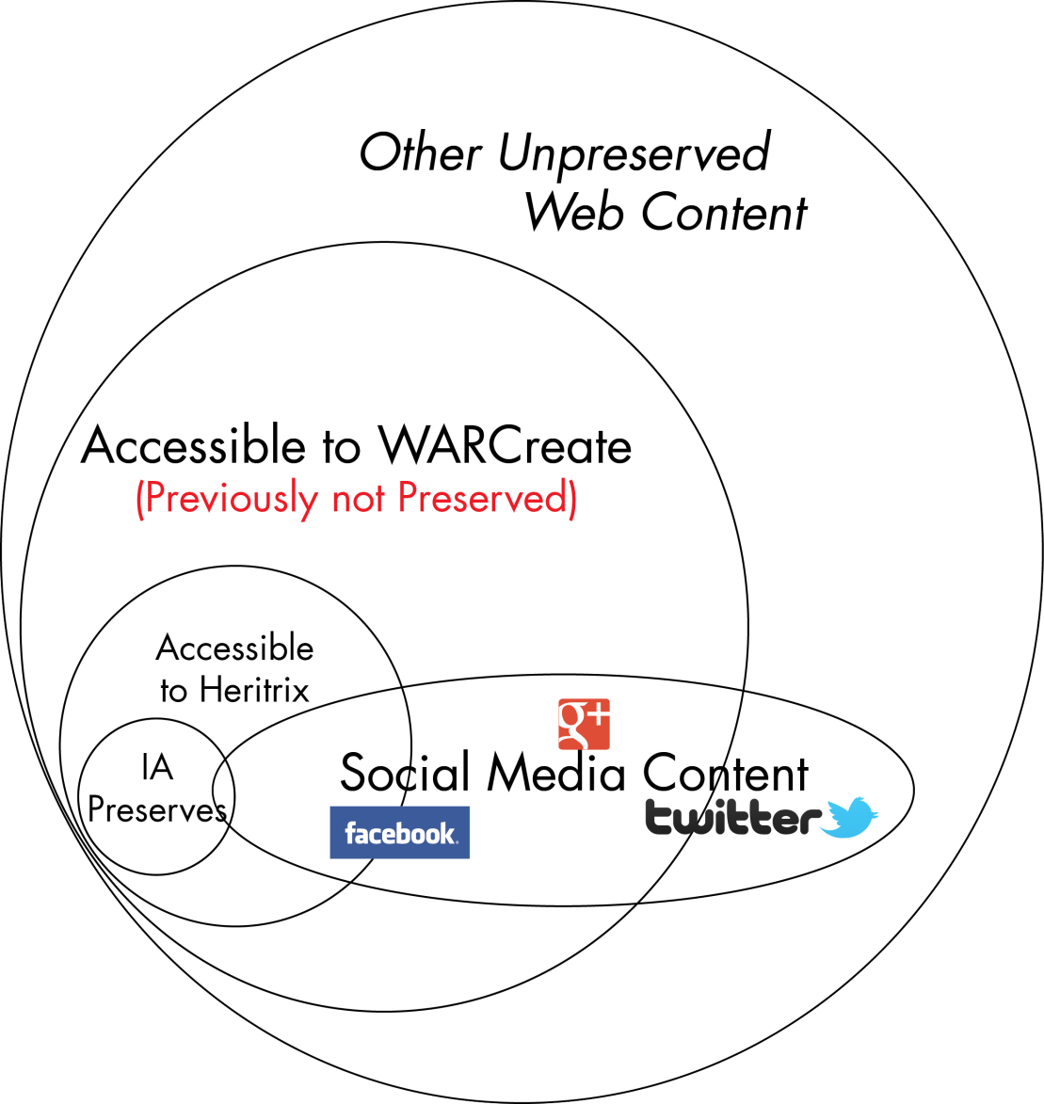
Preserving More!
Much digital information is needlessly lost
User chooses what they deem important
Compatible with standard archiving tools.
Notes:
Since bank st, twit feed et al are not arch, what else isn’t preservd?
A lg majority of web inaccessible Heritr & IA or simply not presvd one reas|anoth.
Evrthn Heritrx can archive, we can see in browser
We also see things Heritr != access to.
Unarchd info == more importnt than info currently archd.
WE should det what’s impt. – can w/ WARCreate

Slide 5
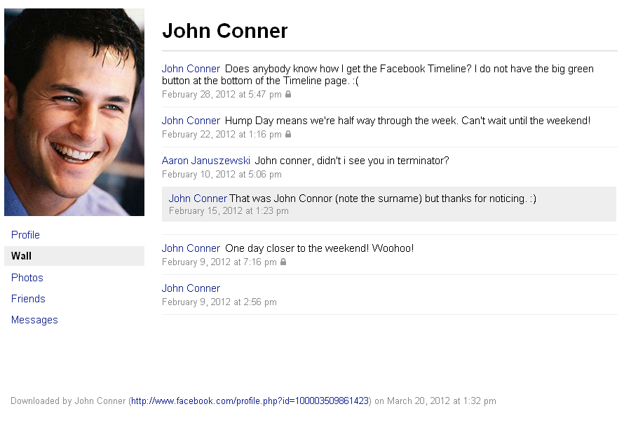
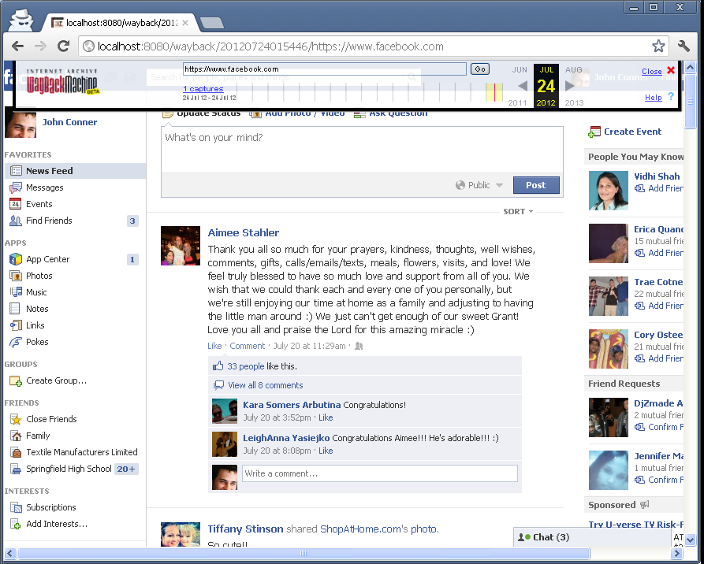
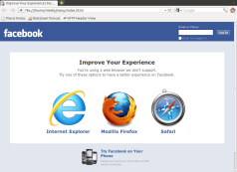
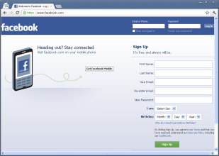
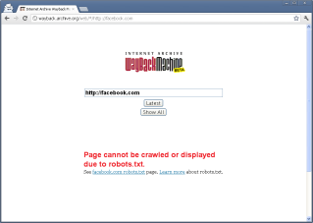
WYSIWYG
Archive created from
WARCreate in Wayback
Facebook-Supplied Data Dump

Slide 6
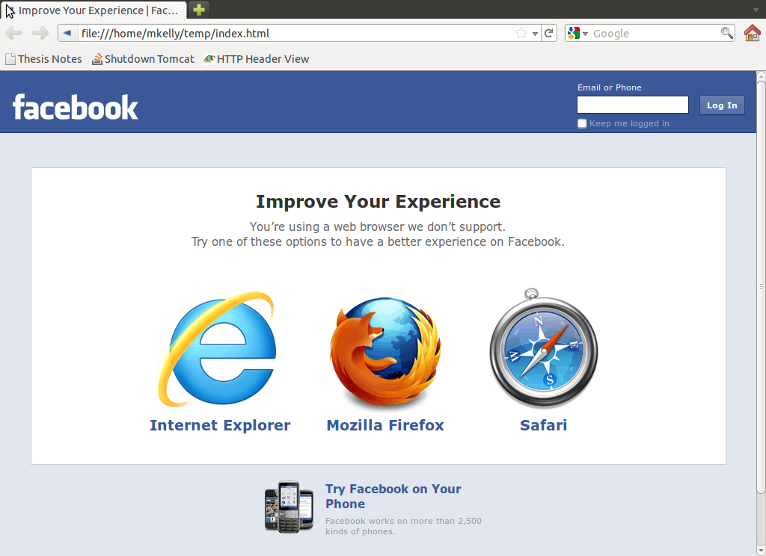
WYSIWYG
Archive created from
WARCreate in Wayback
Using Scraping Tools (e.g. wget)

Slide 7
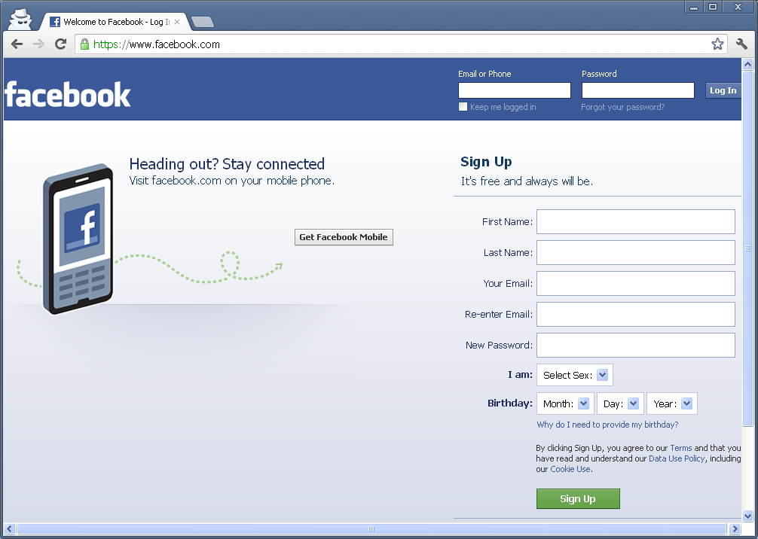
WYSIWYG
Archive created from
WARCreate in Wayback
A Crawler Has No Context

Slide 8
WYSIWYG
Archive created from
WARCreate in Wayback
IA/HERITRIX OBEY ROBOTS

Slide 9
Goals
Make it easy to use (GUI-based, no cmd line)
Make it useful (fill the need)
Demonstrate novelty of browser-instigated preservation
Show value of WARC format for Personal Web preservation
Bring WARC format to Personal Digital Archiving
Notes:
High Levl proj - don't want transf the complications formt to user but inst allow user to util format w/o knowing ins/outs.
Wanna make it easy to use.
Interface,as see = simple at root but powerful below root.
Wanna fulfill goal of presving contt || auth & contt currently being lost/time bc !being preserved.
Esp. wanna show browser, when extdd, used as tool for preservation in way that mks most sense for pers web preserv,
i.e. we preserve what we can see and deem important.
Finly, wanna show that WARC formt is applicble beyond scope of convent web archiving.

Slide 10
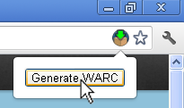
WARC Generation is Quick & Easy
Navigate to a webpage
Click the WARCreate Icon
Click Generate WARC
Extension Output Options:
In-Browser viewing of raw WARC
Download to Local Disk
Notes:
Said before, Interface is simple.
1. User navigates to webpg want archived, clicks WC icon, clks generate warc button& out pops aWARC.
Simple.
Threre are many user customizable options hidden beneath simplicity
but for simple WARC creation of the webpage you’re viewing, it’s one-click and you’re done.

Slide 11
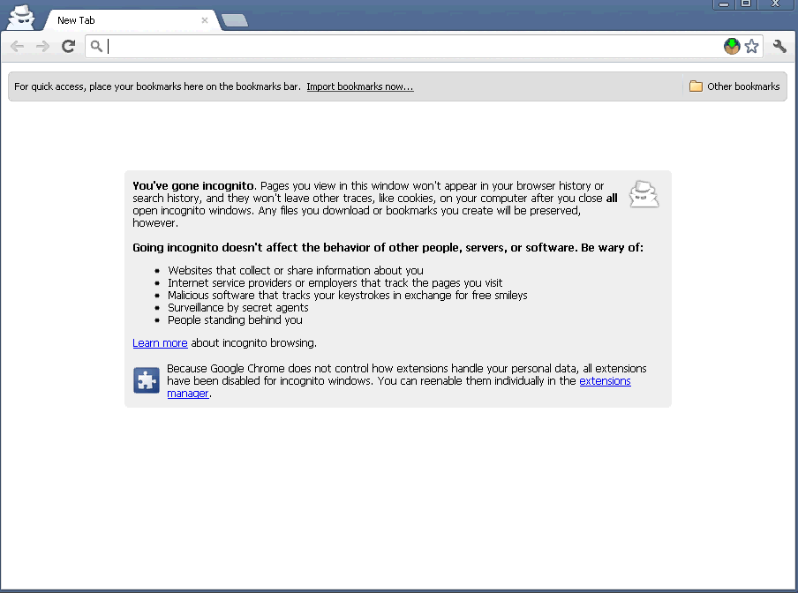
Creating a WARC

Slide 12
I’ve Made a WARC. Now what?
What you do with the archive is up to you.
Install it in your local Wayback instance
Who has their own Wayback Instance!?
Wayback is free & open source
That seems like a lot of work!
One additional reason for users NOT to preserve what they would like archived
Notes:
So, you've used WCto create WARC. Mission success! Let's all go home.
What good is presrvd formt if cannot be re-expercd? IA’s WB is FOSS!
You can dl copy and replay these WARCs.
But that sounds excessive &difficult and who really wants to host their own WB intance?
THESE precisely some reasons that have prevntd utilizn of convtnl web arch practices & tools into realm of personal web archiving.
But we have a solution for this, too.

Slide 13





WARC Creation & Replay
3. User Selects “Generate WARC”
button in WARCreate
6. User accesses local wayback
to view preserved content
1. User visits a website using their browser
2. WARCreate captures the HTTP Headers
4. WARC generated, saved locally
5. Local Wayback instance indexes WARC
…to directory accessible to local wayback
1
2
3
6
4
5
Notes:
y

Slide 14
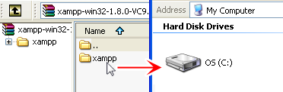



Suite Installation & Interaction
Drag & Drop .zip to hd
Start relevant services using GUI
Execute WARCreate process
View Archive at http://localhost/wayback
Notes:
Might STILL complctd, so here's a better synopsis.
Drag&Drop zipped suite to root of HD.
Start Apache serv by clicking a button.
Start Tomcat serv by clicking a button.
Create WARC from any page on the web using WC.
Save WARC to your HD.
Wait for WB instc to index -> any content you can view is then preserved into WARC format and replayable from your local machine.

Slide 15
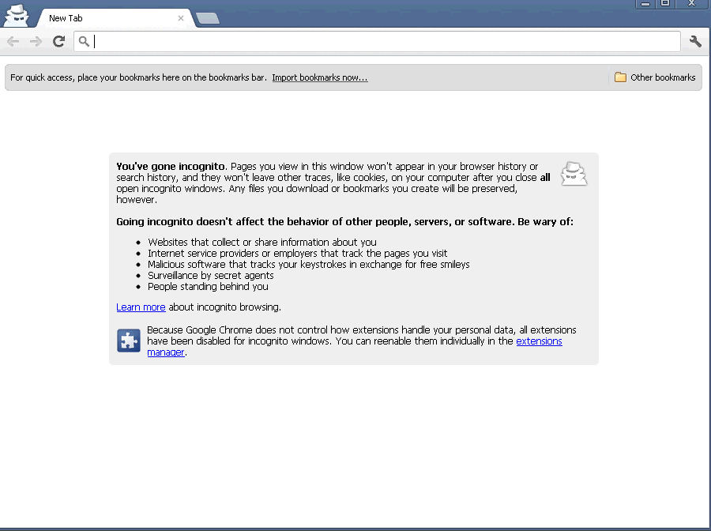
Replay of Preserved Twitter page

Slide 16
And My Bank Statements?
Preserved content:
never leaves WARC files
never leaves local machine
WARCreate provides preliminary encoding/encryption support
Wayback instance is hosted on your own machine – no external access by default
Notes:
Apache = web server, my bank statements? Exposed to world?
Evrthng in Suite is on your machine.
Aside frm grabng content you wanna presv from web, none output is exposed.
Further, I’ve worked in preliminary support for encding/encrypn to ease nerves a little
but real power = your priv archives are !expsd as would be if handedoff to instit.
Meanwhile, ur able to util instit facilitts.

Slide 17
What It Doesn’t Do
Archive entire websites with a click
Submit your WARCs to IA
Contain comprehensive support for WARC format
A subset is utilized and all generated WARCs validated at time of creation
Provide a direct means for replay
Replay is executed through the XAMPP suite
Notes:
K,snds good. Doesn’t do?
* doesnot archive entire website into single WARC. - purely WYSIWYG - What you see is what you get.
* does not submit WARCs to IA. So, even if y’ad PersWebArch wantd world to see one day, tool willnt auto’ly submit WARCs.
* only implmnts subset WARC formt. While ths WARCs validt, compreh support format has mny edge cases and must take into account all of the nuances of the web experience.
* Doesnt prvd means replay - job of the supplemtry PWA suite, which will be freely available with WC.

Slide 18
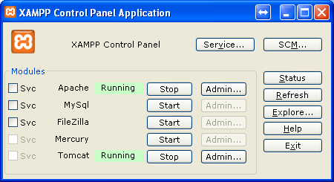
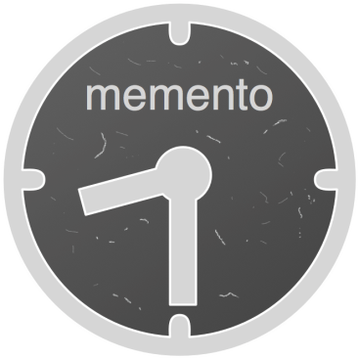




Why Use a Client-Side Server?
Server scripts do what JS can’t
Can reside on your machine!
Controls are GUI based
Resource fetching w/o XSS issues
 | Local Wayback Instance | WARCreate Server-Side Support | Memento Proxy
… | Tomcat | Apache
XAMPP-Based Personal Web Archiving Suite
Built On
Notes:
Some extras, configing all packages on a system is hard.
WC contns sanity checks - ensure u setup the suite correctly and can take advantage of the full extent of the extension.
By using this client-side server approach, able to overcome some short comings of JS &web browser.
Start off, !Apache | !Tomcat running
Can still create WARCs using just extension but !validated & might run into website-based security issues trying to store sites' content locally.
So, we dragged the suite to our hard drive, per the procedure before and we're now ready to fire up Apache. We click the button.

Slide 19
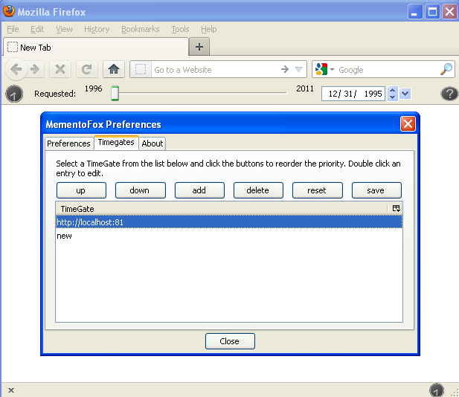
Extras: Memento Support
Suite’s includes tailored Timegate
Memento abstraction is beyond WARC
Point MementoFox (or other Memento tools) to localhost
Notes:
Why wasnt Memento support integr into gend WARCs?
Simput, beyond abstraction WARCs & instd in realm of replay rather than src replay.
By utilizng suite that origly built to supplmnt WC → also able incld facilities for Memento to handle reqts approply
& retn to user date of archive reqd from local WB inst.

Slide 20

How it All Relates
BROWSER
Personal Archives Accessible at localhost
Memento negotiated
& returned
Local
Timegate
Browser Extensions
MementoFox
Send Desired Date
Local
Wayback
Instance
WARCreate
WARC/1.0
WARC-Type: warcinfo
WARC-Date: 2012-07-15T22:15:59.485Z
WARC-Filename: 2220471175c820fee3fec986040ebd1f.warc
Generates WARC file
Index WARCs
Notes:
Tie all together:
WC gens WARCs
Suite contains support for Wayback and a host of WARC tools that supplement creation WARCs.
Also included custom Memento Timegate in suite
* so when you go to query your persWebArchvs on your machine, matter put’ng localhost addr of timegate =
* all the your personal web archives are temporally navigable.

Slide 21
Contribution of Work
Facilitate browser-based Personal Web Archiving
Determine feasibility of fully Client-Side Preservation
Integrate with existing tools for establishing use cases
Notes:
Synop
* wanted show browser bsd persWebArch very feasible endeavor to implmt
* By taking into acct pre-existing tools, able to show that WARCs we’re creating aren't some esoteric format that, too, will be lost in time when format dies ->
* rather an established, standard format that integrates with pre-existing offerings.

Slide 22
WARCreate Create Wayback-Consumable WARC Files from Any Webpage
http://WARCreate.com

Slide 23
Backup Slides

Slide 24
Future Work
Decouple from “server”
Refine Memento integration
Reference full WARC spec
Built-in WARC validation
Built-in replay
Compression
Optimization (removing duplicates)
…many more
Notes:
Fut. Work WARCreate
* Decouple from “server”
* Refine Memento integration
* Reference full WARC spec
* Built-in WARC validation
* Built-in replay
* Compression
* Optimization (removing duplicates)
* …many more

Slide 25
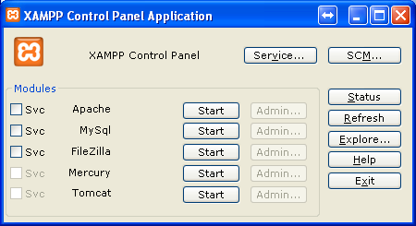
Extras: Configuration Sanity Check
Server scipts make up for Javascript shortcomings
The server can reside on your machine!
Setup,Start,Stop are GUI based
✗
✗
✗
✗
✗
WARC Validation
AJAX XSS Circumvention
HTML5 Sandbox Escaping
Memento Support
Local Wayback Instance
In WARCreate
Notes:
Some extras, configing all packages on a system is hard.
WC contns sanity checks - ensure u setup the suite correctly and can take advantage of the full extent of the extension.
By using this client-side server approach, able to overcome some short comings of JS &web browser.
Start off, !Apache | !Tomcat running
Can still create WARCs using just extension but !validated & might run into website-based security issues trying to store sites' content locally.
So, we dragged the suite to our hard drive, per the procedure before and we're now ready to fire up Apache. We click the button.

Slide 26
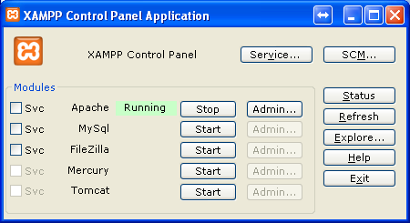
Extras: Configuration Sanity Check
Apache allows generated WARCs to be validated
Javascript cannot write to disk, server-side scripts can
Server prevents hot- linking & has security
Content better preserved using server techs
✓
✓
✓
?
✗
WARC Validation
AJAX XSS Circumvention
HTML5 Sandbox Escaping
Memento Support
Local Wayback Instance
In WARCreate
Notes:
Custom conf of Apach suite gives
* access to WARC validatn
* allows overcome protection of website in keeping us from preserving content
*able to interact with local filesys - something Javascript has severe limitations on doing.
Replay sys isn't up yet though & that's because the Java-based FOSS Wayback requires Tomcat.
Also, wanna able jump in time between our archives using Me, so we cannot experience this without our Wayback instance being up.
We start up Tomcat.

Slide 27
Extras: Configuration Sanity Check
Memento requires Wayback Wayback requires Tomcat ∴ Memento requires Tomcat
Memento Timegate req’s Python+modules (pre-packaged + included)
✓
✓
✓
✓
✓
WARC Validation
AJAX XSS Circumvention
HTML5 Sandbox Escaping
Memento Support
Local Wayback Instance
In WARCreate
Notes:
&now complt pkg = operatnl
Incldd w/ suite is impl of Memento framework built specif for persWebArch.
Ths supprt is fairly new and not tied into suite yet, so reqs a lil more s/w, also included

