Slide 1




Archive What I See Now
Mat Kelly, Michael L. Nelson, Michele C. Weigle
Old Dominion University {mkelly,mln,mweigle}@cs.odu.edu
Web Science and Digital Libraries Research Group
ws-dl.blogspot.com

Slide 2
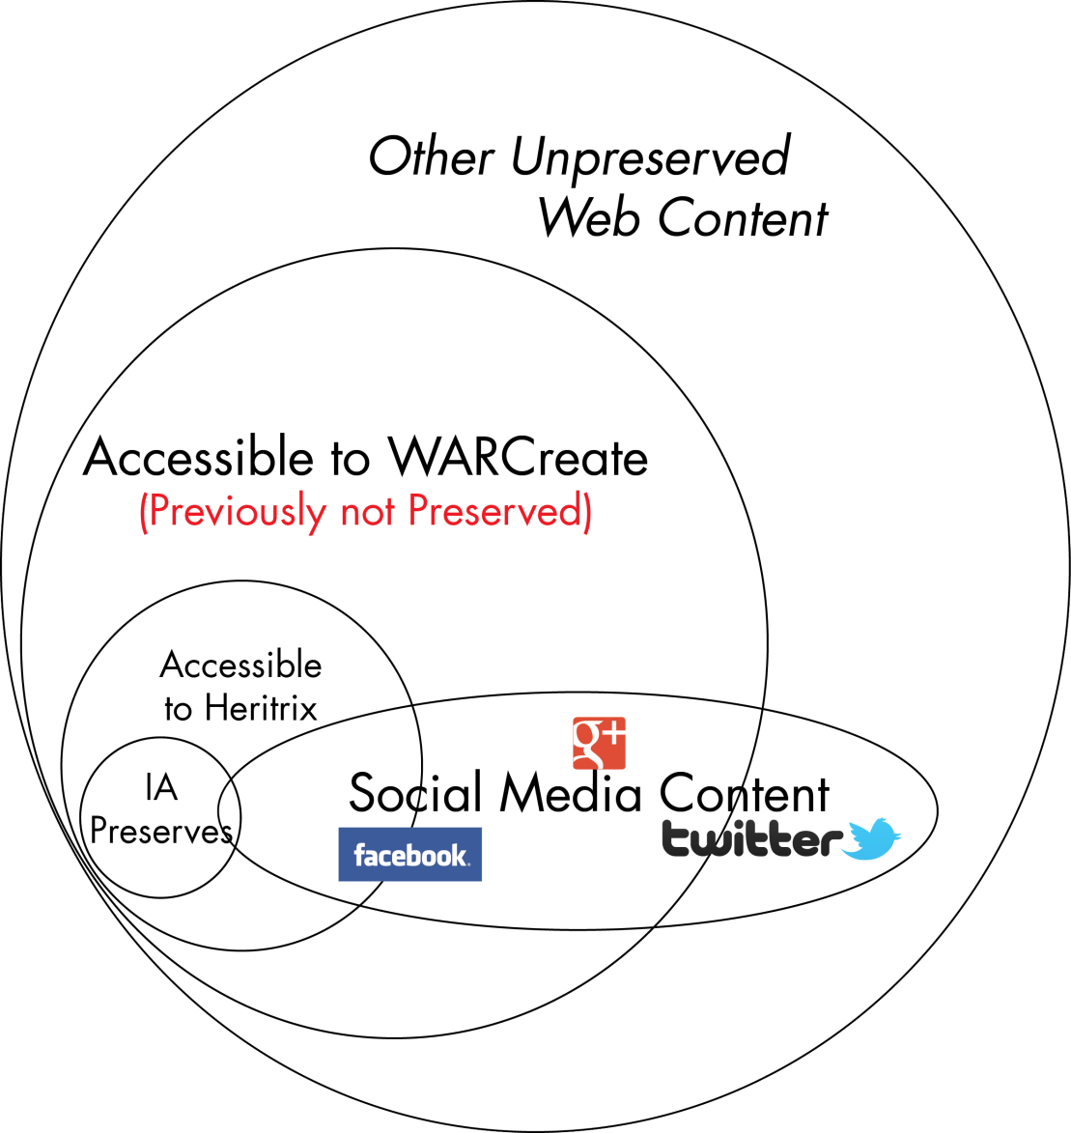
What’s the Problem?
Web archives capture a lot but not everything
Individuals’ interests may not be captured
Timely capture is important
Capture capability must be enabled for all
November 12, 2013 Salt Lake City, Utah
2013 Archive-It Partner Meeting

Slide 3
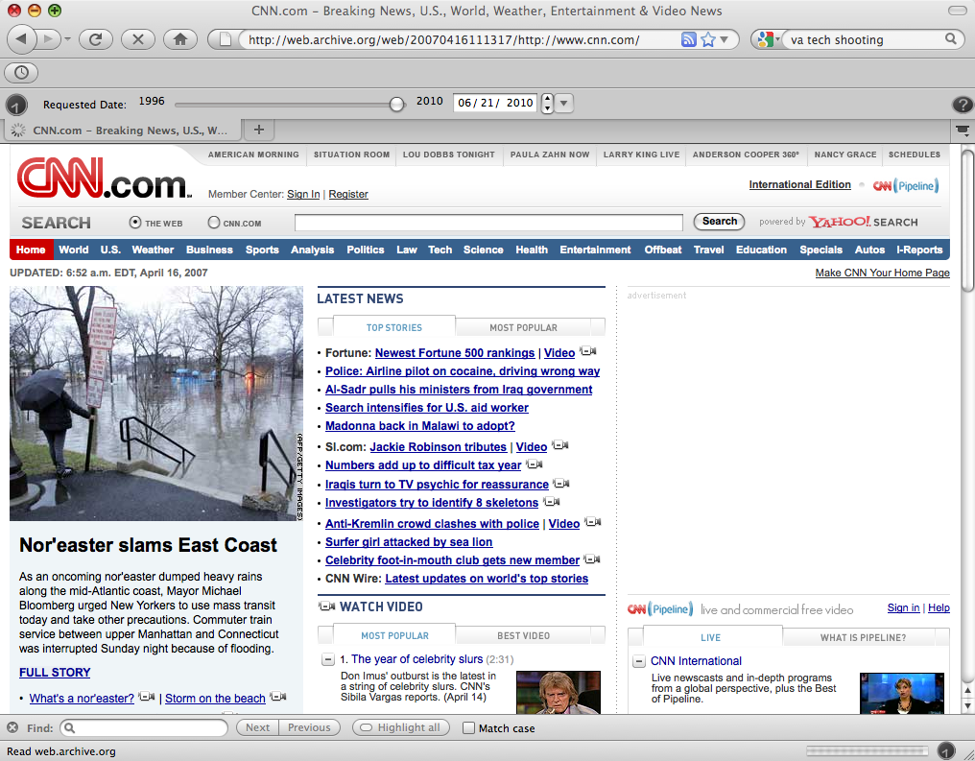
Timely Capture Is Important Use Case: Capturing Breaking Stories
Calls for seed URIs are reactionary
Not quick enough for rapidly evolving events
November 12, 2013 Salt Lake City, Utah
2013 Archive-It Partner Meeting

Slide 4
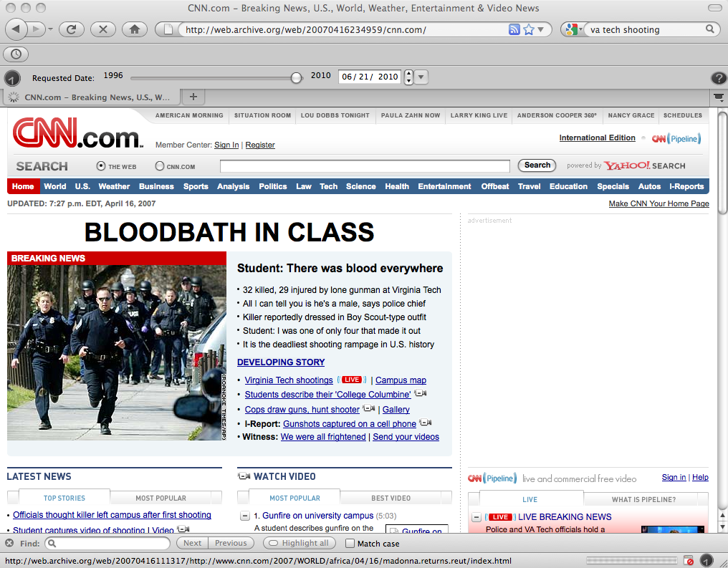
Timely Capture Is Important Use Case: Capturing Breaking Stories
Intermediate mementos missed
The story is incomplete
November 12, 2013 Salt Lake City, Utah
2013 Archive-It Partner Meeting

Slide 5
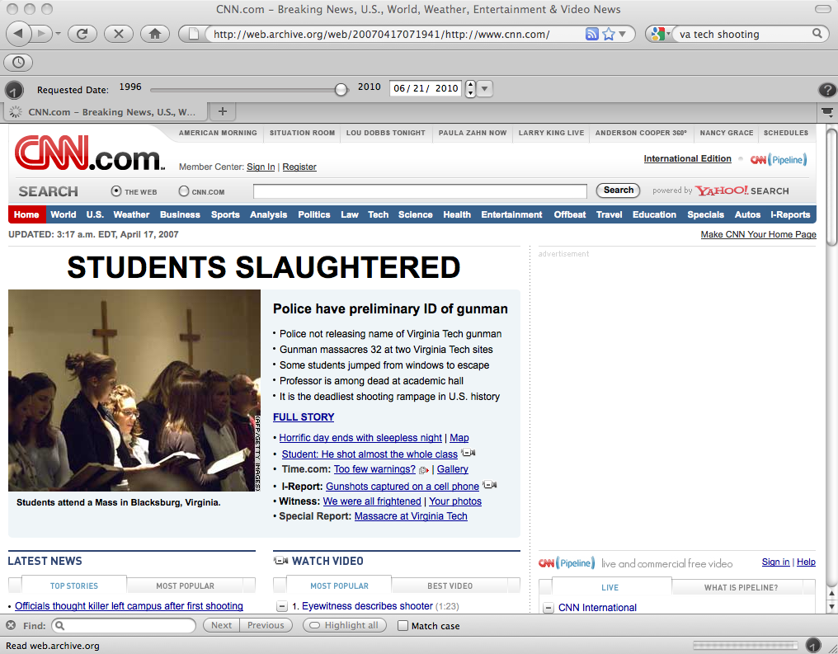
Timely Capture Is Important Use Case: Capturing Breaking Stories
November 12, 2013 Salt Lake City, Utah
2013 Archive-It Partner Meeting

Slide 6
Timely Capture Is Important Use Case: Capturing Breaking Stories
How Much of the Story IS MISSING
in the Web Archives?
November 12, 2013 Salt Lake City, Utah
2013 Archive-It Partner Meeting

Slide 7
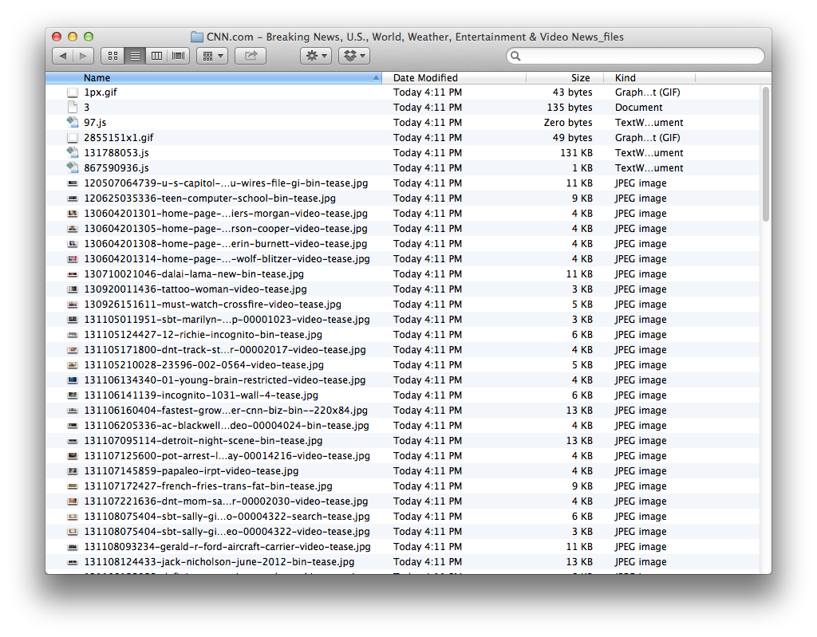

The Amateur Archivist’s Approach to Just-In-Time capture
Users take ad hoc approaches
Screenshots of Pages
Other sub-optimal approaches
November 12, 2013 Salt Lake City, Utah
2013 Archive-It Partner Meeting

Slide 8

Enabling The Amateur Web Archivist
Acknowledge the problem:
THE TOOLS ARE DIFFICULT!
Resolve the problem:
Build more accessible tools (make it EASY)
Appeal to standards (e.g., WARC)
Make interoperable
28500:2009
November 12, 2013 Salt Lake City, Utah
2013 Archive-It Partner Meeting

Slide 9
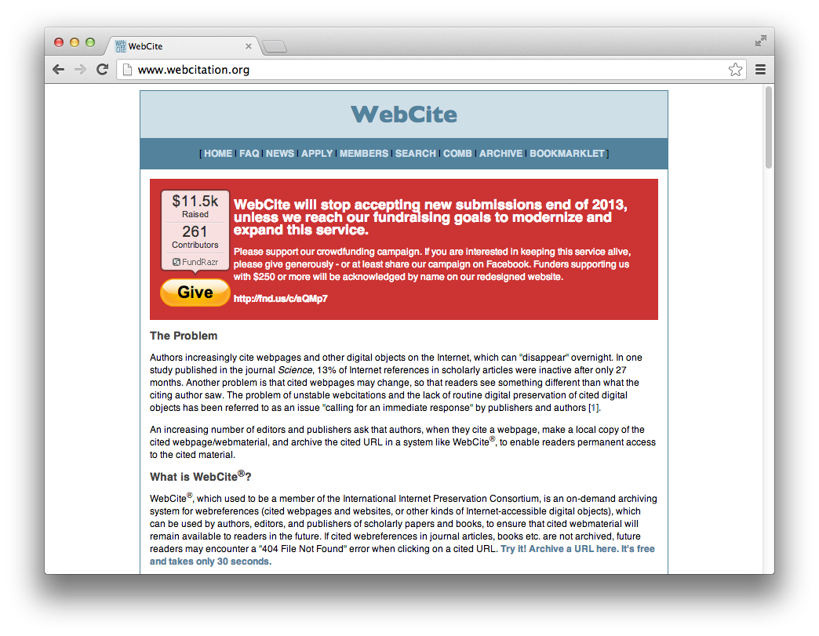
The Institutional Dilemma
Safety of Archives Requires $
Institutions Require Funding
Users’ Hard Drives Fail
No Access to Save-As files and Screenshots
Hybrid approach needed
Leverage institutional safety, formats, and tech
allow direct user deposits
November 12, 2013 Salt Lake City, Utah
2013 Archive-It Partner Meeting

Slide 10
So we built it!
WARCreate – Google Chrome extension
Create web archives from browser
Capture personalized content
Preserve on a whim
Mat Kelly and Michele C., "WARCreate - Create Wayback-Consumable WARC Files from Any Webpage," In Proceedings of the ACM/IEEE Joint Conference on Digital Libraries (JCDL 2012). Washington, DC, June 2012, pp. 437-438
Mat Kelly, Michele C. Weigle , Michael Nelson. "WARCreate - Create Wayback-Consumable WARC Files from Any Webpage," Digital Preservation 2012, Tools Demo Session: Web Archiving; 2012 Jul 25; Washington, DC.
November 12, 2013 Salt Lake City, Utah
2013 Archive-It Partner Meeting

Slide 11
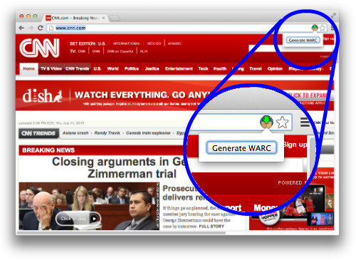
WARCreate – How it Works
November 12, 2013 Salt Lake City, Utah
2013 Archive-It Partner Meeting

Slide 12
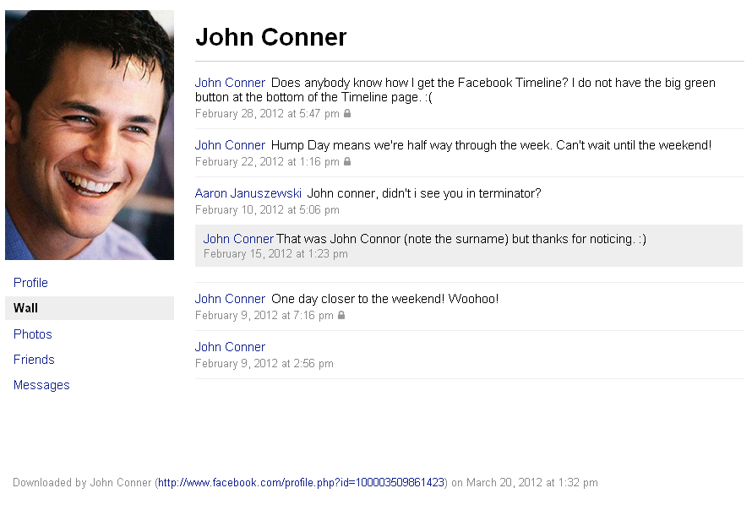
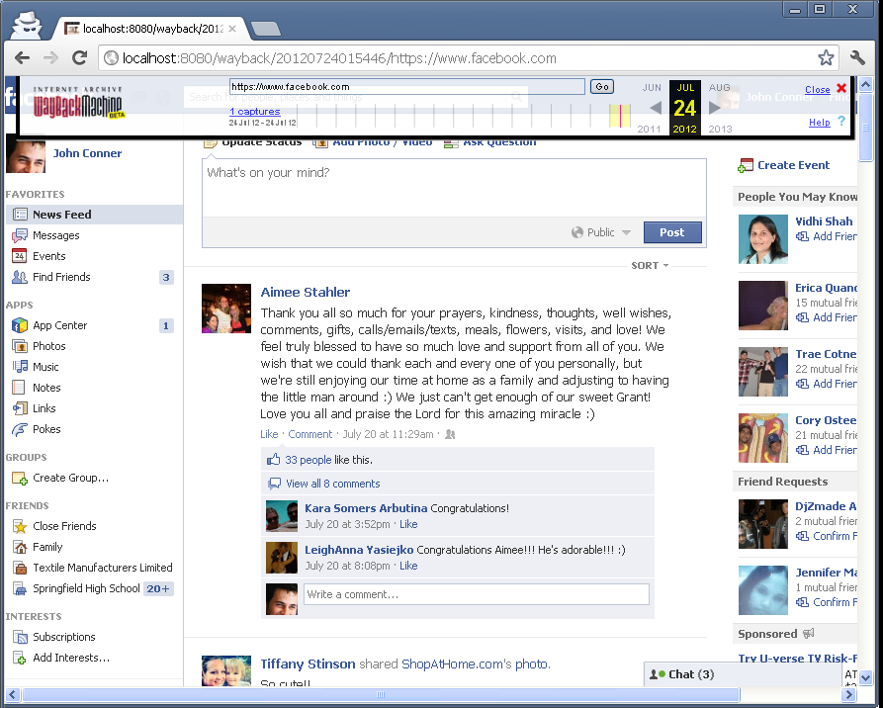
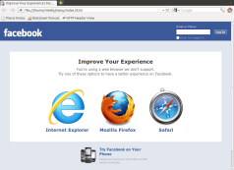
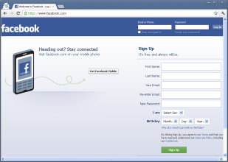
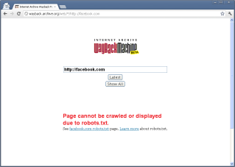
Preserving the Original Context Use Case: Capturing Facebook
Archive created from
WARCreate in Wayback
Facebook-Supplied Data Dump
Liberated Data Doesn’t Give The Whole Picture
November 12, 2013 Salt Lake City, Utah
2013 Archive-It Partner Meeting

Slide 13
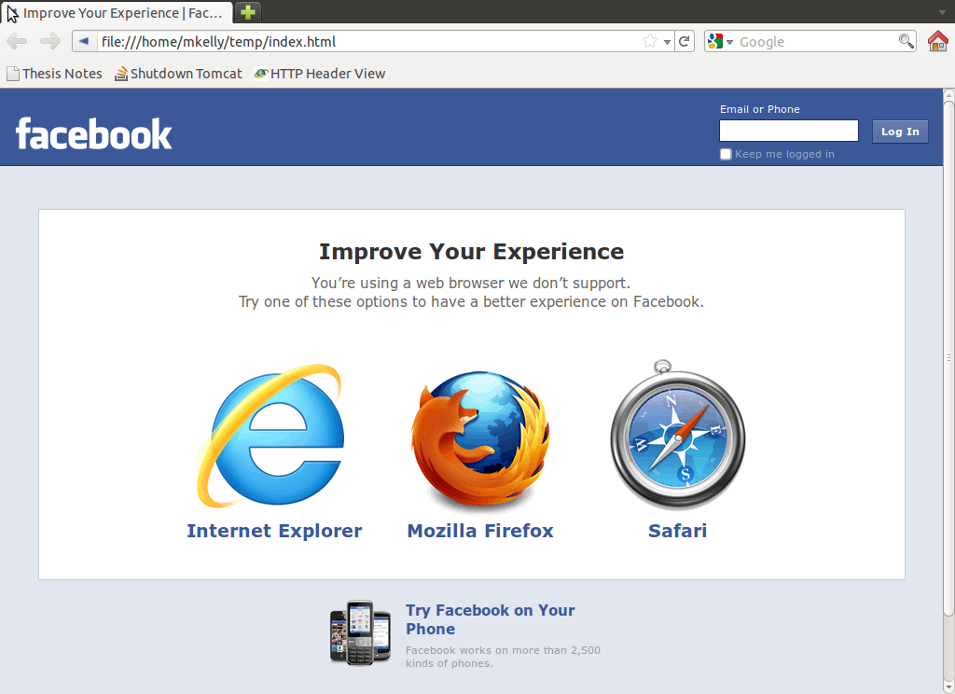
Preserving the Original Context Use Case: Capturing Facebook
Archive created from
WARCreate in Wayback
Using Scraping Tools (e.g. wget)
The Target Controls What is Allowed
November 12, 2013 Salt Lake City, Utah
2013 Archive-It Partner Meeting

Slide 14
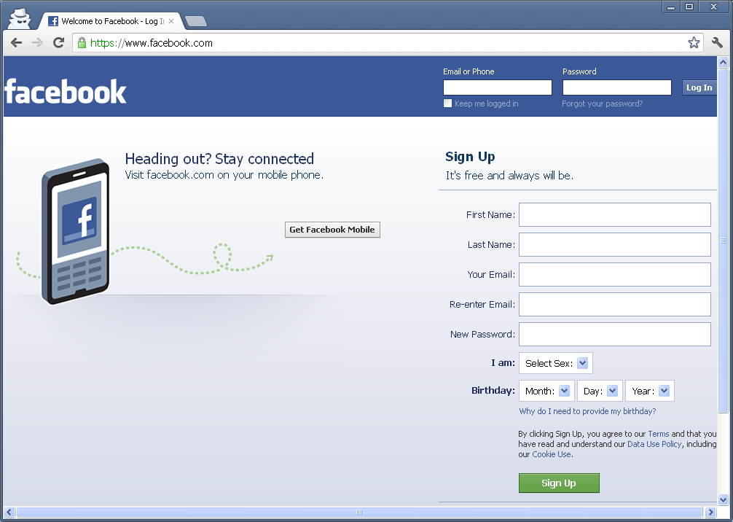
Preserving the Original Context Use Case: Capturing Facebook
Archive created from
WARCreate in Wayback
A Crawler Has No Context
No Credentials → No Entry → No Archiving
November 12, 2013 Salt Lake City, Utah
2013 Archive-It Partner Meeting

Slide 15
Preserving the Original Context Use Case: Capturing Facebook
Archive created from
WARCreate in Wayback
IA/HERITRIX OBEY ROBOTS
No Means No, if They Say and you Obey
November 12, 2013 Salt Lake City, Utah
2013 Archive-It Partner Meeting

Slide 16
So we built it!
WARCreate – Google Chrome extension
Create web archives from browser
Capture personalized content
Preserve on a whim
YAY!
Users Can Now Create WARC Files!
November 12, 2013 Salt Lake City, Utah
2013 Archive-It Partner Meeting

Slide 17
Users can now create WARCs!
WARCreate – Google Chrome extension
Create web archives from browser
Capture personalized content
Preserve on a whim
CAVEAT:
Users don’t know WHAT TO DO with WARC files
November 12, 2013 Salt Lake City, Utah
2013 Archive-It Partner Meeting

Slide 18

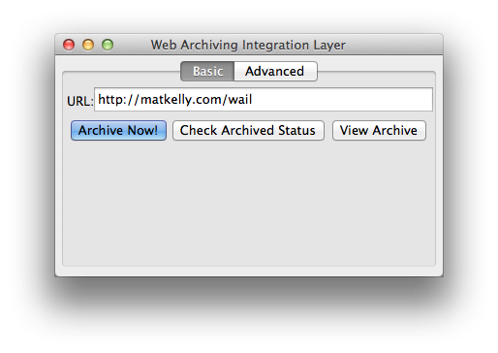


So, again, we built it!
Web Archiving Integration Layer (WAIL)
Heritrix, Wayback, etc. packaged for PC
GUI front-end allows “One-Click Preservation”
Provides means to replay WARCs
Mat Kelly, Michele C. Weigle, Michael Nelson. "Making Enterprise-Level Archive Tools Accessible for Personal Web Archiving," Personal Digital Archiving 2013, Poster Session; 2013 Feb 21; College Park, MD.
Mat Kelly, Michael Nelson and Michele C. Weigle. "WARCreate and WAIL: WARC, Wayback and Heritrix Made Easy," Digital Preservation 2013, Workshops and Sessions: Web Archiving; 2013 Jul 24; Alexandria, VA
November 12, 2013 Salt Lake City, Utah
2013 Archive-It Partner Meeting

Slide 19
So, again, we built it!
Users want to CREATE ARCHIVES of their content but store them at institutions (for safety)
Web Archiving Integration Layer (WAIL)
Heritrix, Wayback, etc. packaged for PC
GUI front-end allows “One-Click Preservation”
Provides means to replay WARCs
November 12, 2013 Salt Lake City, Utah
2013 Archive-It Partner Meeting

Slide 20
The Archive What I See Now Project
November 12, 2013 Salt Lake City, Utah
2013 Archive-It Partner Meeting

Slide 21




The Archive What I See Now Project: Three Goals
Port
Add functionality in: … to upload WARCs to:
Implement Sequential Archiving
&
&
November 12, 2013 Salt Lake City, Utah
2013 Archive-It Partner Meeting

Slide 22
Porting WARCreate to Firefox
Disjoint extension/add-on APIs
Little logic can be re-used
Problems with HTTP header capture in Chrome are trivial in Firefox
Chrome = highly asynchronous fetching
Code to save WARC to PC from browser reusable in Firefox
November 12, 2013 Salt Lake City, Utah
2013 Archive-It Partner Meeting

Slide 23
The Archive What I See Now Project: Three Goals
✓ In βeta now!
Port
Add functionality in: … to upload WARCs to:
Implement Sequential Archiving
&
&
November 12, 2013 Salt Lake City, Utah
2013 Archive-It Partner Meeting

Slide 24
The Archive What I See Now Project: Three Goals
Port
Add functionality in: … to upload WARCs to:
Implement Sequential Archiving
&
&
November 12, 2013 Salt Lake City, Utah
2013 Archive-It Partner Meeting

Slide 25
Uploading WARCs: An Open Question
Working with Archive-It to determine feasibility of user-provided WARCs
Consideration of data integrity
Should data be merged with A-IT crawled WARCs?
How do we account for your www.facebook.com vs. my www.facebook.com
Privacy?
November 12, 2013 Salt Lake City, Utah
2013 Archive-It Partner Meeting

Slide 26
The Archive What I See Now Project: Three Goals
Port
Add functionality in: … to upload WARCs to:
Implement Sequential Archiving
&
&
November 12, 2013 Salt Lake City, Utah
2013 Archive-It Partner Meeting

Slide 27




Sequential Archiving?
Similar to a focused crawl but URIs defined on per-site basis to be comprehensive
Akin to Archive Facebook but generalized
Implemented into WARCreate
Utilize per-site specification to keep tools from breaking★
personal stream | wall | posts | my tweets
global stream | news feed | streams | followees’ tweets
multimedia-photos | photos | photos | N/A
multimedia-videos | videos | videos | N/A
photo collection | albums | N/A | N/A
posts | notes | N/A | N/A
friends | friends | circles | following
Discovery & Scraping:
The Information Retrieval Approach
- versus -
The Digital Libraries Approach★
November 12, 2013 Salt Lake City, Utah
2013 Archive-It Partner Meeting

Slide 28
Online Hierarchy Definition
Only (and optionally) applied on recognized sites
scraping as fallback for establishing hierarchy
Not limited to social media
CNN.com, MSNBC.com, etc have similar hierarchies
Lives online, tools allude to and are always updated
Standardized spec* prototype is live online
* M. Kelly, An Extensible Framework for Creating Personal Archives of Web Resources Requiring Authentication, Aug 2012
November 12, 2013 Salt Lake City, Utah
2013 Archive-It Partner Meeting

Slide 29
Summary
Firefox WARCreate in Beta
Chrome WARCreate Users Can Currently Archive What They See Now with
Sequential Archiving Implemented in Chrome WARCreate, needs porting
Next Big Hurdle: Working with Archive-It in WARC upload logistics
&
November 12, 2013 Salt Lake City, Utah
2013 Archive-It Partner Meeting

Slide 30
Archive What I See Now
Download Our Archiving Tools!
Share Your Use Cases for Capturing the Unpreserved and the Unpreservable
Help Us Improve Our Tools, Give Feedback!
http://bit.ly/wc-wail
Web Archiving Integration Layer (WAIL)
http://matkelly.com/WAIL
One-Click Preservation
Heritrix, Wayback and Others On Your PC!
WARCreate for Chrome
http://WARCreate.com
Create WARC files form any web page from your browser
version in beta
Available Soon!
November 12, 2013 Salt Lake City, Utah
2013 Archive-It Partner Meeting

