Slide 1
Graph-Based Navigation of a Box Office Prediction System
Mat Kelly
Web Science and Digital Libraries Research Group
Old Dominion University mkelly@cs.odu.edu
Presented at: IEEE VIS 2013, 16 October 2013 & CS595, Intro to Web Science, 24 October 2013

Slide 2
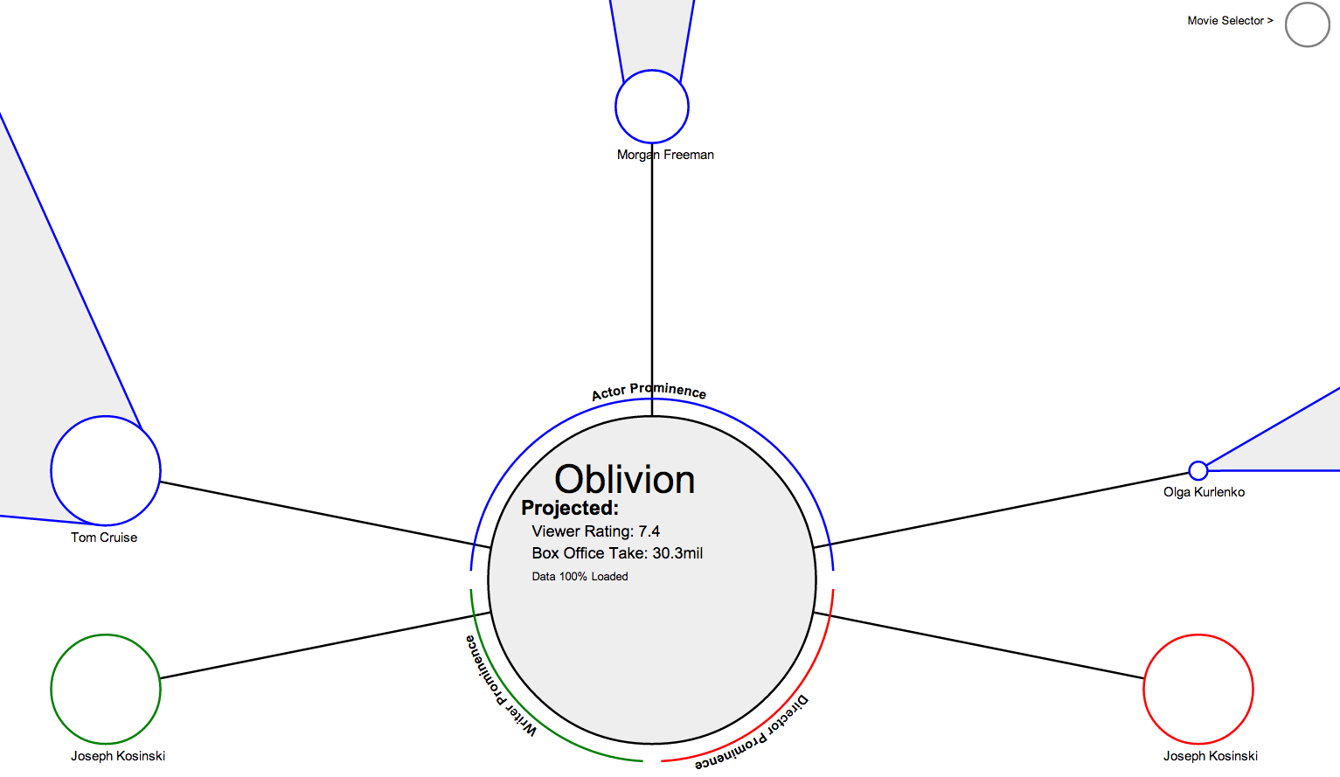
What?

Slide 3



Why?
VAST Challenge
Weigle’s Visual Analytics class (Spring ‘13)
Data: IDs, .list files
No other data sources allowed
Predict Box Office Rating and Take
src: bit.ly/movieExplorer
demo: bit.ly/ieeevis2013

Slide 4
How?
D3.js, JavaScript, Canvas/SVG, HTML5
API v. 1.1 (rate limited)
RegEx, object-ifying for data
src: bit.ly/movieExplorer
demo: bit.ly/ieeevis2013

Slide 5
How?
D3.js, JavaScript, Canvas/SVG, HTML5
API v. 1.1 (rate limited)
RegEx, object-ifying for data
OFFICIAL SRC
UNWEILDY!
sentiment classifier required
no initial causal relationship
BIG
dirty
incomplete
src: bit.ly/movieExplorer
demo: bit.ly/ieeevis2013

Slide 6
How Else?
Remove data set restriction (→ cannot VAST)
Targeted VIS conf instead
Utilize official/unofficial IMDB API
Only certain info available through official
Unofficial occasionally got C&D’d, went down
UNOFFICIAL
src: bit.ly/movieExplorer
demo: bit.ly/ieeevis2013

Slide 7
Brute Force
Scrape data at runtime
Sanitize data
Discarded irrelevant markup
Save id, entity name, other meta info
Cache data
Reference cache on subsequent runs
DISALLOWED
src: bit.ly/movieExplorer
demo: bit.ly/ieeevis2013

Slide 8
The Desired Data
MOVIE1
…
MOVIE2
MOVIE3
src: bit.ly/movieExplorer
demo: bit.ly/ieeevis2013

Slide 9
The Desired Data
MOVIE1
ACTOR1
…
ACTOR2
ACTOR3
WRITER
MOVIE2
DIRECTOR
MOVIE3
src: bit.ly/movieExplorer
demo: bit.ly/ieeevis2013

Slide 10
The Desired Data
MOVIE1
ACTOR1
MOVIE1,1
…
ACTOR2
MOVIE1,2
ACTOR3
WRITER
MOVIE1,3
MOVIE2
DIRECTOR
MOVIE3
src: bit.ly/movieExplorer
demo: bit.ly/ieeevis2013

Slide 11
The Desired Data
MOVIE1
ACTOR1
MOVIE1,1
…
ACTOR2
MOVIE1,2
ACTOR3
WRITER
MOVIE1,3
MOVIE2
DIRECTOR
MOVIE3
might be
src: bit.ly/movieExplorer
demo: bit.ly/ieeevis2013

Slide 12
The Desired Data
MOVIE1
ACTOR1
MOVIE1,1
ACTOR1
ETC
…
ACTOR2
ACTOR2
MOVIE1,2
ACTOR3
ACTOR3
WRITER
WRITER
MOVIE1,3
MOVIE2
DIRECTOR
DIRECTOR
MOVIE3
might be
src: bit.ly/movieExplorer
demo: bit.ly/ieeevis2013

Slide 13
Caveat! IMDB doesn’t like scraping
Use proxy to get over JS Same-Origin issues
Movie
Explorer
My proxy
script
HTTP GET
w/ params
cURL
src: bit.ly/movieExplorer
demo: bit.ly/ieeevis2013

Slide 14
Caveat! IMDB doesn’t like scraping
Use proxy to get over JS Same-Origin issues
Movie
Explorer
My proxy
script
HTTP GET
w/ params
cURL
Scrape
Sanitize
Cache
Return webpage
src: bit.ly/movieExplorer
demo: bit.ly/ieeevis2013

Slide 15
Caveat! IMDB doesn’t like scraping
Use proxy to get over JS Same-Origin issues
Movie
Explorer
My proxy
script
HTTP GET
w/ params
cURL
Scrape
Sanitize
Cache
Sanitized data
returned
Return webpage
src: bit.ly/movieExplorer
demo: bit.ly/ieeevis2013

Slide 16

So, D3.js?
-esque
Custom attrs keep nodes JS accessible
OOP abstraction used, converted to D3 nodes
var r = 50*prominences[a]/maxProminence;
var c = viz.svg.insert("circle")
.attr("stroke","blue")
.attr("stroke-width","2")
.attr("class", "node actor")
.attr("context", "movie")
.attr("id","actorCircle"+a)
.attr("fill","blue")
.attr("alt",names[a])
.attr("cx",viz.centralNode.mCircleX)
.attr("cy",viz.centralNode.mCircleY)
.attr("r",1)
.transition()
.duration(2000)
.attr("cx",pos[a][0])
.attr("cy",pos[a][1])
.attr("r", r)
.ease("elastic");
src: bit.ly/movieExplorer
demo: bit.ly/ieeevis2013

Slide 17
Object Model → D3
CONTEXT_ENTITY (CE)
Visualization
- movies : Movie[]
- actors : Actor[]
canvas : DOMCanvasElement
centralNode : CE
drawBasicLayout ()
setupCentralNode ()
setupNodeInteraction ()
+ switchContext : (newContextEntity : CE)
MOVIE
- id : String
- title : String
- actors : String[]
- writers : String[]
- directors : String{}
ACTOR
- name : String
- movies : String[]
- fetchActors (id : String)
+getMoviesInThreatres ()
- fetchMovies ()
+ setMovies (actorName: String)
src: bit.ly/movieExplorer
demo: bit.ly/ieeevis2013

Slide 18
Object Model → D3
CONTEXT_ENTITY (CE)
Visualization
- movies : Movie[]
- actors : Actor[]
canvas : DOMCanvasElement
centralNode : CE
drawBasicLayout ()
setupCentralNode ()
setupNodeInteraction ()
+ switchContext : (newContextEntity : CE)
MOVIE
- id : String
- title : String
- actors : String[]
- writers : String[]
- directors : String{}
ACTOR
- name : String
- movies : String[]
- fetchActors (id : String)
+getMoviesInThreatres ()
- fetchMovies ()
+ setMovies (actorName: String)
src: bit.ly/movieExplorer
demo: bit.ly/ieeevis2013

Slide 19
switchContext(newContextEntity:CE)
Converts JS Objects to nodes
Resolves references to obj attrs by IDs
Fires off D3 functions
Setup – hide old objects, remove from mem
Drawing – write SVG DOM elems to canvas
Interaction – hover/click FX, re-binding to switchContext() for new elements
src: bit.ly/movieExplorer
demo: bit.ly/ieeevis2013

Slide 20
Demo
http://machawk1.github.io/movieExplorer/
src: bit.ly/movieExplorer
demo: bit.ly/ieeevis2013

