Slide 1


WARCreate and WAIL: WARC, Wayback and Heritrix Made Easy
Mat Kelly, Michael L. Nelson, Michele C. Weigle
Old Dominion University {mkelly,mln,mweigle}@cs.odu.edu
Web Science and Digital Libraries Research Group
ws-dl.blogspot.com

Slide 2


The Problem Institutional Tools, Personal Archivists
ON YOUR MACHINE
Complex to Operate
Require Infrastructure
DELEGATED TO INSTITUTIONS
$$$
Lose original perspective
Locale content tailoring (DC vs. San Francisco)
Observation Medium (PC web browser vs. crawler)
July 24, 2013 Arlington, Virginia
Digital Preservation 2013
Notes:
First start with identifying problem:
Digital preservation tools are ill suited for use by individual digital archivists
Tools of focus, Htrix and Wayback, while FOSS, require technical know-how.
To remedy, individuals can delegate the task of digpres to institutions but this poses many more problems
One we have investigates are variances in perspective, as examplified by early crawls of Cragslist, which used GeoIP, and thus attached the saved content to the San Fran CL;
Variance in perpective relative to tool used, i.e., what crawler sees may not be the same as what we want preserved

Slide 3

The Normal Solution Ad Hoc Approaches
Variable Output
Deviate from standards (e.g., WARC)
Swell for Saving A Copy
Bad Practice for Preservation
Archive Facebook
July 24, 2013 Arlington, Virginia
Digital Preservation 2013

Slide 4


Better Solution
Adapt institutional tools & mediums
July 24, 2013 Arlington, Virginia
Digital Preservation 2013

Slide 5
MAKING THE TOOLS SUITABLE
July 24, 2013 Arlington, Virginia
Digital Preservation 2013

Slide 6
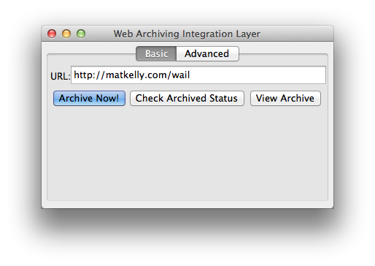
Web Archiving Integration Layer (WAIL)
Packages Wayback, Heritrix and other preservation tools into a GUI
Tools are pre-configured to work together
“One Click User-Instigated Preservation”
July 24, 2013 Arlington, Virginia
Digital Preservation 2013
Notes:
Create WAIL
Took institutional tools
Configured for relativity
Coded up GUI to interact with tools
Allow crawls to be initiated and interacted with via GUI
Made it easy: One Click User-Instigated Preservation

Slide 7
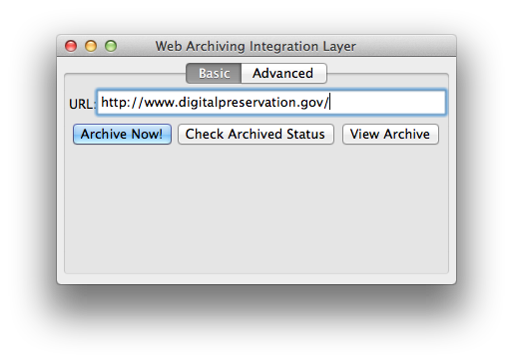
Working with WAIL (Simple)
Enter URL
Click button
Come back later
Hit VIEW ARCHIVE
July 24, 2013 Arlington, Virginia
Digital Preservation 2013
Notes:
Simple working for a one-off crawl:
Enter URL
Hit the Archive Now button
Check back later

Slide 8
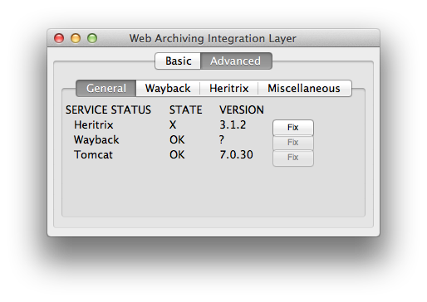
Working with WAIL (Custom)
Enter multiple seed URLs (Heritrix tab)
Customize Crawl Parameters
Observe crawl state
Get included tool info
Get meta info on crawls
July 24, 2013 Arlington, Virginia
Digital Preservation 2013
Notes:
Allow further capability like
services management
Custom crawl
Crawl status checking
All still GUI-based

Slide 9
And More?
Other preservation tools packaged
(e.g., Archive Team’s WARC-Proxy)
GUI is extensible to facilitate further integration of other tools
Currently working to package UKWA’s WARC-Explorer, ODU/LANL’s mcurl, UKWA’s monitrix, a custom memento proxy, etc.
July 24, 2013 Arlington, Virginia
Digital Preservation 2013

Slide 10
PRESERVING IN THE ORIGINAL CONTEXT
July 24, 2013 Arlington, Virginia
Digital Preservation 2013

Slide 11

WARCreate Create WARC files from any webpage
extension
Preserves what you see instead of what crawler sees
Capture pages behind authentication
Manipulate then preserve
No more preservation delegation
Created WARCs compatible with WAIL and Wayback instance
July 24, 2013 Arlington, Virginia
Digital Preservation 2013

Slide 12
Ad hoc to Generally Applicable
App Type
Browser (Firefox) | Browser (Chrome)
Output
Navigable Webpages | Web ARCive (WARC) files
Target
Facebook.com | Any website
Archive Facebook
WARCreate
July 24, 2013 Arlington, Virginia
Digital Preservation 2013

Slide 13
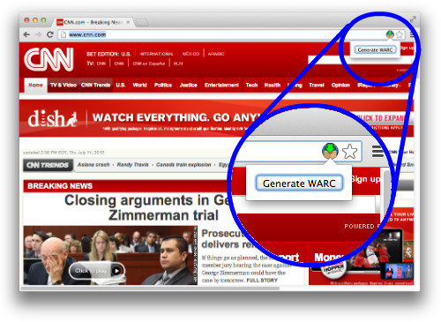
Working with WARCreate
Browse as usual
Preserve on a whim
WARC output to your Downloads folder
July 24, 2013 Arlington, Virginia
Digital Preservation 2013

Slide 14
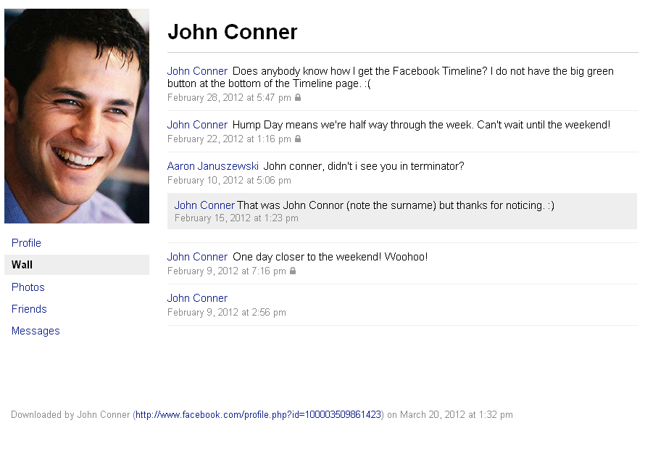
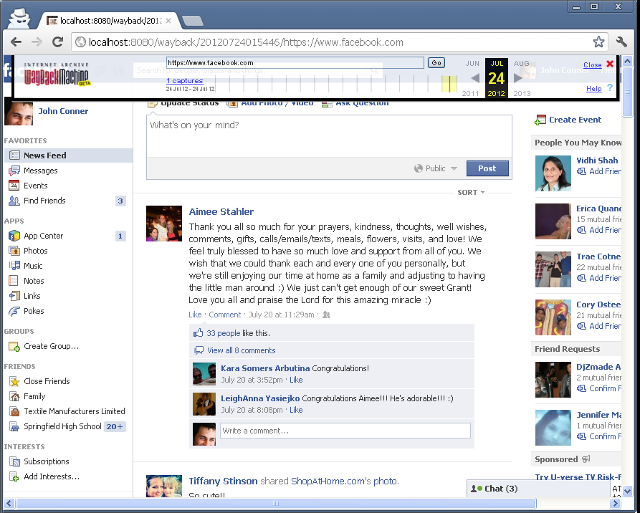
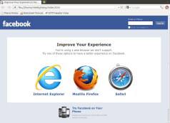
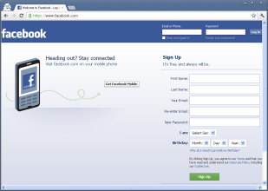
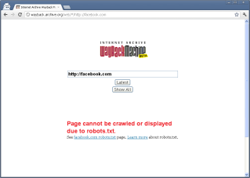
Preserving the Original Context
Archive created from
WARCreate in Wayback
Facebook-Supplied Data Dump
July 24, 2013 Arlington, Virginia
Digital Preservation 2013

Slide 15
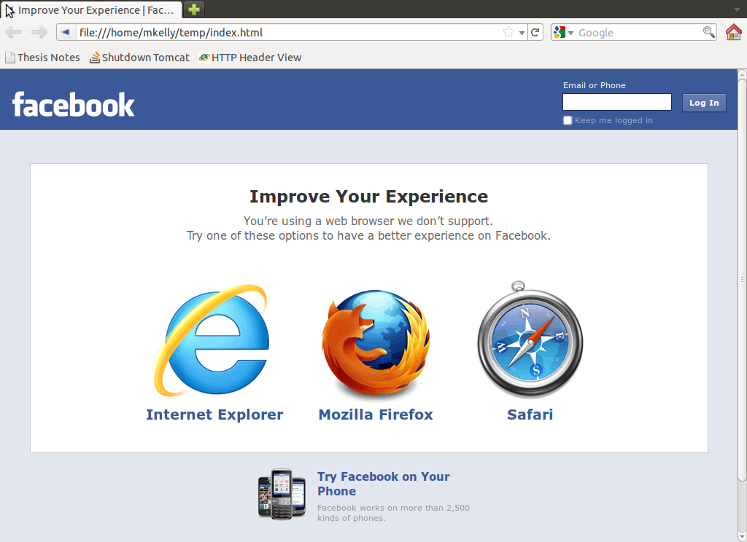
Preserving the Original Context
Archive created from
WARCreate in Wayback
Using Scraping Tools (e.g. wget)
July 24, 2013 Arlington, Virginia
Digital Preservation 2013

Slide 16
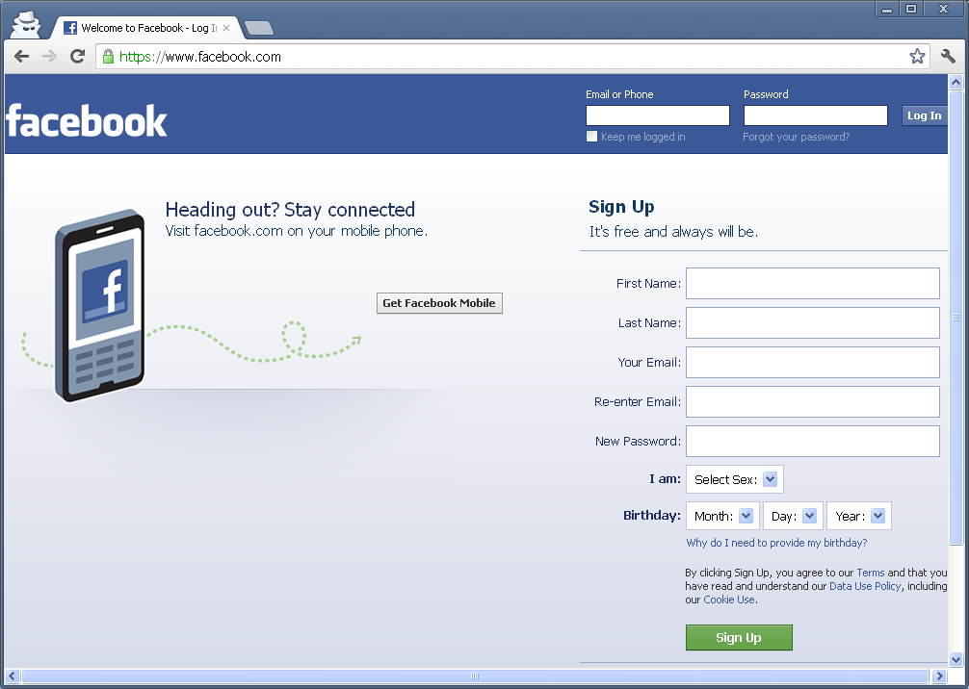
Preserving the Original Context
Archive created from
WARCreate in Wayback
A Crawler Has No Context
July 24, 2013 Arlington, Virginia
Digital Preservation 2013

Slide 17
Preserving the Original Context
Archive created from
WARCreate in Wayback
IA/HERITRIX OBEY ROBOTS
July 24, 2013 Arlington, Virginia
Digital Preservation 2013

Slide 18
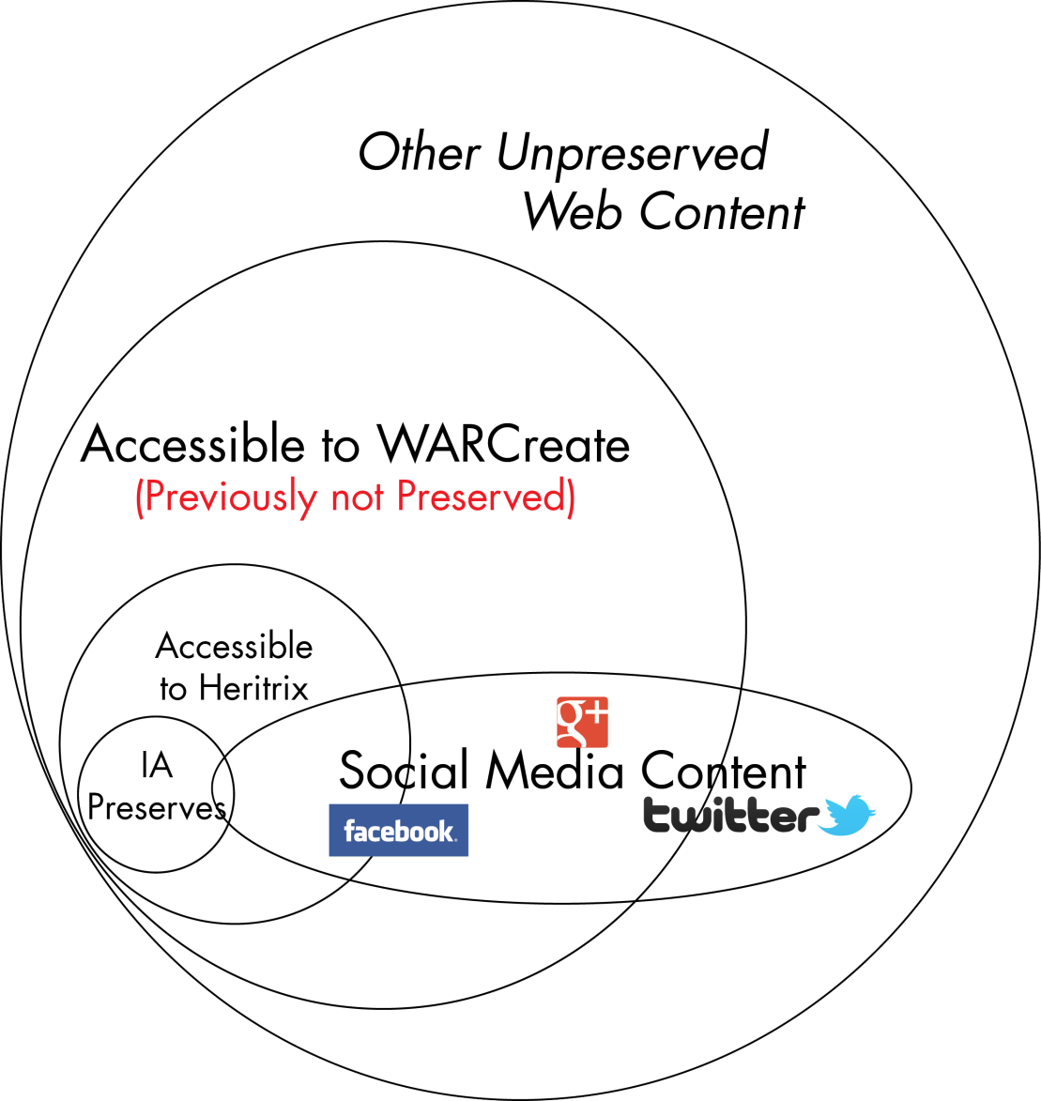
Preserving Beyond the Surface Web
July 24, 2013 Arlington, Virginia
Digital Preservation 2013

Slide 19
Creating a WARC of Your Twitter Feed (Behind Authentication)
July 24, 2013 Arlington, Virginia
Digital Preservation 2013

Slide 20
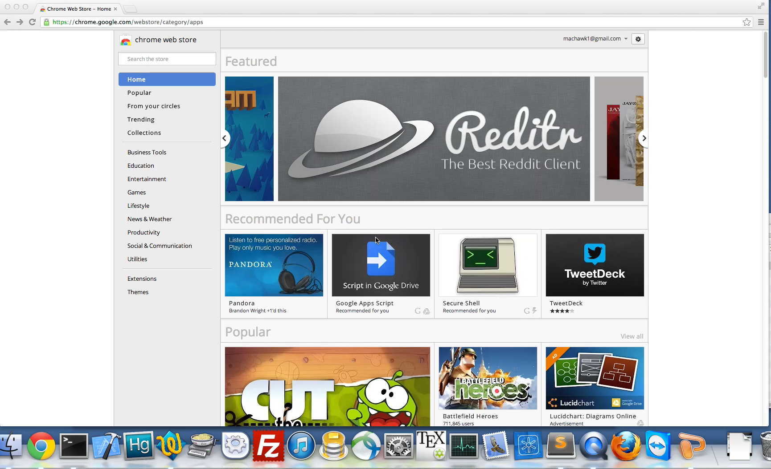
Preserving Twitter Feeds

Slide 21
Tools’ History
June 2012 WARCreate presented at Joint Conference on Digital Libraries (JCDL) ’12
* required XAMPP, “local server”
July 2012 WARCreate presented at Digital Preservation 2012
* NDSA/NDIIPP award for Future Steward
February 2013 WARCreate decoupled from XAMPP, WAIL created, presented at Personal Digital Archiving 2013
May 2013 NEH grant begins to “Archive What I See Now”, port of WARCreate to Firefox & Much More
July 2013 WARCreate re-finalized, 1.0 released, presented at Digital Preservation 2013
July 24, 2013 Arlington, Virginia
Digital Preservation 2013

Slide 22
Filling a Need
Capable tools prevent ad hoc archiving
Keep it familiar
WARCreate as Chrome extension
Or keep it native
WAIL has respective OS look-and-feel
Good Archiving practices only begin with content capture, much to do
July 24, 2013 Arlington, Virginia
Digital Preservation 2013

Slide 23





Available Now!
WARCreate
WARCreate.com
available for:
SOON
Web Archiving Integration Layer (WAIL)
matkelly.com/wail
available for:
SOON
bit.ly/digpres2013

