Slide 1
Assessing the Quality of Web Archives
Michael L. Nelson
Scott G. Ainsworth, Justin F. Brunelle,
Mat Kelly, Hany SalahEldeen,
Michele C. Weigle
Old Dominion University
Web Science & Digital Libraries Research Group
ws-dl.cs.odu.edu
@WebSciDL

Slide 2
The State of Web Archiving
"Hooray! It's in the archive!"
vs.
"How well was it archived?"
current:
future:

Slide 3
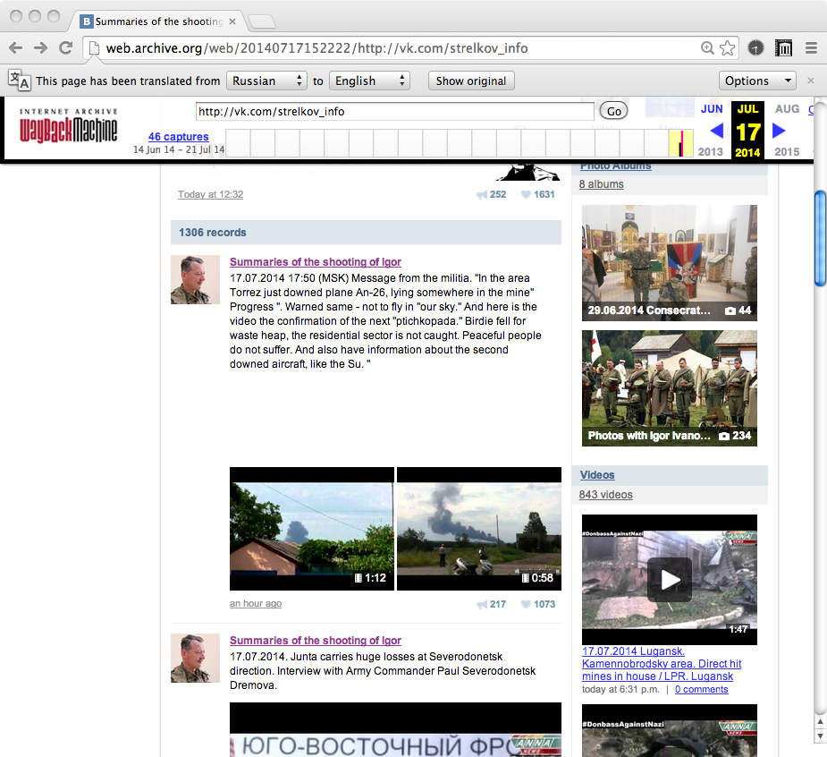
http://web.archive.org/web/20140717152222/http://vk.com/strelkov_info
http://www.csmonitor.com/World/Europe/2014/0717/Web-evidence-points-to-pro-Russia-rebels-in-downing-of-MH17-video

Slide 4
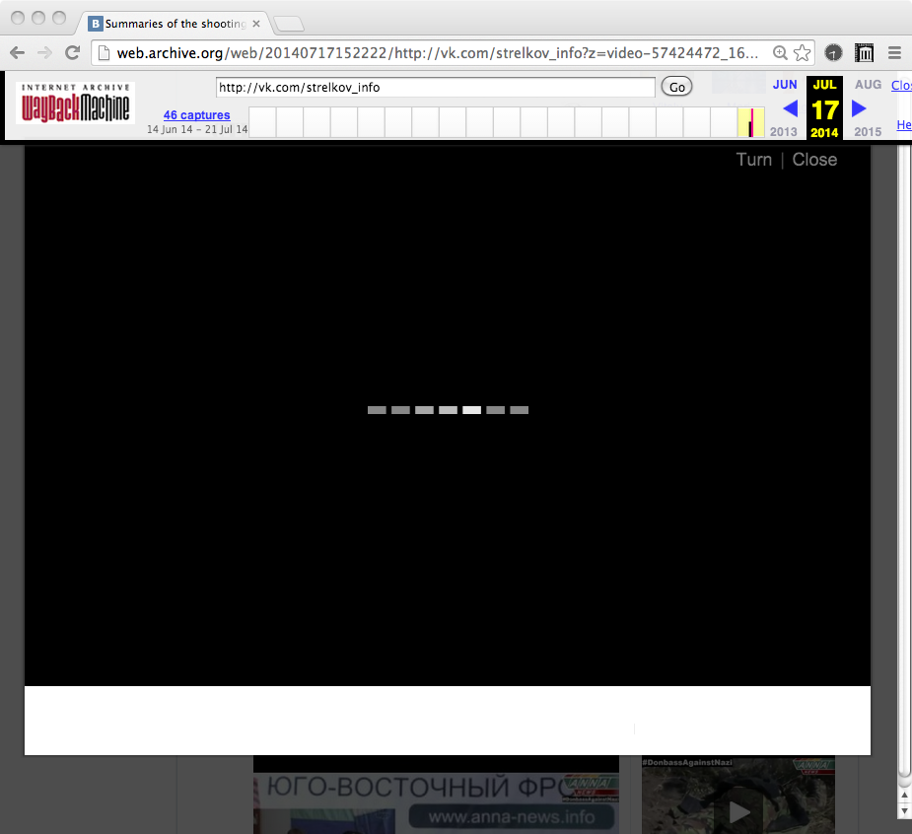
http://web.archive.org/web/20140717152222/http://vk.com/strelkov_info
http://www.csmonitor.com/World/Europe/2014/0717/Web-evidence-points-to-pro-Russia-rebels-in-downing-of-MH17-video

Slide 5
Three Ways We're
Assessing Quality
Weighting the "importance" of missing embedded resources
  "damage" measure for comparing archived pages
Detecting "temporal violations"
  some rendered pages never existed
Defining an archival tool benchmark
  "Archive Acid Test"

Slide 6
Not All Mementos Are Created Equal:
Measuring The Impact Of Missing Resources
JCDL 2014
http://www.cs.odu.edu/~mln/pubs/jcdl-2014/jcdl-2014-brunelle-damage.pdf

Slide 7
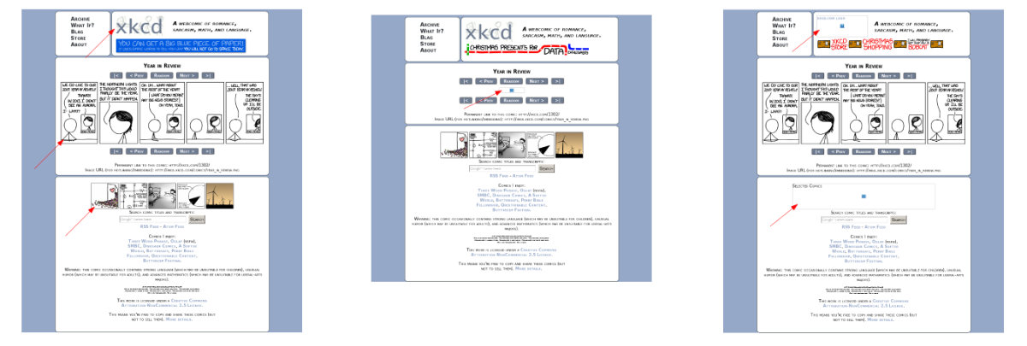
Synthetic Damage:
Removing Images From xkcd.com
M = 0.17
D = 0.09
(live web)
M = 0.24
D = 0.41
(missing main)
M = 0.29
D = 0.36
(missing logo + navigation)
damage (D) differs from % missing (M)!

Slide 8

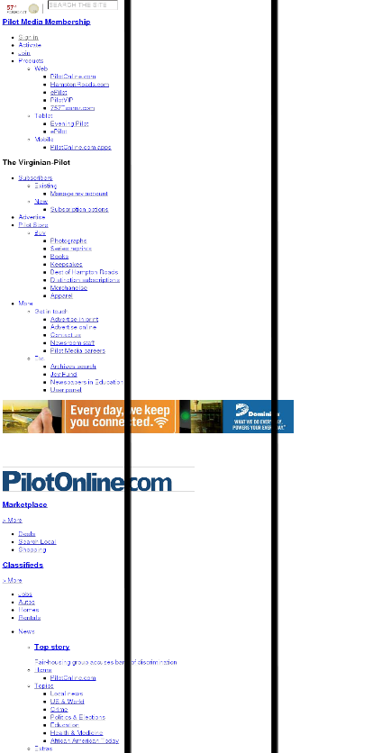
Was missing
resource
important?
<img>and
<embed>
can leave hints
about size and
centrality.
For CSS, we
look at the
distribution of
background
color in page
divided into
vertical thirds.
33%
26%
29%
84%
15%
1%

Slide 9
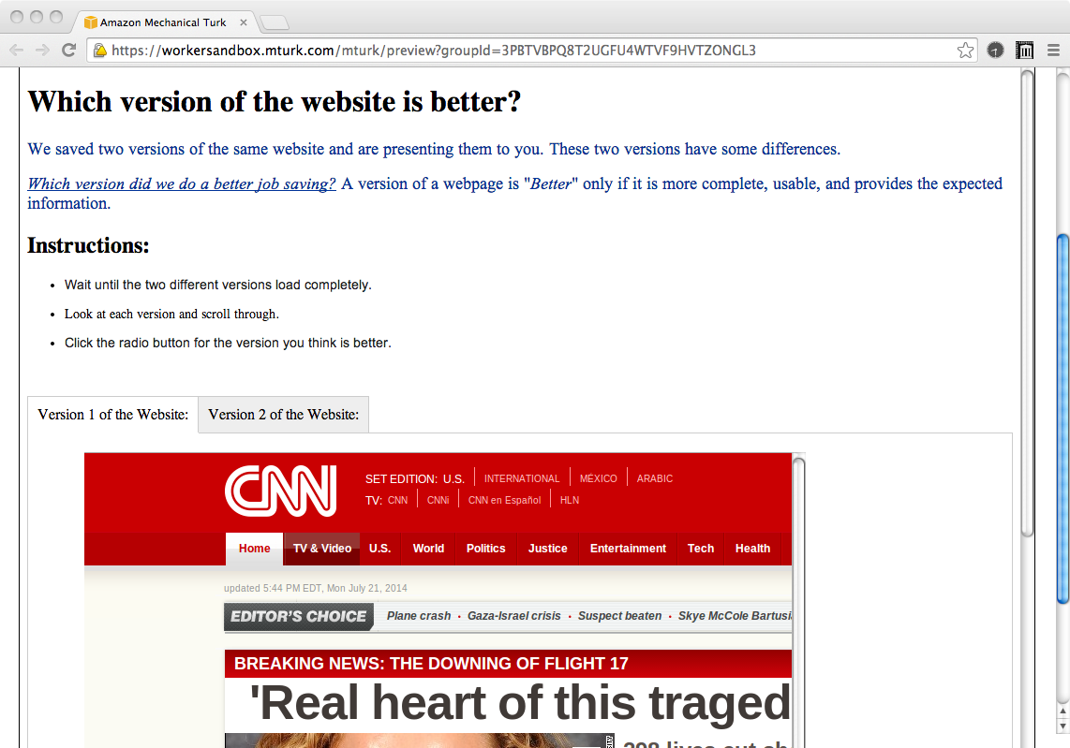
Weights from Turker Assessment of Damage
first: establish that Turkers
can determine damaged vs.
undamaged pages (81% of the time)
second: find weights that match
Turker's rankings of (real) differently
damaged versions of the same page

Slide 10
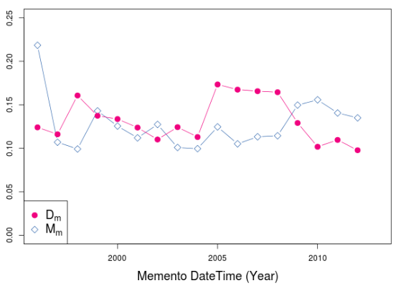
Good News:
Although M is steady/increasing, D is decreasing

Slide 11
A Framework for Evaluation of
Composite Memento Temporal Coherence
(in preparation)
http://arxiv.org/abs/1402.0928

Slide 12
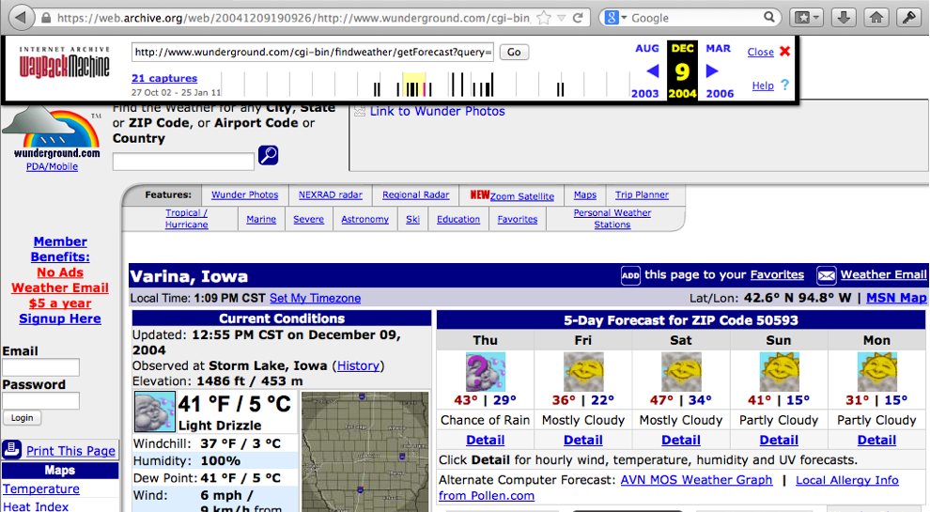
As Presented by IA
http://web.archive.org/web/20041209190926/http://www.wunderground.org/cgi-bin/findWeather/getForecast?query=50593 (now 404, but that's a different story…)
Notes:
A memento a presented by the Internet Archive.

Slide 13
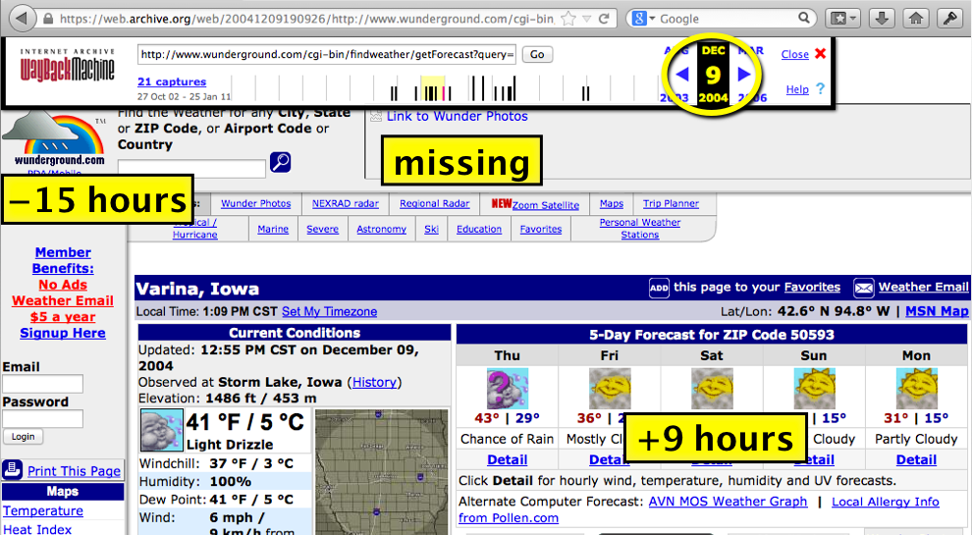
Not Everything Is 200412091900926
+ 9 months
http://web.archive.org/web/20041209190926/http://www.wunderground.org/cgi-bin/findWeather/getForecast?query=50593 (now 404, but that's a different story…)

Slide 14
Consider:
<html>
<img src="foo.jpeg">
</html>
jpeg
jpeg
html
jpeg
change
change
change
change

Slide 15
Correct Archival Rendering
jpeg
jpeg
html
jpeg
change
change
change
change

Slide 16
But Archives Miss Updates…
jpeg
jpeg
html
jpeg
change
missed
change
change
change

Slide 17
You Can Choose the Closest
(closest is the current policy of most archives)
jpeg
jpeg
html
jpeg
change
missed
change
change
change

Slide 18
You Can Choose the Past
jpeg
jpeg
html
jpeg
change
missed
change
change
change

Slide 19
Or You Can "Bracket" the HTML
(when possible, brackets can be made via HTTP metadata or content comparison)
?
jpeg
jpeg
html
jpeg
change
missed
change
change
change
In this case, there is no right answer.
Either choice will result in a temporal violation.

Slide 20
Completeness vs. Coherence
Description | Closest Single Archive | Closest Multi-Archive | Bracket Single Archive | Bracket Multi-Archive
Completeness
Mean complete | 76.1% | 80.2% | 76.2% | 80.3%
Mean missing | 23.9% | 19.8% | 23.8% | 19.7%
Temporal Coherence
Mean prima facie coherent | 41.0% | 40.9% | 54.7% | 54.6%
Mean possibly coherent | 27.3% | 27.3% | 12.8% | 14.2%
Mean probably violative | 2.5% | 5.3% | 2.5% | 5.3%
Mean prima facie violative | 5.3% | 5.3% | 6.2% | 6.2%
At least 5% of pages can be shown to be temporal violations
Notes:
mindist = minimum distance = closest
bracket = closest, but choose bracket if available

Slide 21
The Archival Acid Test:
Evaluating Archive Performance on
Advanced HTML and JavaScript
JCDL 2014
http://ws-dl.blogspot.com/2014/07/2014-07-14-archival-acid-test.html
http://acid.matkelly.com/

Slide 22
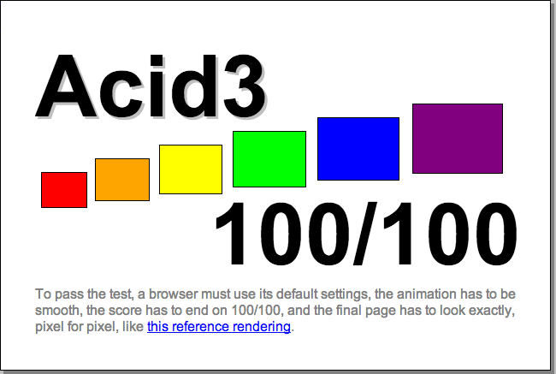

Inspired by the
Acid3 Test for Browsers
http://acid3.acidtests.org/
http://en.wikipedia.org/wiki/Acid3

Slide 23








The Archival Acid Test
Archiving Tools
Heritrix
GNU Wget
WARCreate
Archives

Slide 24
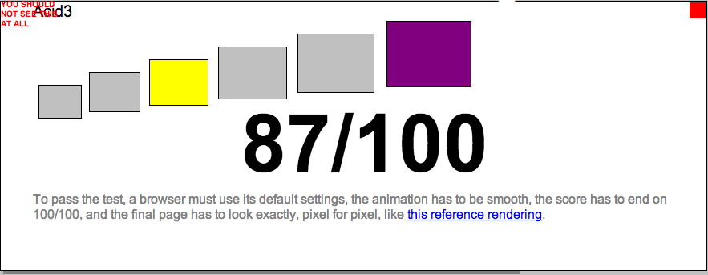
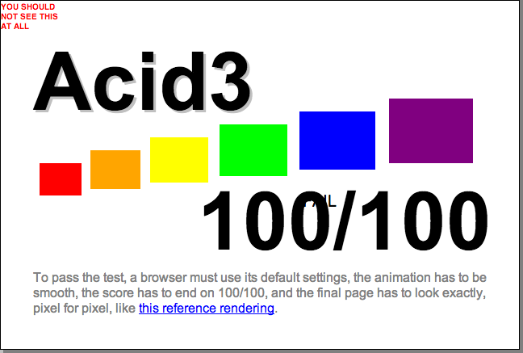
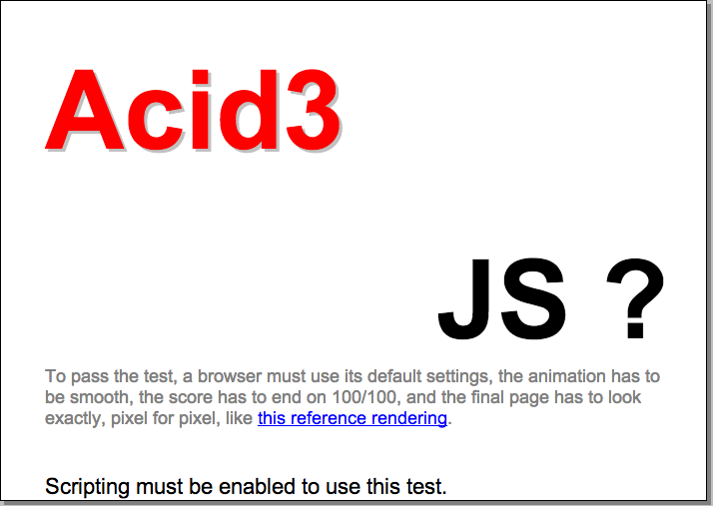
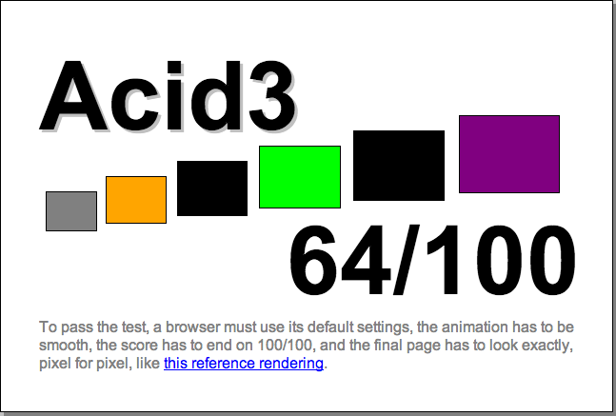
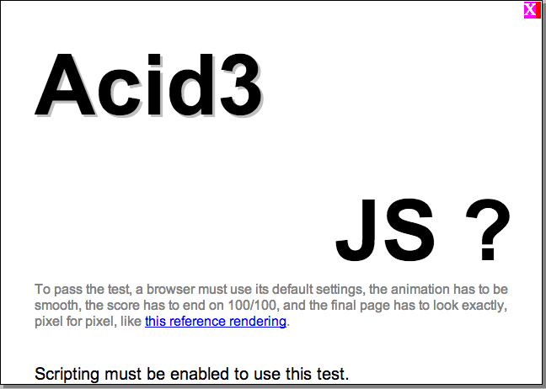
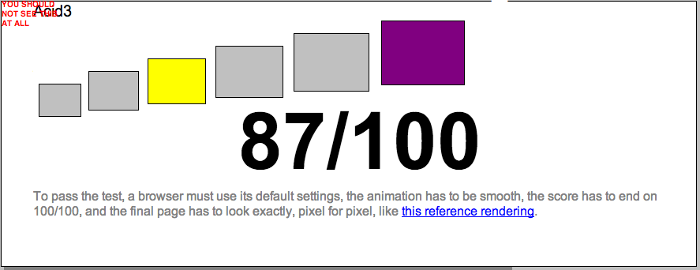
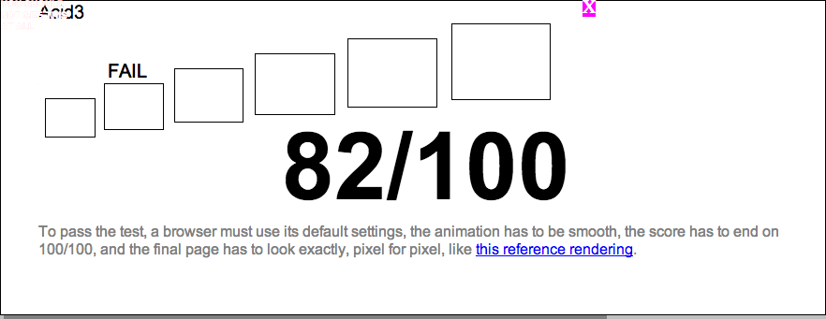
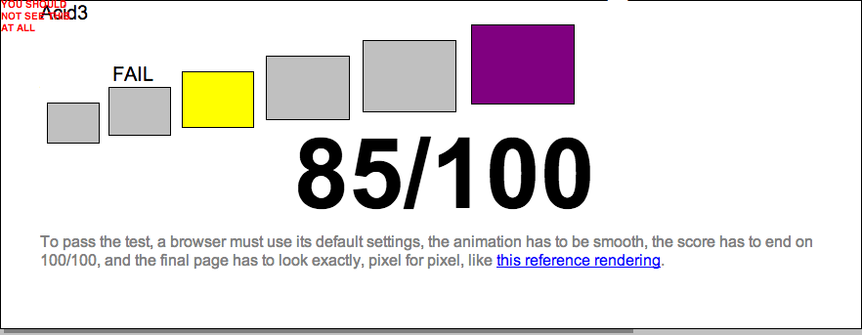
Archival Tools & Sites on Acid3

Slide 25
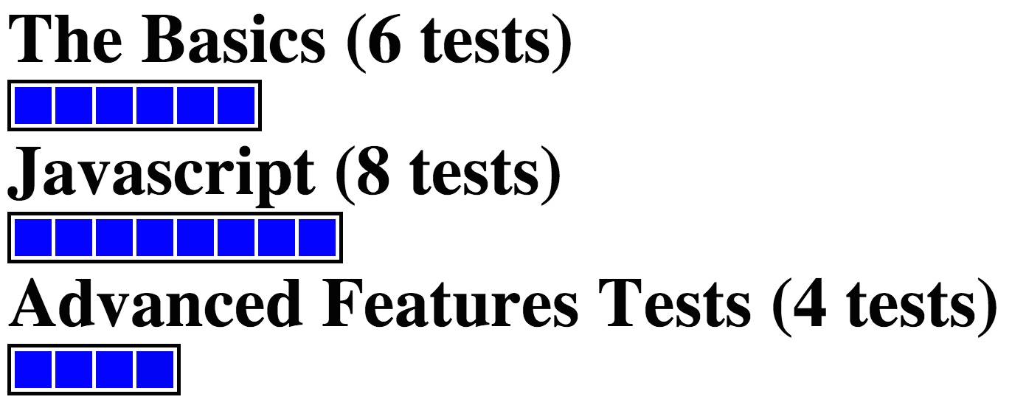
Archival Acid Tests

Slide 26
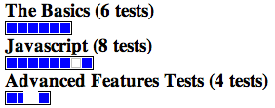
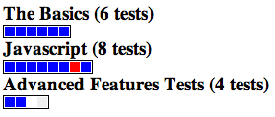
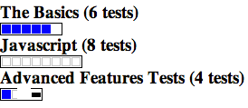
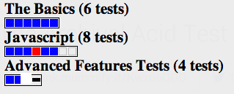
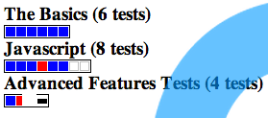
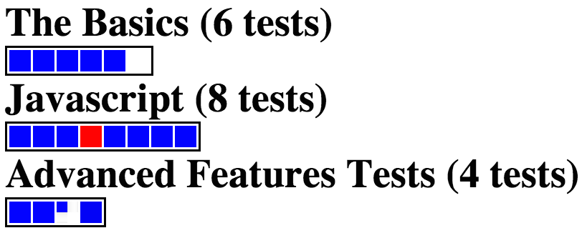
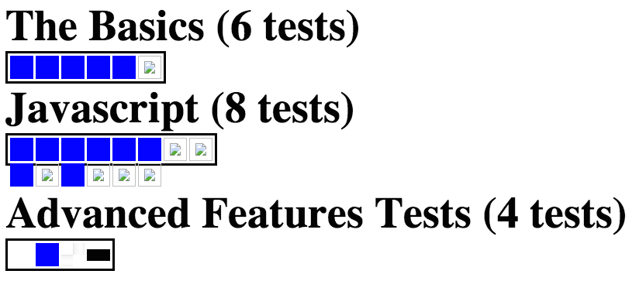
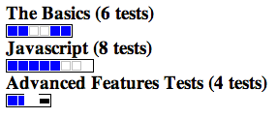
Archival Tools & Sites on AAT
(mummify.it died
in early 2014)

Slide 27
Future of Web Archiving:
Increasing Quantitative Analysis
Measure "damage" instead of completeness of archived pages
  enables large-scale comparison of archives
Even if an embedded resource is present, it doesn't mean it's right
  ~5% of archived pages have temporal violations
To improve the quality of the archives, we need to be able to benchmark archival tools
  Archival Acid Test is an easy to use benchmark

