Slide 1
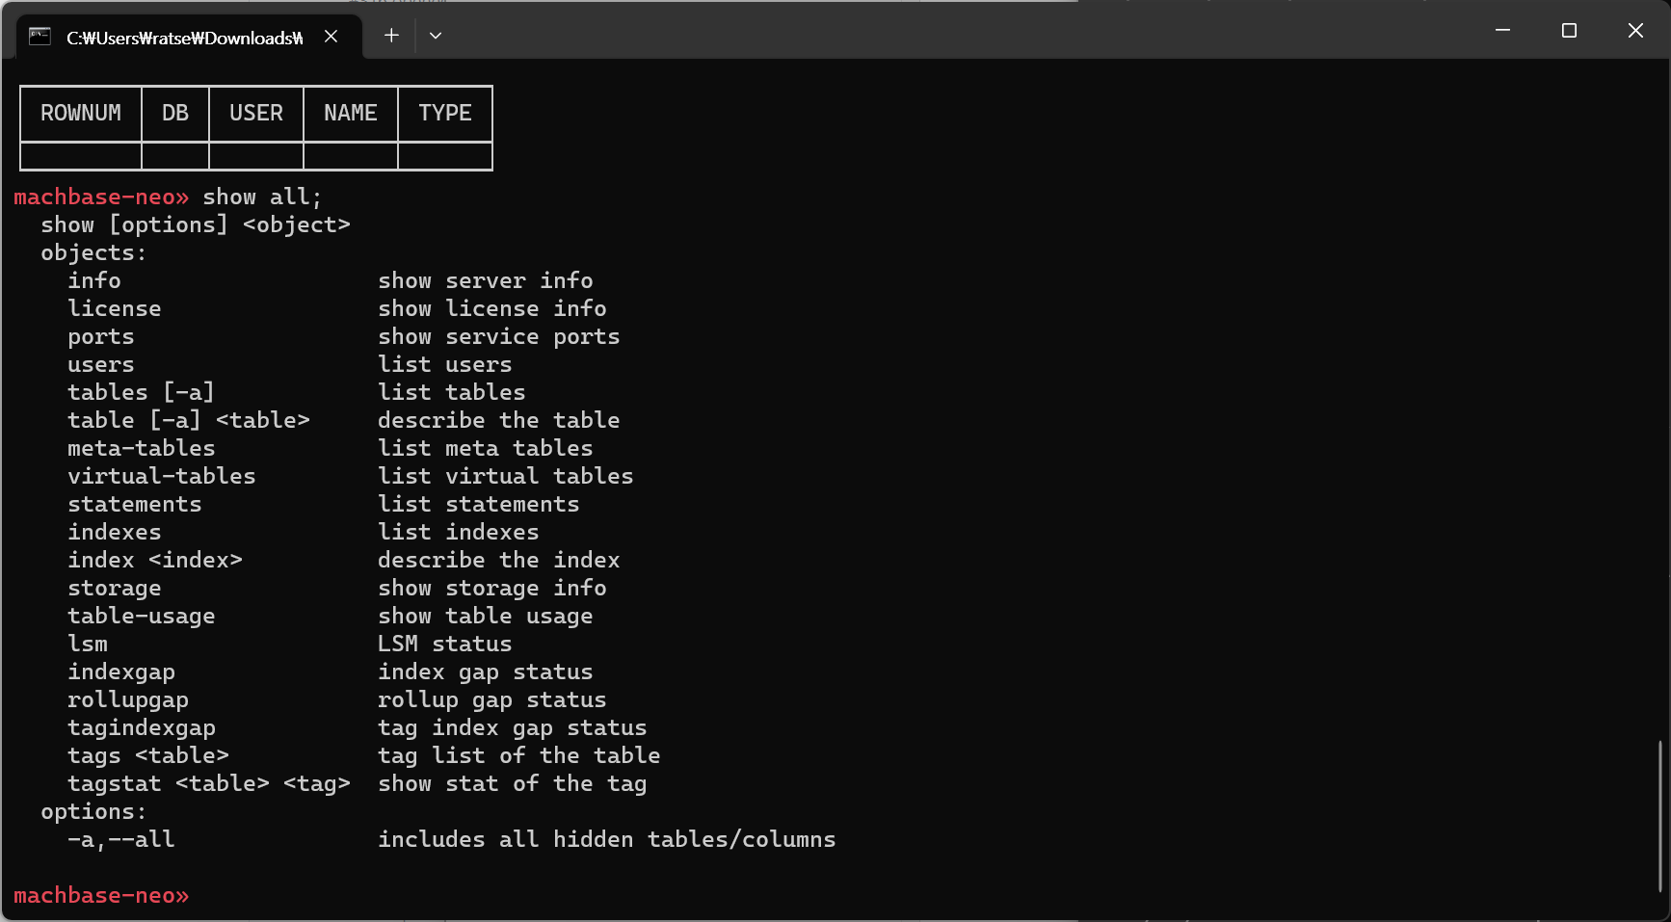
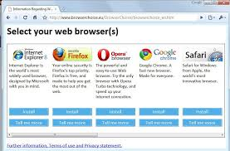
SSH
terminal
Machbase
gRPC Apps
Neo Edition
SSH
(5652)
gRPC
(5655)
InfluxDB
Line-Protocol
Apps
SSH
Server
gRPC
Server
Machbase
Native Apps (ODBC,CLI,C#,JDBC)
HTTP
(5654)
HTTP
Server
Machbase
DBMS
Engine
Machbase
Rest API
Apps
MACH
(5656)
Machbase
Native
Console Tools
Browser
MQTT
Server
MQTT
(5653)
MACH
(5656)
MQTT
Publisher
MQTT
Publisher

Slide 2
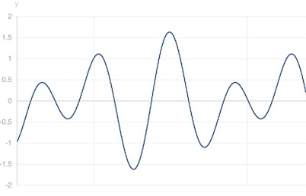
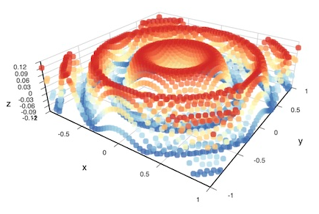
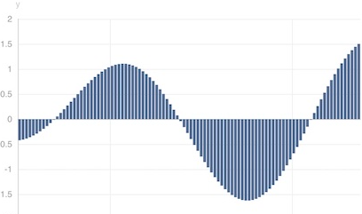
data
MQTT (KAFKA) (NATS)
MQ Server
data
Rest API Apps
data
data
MACH
BASE
Timer
Text
Rows
HTTP
Server
Subscriber
Sqlite
MySQL
MSSQL
PostgreSQL
(Oracle)
data
SQL()
QUERY()
STRING()
BYTES()
FAKE()
SOURCE
RDBMS
SQL()
CSV
file
CSV()
TQL
(Transforming
Query Language)
SOURCE Function (input)
MAP Function (take, drop, script …)
SINK Function (output)
http://host/db/tql/trans.tql?XYZ
MAP
CHART_LINE()
CHART_BAR()
CHART_SCATTER()
CHART_LINE3D()
CHART_BAR3D()
CHART_SCATTER3D()
INSERT()
Sqlite
MySQL
MSSQL
PostgreSQL
(Oracle)
RDBMS
INSERT()
APPEND()
SCRIPT()
CSV()
JSON()
MACH
(5656)
MARKDOWN()
SINK
MACH
BASE
HTML
CHARTs
MQTT Server
CSV
JSON
MARK
DOWN

