Slide 1
FASHIONISTA
Team Members:
Mạch Chí Tài
Thanh Tài
Lee Young Hyun
Date:
Version:
June 18th
1.0

Slide 2
Table of contents
1/ Vision and Scope
Background
Team Structures
Outline Plan
2/ System requirement
Use cases list
FR & NFR
3/ System Architecture :
SA & ERD
Activity Diagram
4/ Test cases:
Features to be tested

Slide 3
Background & Problems
Project’s background :
FASHIONISTA is a company in HCMC excel in selling clothes to our customer.
Present version provides basic functions ( login/ log out, register, etc..) along with ordering products from website.
Future version provides three news features :
Captcha
Advanced Search
Reset passwords via email

Slide 4
Project Team Structure
Project Manager
Secretary
Front-end Dev
Back-end Dev
Notes:
Draw project team structure here, including all the key roles for the project.

Slide 5
Outline Plan
Sep
Dec
Nov
Initial Release
Complete base functions
Subsequent Release
Improve base functions
Create new functions
Test existing functions
Subsequent Release 2
Fully implemented and tested all function
Management Reporting
Notes:
This slide should contain an outline plan, indicating the timescales for the key phases of the project.

Slide 6
Use cases list
Add to cart
View Products Detail
View Buying History
Remove From Cart
Create New Category
Delete Category
Edit Category
Register
Login
Edit Account Information
Delete Account
Search Account
Add new Product
Edit Product Information
Remove Product
Search Product
Edit Order
Delete Order
Advanced Search
Reset Password
Displaying Captcha
Notes:
What are the objectives of the project?
The Project Objectives section specifies the product’s objectives, showing how the project’s final aim will be achieved by a series of measurable components.

Slide 7
Funtional Requirements
No. | Name
FR – 1 | System sends an email for users to input new password.
FR – 2 | User input a non-existent username.
FR – 3 | Advance product search
FR – 4 | Enter Captcha at Login
Notes:
What are the objectives of the project?
The Project Objectives section specifies the product’s objectives, showing how the project’s final aim will be achieved by a series of measurable components.

Slide 8
Non - Funtional Requirements
No. | Name
NF – 1 | System sends an email for users to input new password.
NF – 2 | User input a non-existent username.
Notes:
What are the objectives of the project?
The Project Objectives section specifies the product’s objectives, showing how the project’s final aim will be achieved by a series of measurable components.

Slide 9
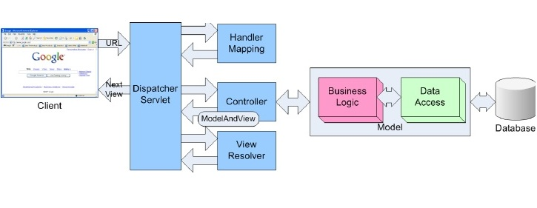
System Architecture
Notes:
What is the intended solution?
This slide should provide a high-level outline of the solution, either as a high-level architecture or a conceptual diagram showing the scope of the solution. Alternatively, if wireframes or visuals have already been done, this section could be a few slides to show how the intended solution will look.

Slide 10
ERD
Notes:
What is the intended solution?
This slide should provide a high-level outline of the solution, either as a high-level architecture or a conceptual diagram showing the scope of the solution. Alternatively, if wireframes or visuals have already been done, this section could be a few slides to show how the intended solution will look.

Slide 11
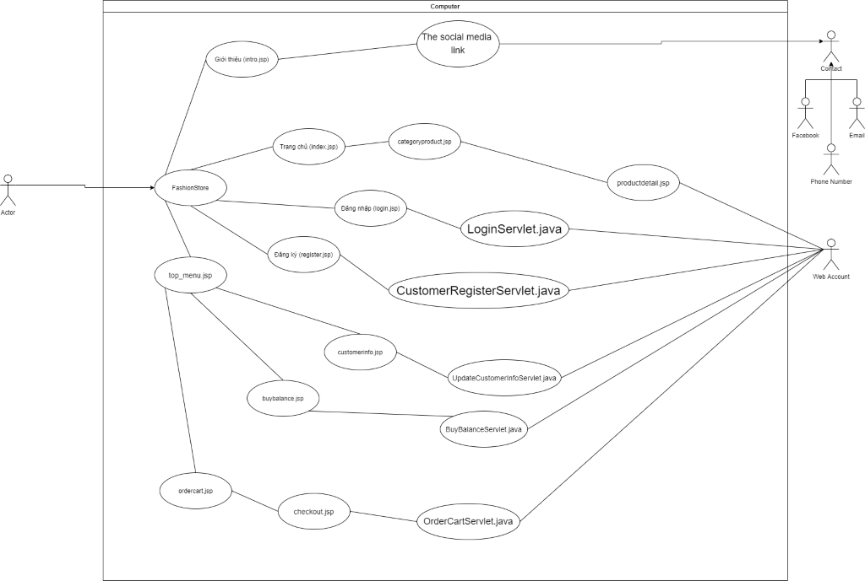
Use Case Diagram

Slide 12
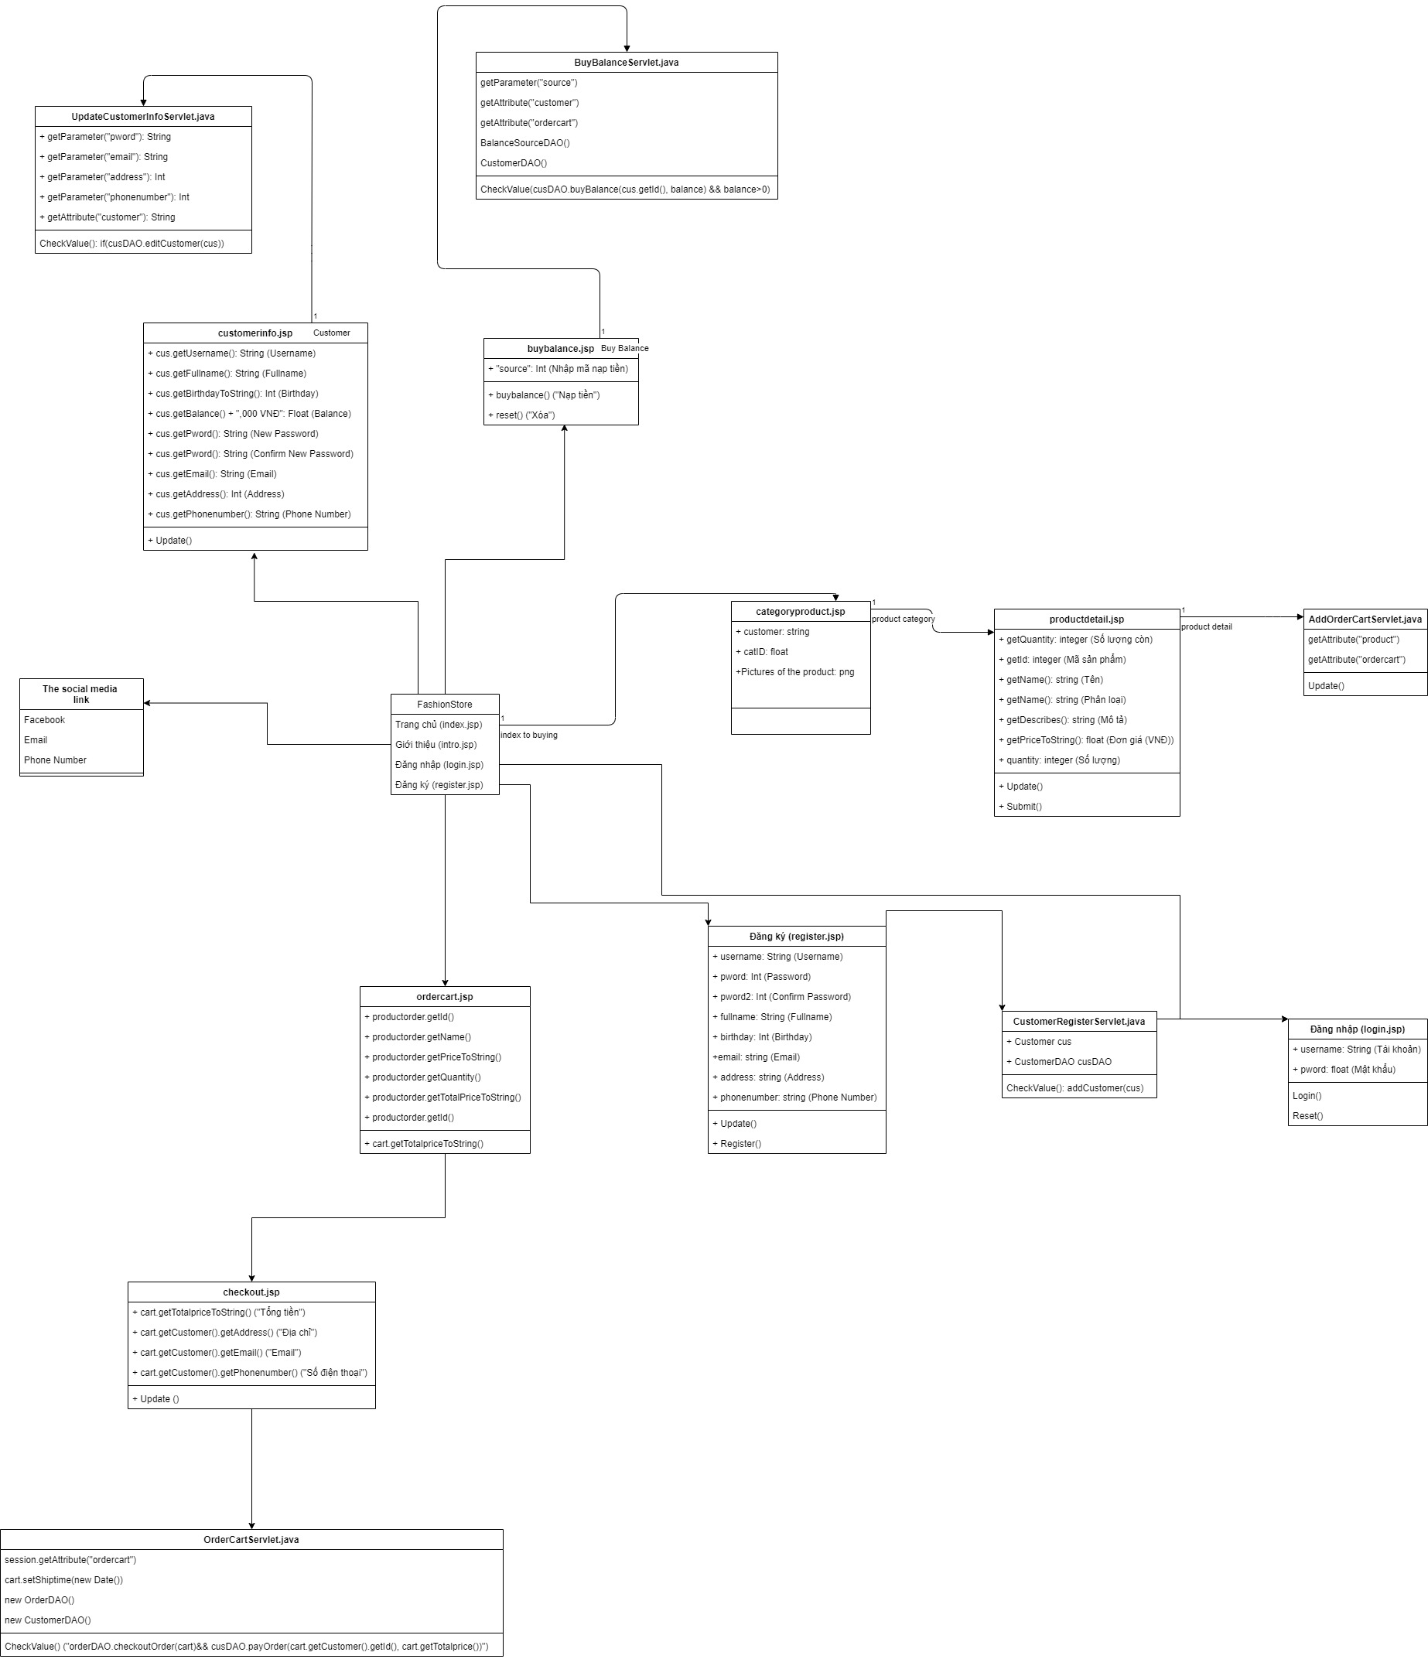
Class Diagram

Slide 13
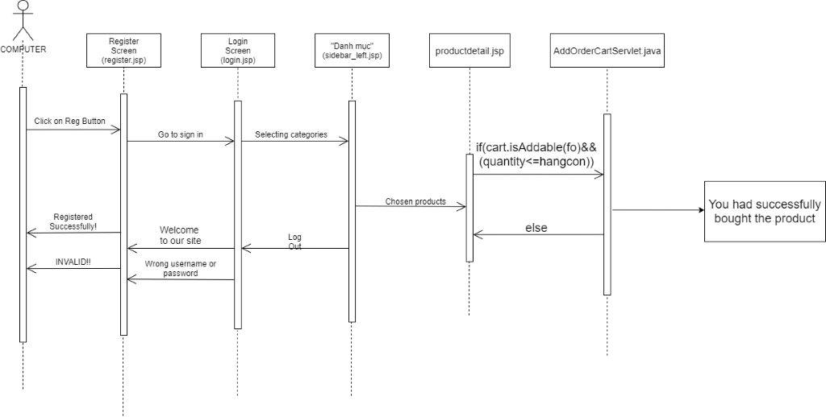
Sequence Diagram

Slide 14
Feature to be tested
Advanced search
Login captcha protection
Reset password via email

Slide 15
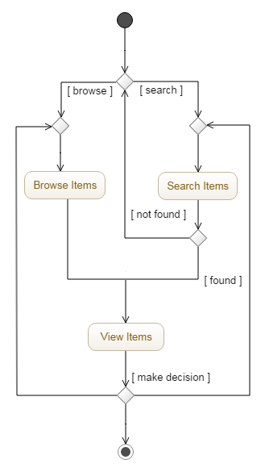
Advanced Search

Slide 16
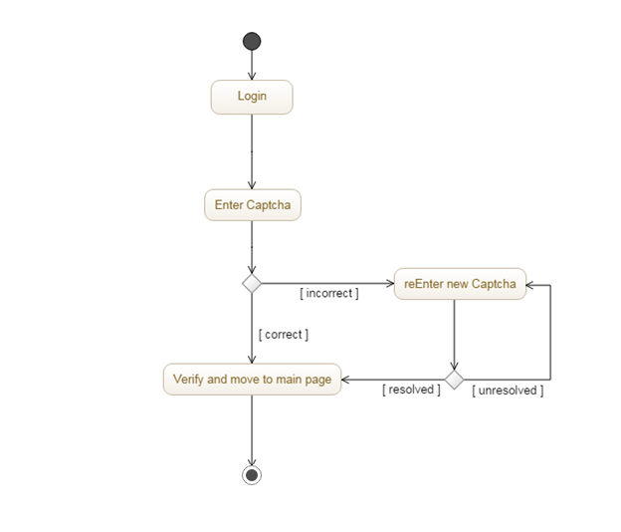
Enter Captcha

Slide 17
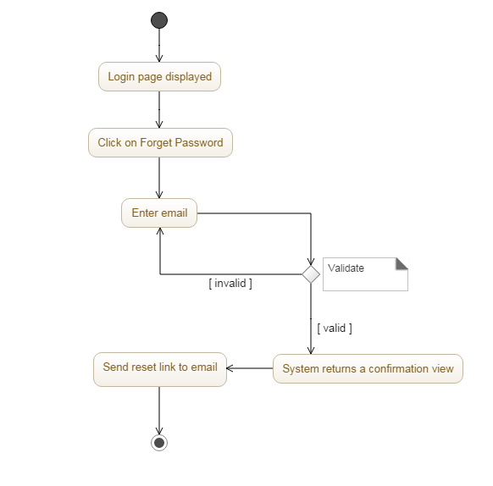
Reset Passwords Via Email

Slide 18
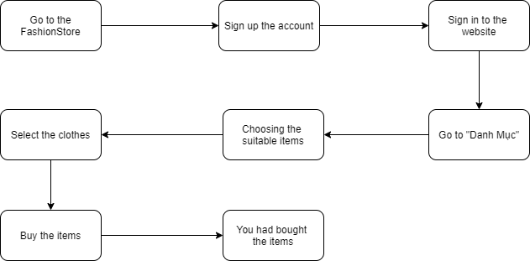
System implementation

Slide 19
Implementation Environment
Netbean
Tomcat Server
Google reCaptcha
MVC
Github
Google Drive
Teamworks
MySQL Workbench – XAMPP

Slide 20
Challenges
Impact
Changing team member
Wrong Analysis
Hardware Problems
3. High
Fail to deliver task on time
2. Medium
1. Low
Browsers Compatibility
Probability
1. Low
2. Medium
3. High
Notes:
Assess probability and impact of key project risks.
Explain mitigation and contingency if appropriate, and response if risk becomes reality

Slide 21
Experiences
Develop soft skills :
Teamwork
Meeting
Make plan
Improve programming language knowledge
Develop management skills :
Time management
Team management
Notes:
Assess probability and impact of key project risks.
Explain mitigation and contingency if appropriate, and response if risk becomes reality

Slide 22
DEMO
Notes:
Summarise Costs, Benefits and Timescales.

