Slide 1
Python Template
Hello John

Slide 2
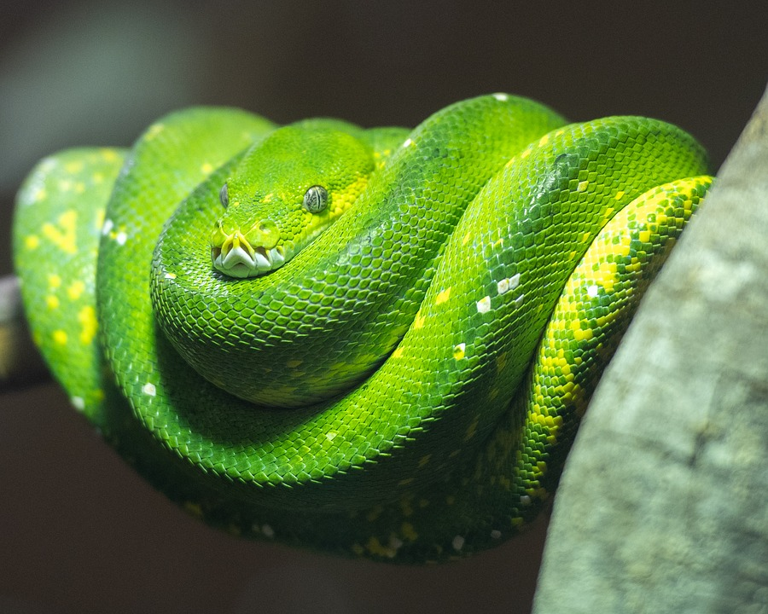


How many snake? 3 snakes

Slide 3
Method
step 1: analysis
step 1: design
step 1: production
step 1: test

Slide 4
Table
Name | Size
张三 | 10
李四 | 1000
王五 | 2000

