Slide 1

Architecture

Slide 2
Architecture overview
Angular is a platform and framework for building client applications in HTML and Typescript. Angular is written in Typescript. It is basically build on architectural design pattern name Model View Controller. Angular architecture consists of following five building blocks.
Module
An angular module declares a compilation context for a set of components that is dedicated to an application domain, a workflow, or a closely related set of capabilities.
Component
Component defines a class that contains application data and logic which is associated with an HTML template that defines a view to be displayed in a target environment.
Template
It’s a HTML part of angular web application, templates represent view that defines how data is displayed to user, how user interacts with application.
Directive
Directive is part of HTML, it defines custom html elements/attributes for template, which determines how a template is rendered in browser and how this view will interacts with its controller.
Service
Service is set of code which is not associated with the logic of view, while it’s may act as a utility class which is responsible for providing data, providing some specific logic related to application business.
Routing
Routing service of an in angular router module responsible for switching from one view to another on base of URL.

Slide 3
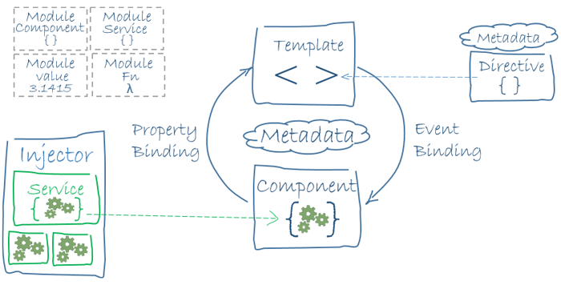
Architecture overview
Following diagram shows how these blocks of angular (except routing) interacts with each other to run an run web app.

Slide 4
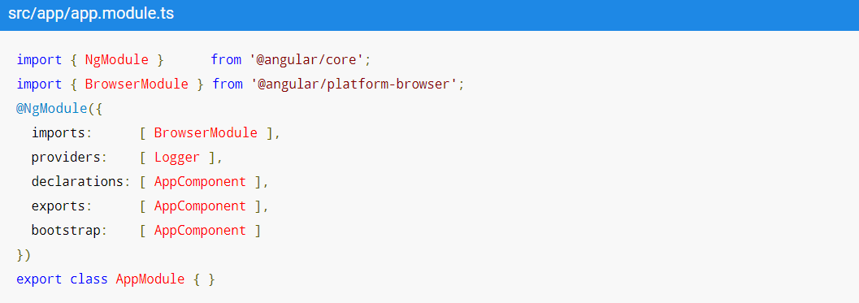
Angular Module
Angular apps are modular and Angular has its own modularity system called NgModules. NgModules are containers for a cohesive block of code dedicated to an application domain, a workflow, or a closely related set of capabilities. They can contain components, service providers, and other code files whose scope is defined by the containing NgModule. They can import functionality that is exported from other NgModules, and export selected functionality for use by other NgModules.
Declarations (components, directives, pipes)
Exports (components, directives, pipes, modules)
Imports (modules)
Providers (services)
Boostrap (root-component)

Slide 5
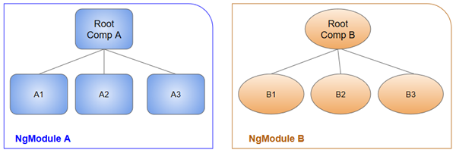
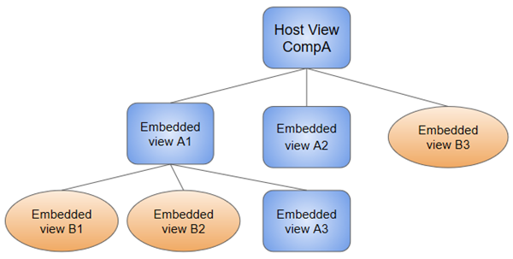
Angular Module
Angular Modules with Components
Components Reusability and View Hierarchy

Slide 6
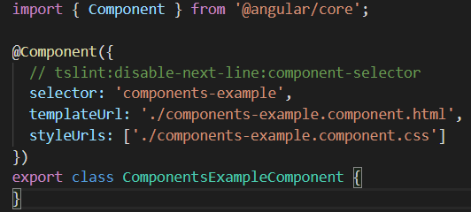
Angular Component
A component controls a patch of screen called view, You define a component’s application logic, what it does to support the view inside a class, it is somehow a control part of MVC pattern, while template is a View part and Data/Event which is passed between Template and Component you may say it as Model. @Component is decorator which is written right above component class, in the decorator metadata is provided which tells angular framework that this class is component and in metadata necessary information is provided. Most important fields of metadata to declare a component are
selector (name of component as html tag element)
templateUrl (path of template html file connected to component)
styleUrls (array of paths of style sheets connected to template)
As component is controller which control the rendering of data in HTML, data rendering is controlled with help of Databinding

Slide 7
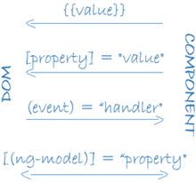
Data Binding
Communication between component class and View is possible with Data Binding, with data binding component tells view what to render and view tells component what user demands. There are four type of data bindings
Data Interpolation (controller → view)
Property Binding (controller → view)
Event Binding (view → controller)
Two way Data Binding (controller ←→ view)

Slide 8
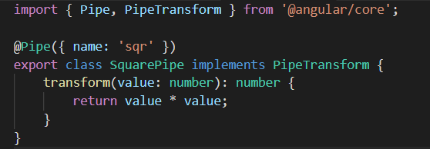

Pipes
Angular pipes let you declare display-value transformations in your template HTML. A class with the @Pipe decorator defines a function that transforms input values to output values for display in a view.
Operator: ( | ) pipe sign
Usage: {{ interpolated_value | pipe_name }}
Square root pipe, a pipe which transfer any number to its square root.
Usage age
It is also declared in module in Declarations field to make it useable in angular.

Slide 9
Directives
Angular templates are dynamic. When Angular renders them, it transforms the DOM according to the instructions given by directives. A directive is a class with a @Directive decorator. A component is technically a directive, as @Component decorator extends @Directive decorator, In addition to Components there are two types of directives
Structural Directive
Structural directives alter layout by adding, removing, and replacing elements in the DOM. The example template uses two built-in structural directives to add application logic to how the view is rendered.
*ngIf
*ngFor
Attribute Directive
Attribute directives alter the appearance or behavior of an existing element. In templates they look like regular HTML attributes, hence the name.
[ ] property binding
{{ }} interpolcation directive
[(ngModel)]
[ngClass]

Slide 10
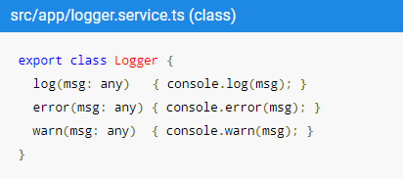

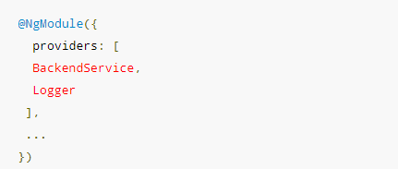
Angular Service
Service is a broad category encompassing any value, function, or feature that an app needs. A service is typically a class with a narrow, well-defined purpose. It should do something specific and do it well. Main difference between angular components is that components are there to handle user experience with UI, while service act as utility, logger, data provider. For example
Services are used by components, directives, pipes to perform some specific tasks which is not related to User experience but other type of backend business logic. Services are not created by you, These are created by angular built-in mechanism of Dependency Injection. Services are decorated with @Injectable decorator as it tells angular these services can be created by angular to make them available to angular component. Services are provided in angular module in array type field Providers as

Slide 11

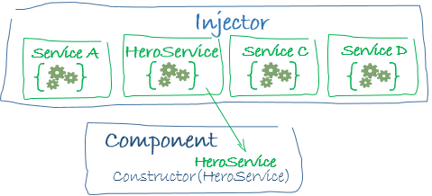
Dependency Injection
Angular Framework has built in dependency injection. In application developer doesn’t create instance of components, pipes, directives usually it is responsibility of angular framework. These types of directives usually depends on services, config values, DI provides it to them on creation.
Injector
Angular creates application wide injector during bootstrap, Developer doesn’t have to create injector. An injector create dependencies, and maintains a DI container for dependency instances. Always use decorator
Provider
Provider is a an object in angular which tells Injector how to create a specific dependency. To fulfil a dependency you must have to register dependencies in providers.

