Slide 1
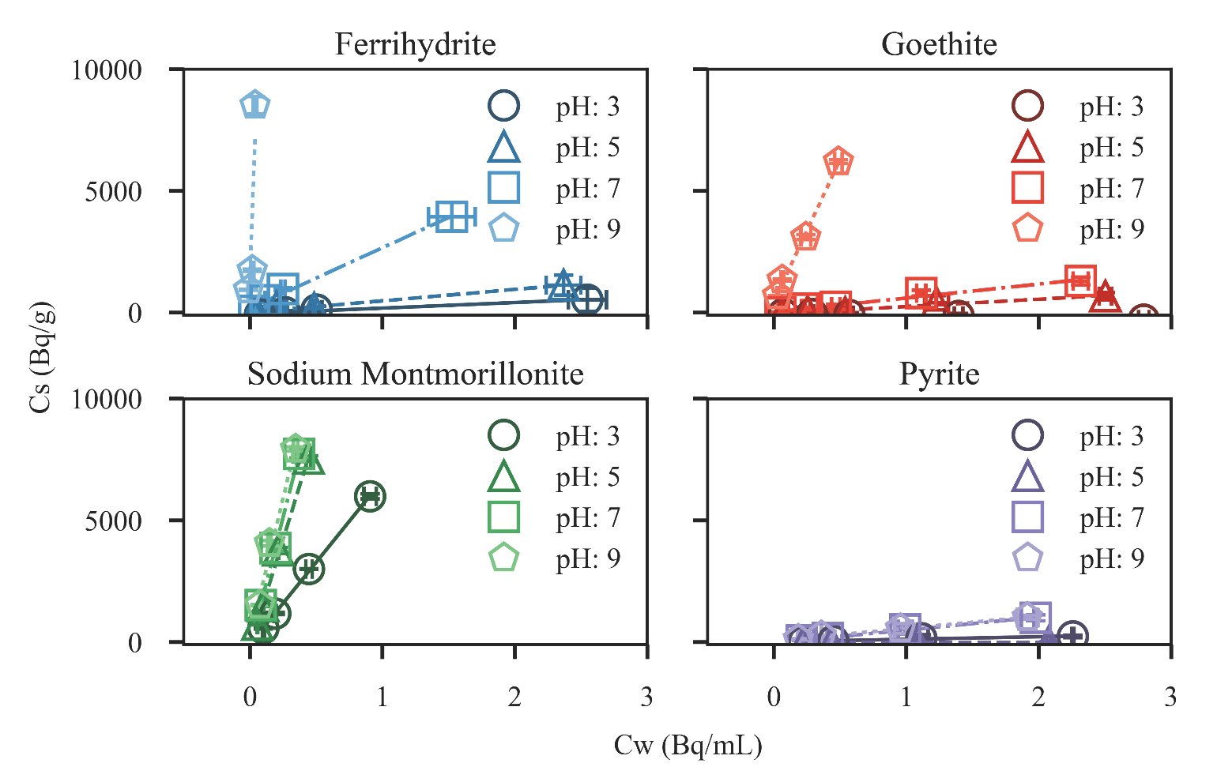
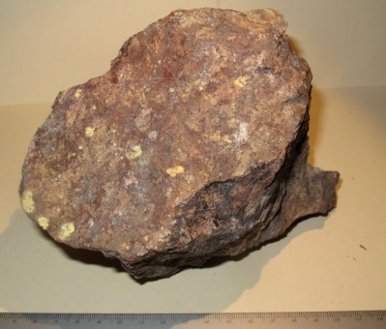
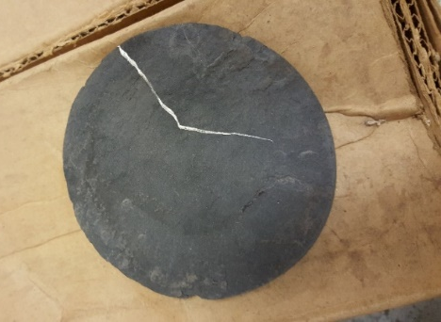
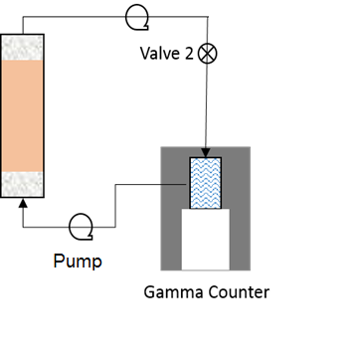
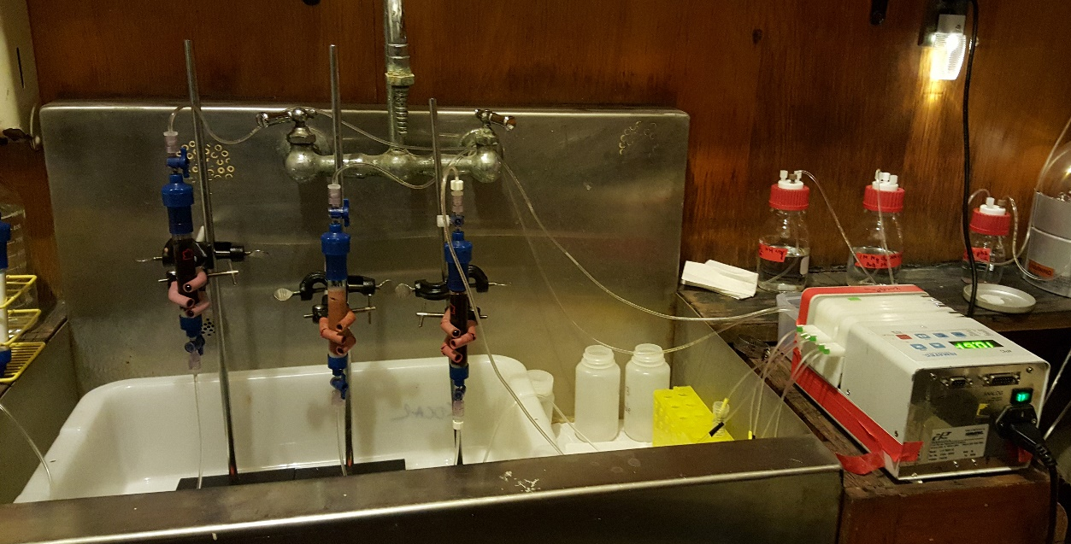
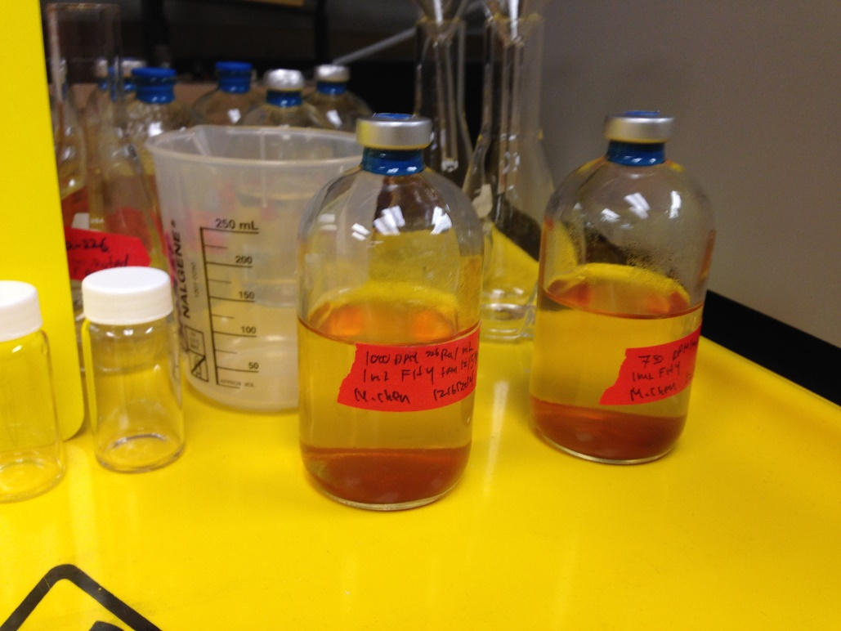
In-Situ and Above-Ground Chemical Oxidation Strategies for Treating Hazardous Flowback Water Generated from Hydraulic Fracturing:
Mineralogical mechanisms controlling radium retention and release
I. Introduction
III. Results
Flowback and produced water (referred to as flowback water) resulting from hydraulic fracturing contains a complex milieu of anthropogenic and natural chemical constituents including naturally occurring toxic inorganic elements such as strontium, barium and naturally occurring radioactive materials such as ²²⁶Radium. Typical produced water concentrations of ²²⁶Ra range from .102-343 Bq/L, often exceeding the EPA drinking water standard of 0.185 Bq/L. Radium isotopes are naturally sourced to solution by radioactive decay of the parent products uranium and thorium, where alpha recoil liberates Ra isotopes from aquifer solids. They then accumulate until they are removed by hydrologic flushing or they reach secular equilibrium with the parent isotopes. Once in solution, Ra isotope transport is primarily controlled by sorption to mineral and organic surfaces. To date, there is minimal study of alpha recoil processes that source Ra to solution, nor a comprehensive model of Ra sorption to minerals typically found in the highly saline, anoxic formations. Prediction of these two critical processes will enable the development of methods to reduce or retard Ra associated with flowback and produced water. Here we present experimental studies of these two Ra processes, alpha recoil and mineral sorption. We present measurements of Ra alpha recoil fluxes from shale samples in the Marcellus formation, as well as measurements of Ra sorption to key mineral phases found in deep formations. These results suggest that geochemical disturbances associated with hydraulic fracturing injections may drive enhanced release of Ra, but minimization of those disturbances can reduce the total hazard of flowback and produced water.
II. Methodology
Granite
BET 2.9 m²/g
Marcellus Shale, PA
BET 6.5 m²/g
10mM NaCl
Radium easily displaced by other metals
Significant sorption onto Iron (Hydr)oxides and clay minerals
Transformation of the pyrite surface will alter solution Ra concentrations
U-Th concentration in acid digested samples as measured by ICP-MS*
 | U | Th
Granite | 3.38 % wt | 0.75 % wt
Shale | 18.97 ppm | 8.2 ppm
IV. Conclusions and Future work
Quantified Ra sorption to key minerals
Alpha recoil something something
Parameters for geochemical transport phenomena controlling Ra isotopes
Use microfluidic devices to simulate Ra retention and release under dynamic redox conditions
Glass experiments
Atomistic modeling
Measured nuclide activities using Gamma-Ray Spectrometer
* USGS SBC-1 is used as a reference material for ICP-MS analysis
Total ²²⁶Ra: 5-270 Bq
Solution: 100 mL 10 mM NaCl
Minerals: 30-40 mg ferrihydrite, goethite, sodium montmorillonite, pyrite
24 hours of shaking
Supernatant filtered, sealed in a bottle, and ²²⁶Ra measured using scintillation counting after 30 days

