Slide 1
Studies of radioisotopes as tracers for groundwater processes
Michael Chen
Thesis Proposal
3/5/2015

Slide 2
Overview
Previous work
Background and Objectives
Radium Studies
Iodine Studies
Summary and Timeline

Slide 3
Previous Research

Slide 4
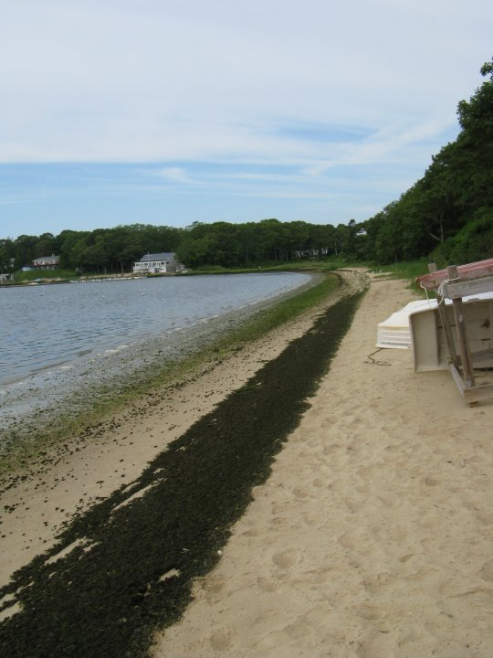
Waquoit Bay Groundwater Dynamics
Undergraduate research examining nitrogen fluxes in estuarine region
Foundational project for interest in groundwater hydrology and geochemistry
Supervisor: Hanan Karam

Slide 5
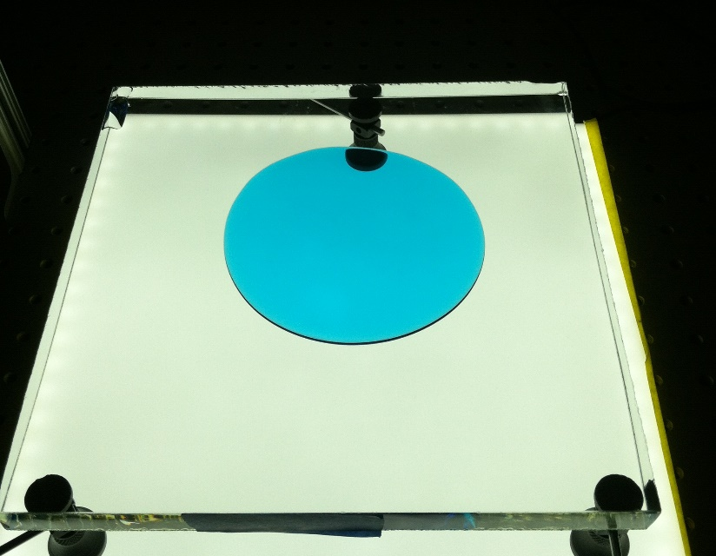
Partial wetting puddle spreading
Masters work studying fluid spread when a finite contact angle is present, a real system lacking convincing models
Reinforced understanding of connection between experimental work and modeling
Supervisor: Ruben Juanes

Slide 6
Background and Objectives

Slide 7
What is this thesis about?
Radioisotopes present a suite of tracers for many groundwater processes
Natural vs anthropogenic
Point and distributed sources
Improved understanding of isotope geochemistry enables tracer usage
Radium as tracer for hydraulic fracturing, other deep water releases
Iodine as tracer for nuclear activities, organic matter cycling

Slide 8
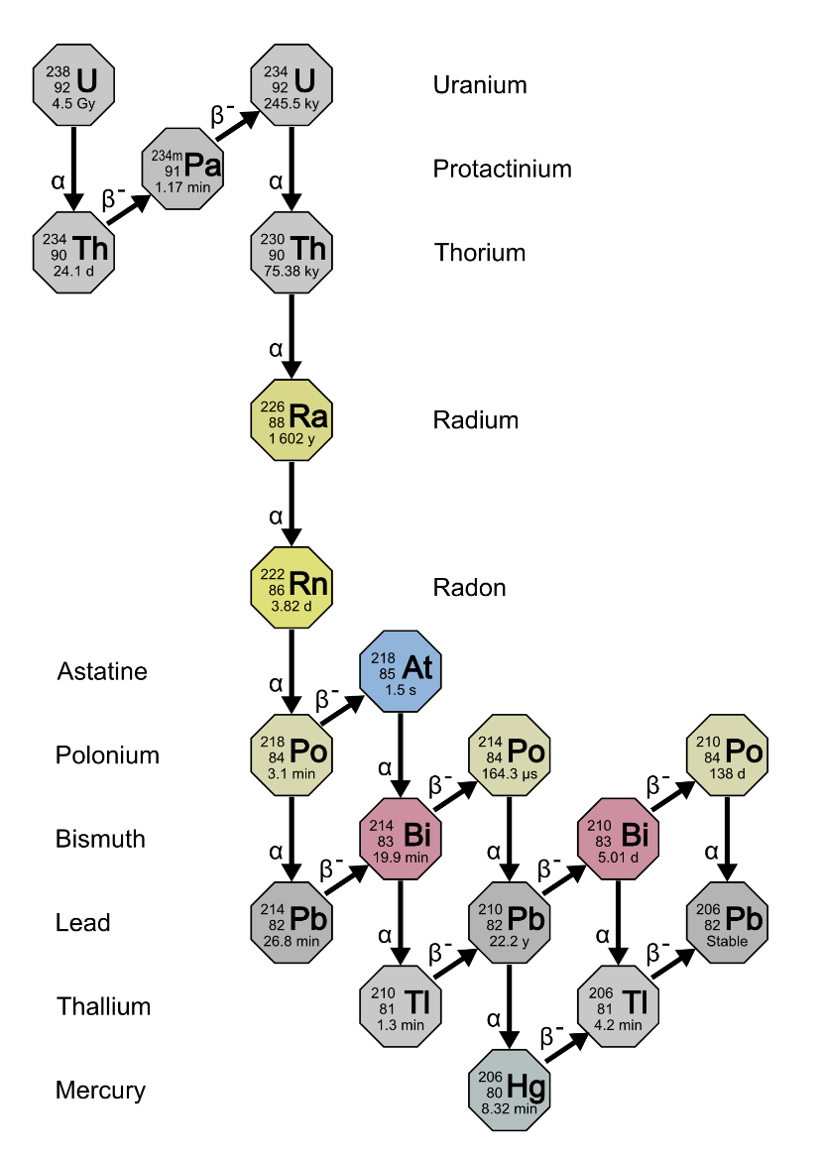
Why radioactive isotopes?
Critical environmental contaminants from energy generation and nuclear medicine
Unique detection methods
Discrete, well defined anthropogenic signals
Broad base natural signals
Timers for natural processes
Uranium Series decay taken from en.Wikipedia.org/Decay_chain

Slide 9
Radioisotopes as environmental tracers
Radium
Iodine
Major Isotopes: ²²⁶Ra, ²²⁴Ra, ²²⁸Ra
Half-life: 3 days-1600 years
Oxidation states: II, 0
Transport retarded by mineral sorption
Isotopes used as tracers for groundwater flow into oceans
Major Isotopes: ¹³¹I, ¹²⁹I, ¹²⁷I (stable)
Half-life: 8 days to millions of years
Oxidation States: VII, V, III, I, 0, -I
Transport dominated by organic matter interactions
Primary ¹²⁹I source from human nuclear activities

Slide 10
General Process
Batch and Transport Experiments
Groundwater modeling
Tracer Usage
Field Scale Experiments

Slide 11
Radium

Slide 12
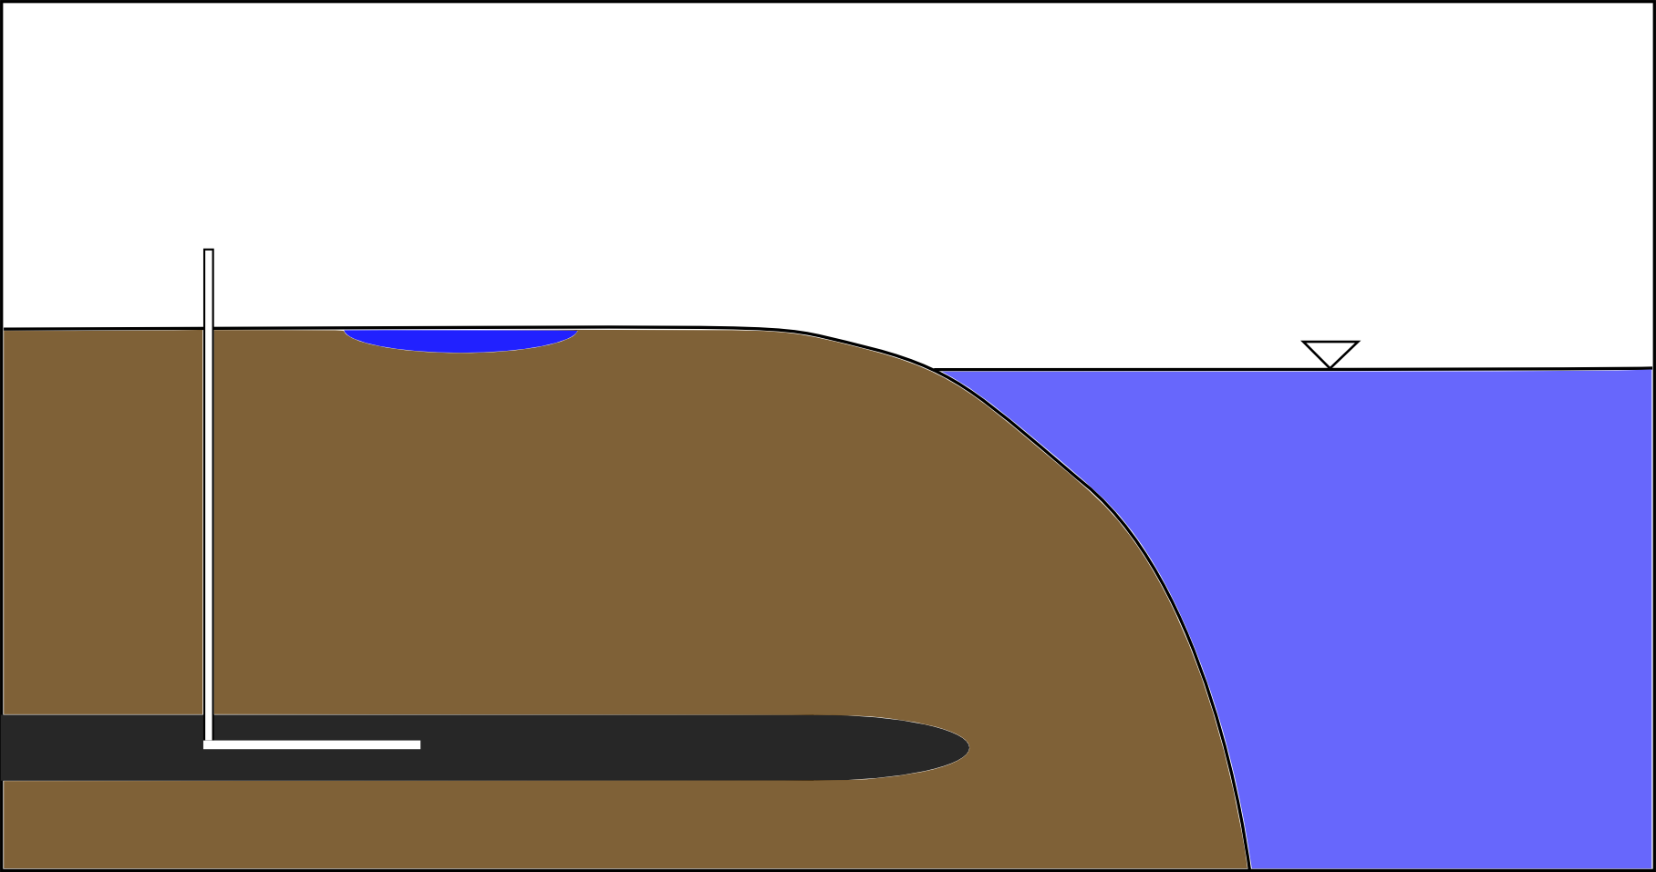
Radium Cycling
²³⁸U -> ²²⁶Ra
²³²Th->²²⁸Ra->²²⁴Ra
Groundwater Flow

Slide 13
Radium Cycling
Produced Water
²³⁸U -> ²²⁶Ra
²³²Th->²²⁸Ra->²²⁴Ra
Hydraulic Fracturing

Slide 14
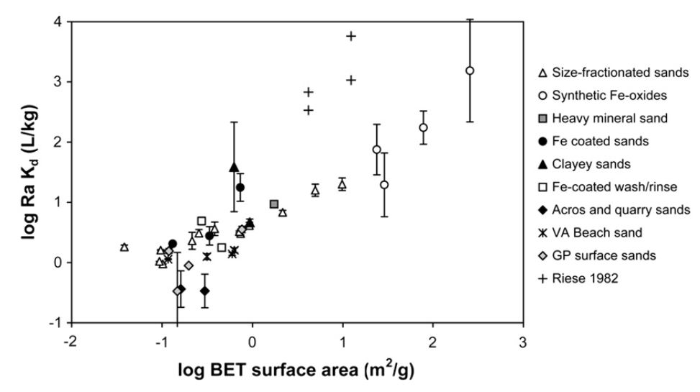
Transport properties…
Radium sorption to marine sands in seawater from Beck & Cochran, 2013

Slide 15
Lab experiments
Media and Sorbents
Experiment Types
Minerals:
Ferrihydrite
Pyrite
Illite
Quartz
Media:
Pure water
Groundwater
Seawater
Fracking brine
Batch sorption
Sorption Kinetics
Surface complexation
Column transport
Retardation factors
Effect of mineral transformations
Detection
Gamma counting
Scintillation counting

Slide 16
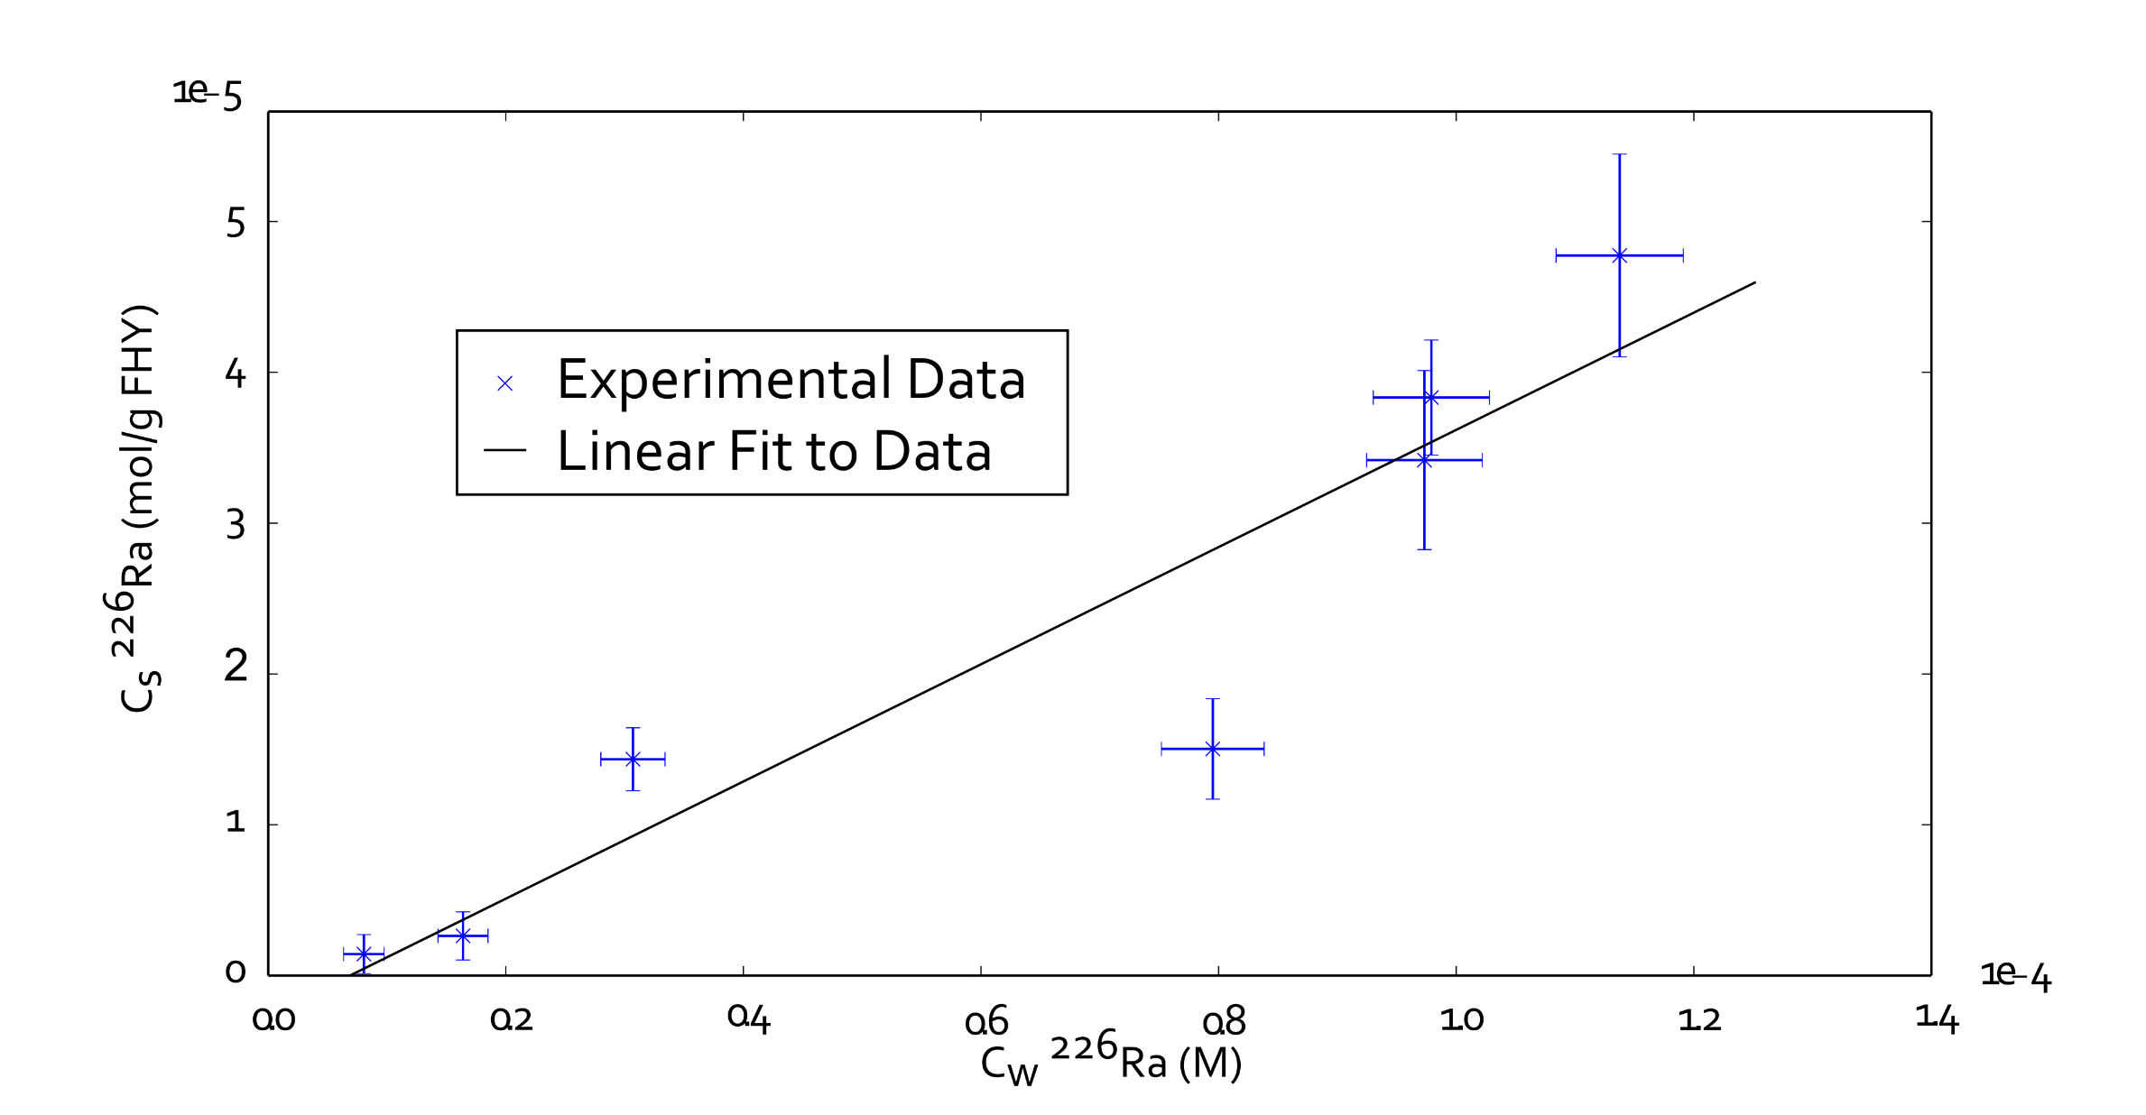
Preliminary Sorption Experiment

Slide 17
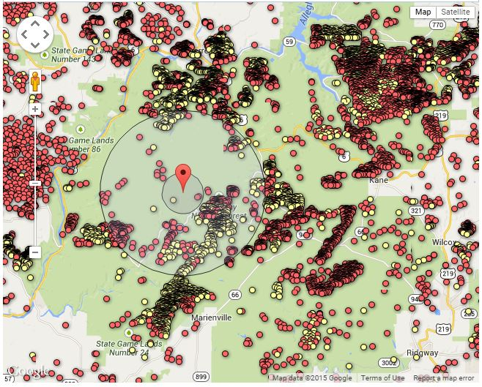
Fieldwork in PA
Hydraulic fracturing prevalent around the United States, especially Pennsylvania
Allegheny National Forest, PA ideal field site to examine potential impacts to shallow groundwater
Hydraulic fracturing wells drilled in Allegheny National Forest http://www.nrdc.org/energy/fracking-map/pa.asp

Slide 18
Expected Results
Radium transport controlled by sorption to metal (hydr)oxides
In situ mineral transformations can alter transport
Develop accurate groundwater transport model
Trace hydraulic fracturing surface water impacts via radium tracers

Slide 19
Iodine

Slide 20
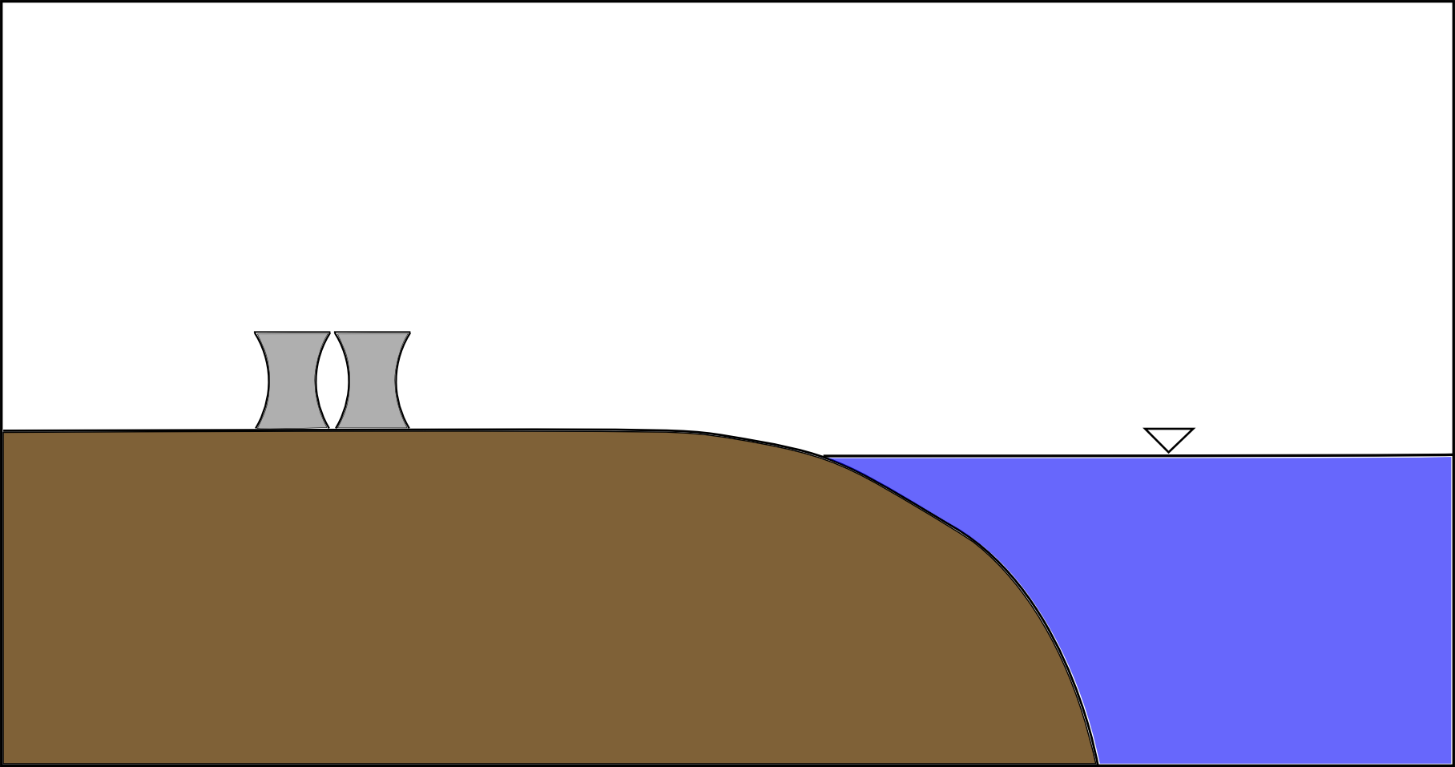
Natural Iodine Isotope Cycling
Cosmic Rays->¹²⁹I
Gas Ebullition
Deposition
¹²⁷I ¹²⁹I
Groundwater Fluxes

Slide 21
Anthropogenic Iodine Isotope Cycling
Deposition
¹²⁹I,¹³¹I from
Bomb testing,
accidents, etc

Slide 22
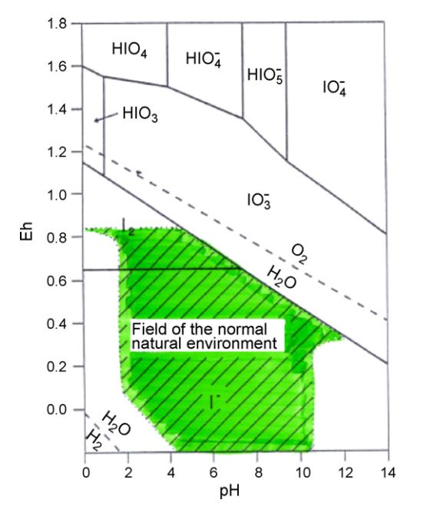
Iodine Speciation and solid interactions
Weak sorption to mineral surfaces
Strong interactions with organic matter
Sorption
Transformation into organoiodines
Speciation of iodine from Hou, et al, 2009

Slide 23
Sorption and Transport Experiments
Batch experiments
Column Experiments
Organic matter interactions
Effect of mineral transformations
Focus on organic matter controls iodine sorption and speciation
Comparison of transport, transformation, sorption
Speciation control and impacts on transport

Slide 24
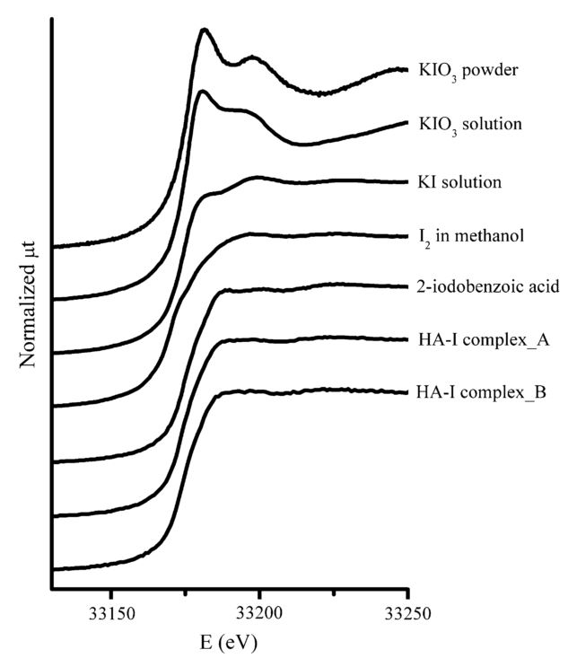
Iodine Detection
Synchrotron power tool for speciation analysis
Pore scale analysis of organic matter samples incubated with iodine
High perfomance liquid chromatograph (HPLC) combined with ICP-MS
K-edge spectra for various iodine compounds from Yamaguchi et al, 2008.

Slide 25
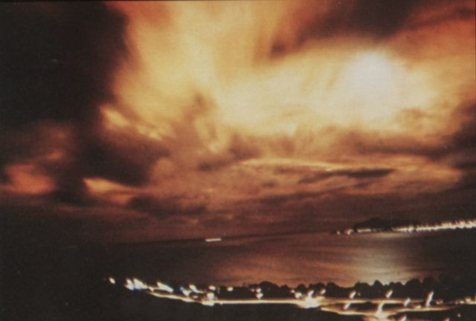
Fieldwork in Hawaii
Focus on studying organic matter cycling
Pulse of ¹²⁹I from bomb testing (Starfish prime)
Characterization of iodine isotope speciation and distribution in soil & GW
Modeling of iodine cycling in system
"Starfish Prime aurora from Honolulu 1". Licensed under Public Domain via Wikimedia Commons - https://commons.wikimedia.org/wiki/File:Starfish_Prime_aurora_from_Honolulu_1.jpg#mediaviewer/File:Starfish_Prime_aurora_from_Honolulu_1.jpg

Slide 26
Expected Results
Parameters for organic matter impacts to iodine
Understanding of iodine-organic matter interactions
Groundwater model accounting for sorption and transformation
Field scale understanding of iodine cycling through organic matter

Slide 27
Summary & Timeline

Slide 28
General Process
Batch and Transport Experiments
Groundwater modeling
Tracer Usage
Field Scale Experiments

Slide 29
Key differences
Radium
Iodine
Sorption dominated by minerals
Increase or decrease sorption by induced mineral transformations
Useful as a tracer for groundwater flow into oceans, hydraulic fracturing activities
Sorption and transformation dominated by organic matter
Changes in speciation and sorption by induced mineral transformations
Tracer for nuclear activity, organic matter-iodine cycling

Slide 30
Timeline
Sept 2015
Jan 2016
Sept 2016
Jan 2017
Jun 2017
Ra sorption
I-OM kinetics at Synchrotron
Initial field work in PA
Classes completed
Finish column experiments
Continue field work in HI and PA
Defend Thesis
I batch sorption
Begin column experiments
Prepare HI field work
Develop models
Thesis writing

Slide 31
Isotope Information
Isotope | Half life | Specific Activity (Bq/g) | Daughter Product
²²⁶Ra | 1600 years | 3.65E10 | ²²²Rn (²²⁶Th, ²¹²Pb, ¹⁴C)
²²⁸Ra | 5.8 years | 1.01E13 | ²²⁸Ac (²¹⁰Pb, ¹⁴C)
²²⁴Ra | 3.6 days | 5.99E15 | ²²⁰Rn
¹³¹I | 8.0 days | 4.60E15 | ¹³¹Xe (stable)
¹²⁹I | 15.7 million years | 6.53E6 | ¹²⁹Xe (stable)

