Slide 1
Studies of radioisotopes as tracers for groundwater
Michael Chen
Thesis Proposal
3/5/2015

Slide 2
Overview
Previous work
Background and Objectives
Radium Studies
Iodine Studies
Summary and Timeline

Slide 3
Previous Research

Slide 4
Waquoit Bay Groundwater Dynamics
Undergraduate research examining nitrogen fluxes in estuarine region
Foundational project for interest in groundwater hydrology and geochemistry
Supervisor: Hanan Karam
A PICTURE A PICTURE A PICTURE

Slide 5
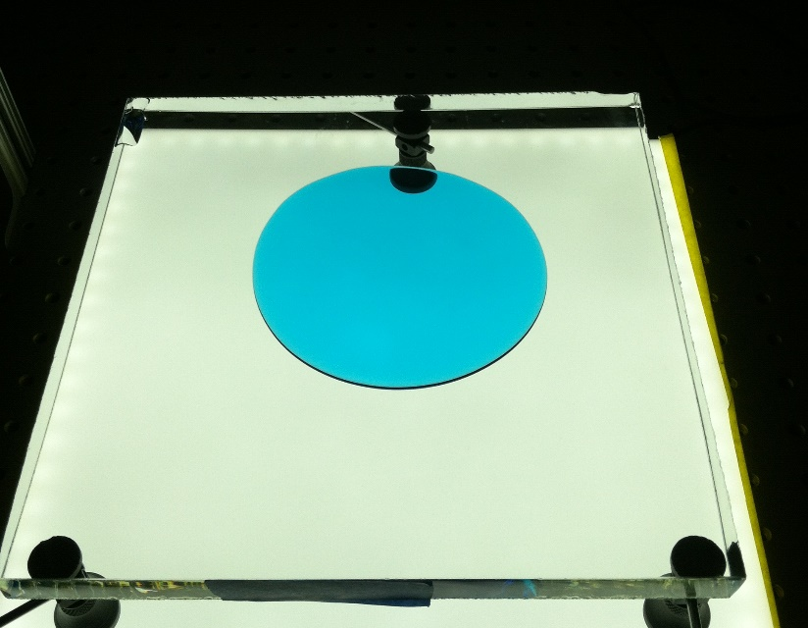
Partial wetting puddle spreading
Masters work studying fluid spread when a finite contact angle is present, a real system lacking convincing models
Reinforced understanding of connection between experimental work and modeling
Supervisor: Ruben Juanes

Slide 6
Background and Objectives

Slide 7
What is this thesis about?
Radioisotopes present a suite of tracers for many groundwater processes
Natural vs anthropogenic
Point and distributed sources
Improved understanding of isotope geochemistry enables tracer usage
Iodine as tracer for nuclear activities, organic matter cycling
Radium as tracer for hydraulic fracturing, other deep water releases

Slide 8
Why radioactive isotopes?
Critical environmental contaminants from energy generation and nuclear medicine
Unique detection methods
Discreet, well defined anthropogenic signals
Broad base natural signals

Slide 9
Radioisotopes as environmental tracers
Radium
Iodine
Major Isotopes: ²²⁶Ra, ²²⁴Ra, ²²⁸Ra
Half-life: 3 days-1600 years
Oxidation states: II, 0
Transport retarded by mineral sorption
Isotopes used as tracers for groundwater flow into oceans
Major Isotopes: ¹³¹I, ¹²⁹I, ¹²⁷I (stable)
Half-life: 8 days to millions of years
Oxidation States: VII, V, III, I, 0, -I
Transport dominated by organic matter interactions
Primary ¹²⁹I source from human nuclear activities

Slide 10
General Process
Batch and Transport Experiments
Groundwater modeling
Tracer Usage
Field Scale Experiments

Slide 11
Radium

Slide 12
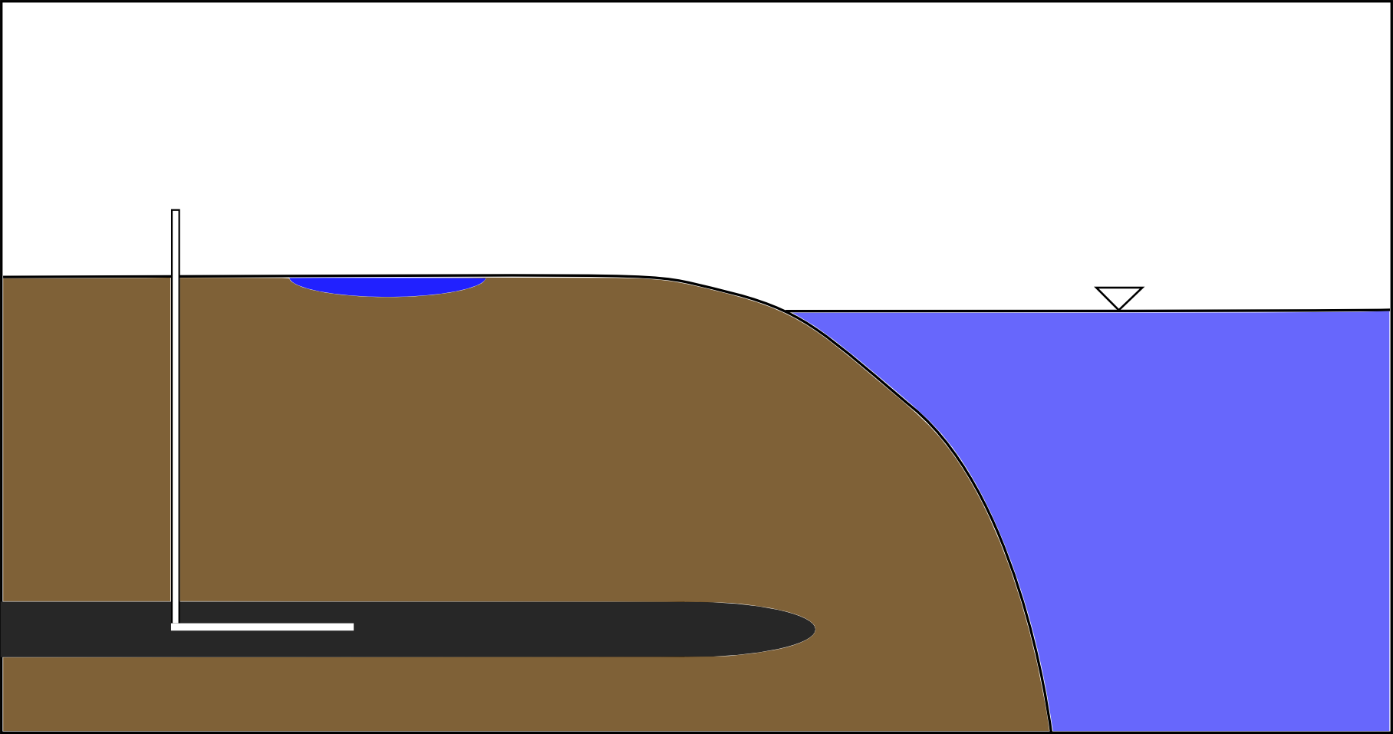
Radium Cycling
²³⁸U -> ²²⁶Ra
²³²Th->²²⁸Ra->²²⁴Ra

Slide 13
Radium Cycling
²³⁸U -> ²²⁶Ra
²³²Th->²²⁸Ra->²²⁴Ra
Groundwater Flow

Slide 14
Radium Cycling
Produced Water
²³⁸U -> ²²⁶Ra
²³²Th->²²⁸Ra->²²⁴Ra

Slide 15
Transport properties…
IMAGE OF RADIUM SORPTION PROPERTIES FOR QUARTZ SAND

Slide 16
Lab experiments
CARTOON:

Slide 17
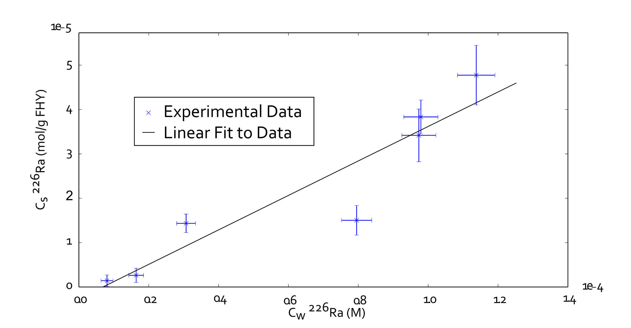
Preliminary Sorption Experiment

Slide 18
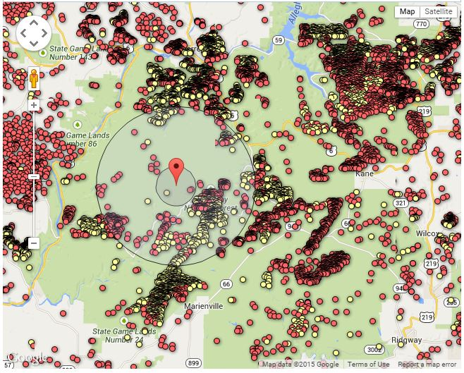
Fieldwork in PA
Hydraulic fracturing prevalent around the United States, especially Pennsylvania
Allegheny National Forest, PA ideal field site to examine potential impacts to shallow groundwater
Hydraulic fracturing wells drilled in Allegheny National Forest http://www.nrdc.org/energy/fracking-map/pa.asp

Slide 19
Iodine

Slide 20
Iodine Cycling
FIGURE OF CYCLING

Slide 21
Interactions with aquifer solids
Figure of relevant, understood processes
Mineral partitioning
Organic matter sorption and transformation

Slide 22
Sorption and Transport Experiments

Slide 23
Synchrotron Work
XANES spectra for iodine species

Slide 24
Fieldwork in HI
Focus on studying organic matter cycling
Pulse of ¹²⁹I from bomb testing (Starfish prime)

Slide 25
Summary

