Slide 1
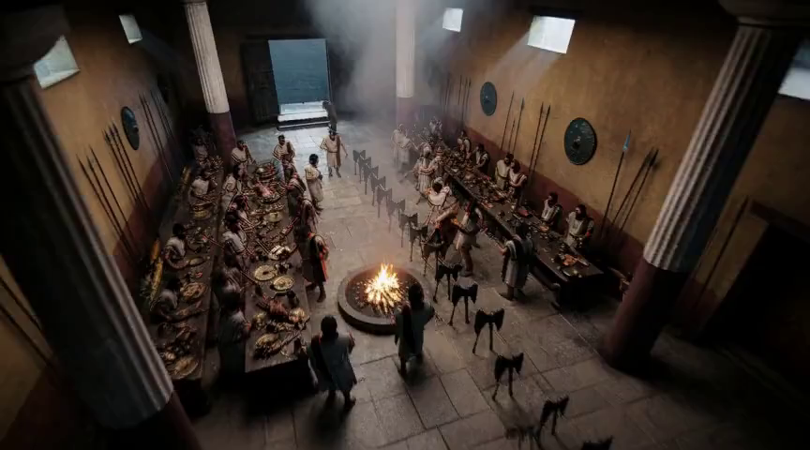
We built a movie studio with AI.
Then we noticed: it was teaching us the loop.
(this frame is real — the AI rendered it from a camera move a human approved)
Notes:
Everything so far has been theory. Now I want to show you one real project where all of it happened to us — in one week. We built an AI filmmaking tool. You paste in a story, an AI director breaks it into shots, designs the camera work, a local GPU renders the footage, and there's an editor to cut it together. A human and an AI co-directing a film. Here's the thing. We didn't sit down and decide "the human will do this part, the AI will do that part." We just kept building — and every task sorted itself into one of the three positions you just saw. The loop chose. Our job was to notice why. [~0:45]

Slide 2
THE MAP
One project, all three positions
IN
picking which shot idea is right
no test can check taste
ON
the AI built features overnight
reviews ran; only judgment calls woke us
OUT
rendering, retries, file safety
tests catch mistakes in milliseconds
The sorting question was never "do we trust the AI?"
It was: "can a machine check this, and what does a mistake cost?"
Notes:
Quick map before the stories. Same project, all three positions at once. Picking which version of a shot is right — that stayed with the human. Not because the AI is bad at it, but because there's no test for taste. Nothing can tell you you're wrong. That's an IN-the-loop job by definition. Building new features — that ran ON the loop. The AI built all night; a second AI reviewed the work; only genuine judgment calls waited for morning. And the routine stuff — rendering, retrying, not corrupting files — fully OUT of the loop, because a test can catch a mistake there in milliseconds. Notice: we never once asked "how much do we trust it?" We asked two questions. Can a machine check this? And if it's wrong — what does that cost? Those two questions did all the sorting. Let me show you. [~1:00]

Slide 3
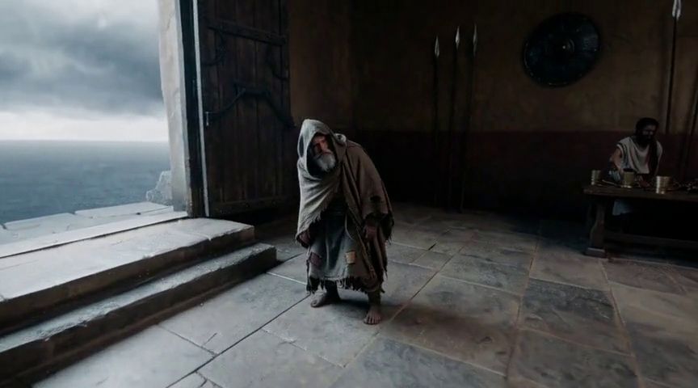
HUMAN IN THE LOOP — "I DO"
The AI pitches. The human picks.
Shot 1, take 1: "hold on the hero, feast behind him." Chosen. Rendered. …Meh.
The human: "Actually — start high over the party, and find him last."
AI re-planned it, re-rendered the 3D preview, human approved — then the GPU rolled.
…and the camera finds him last.
Why the human? Because nothing can tell you you’re wrong.
Notes:
IN the loop. We built a thing called the Director's Table. For every shot, the AI pitches two or three different takes on the scene — with its recommendation and its reasoning — and the human clicks one. Or edits one. Or writes their own. Real example. Opening shot of our film — Odysseus disguised as a beggar while his enemies feast. The AI recommended: hold on the beggar, party behind him. I picked it, we rendered it... and it was fine. Just fine. So I came back and said: actually, flip it. Start high above the feast, all the noise and arrogance, and let the camera discover the beggar last — the audience finds him the way the room ignores him. The AI re-planned the shot, updated the 3D preview, I approved the camera move, and THEN we spent GPU money. That's the point of IN the loop: this decision has no right answer a machine could verify. It's taste. So the system is built to stop and ask. And one more thing — it records what I rejected and why. My taste becomes data the AI uses next time. In-the-loop effort should compound. If it doesn't, you're just micromanaging. [~1:15]

Slide 4
HUMAN ON THE LOOP — "WE DO"
“I’m going to bed. Do the plan. I believe in you.”
Overnight: 6 features built, reviewed, fixed, merged, shipped.
Every build was reviewed by a different AI — told to be suspicious.
What woke the human? Nothing.
What waited for the human?
one design judgment
one publish button
anything that deletes
The human’s job wasn’t watching. It was choosing what escalates.
Notes:
ON the loop. One night during this project, the human literally said "I'm going to bed, do our plan, I believe in you" — and went to sleep. Overnight, six features got built, reviewed, fixed, and shipped. But here's what made that safe, and it's not trust. Every piece of work was reviewed by a SEPARATE AI whose entire job was to be suspicious of the first one — reproduce the bugs, check the claims, refuse to take "tests pass" as an answer. And the human's role was baked in before bed: the rules for what escalates. Taste decisions? Wait for morning. Publishing to the world? Human's button, always. Deleting anything a user made? Never automatic. So the human wasn't watching. The human had DESIGNED what deserves their attention. That's the whole ON-the-loop job: you don't verify the work, you verify the exceptions — and you decide, ahead of time, what counts as one. [~1:15]

Slide 5
THE FAILURE: THE RUBBER-STAMP
Green tests lied to us. Three times. One night.
1. A dialog rendered BEHIND its own background — invisible.
tests: ✅
2. The video-export feature had never once worked.
tests: ✅
3. The API-key checker’s fake never saw the key.
tests: ✅
All three fakes were built to match the code’s assumption.
A green checkmark is a claim, not evidence.
Notes:
Now the rubber-stamp slide, because we lived it — three times in one night. A new dialog: twenty-plus passing tests. In a real browser it rendered BEHIND its own dark background. Invisible. Unclickable. The tests couldn't see layout, so they cheerfully passed. Worse: a video-export feature that had shipped weeks earlier — over a thousand tests green the whole time — had NEVER ONCE worked with the real video encoder. Every test used a fake encoder that happily accepted anything. The first time a test used the real one, it failed instantly. Third one: a feature that validates your API key. Its test used a fake that never actually looked at the key. The test proved nothing, greenly. Same root cause every time: the fake was built to match what the code assumed, instead of what reality does. So we made it a house rule: the fake may never move to match the assumption. If you're ON the loop and your verifier wants to please the thing it's verifying — you don't have a verifier. You have a rubber stamp with extra steps. [~1:15]

Slide 6
THE FAILURE: THE ABSENT LANDLORD
The scariest bug: nothing crashed
The human made decisions at the Table. The UI said: ✓ applied
The renders quietly ignored every one of them.
One config flag. The AI’s own draft rendered instead. No error. No warning.
The human thought they were in the loop.
The system had them out of it.
Fix: the system must say, out loud, when a decision can’t reach the output.
Notes:
OUT of the loop now — and the failure mode, the absent landlord. This is the scariest bug we found, and it's scary because nothing crashed. Remember the Table, where the human picks the shot designs? We discovered that for a while, thanks to one configuration flag, every decision the human made was being saved, shown in the UI as "applied"... and then completely ignored at render time. The AI's own first draft was what actually got rendered. No error. No warning. The interface PERFORMED human-in-the-loop while the pipeline ran without one. That's the real danger of automation — not that the machine does the wrong thing, but that it manufactures your confidence that you're still in control. That's your lost situational awareness, in one bug. The fix wasn't more human vigilance — you can't out-stare a silent failure. The fix was making silence impossible: now, any time a human decision cannot reach the final output, the system says so, by name, in the same breath it accepts the decision. It took three rounds of adversarial review to close every gap. Worth every round. [~1:15]

Slide 7
THE MACKWORTH CLOCK, LIVE
Our test suite gave us alarm fatigue
Three tests failed randomly — about half of all runs. Never a real bug.
Week one: we investigated every alarm.
Week two: “eh, probably those three again.”
← that sentence is the vigilance decrement
Fix: not “pay more attention” — make the alarm honest.
An alarm that cries wolf doesn’t just waste time. It spends your vigilance.
Notes:
Remember the Mackworth clock — humans going blind to rare signals? We reproduced it. In our test suite. By accident. Three tests would fail randomly under heavy load — timing issues, never a real bug. First few times, we dug into every failure like it mattered. By the end of the week, a red X would show up and the honest reaction was "eh, it's probably those three again." That sentence should terrify you — because the day it's NOT those three, that's the day it matters, and that's exactly the day we'd have shrugged. The fix was not discipline. Humans don't win against boring alarms — that's the whole lesson of the clock. The fix was making the alarm honest: we gave those tests realistic time limits so they only fail when something's actually wrong. Boring, unheroic — and now a red X means something again. If your monitoring cries wolf, fixing the wolf-crying is the highest-leverage reliability work you can do. [~1:00]

Slide 8
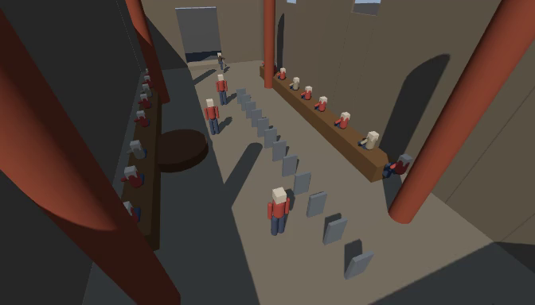
BLAST RADIUS, IN DOLLARS AND MINUTES
A final shot costs 40 GPU-minutes. So:
words
3D preview
draft render
final
→
→
→
free
seconds
~15 min
40 min
Real save: a draft came back missing the entire crowd.
Cost: minutes, not an evening.
Want more autonomy?
Don’t loosen oversight.
Cheapen the mistakes.
the seconds tier (grey boxes, real camera)
the same camera move, rendered
Notes:
Last concept: blast radius. In our world it has a price tag — a final-quality AI shot costs about forty minutes of GPU time. So the entire pipeline is a ladder where every mistake gets caught on a cheaper rung. Describing a shot in words: free. Then a 3D preview — grey boxes, but it renders the ACTUAL camera move in seconds on the CPU. Then a half-resolution draft, about fifteen minutes. Only when all of that passes do we spend the forty. Real example: that feast shot came back with NO feast. Empty hall. Turned out our "empty room" reference image was quietly overpowering the prompt. Because it was a draft, the mistake cost minutes. And the fix moved up the ladder — the 3D preview now includes the crowd, so next time we'd catch it in the seconds tier, before the GPU is even involved. And this is the answer to "how do I let the AI do more?" Never once did we say "let's trust it more." Every time we wanted more autonomy, we did one of two things: built a check a machine can run, or made the mistake cheaper. Autonomy followed. Free. [~1:15]

Slide 9
We never chose our position in the loop.
The work chose it.
Two questions did all the sorting:
Can a machine tell us it’s wrong?
What does wrong cost?
Your levers: make more of your world checkable. Make mistakes cheaper.
The loop takes care of the rest.
Notes:
So — one project, one week, every slide from the first half of this talk showed up in it uninvited. We never once decided how much to trust the AI. We asked two questions, over and over: can a machine tell us when this is wrong? And when it's wrong, what does it cost? Taste stayed human. Overnight builds got adversarial reviewers. Routine work got tests and cheap do-overs — and ran completely alone. You don't choose your position in the loop. The loop chooses you. The only levers you actually hold are these: make more of your world machine-checkable, and make your mistakes cheaper. Do that, and the right amount of autonomy just... happens. Thanks. [~0:30]

