Slide 1

Finding relations in documents with IEPY
Daniel F. Moisset – dmoisset@machinalis.com
tw: @dmoisset

Slide 2
This is a talk about...
A (very brief) intro about IE
Example applications
IEPY, an open source tool to do it in python
https://github.com/machinalis/iepy

Slide 3
About me
I am a Computer Scientist
I am a cofounder and technical leader at Machinalis
Machinalis (http://www.machinalis.com) provides development services for Machine Learning applications.
I participated in the development of IEPY

Slide 4
Information Extraction
Unstructured documents
(News articles, a wiki, a knowledge base)
Structured data
(“facts” on a database)

Slide 5
Some applications
Given… Obtain a table of
A collection of medical papers Genes and proteins expressed by them
Wikipedia Relevant people and their dates of birth
A set of business articles Company acquisitions and fundings
Social media posts Foodborne disease outbreaks

Slide 6
In general...
Extract RELATIONS
(tuples of a given arity expressing some known concept/meaning)
Between ENTITIES
(People, places, organizations, dates, amounts of money, …)
From DOCUMENTS
(text and maybe some associated metadata. Also possible over other media, not discussed in this talk)
Example: Pandas is a software library written for the Python programming language for data manipulation and analysis. In particular, it offers data structures and operations for manipulating numerical tables and time series. Pandas is free software released under the three-clause BSD license.

Slide 7
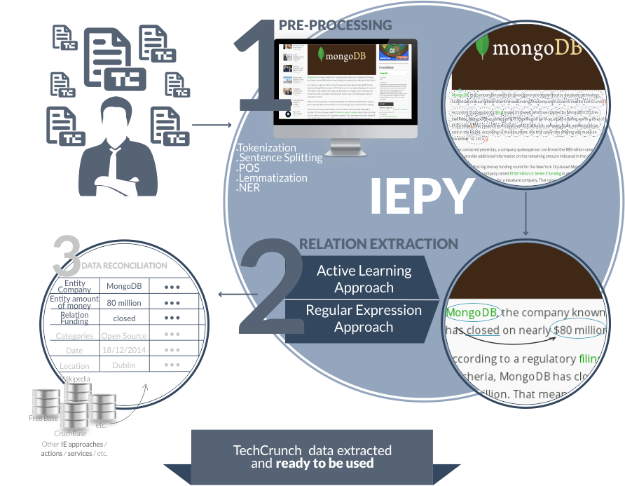
An example: iepycrunch
http://iepycrunch.machinalis.com/

Slide 8
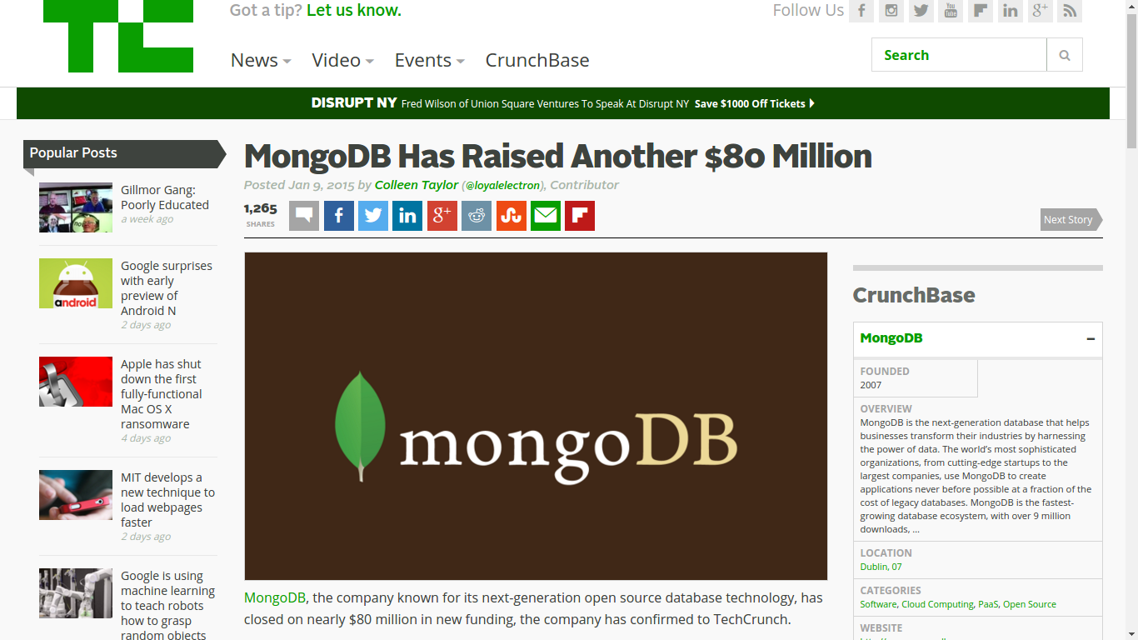

Slide 9
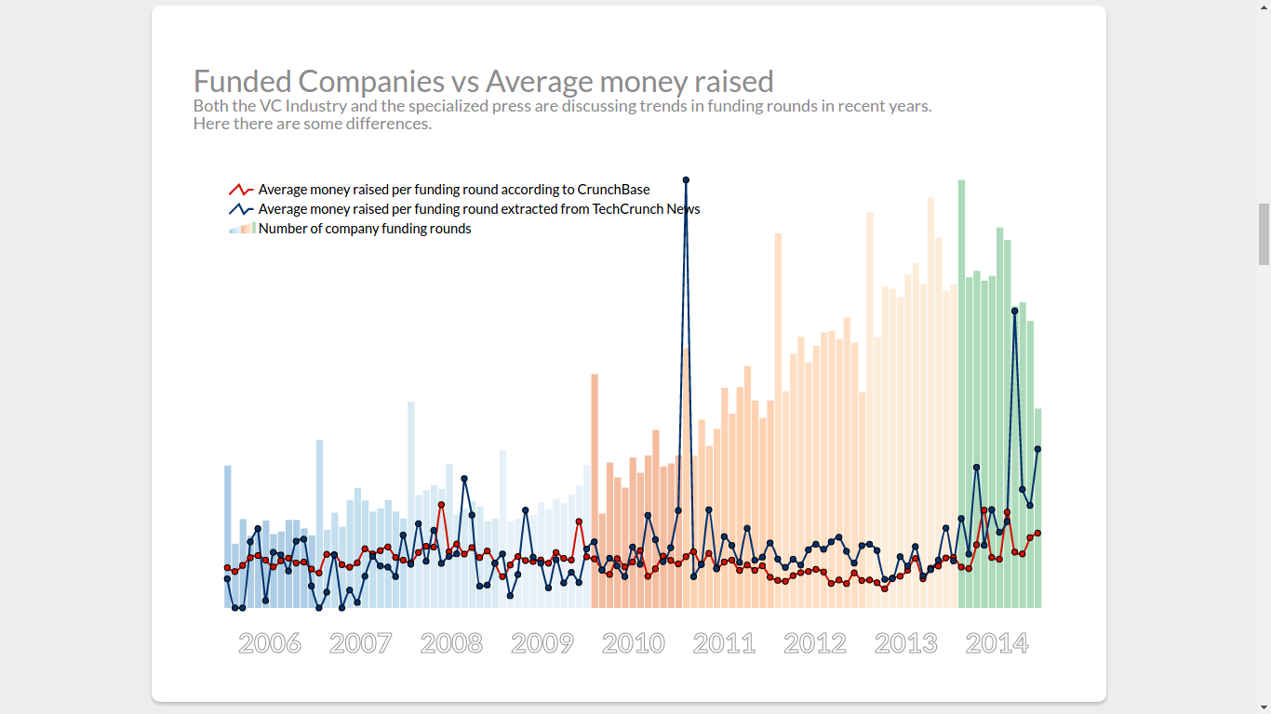

Slide 10
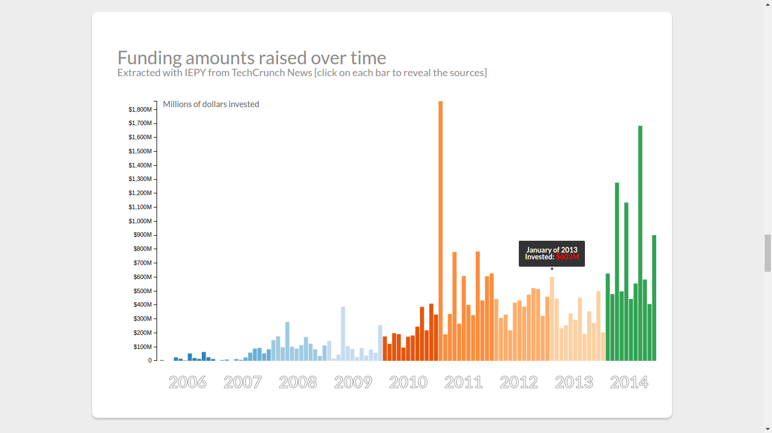

Slide 11
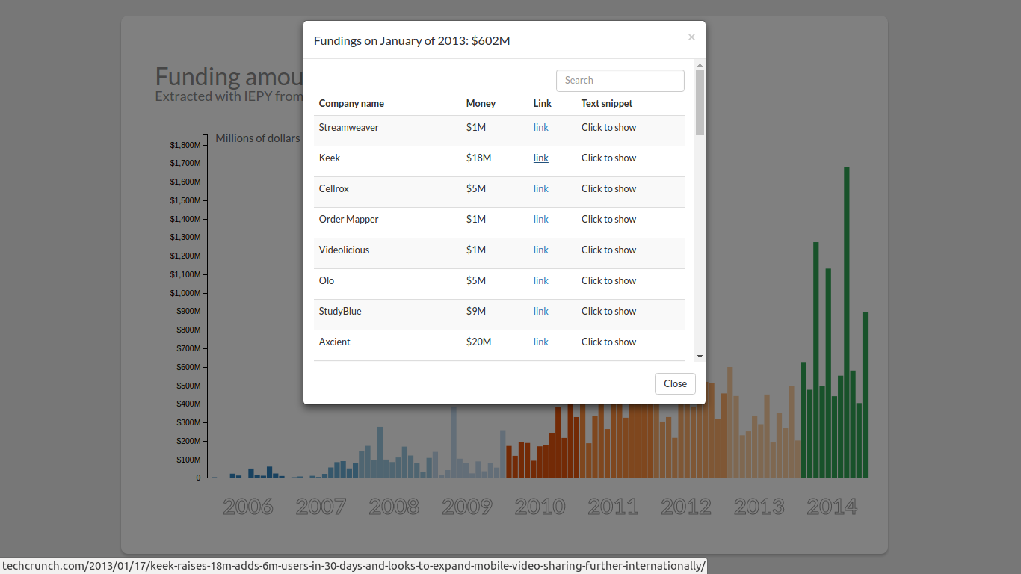

Slide 12
IEPY
https://github.com/machinalis/iepy
Python based tool + framework for creating IE applications
Some parts of the pipeline have defaults that can be replaced
Supports automatic, manual, or hybrid approaches
Includes a web UI for manual interaction
Python (+ external components), BSD open-source

Slide 13
IEPY pipeline: Load the documents
https://github.com/machinalis/iepy
IEPY manages its own database for storing documents
A simple CSV importer is included
You can write others or convert to CSV
It is possible to do incremental updates
Some work is typically required here given the variety of possible inputs

Slide 14
IEPY pipeline: Preprocessing (1)
Tokenization
Segmentation in sentences
Lemmatization
Part of Speech tagging
IEPY uses off-the-shelf tools like Stanford NLP toolkit, you can add/change steps.

Slide 15
IEPY pipeline: Preprocessing (2)
Entity recognition
  NER tagger (Stanford's). This one does pronoun resolution and coreferencing
  Gazettes resolution
  Custom rules
Parsing (Stanford's)
Segmentation

Slide 16
IEPY pipeline: Extraction
Simpler but least interesting option is human-based...
Allows integrating domain experts through a friendly UI
Manually entered data can feed the active learning core

Slide 17
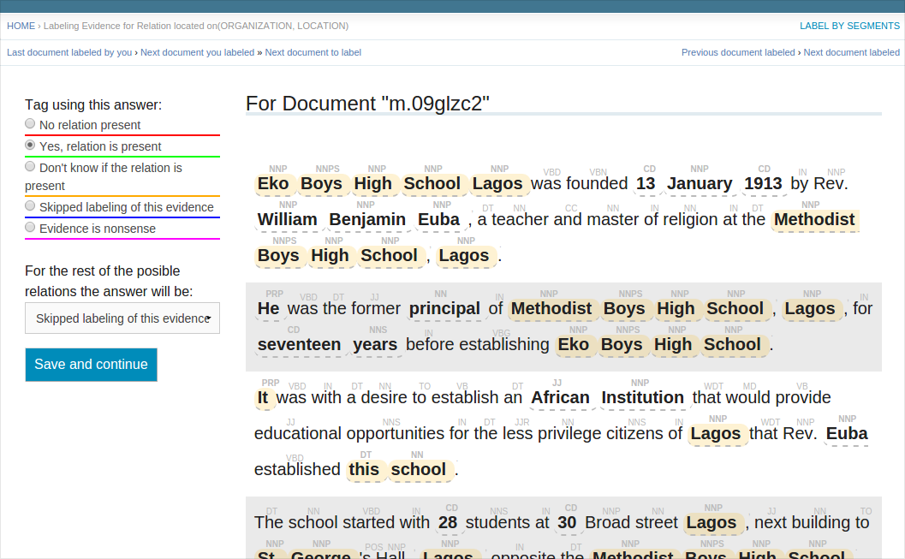
IEPY pipeline: Extraction
Simpler but least interesting option is human-based...
Allows integrating domain experts through a friendly UI
Manually entered data can feed the active learning core

Slide 18
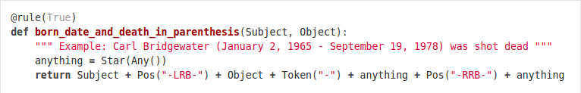
IEPY pipeline: Extraction
You can get precision (but not always high recall) with rules:
Rules are defined by regular expressions-like patterns on words
Some tools for debugging rules

Slide 19
IEPY pipeline: Extraction
You can enhance your results through active learning methods (and reduce human time required which is the end-goal)
Learns from positive and negative examples found by other methods.
Some predefined features (entity distance, bag of words, bag of bigrams, …)
Many predefined classifiers (defaults to SVC from scikit-learn)
Tunable parameters for high precision or high recall

Slide 20
A real use-case: Archivo de la Memoria
Background history:
In 1976 Argentina, amidst heavy unrest and civil guerrilla/terrorism, the military forces removed the president by coup and set up a new government that lasted until 1983.
During that period, people considered “subversive” (members of the terrorist organizations, but also any political dissenter) were taken away without warrant, and many of them never seen again (killed without trial and with no record). Those are called “Desaparecidos” (disappeared)

Slide 21
A real use-case: Archivo de la Memoria
In many of those cases, spouses and small children of desaparecidos were also kidnapped. Also some pregnant women gave birth while imprisoned. Those children were given under clandestine adoption to families in the military or connected with them.
Today, most of the military top leaders of that age have been tried and convicted for Human Rights violations. But many people in their 30's have been lied about their real identity. Only 119 have been found as of December of 2015. Nearly 400 haven't been located yet.

Slide 22
A real use-case: Archivo de la Memoria
A collaboration work between
The NLP group at FaMAF, UNC (a research dept)
The Province Archives of Remembrance (http://www.apm.gov.ar/ , government agency)
  Clearance to access classified military files
  Recovery and conservation of documents

Slide 23
A real use-case: Archivo de la Memoria
Input data: Army bulletins
Personnel movements/assignments/transfers
Training activities (“interrogation”, “intelligence”)
Promotions, retirements.
Scanned and OCR'd from typewritten documents. Tagged with metadata (location, date)

Slide 24
A real use-case: Archivo de la Memoria
Entity recognition
Rule based: Stanford NLP is not very good in Spanish
Rule based: To match military document conventions

Slide 25
A real use-case: Archivo de la Memoria
Relationship extraction
Rule based: Taking advantage of having very regular language.
ML based: SVM classifier to increase recall.
Human based: some rounds of manual validation.
ML based: retrained and relabeled after human intervention.

Slide 26
A real use-case: Archivo de la Memoria
Some results
67K people identified by rules, raised to 141K with a classifier.
10K transfers identified by rules, raised to 22K with a classifier

Slide 27
Where IEPY works well
Single domain improves success rate
Best on binary relations.
Best on regular documents
“Medium” sized datasets

Slide 28
Be careful about
You are detecting occurrences, not actual entities
  Is ambiguity or “denormalization” harmful to you?
  For temporal events is a duplicate harmful?
You get what the document says
  Are your documents consistent?
  Are your documents “truth”?

Slide 29
Thank you!
Daniel F. Moisset – dmoisset@machinalis.com
tw: @dmoisset

Slide 30
Future work
Usability
Installability
Having its own DB makes some thing easier but others harder:
  Add the ability to work on stand alone documents.

