Slide 1
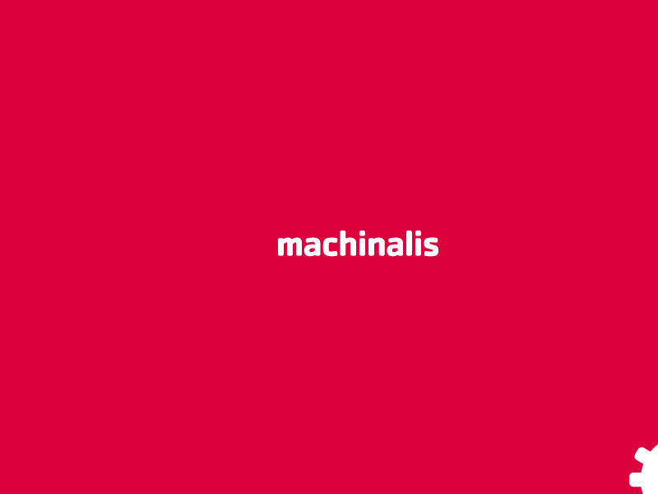
Feature Forge
PyData – Silicon Valley 2014
Daniel F. Moisset – dmoisset@machinalis.com

Slide 2
Writing Features is easy!
We do it all the time, usually it's just a 1-2 liner!
Notes:
As you have seen, the approach we've used for the problem is very simple, but it has some good properties I'd like to highlight.
The first one, that is very important for us as a company that needs to build products based on this tool, is that you can add effort incrementally and get results that benefit the application, so it's very low risk. This is different from machine learning or statistical approaches where you can use a lot of project time building a model and you might end up hitting gold, or you might end up with something that adds 0 visible results to a product. So, as much as we love machine learning where I work, we refrained ourselves from using it, getting something that''s not state-of-the-art in terms of coverage, but it is a very safe approach. Which is great value when interacting with customers

Slide 3
What about bugs
A normal bug crashes your program, or generates ludicrous results
A feature bug might decrease your classification accuracy by 4.3%
A feature bug might crash your 3-day long experiment after 2.81 days of running
97.1% of the statistics on these slides might be invented

Slide 4
Feature Forge
Low boiler plate
Add specifications about input data
Add specifications on output values
Testing!
  Fixture based
  Fuzz testing (generate valid random data and feed it)

Slide 5
Feature evaluation
Supports mixed types of features (vectors, multi-label, bag of words, …)
Generates a numpy array, ready to feed it to scikit learn or whatever you want
Strict mode or “tolerant mode”
  Discards samples that fail to evaluate
  Discards features that fail on many samples
Generates debugging info (mapping column 2317 to a feature)

Slide 6
Experimentation support
Not just feature oriented, allows you to play with model parameters
Keep a good log of experiments you already run, what were the parameters and input data for each, and whatever scores you got out of it
Run experiments in parallel

Slide 7
What we want to do
Integrate scikit learn and validation metrics
  We have an internal IPython notebook for this, needs love.
Add caching layers (to avoid repeated evaluation/vectorization when it helps)
Improve fuzz testing (more data structures, more speed)
Get more users!

Slide 8
Thanks!

