Slide 1



Big Bio-Data Analysis (Artificial Intelligence and Machine Learning)
Introduction to Deep Learning
By
Moses Ainembabazi
Department of microbiology, Mbarara University, Uganda mozeyrix@gmail.com

Slide 2
What is Deep Learning?
Deep learning is a subset of machine learning where algorithms inspired by the human brain(neural networks) learn from large amounts of data.
Good old Neural Networks with more layers
Essentially any neural network with two or more hidden layers is deep.
Deep learning algorithms attempt to learn (multiple levels of) representation by using a hierarchy of multiple layers

Slide 3
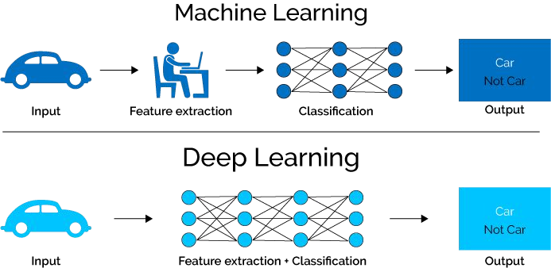

Slide 4
Feature Engineering vs Learning
Feature engineering is the process of using domain knowledge of the data to create features that make machine learning algorithms work.
“When working on a machine learning problem, feature engineering is manually designing what the input x's should be.”
-- Shayne Miel
“Coming up with features is difficult, time consuming, requires expert knowledge.”
-- Andrew Ng

Slide 5
Why Deep Learning Now?
Hardware Improvement (GPU, TPU)
Data (labeled data)
Algorithmic advances (activation functions for neural layers, better Optimisation algorithms)
new wave of investment
Open source tools and libraries

Slide 6
Deep learning Applications
Natural Language Processing
Machine Translation, Speech Recognition
Computer Vision
Self driving cars, health care , drug discovery
Games : Chess and Go
Robotics
Biological sequences
Predicting DNA motifs or protein classes
Protein folding

Slide 7
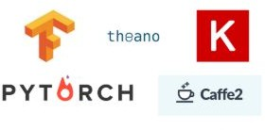
Tools for Deep Learning

Slide 8
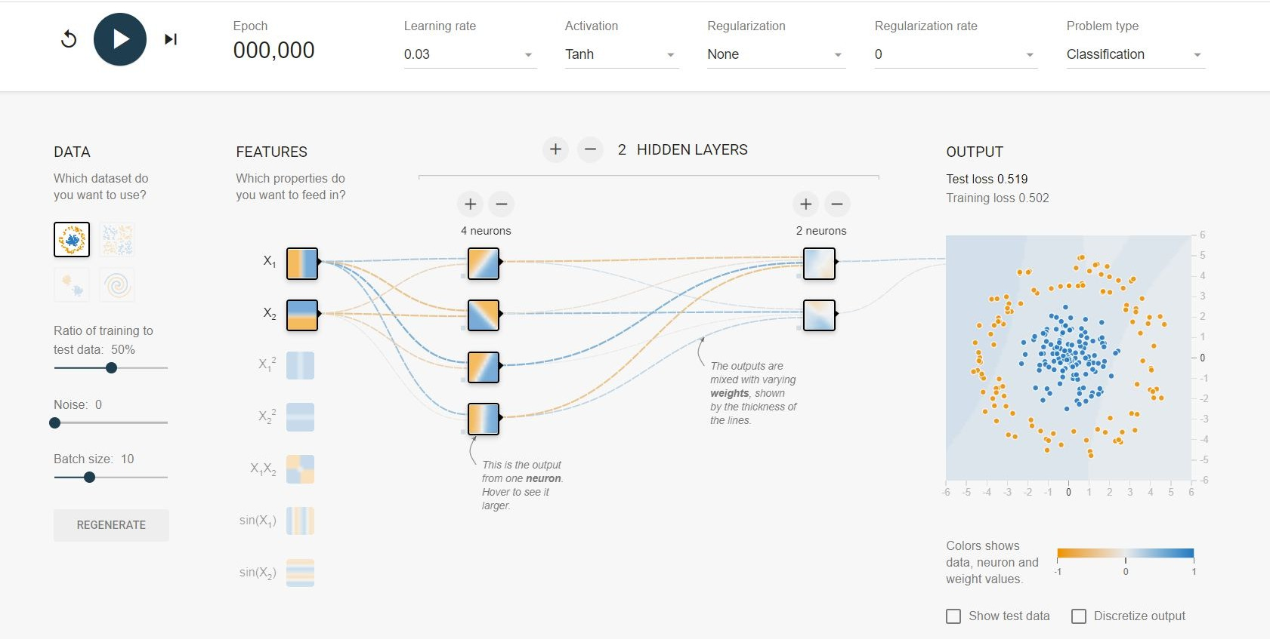
LIVE DEMO
link to demo

Slide 9
Deep Learning Models
Common deep learning models:
Deep Feed Forward Neural Networks (DNN)
Convolutional Neural Networks(CNNs)
Recurrent Neural Networks (RNNs)
Long Short Term Memory Neural Networks (LSTMs) Others
Generative Adversarial Networks (GANs)
Encoder Decoder model

Slide 10
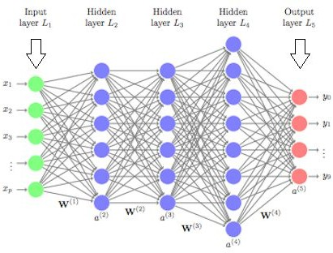
Deep Feed Forward Neural Networks
Feed forward neural networks with more than 2 hidden layers

Slide 11
Convolutional Neural Networks
Class of deep neural networks, most commonly applied to analyzing visual imagery
CNNs have been so successful at computer vision tasks Key two characteristic /properties of CNNs:
They can learn spatial hierarchies of patterns
The patterns they learn are translation invariant.

Slide 12
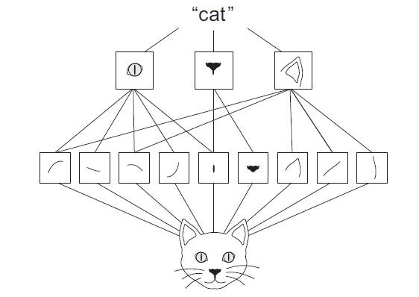
Convolution Operation
Convolutions operate over 3D tensors, called feature maps, with two spatial axes (height and width) as well as a depth axis (also called the channels axis).
Convolution operation extracts patches from its input feature map and applies the same transformation to all of these patches, producing an output feature map

Slide 13
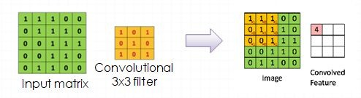
Convolutions are defined by two key parameters:
Size of the patches extracted from the inputs
Depth of the output feature map
These are typically 3 × 3 or 5 × 5. In the example, they are 3 × 3, which is a common choice.
Stride: Number of steps a filter is moved

Slide 14
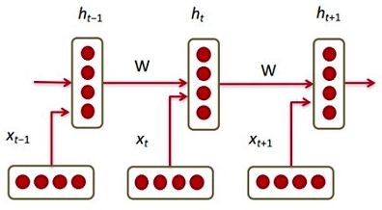
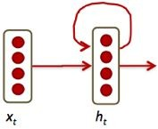

Recurrent Neural Networks
Humans don’t start their thinking from scratch every second.
RNN address this issue.
They are networks with loops in them, allowing information to persist.

Slide 15
RNNs can be used for sequential prediction and time series prediction.
RNNs experience the problem of Long-Term Dependencies and this is solved by a special kind of RNN called LSTMs

Slide 16
Long Short Term Memory Neural Networks
LSTMs are a special kind of RNN capable of learning long-term dependencies.
They have some internal contextual state cells that act as long-term or short-term memory cells.
The output of the LSTM network is modulated by the state of these cells.

Slide 17
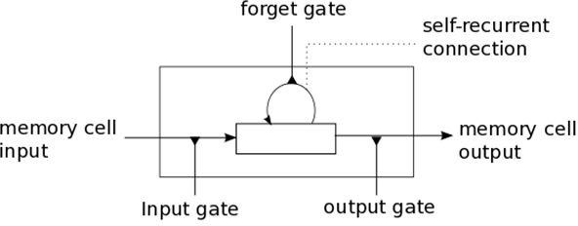
In addition to the cells, the LSTM units have gates (input gate, output gate and forget gate) that are used to control the flow of information into and out of the cells.
LSTMs elegantly address the problem of vanishing and exploding gradients encountered in vanilla RNNs

Slide 18
Vanishing Gradient Problem
Difficulty found in training neural networks with gradient-based learning methods and back propagation.
Each of the neural network's weights receives an update proportional to
the partial derivative of the error function with respect to the current weight in each iteration of training.
The problem is that in some cases, the gradient will be vanishingly small, effectively preventing the weight from changing its value.
In the worst case, this may completely stop the neural network from further training.
●

Slide 19
Training Deep Neural Network
How do DNNs learn so well? (Backpropagation)
The key is they compute answers across layers in a forward pass and then to use a backwards pass to optimize the weights.
This way all layers are updated each round (sometimes called an ‘epoch’) of training!
How does this backward pass work?
The chain rule (remember from calculus?) – where we can calculate the derivative (the slope or rate of change) from two or more functions.

Slide 20
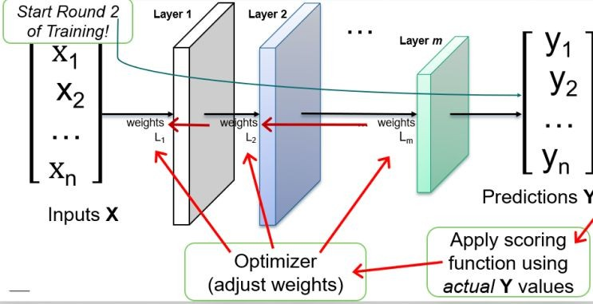
Training Deep Neural Networks (Cont’d)

Slide 21
Training Deep Neural Networks (Cont’d)
Given an example (or group of examples)
we know how to compute the derivative for each weight.
How exactly do we update the weights?
How often? (after each training data point? after all the training data points?)

Slide 22
Gradient Descent
W_new= W_old- lr* derivative
Classical approach—get derivative for entire data set, then take a step in that direction
Pros: Each step is informed by all the data
Cons: Very slow, especially as data gets big

Slide 23
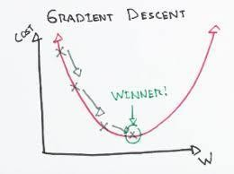
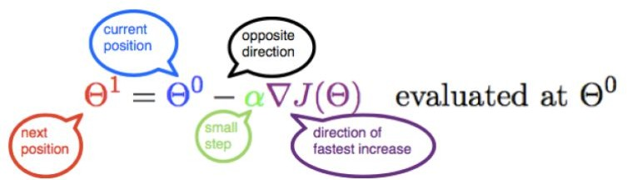
Gradient Descent
Step 1: Calculate the gradient of the function w.r.t the parameter. If there are multiple parameters, then use partial derivatives w.r.t the various parameters.
Step 2: Calculate the descent value for different parameters by multiplying the value of derivatives with learning or descent rate (step size) and -1.
Step 3: Update the value of parameter by adding up the existing value of parameter and the descent value.

Slide 24
Another Approach: Stochastic Gradient Descent
Get derivative for just one point, and take a step in that direction
Steps are “less informed” but you take more of them
Should “balance out”
Probably want a smaller step size
Also helps “regularize”

Slide 25
Compromise approach: Mini-batch
Compromise approach: Mini-batch
Get derivative for a ”small” set of points, then take a step in that direction
Typical mini batch sizes are 16, 32 Strikes a balance between two extremes

Slide 26
Compromise approach: Mini-batch
Full-batch: Use entire data set to compute gradient before updating
Mini-batch: Use a smaller portion of data (but more than single example) to compute gradient before updating
Stochastic Gradient Descent (SGD): Use a single example to compute gradient before updating
An Epoch : refers to a single pass through all of the training data.

Slide 27
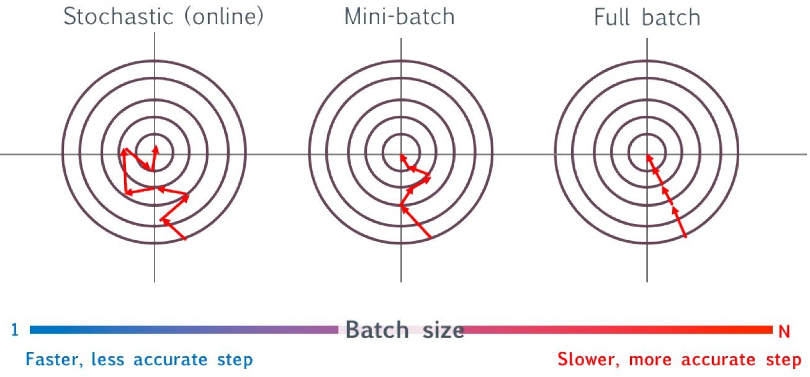
Comparison of Batching Approaches

Slide 28
Regularization Techniques for Deep Learning
We have several means by which to help “regularize” neural networks - that is, to prevent overfitting
Regularization penalty in cost function
One option is to explicitly add a penalty to the loss function for having high weights
Dropout:
Dropout is a mechanism where at each training iteration (batch) we randomly remove a subset of neurons

Slide 29
Regularization Techniques for Deep Learning
Early stopping
Another, more heuristical approach to regularization is early stopping.
This refers to choosing some rules after which to stop training.
Stochastic / Mini-batch Gradient descent (to some degree)

Slide 30
Optimizers for training deep learning models
There are several variants to updating the weights which give better performance in practice.
These successive “tweaks” each attempt to improve on the previous idea. The resulting (often complicated) methods are referred to as “optimizers”.
RMSProp
Adam
RMSProp and Adam seem to be quite popular now.
Difficult to predict in advance which will be best for a particular problem.

Slide 31
Transfer Learning
Transfer learning is a machine learning method where a model developed for a task is reused as the starting point for a model on a second task.
Popular approach in deep learning where pre-trained models are used as the starting point on computer vision and natural language processing tasks.
Several Pre-trained models exist and usually are part of the deep learning libraries e.g Keras.
These include;
VGG, ResNet, Inception, Inception-ResNet

Slide 32
There are two ways to use a pre-trained network:
feature extraction and fine-tuning

Slide 33
Caution
Majority of the problems can be solved by classical machine learning algorithms.
Use deep learning only when you really need it.

Slide 34
References
http://colah.github.io/posts/2015-08-Understanding-LSTMs/
Deep learning with python book
Deep learning Specialization (Cousera)
Deep Learning Book (Ian Goodfellow)
https://cs231n.github.io/convolutional-networks/
http://introtodeeplearning.com/slides/6S191_MIT_DeepLearning_L1.pdf

Slide 35
Thank you

