Slide 1



Big Bio-Data Analysis (Artificial Intelligence and Machine Learning)
Introduction to Neural Networks
By
Moses Ainembabazi
Department of Microbiology, Mbarara University, Uganda mozeyrix@gmail.com

Slide 2
Neural Networks
Neural Networks : information processing paradigm inspired by biological nervous systems, such as our brain
Structure : large number of highly interconnected processing elements (neurons) working together
Like people, they learn from experience (by example)

Slide 3
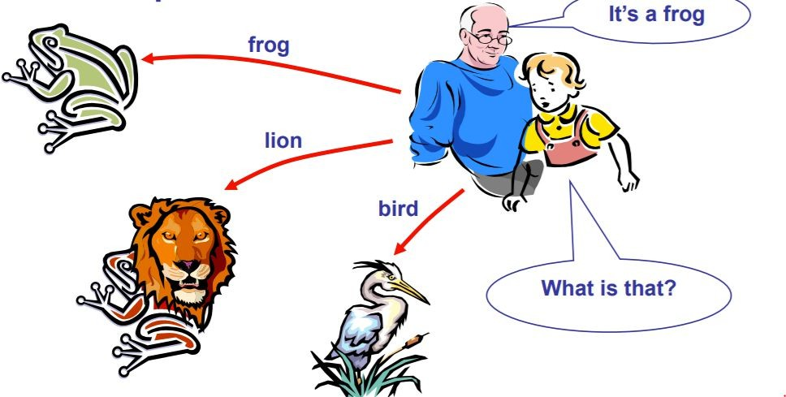
The idea of Neural Networks
Neural Networks learn relationship between cause & effect or organize large volumes of data into orderly and informative patterns

Slide 4
Motivation for Neural Networks
Use biology as inspiration for mathematical model
Get signals from previous neurons
Generate signals (or not) according to inputs
Pass signals on to next neurons
By layering many neurons, can create complex model

Slide 5
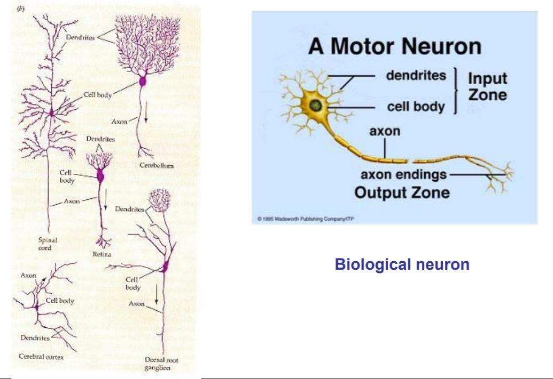
Biological Neural Networks

Slide 6
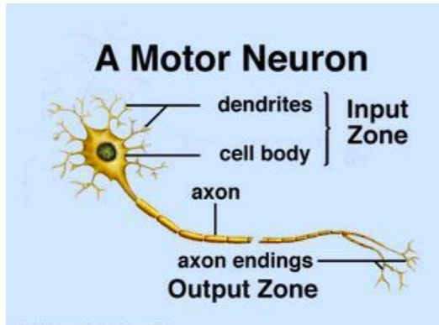
Biological Neural Networks (Cont’d)
A biological neuron has 3 types of main components; dendrites, soma (cell body) & axon
Dendrites receives signals from other neurons.
The soma, sums the incoming signals.
When sufficient input is received, the cell fires;
that is it transmit a signal over its axon to other cells

Slide 7
Several key features of the processing elements of NN are suggested by the properties of biological neurons:
The processing element receives many signals
Signals may be modified by a weight at the receiving synapse
The processing element sums the weighted inputs.
Under appropriate circumstances (sufficient input), the neuron transmits a single output
The output from a particular neuron may go to many other neurons

Slide 8
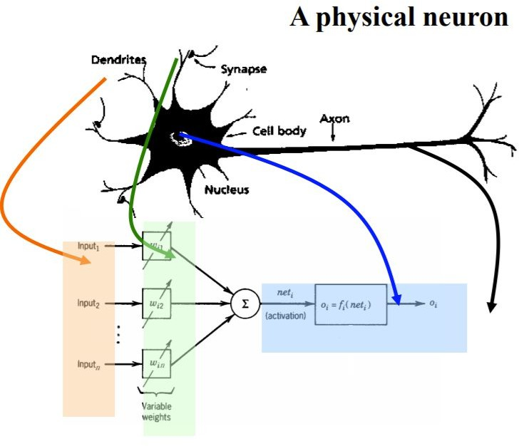
An Artificial Neuron

Slide 9
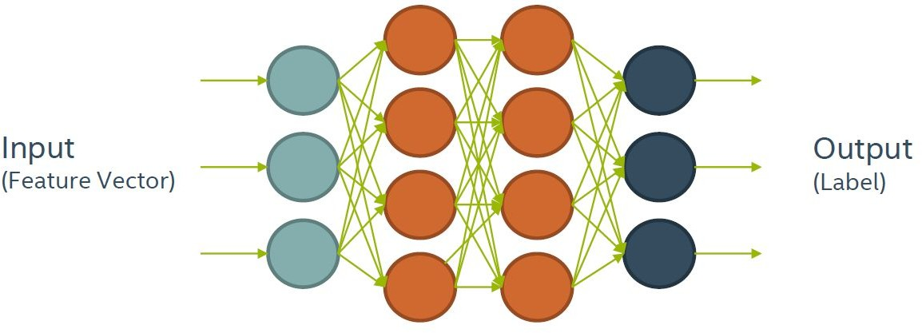
Structure of Neural Network
Can think of it as a complicated computation engine

Slide 10
Structure of Neural Network(Cont’d)
Information processing occurs at many simple elements called neurons.
Signals are passed between neurons over connection
links
Each connection link has an associated weight, which, in typical neural network, multiplies the signal transmitted
Each neuron applies an activation function to its net input to determine its output signal

Slide 11
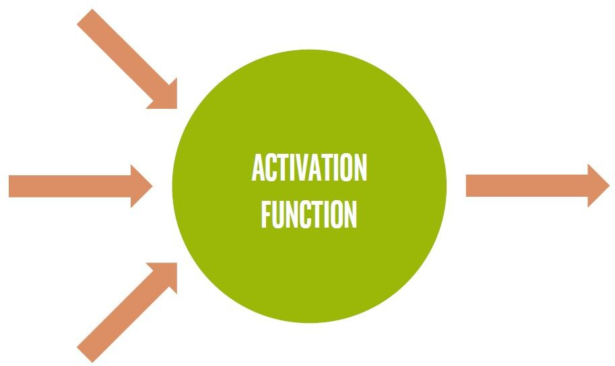
Basic Neuron Visualization

Slide 12
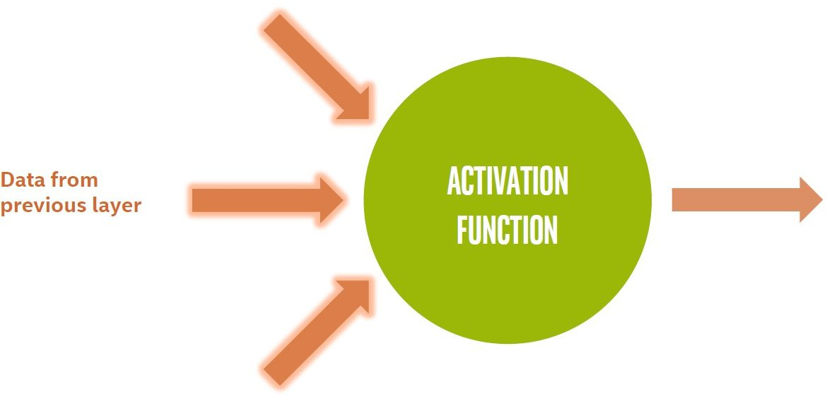
Basic Neuron Visualization

Slide 13
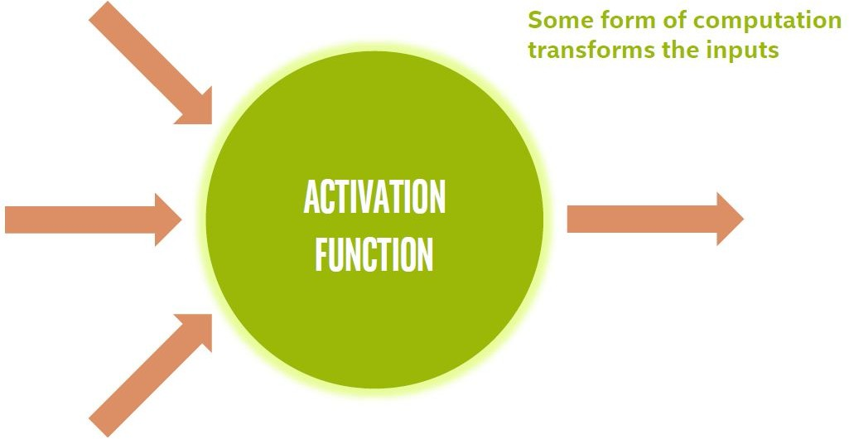
Basic Neuron Visualization

Slide 14
Basic Neuron Visualization

Slide 15
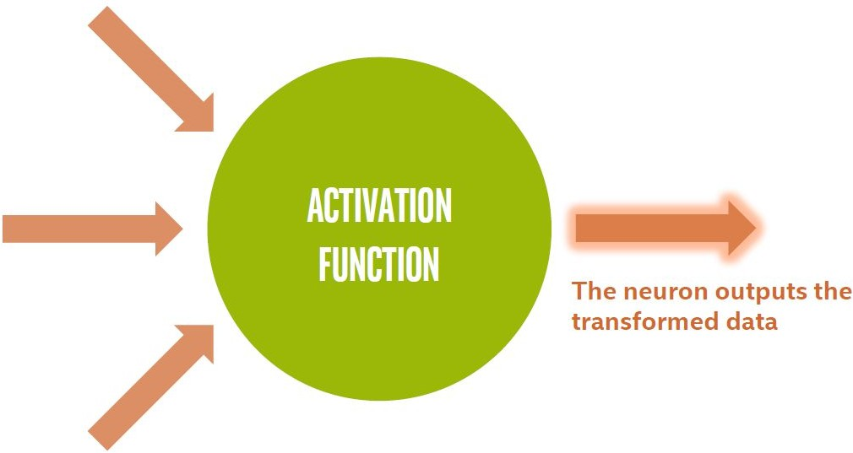
Basic Neuron Visualization

Slide 16
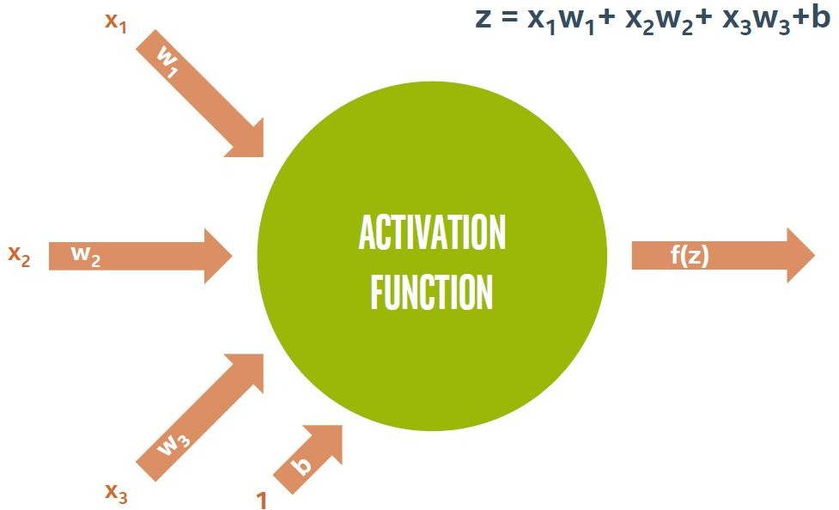
Basic Neuron Visualization

Slide 17
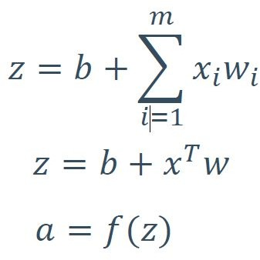
In Vector Notation
z = “net input” b = “bias term”
f = activation function a = output to next layer

Slide 18
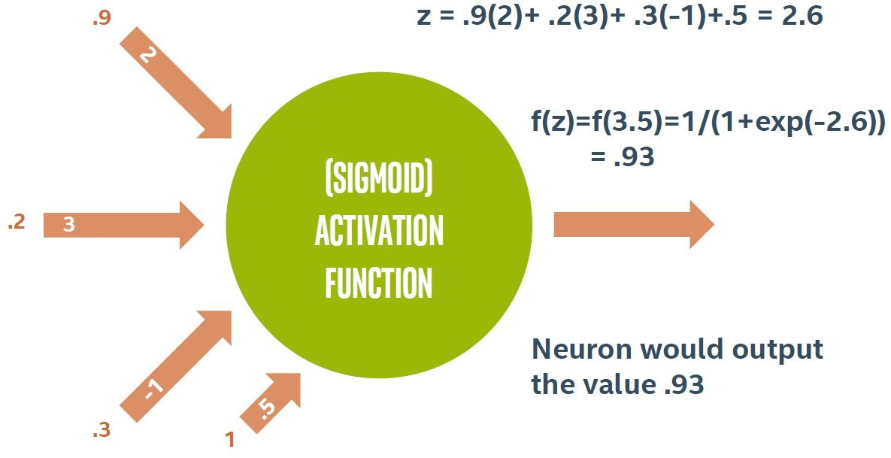
Example Neuron Computation

Slide 19
Types of Neurons
Input and Output Neurons
Nearly every neural network has input and output neurons.
The input neurons accept data from the program for the network.
The output neuron provides processed data from the network back to the program

Slide 20
Types of Neurons (Cont’d)
Hidden Neurons
Hidden neurons have two important characteristics.
Hidden neurons only receive input from other neurons, such as input or other hidden neurons.
Hidden neurons only output to other neurons, such as output or other hidden neurons.
They help the neural network understand the input, and they form the output.
They are not directly connected to the incoming data or to the eventual output

Slide 21
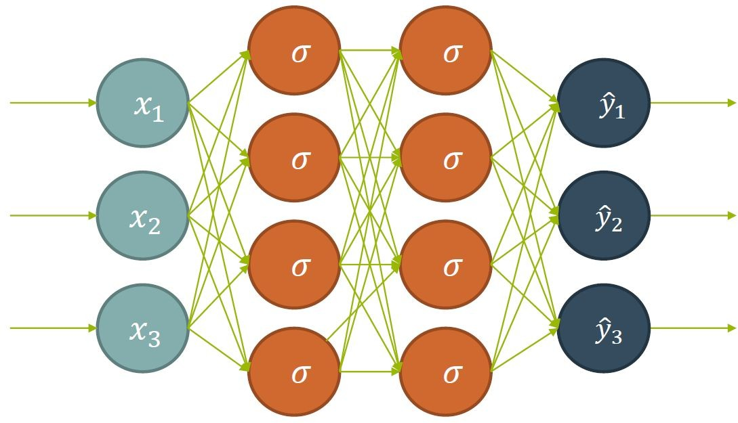
Types of Neurons (Cont’d)

Slide 22
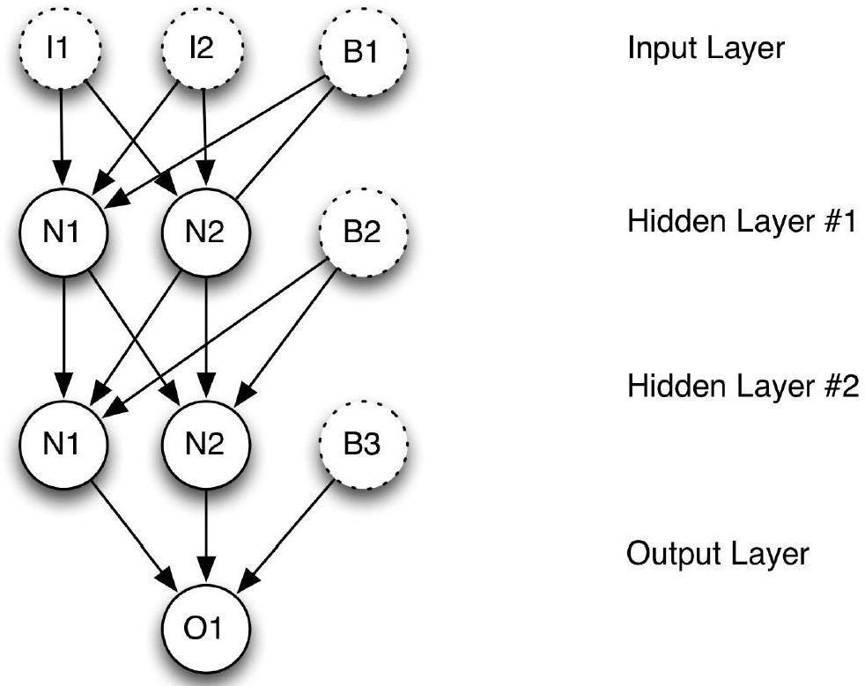
Types of Neurons (Cont’d)
Bias Neurons
Bias neurons function like an input neuron that always produces the value of 1
They are not connected to the previous layer, Because the bias neurons have a constant output of 1
Not all neural networks have bias neurons

Slide 23
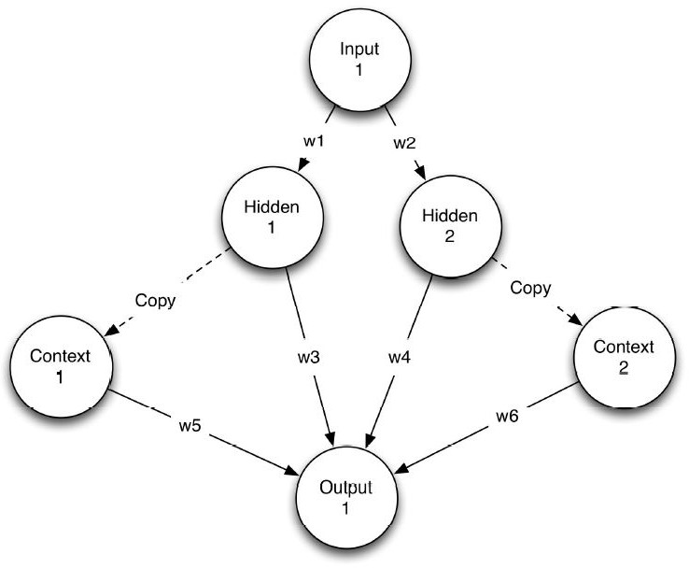
Types of Neurons (Cont’d)
Context Neurons
Used in recurrent neural networks.
This type of neuron allows the NN to maintain state.
As a result, a given input may not always produce exactly the same output.
This inconsistency is similar to the workings of biological brains

Slide 24
Characterization of Neural Networks
Architecture
A pattern of connections between neurons
Single Layer Feedforward
Multilayer Feedforward
Recurrent
Strategy / Learning Algorithm
A method of determining the connection weights.
Supervised (Feedforward, Perceptron)
Unsupervised (e.g Self Organising Maps)
Activation Function
Function to compute output signal from input signal

Slide 25
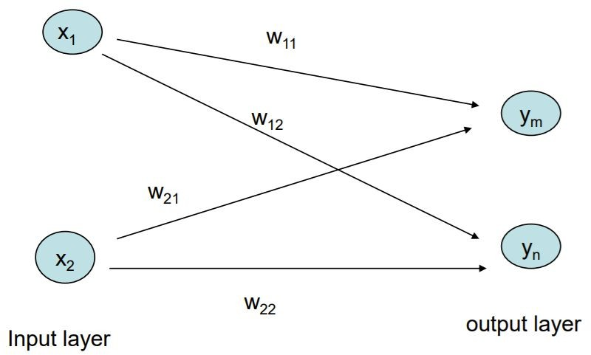
Single Layer Feedforward NN

Slide 26
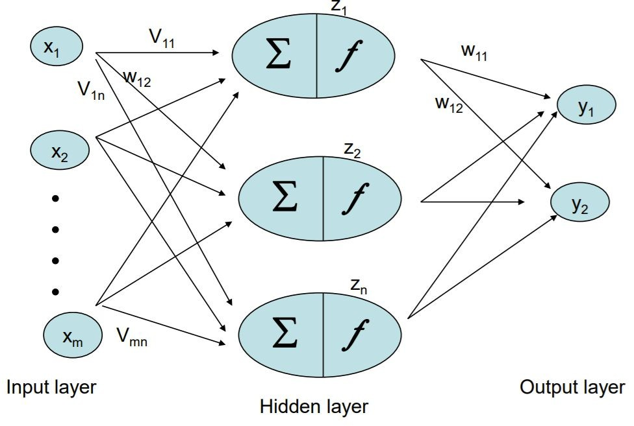
MultiLayer Feedforward NN

Slide 27
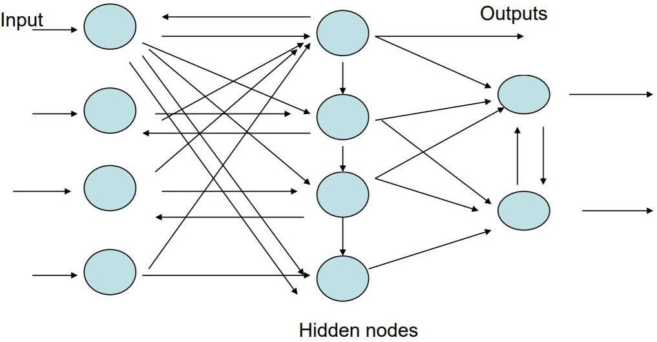
Recurrent NN

Slide 28
Activation Functions
Activation or transfer functions establish bounds for the output of neurons.
Neural networks can use many different activation functions.
Most common activation functions : ~6
Linear Activation Function, Step Activation Function
Sigmoid Activation Function, Hyperbolic Tangent Activation Function,
Rectified Linear Units (ReLU), Softmax Activation Function

Slide 29
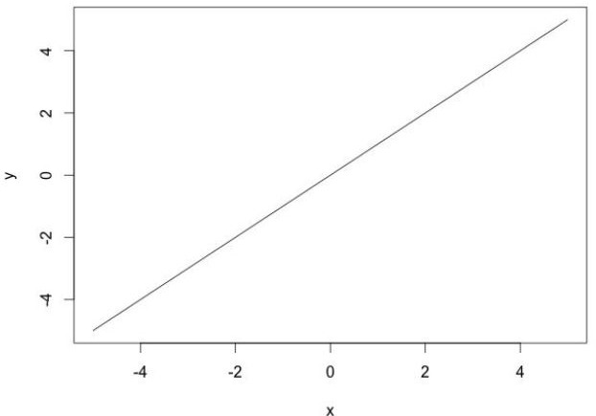

Activation Functions (Cont’d)
Linear Activation Function
Most basic activation function is the linear function.
It does not change the neuron output at all
Eqn shows how the program typically implements a linear activation function

Slide 30
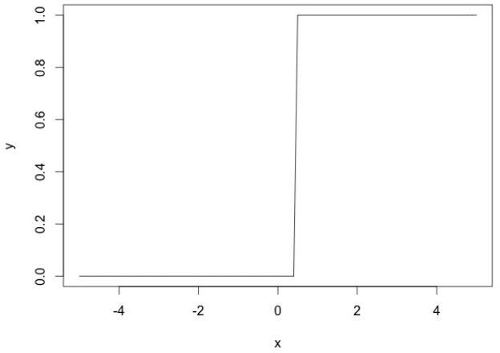
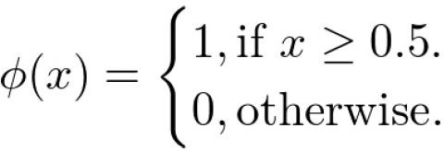
Activation Functions (Cont’d)
Step Activation Function
The step or threshold activation function is another simple activation function.
Outputs a value of 1 for incoming values of 0.5 or higher and 0 for all other values.

Slide 31
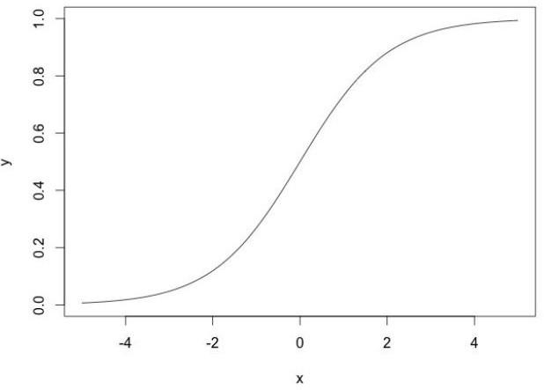
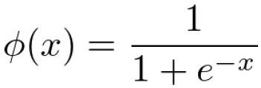
Activation Functions (Cont’d)
Sigmoid Activation Function
The sigmoid or logistic activation function is a very common choice for feedforward neural networks that need to output only positive numbers
It ensures that values stay within a relatively small range

Slide 32
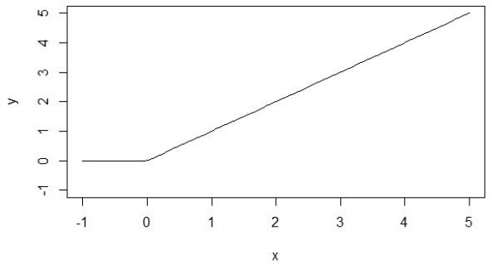

Activation Functions (Cont’d)
Rectified Linear Units (ReLU)
ReLU activation function is a linear, non-saturating function
Most current research now recommends the ReLU due to superior training results.
Unlike the sigmoid & the hyperbolic tangent activation functions, the ReLU does not saturate to -1, 0, or 1

Slide 33
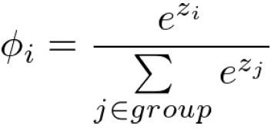
Activation Functions (Cont’d)
Softmax Activation Function
Softmax is usually found in the output layer of a neural network.
The softmax function is used on a classification neural network.
The neuron that has the highest value claims the input as a member of its class.

Slide 34
Typical Activation Function
Problem | Final-Layer Activation | Loss Function
Binary Classification | sigmoid | Binary_crossentropy
Multiple Classes but One Label | softmax | Categorical_crossentropy
Multiple Classes and Multiple Labels | sigmoid | Binary_crossentropy
Logistic Regression (numbers 0-1) | NONE | Mean Square Error (MSE)
Regression (arbitrary numbers) | sigmoid | MSE or binary_crossentropy

Slide 35
Why Neural Networks?
Why not just use a single neuron?
Why do we need a larger network?
A single neuron (like logistic regression) only permits a linear decision boundary.
Most real-world problems are considerably more complicated!

Slide 36
Applications of Neural Networks
Signal processing
Pattern recognition, e.g. handwritten characters or face identification.
Diagnosis or mapping symptoms to a medical case.
Speech recognition
Human Emotion Detection

Slide 37
Applications of Neural Networks
Prediction of Protein Secondary Structure
Prediction of Signal Peptides and Their Cleavage Sites
Applications for DNA and RNA Nucleotide Sequences
Eukaryotic Gene Finding and Intron Splice Site Prediction
Prediction of Intron Splice Sites by Combining Local and Global Sequence Information

Slide 38
References
Artificial Intelligence for Humans Volume 3 (Geof Heaton)
Intel Academy Deep Learning Course
Lecture notes by Prof. Sai Saranya
Bioinformatics: The machine learning approach (Pierre Baldi and Søren Brunak)
Introduction to Machine Learning and Bioinformatics
extra resource on ml

Slide 39
Thank you!
If you have any questions feel free to email me: mozeyrix@gmail.com

