Slide 1



Big Bio-Data Analysis (Artificial Intelligence and Machine Learning)
Machine Learning Algorithms
By
Ainembabazi Moses
Department of microbiology,Mbarara University, Uganda mozeyrix@gmail.com

Slide 2
Overview
Linear Regression
Introduction to Linear Regression
Simple & Multi-Linear Regression
Regularization: Ridge & Lasso Regression
Logistic Regression
Introduction to Logistic Regression (Binary Logistic Regression)
Odds Ratio
Maximum Likelihood Estimation
Support Vector Machine

Slide 3
Introduction to Linear Regression
Linear regression is one of the most well known and well understood algorithm in statistics and machine learning.
Linear regression is studied as a model for understanding the relationship between input and output numerical variables.
Regression is a statistical procedure that determines the equation for the straight line that best fits a specific set of data

Slide 4
Introduction to Linear Regression(cont’d)
Any straight line can be represented by an equation of the form Y = 𝛽X + 𝛼, where b and 𝛼 are constants.
The value of 𝛽 is called the slope constant and determines the direction and degree to which the line is
tilted.
The value of 𝛼 is called the Y-intercept and determines the point where the line crosses the Y-axis.

Slide 5
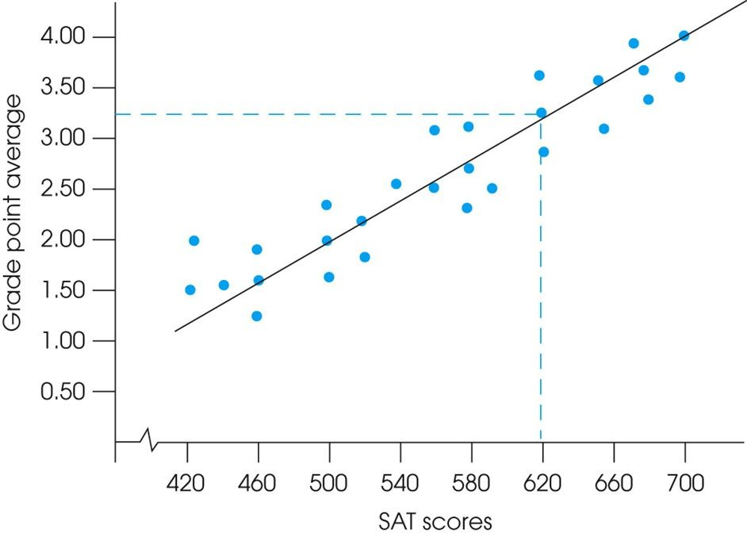
Introduction to Linear Regression(cont’d)

Slide 6
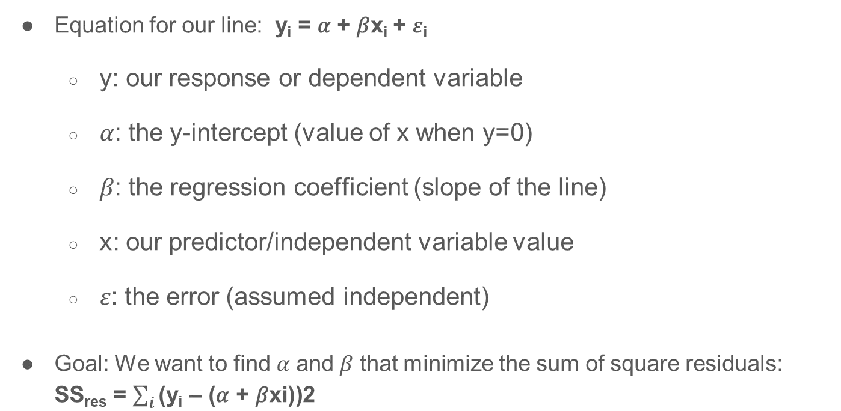
Simple Linear Regression (cont’d)
●

Slide 7
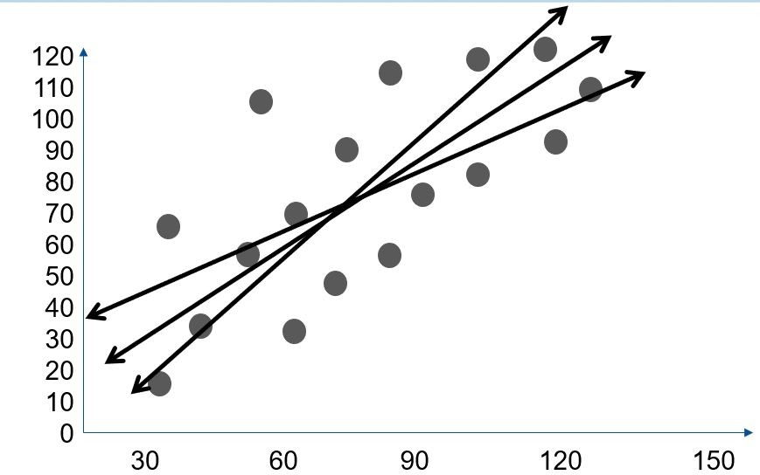
Simple Linear Regression (cont’d)
Fitting a line to data

Slide 8
How well a set of data points fits a straight line can be measured by calculating the distance between the data points and the line.
The total error between the data points and the line is obtained by squaring each distance and then summing the squared values.
The regression equation is designed to produce the minimum sum of squared errors

Slide 9
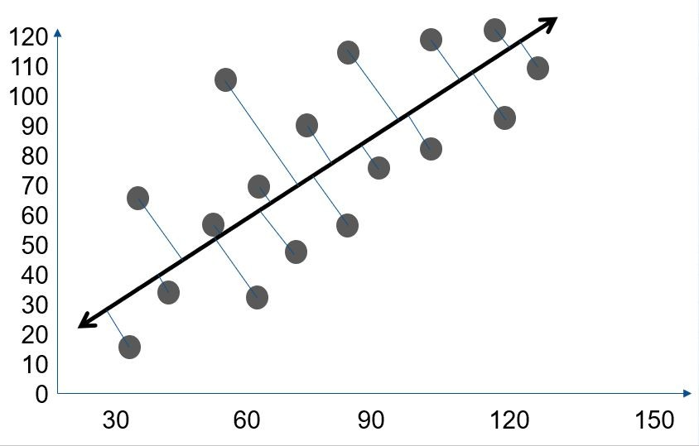
Simple Linear Regression (cont’d)
Fitting a line to data
Select the “best” line that minimizes the sum of the distances of points to the fitted line –these distances are called the “residuals”

Slide 10
Multi-Linear Regression
In the same way that simple linear regression produces an equation that uses values of X to predict values of Y, multiple regression produces an equation that uses two different variables (X₁ and X₂) to predict values of Y.
Multiple predictors
The equation is determined by a least squared error solution that minimizes the squared distances between the actual Y values and the predicted Y values.

Slide 11
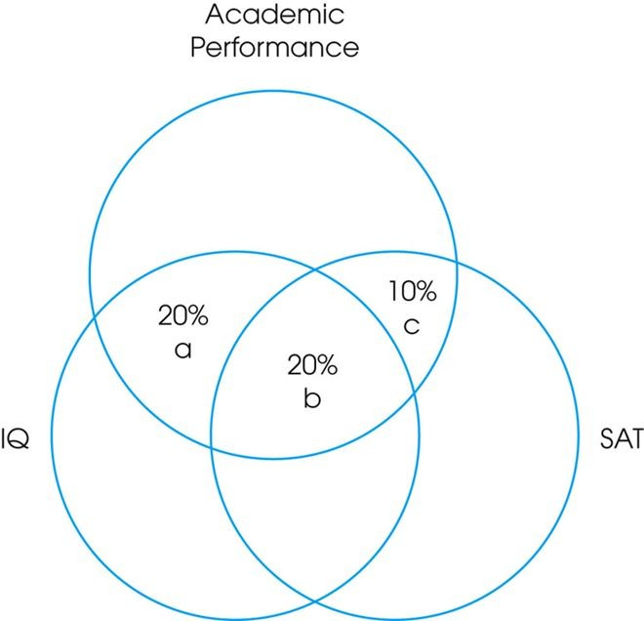
Multi-Linear Regression (Cont’d)
Predicting the variance in academic performance from IQ and SAT scores.
The overlap between IQ and academic performance indicates that 40% of the variance in academic performance can be predicted from IQ scores.
Similarly, 30% of the variance in academic performance can be predicted from SAT scores.
However, IQ and SAT also overlap, so that SAT scores contribute an additional predication of only 10% beyond what is already predicted by IQ.

Slide 12
Multi-Linear Regression (cont’d)
General form of the equation: y = 𝛽₀+𝛽₁x₁+𝛽₂x₂+…+𝛽_{n}x_{n}+ 𝜀
y: our response or dependent variable
𝛽₀: the y-intercept coefficient
𝛽_{i} : the regression coefficient (slope of the line) x: our predictor/independent variable value
𝜀: the error (assumed independent)
Goal: We want to minimize the sum of square residuals for all predictors

Slide 13
Multi-Linear Regression (cont’d)
General form of the equation: y = 𝛽₀+𝛽₁x₁+𝛽₂x₂+…+𝛽_{n}x_{n}+ 𝜀
y: our response or dependent variable
𝛽₀: the y-intercept coefficient
𝛽_{i} : the regression coefficient (slope of the line) x: our predictor/independent variable value
𝜀: the error (assumed independent)
Goal: We want to minimize the sum of square residuals for all predictors

Slide 14
Multi-Linear Regression (cont’d)
Important Assumptions
For a linear regression to be valid, the relationship between the response and predictor should be (nearly) linear.
Residuals should be checked for the following:
Independence
Normally distributed
Equal variance (should occur on both sides of line)

Slide 15
Bias-Variance Trade-Off
There are two critical characteristics of estimators to be considered i.e. the bias and the variance.
The bias is the difference between the true population parameter and the expected estimator. It measures the accuracy of the estimates.
The Variance measures the spread, or uncertainty, in the estimates.

Slide 16
Bias-Variance Trade-Off (cont’d)
Both the bias & the variance are desired to be low, as large values result in poor predictions from the model.
The OLS estimator has the desired property of being unbiased. However, it can have a huge variance. Specifically, this happens when:
The predictor variables are highly correlated with each other;
There are many predictors
The solution to this is: reduce variance at the cost of introducing some bias. This approach is called regularization

Slide 17
Regularization:Ridge & LASSO Regression
Regularization revolves around modifying the loss function L; in particular, we add a regularization term that penalizes some specified properties of the model parameters.
where 𝜆 is a scalar that gives the weight (or importance) of the regularization term.
Fitting the model using the modified loss function L_{reg} would result in model parameters with desirable properties.

Slide 18
Regularization:Ridge & LASSO Regression
Ridge Regression (L2)
Technique used when the data suffers from multicollinearity ( independent variables are highly correlated)
Regularization term penalizes the squares of the parameter magnitudes
Penalty shrinks magnitude of all coefficients
Larger coefficients strongly penalized because of the squaring

Slide 19
Regularization:Ridge & LASSO Regression
LASSO Regression (L1)
Technique that performs both variable selection and regularization in order to enhance the prediction accuracy and interpretability of the resulting model
Regularization term penalizes the sum of the parameter absolute values (L1 penalty)
Penalty selectively shrinks some coefficients & larger penalties result in coefficient values closer to zero.

Slide 20
Linear Regression : The Syntax
Import the class containing the regression method
from sklearn.linear_model import LinearRegression
Create an instance of the class
LR= LinearRegression()
Fit the instance on the data and then predict the expected value
LR= LR.fit(X_train, y_train) y_predict= LR.predict(X_test)

Slide 21
Logistic Regression (LR)
LR is a type of regression for binary prediction problems (the response classes are 0/1, TRUE/FALSE, etc.)
It provides a smooth probabilistic transition between the two classes while also controlling for over-fitting
Output values are forced between [0,1]

Slide 22
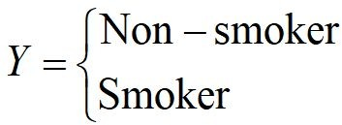

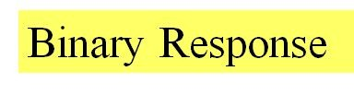

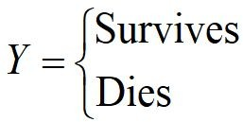
Logistic Regression (LR)
Whether or not a person smokes
Success of a medical treatment

Slide 23
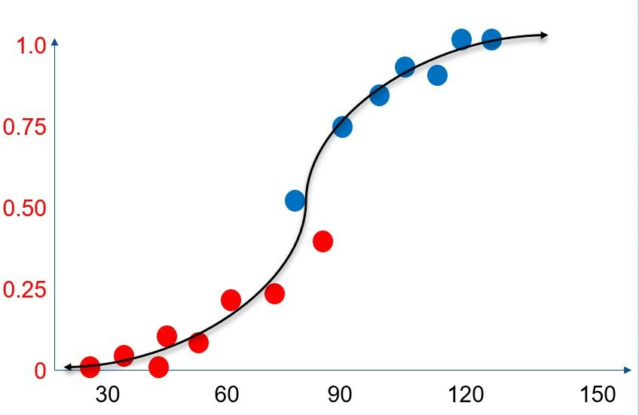
Logistic Regression (Cont.)
LR squeezes predictions to be probabilities between 0-1
New predictions can be assigned to one class or another using a cutoff (typically > 0.5)

Slide 24
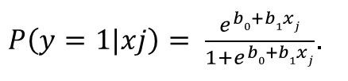
Logistic Regression (cont’d)
Model Construction with Logistic Regression
Given a set of binary class labels y∈{0,1}, we can provide the probability of a class for a single attribute using the equation:
Above, b are regression coefficients, and x is the j^{th}
j
predictor/feature.
The more general form of the ”logit” function is:
Logit(p) = log(p/1-p) which is a sigmoid function

Slide 25
LR (Cont.): Odds Ratio
The logit function (not the regression coefficients) has a linear relationship with predictors.
This is hard to interpret so LR often provides “odds ratios” with results
Odds ratios are: prob. of success / prob. of failure
So an odds ratio of 1 is equivalent to a probability of 0.5

Slide 26
Odds Ratio Example
Example:
The probability of passing is 0.8, the prob. of failing is 1 –
0.8 = 0.2.
The odds of success are 0.8/0.2 = 4 (e.g. “4-to-1 odds of passing”)

Slide 27
Logistic Regression (Cont.)
With Linear Regression we tried to minimize the squares of the residuals, to get the best fitting line.
But this doesn’t work for Logistic Regression.
Errors won’t be normally distributed (have 2 values)
We use something called maximum likelihood to estimate what the β and α are.

Slide 28
Maximum Likelihood Estimation
Maximum likelihood estimation (MLE) is an iterative process that estimates the best fitted equation.
The iterative bit just means that we try lots of models until we get to a situation where tweaking the equation any further doesn’t improve the fit.
MLE is kind of complicated, although the underlying assumptions are simple to understand, and very intuitive.
The basic idea is that we find the coefficient value that makes the observed data most likely.

Slide 29
Maximum Likelihood Estimation
MLE is a statistical method for estimating the coefficients of a model.
The likelihood function (L) measures the probability of observing the particular set of dependent variable values (p₁, p₂, ..., p_{n}) that occur in the sample:
L = Prob (p₁* p₂* * * p_{n})
The higher the L, the higher the probability of observing the ps in the sample.

Slide 30
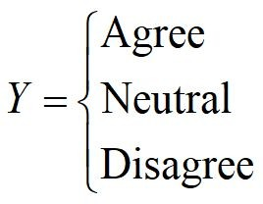


Non-binary variables
A lot of categorical variables are not binary though, what can we do with these?
A B O AB
Which blood type does a person have, given the results of various diagnostic tests?

Slide 31
Multinomial Logistic Regression
Often we can recode them to a binary response.
You often see vote choice in Britain coded to Conservative or not (with the not category including Labour, the Liberal Democrats and everyone else).
We could use something called multinomial logistic regression. This allows the dependent categorical variable to have more than two categories.

Slide 32
Logistic Regression : The Syntax
Import the class containing the regression method
from sklearn.linear_model import LogisticRegression
Create an instance of the class
LR= LogisticRegression(random_state=0)
Fit the instance on the data and then predict the expected value
LR= LR.fit(X_train, y_train) y_predict= LR.predict(X_test)

Slide 33
Support Vector Machine (SVM)
Support vector machine (SVM) is a popular machine learning algorithm, often employed for classification or regression.
The algorithm tries to find the optimal hyperplane (boundary) that can separate two classes of data.
Here, “optimal” refers to the decision boundaries forming the widest margin between classes- the support vectors.

Slide 34
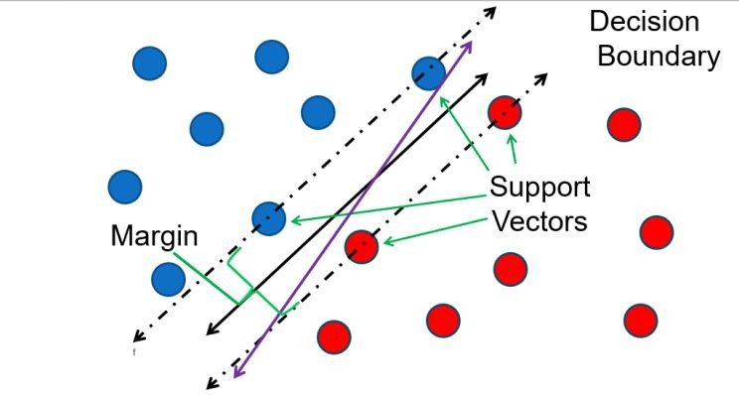
A Linear SVM Example

Slide 35
SVM Terminology
Support Vectors
Support vectors are the data points, which are closest to the hyperplane.
They define the separating line better by calculating margins.
Hyperplane
A hyperplane is a decision plane which separates between a set of objects having different class memberships
Margin
A margin is a gap between the two lines on the closest class points.
It is calculated as the perpendicular distance from the line to support vectors or closest points

Slide 36
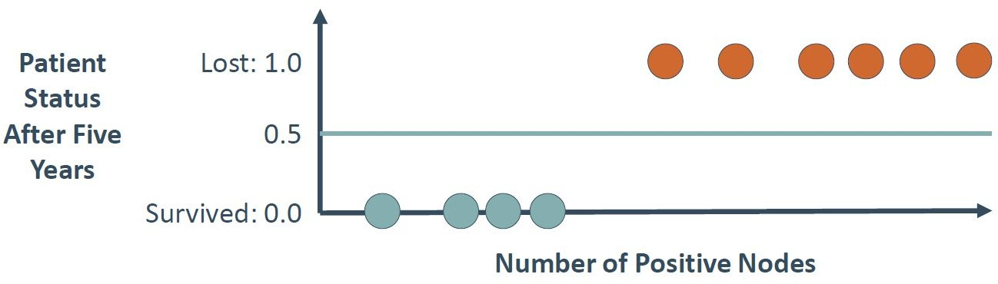
Support Vector Machine (SVM)

Slide 37
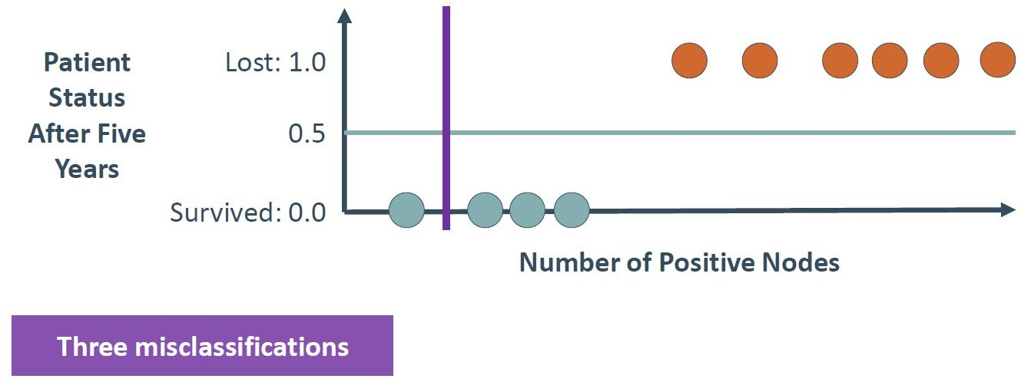
Support Vector Machine (SVM)

Slide 38
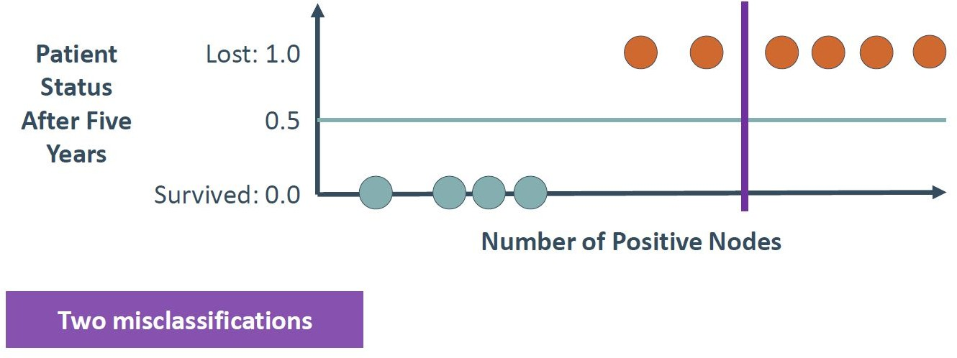
Support Vector Machine (SVM)

Slide 39
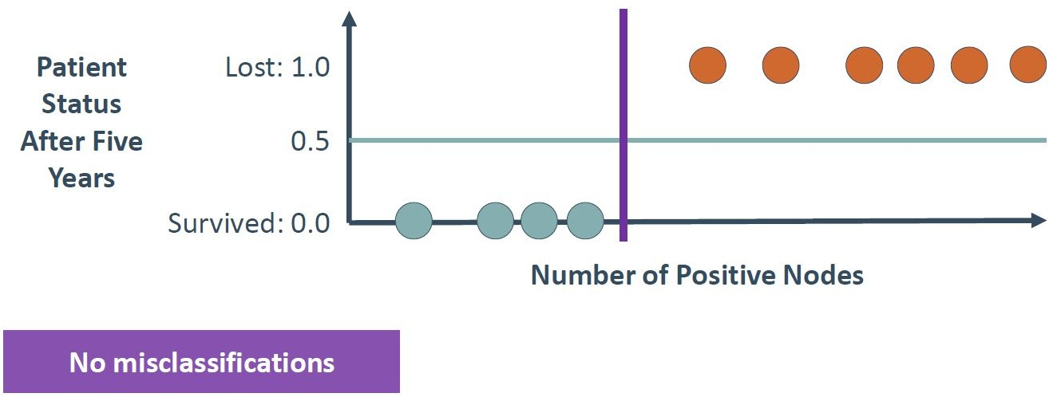
Support Vector Machine (SVM)

Slide 40
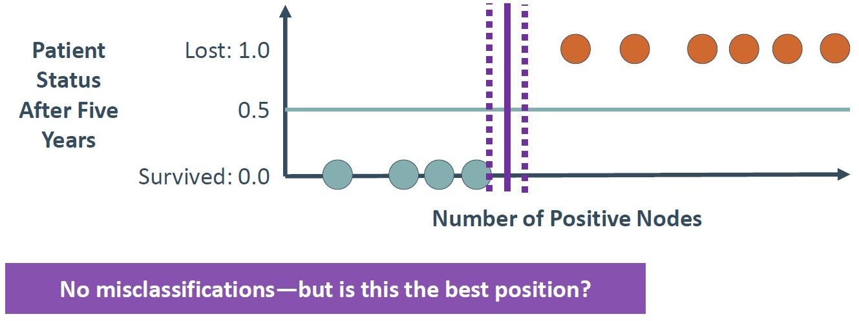
Support Vector Machine (SVM)

Slide 41
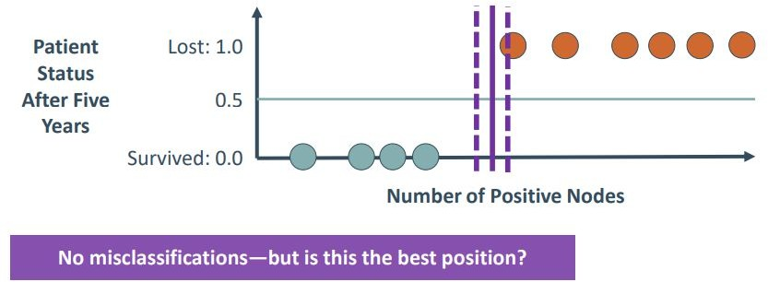
Support Vector Machine (SVM)

Slide 42
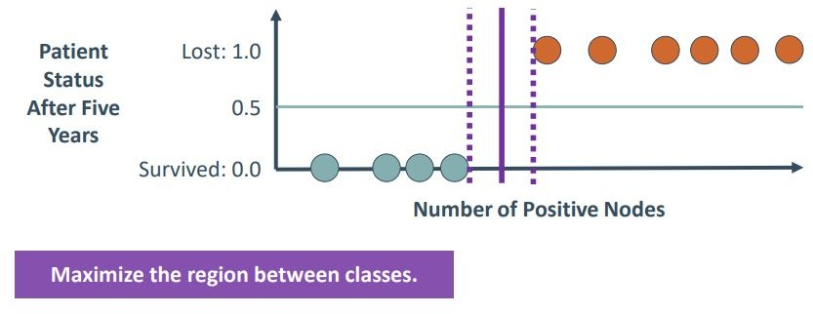
Support Vector Machine (SVM)

Slide 43
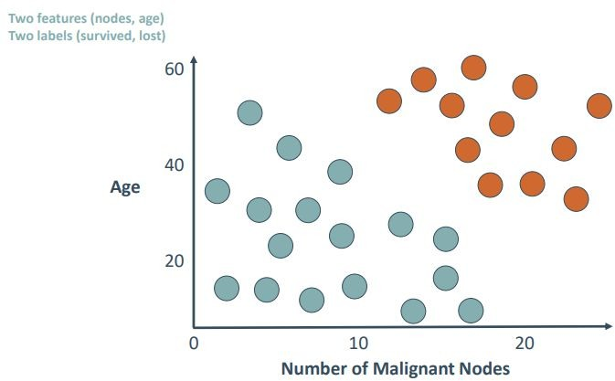
Classification with SVMs

Slide 44
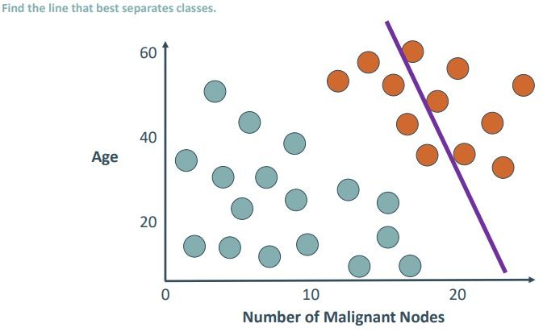
Classification with SVMs

Slide 45
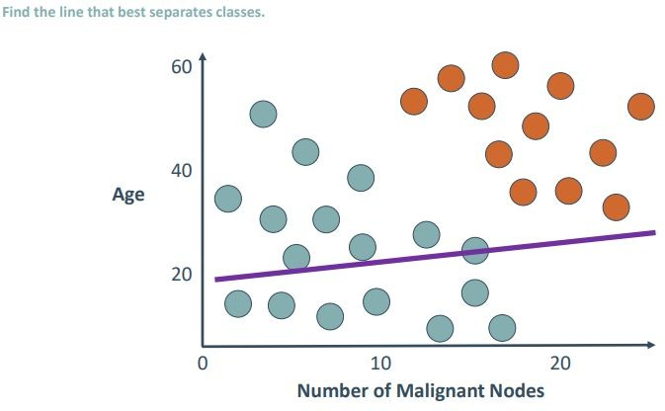
Classification with SVMs

Slide 46
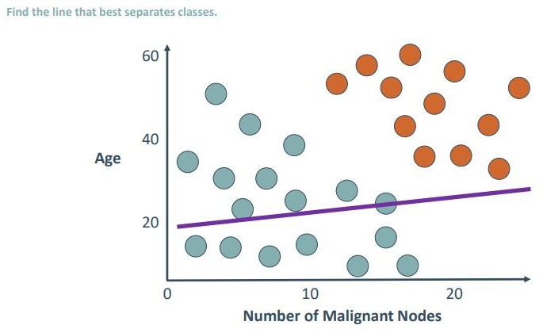
Classification with SVMs

Slide 47
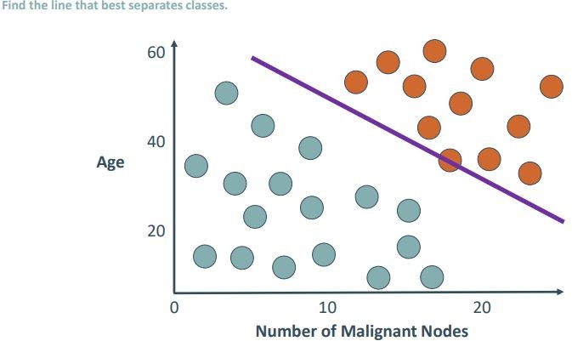
Classification with SVMs

Slide 48
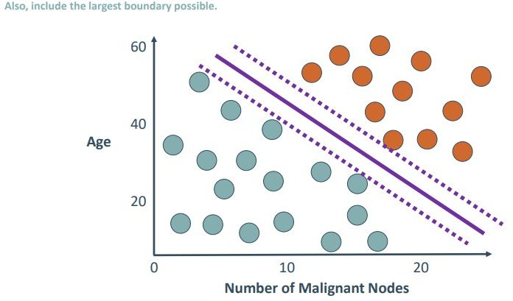
Classification with SVMs

Slide 49
Linear SVM: The Syntax
Import the class containing the classification method.
from sklearn.svm import LinearSVC
Create an instance of the class
LinSVC = LinearSVC(penalty='l2', C=10.0)
Fit the instance on the data and then predict the expected value
LinSVC = LinSVC.fit (X_train , y_train) y_predict = LinSVC.predict ( X_test)

Slide 50
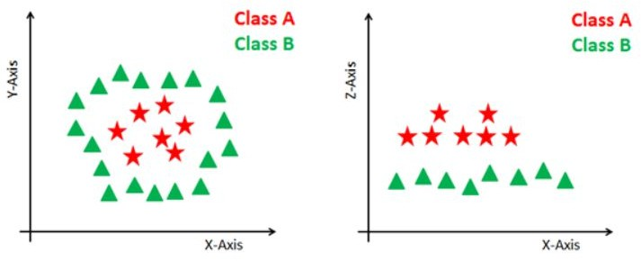
Dealing with non-linear & inseparable planes
Some problems can’t be solved using linear hyperplane, as shown in the figure (left-hand side).
In such situation, SVM uses a kernel trick to transform the input space to a higher dimensional space as shown on the figure (right-hand side)
The data points are plotted on the x-axis and z-axis.
Now you can easily segregate these points using linear separation

Slide 51
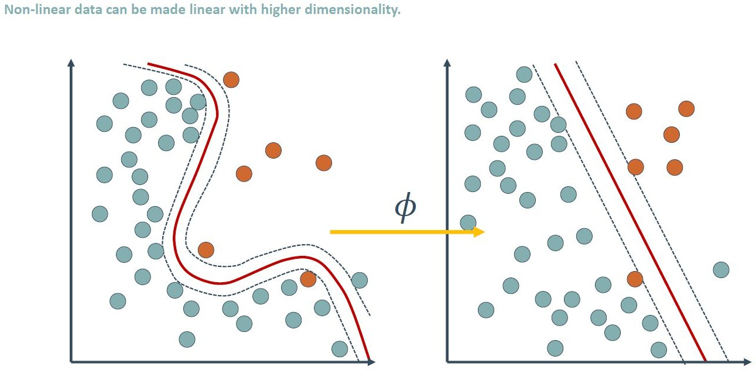
Non Linear Decision Boundaries with SVM

Slide 52
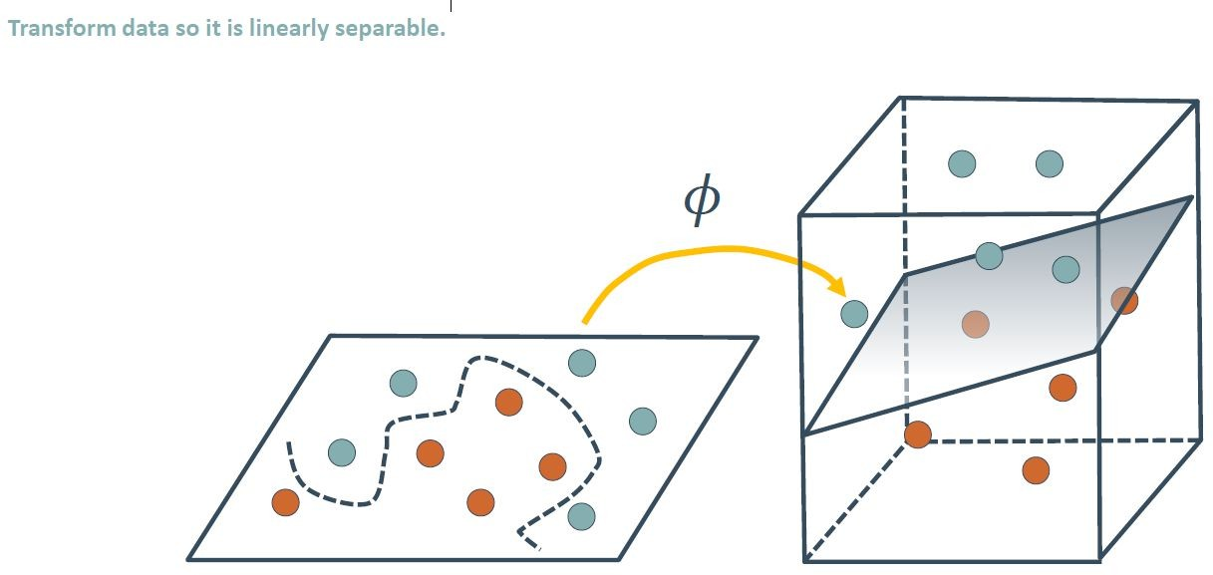
The Kernel Trick

Slide 53
SVM Gaussian Kernel (Radial Basis Function Kernel)
Linear Kernel
Polynomial Kernel
etc

Slide 54
Advantages of SVM
SVM Classifiers offer good accuracy and perform faster prediction compared to Naïve Bayes algorithm.
SVM use less memory because they use a subset of training points in the decision phase
SVM works well with a clear margin of separation and with high dimensional space.

Slide 55
Disadvantages of SVMs
SVM is not suitable for large datasets because of its high training time and it also takes more time in training compared to Naïve Bayes.
It works poorly with overlapping classes
Sensitive to the type of kernel used.

Slide 56
TAKE HOME ASSIGNMENT
RESEARCH & READ ABOUT
THE K-NEAREST NEIGHBOUR ALGORITHM
NAÏVE BAYES ALGORITHM

Slide 57
References
https://machinelearningmastery.com/linear-regression-for-machine-learning/
Linear Regression Wiki page
Lecture notes by Tom Mitchel
Lecture notes by Dan Veltri
Lecture notes by Jeff Witmer
Hands-On Machine Learning with Scikit-Learn & TensorFlow
https://scikit-learn.org/stable/modules/generated/sklearn.linear_model.Linear Regression.html
https://en.wikipedia.org/wiki/Maximum_likelihood_estimation
https://en.wikipedia.org/wiki/Multinomial_logistic_regression
https://people.umass.edu/biep540w/pdf/Whitlock%20Schluter%20Ch%2017% 20regression.pdf

Slide 58
References
Intel Academy Machine Learning Course
https://www.datacamp.com/community/tutorials/svm-classification-scikit-learn- python

Slide 59
Thank you
If you have any questions feel free to email me: mozeyrix@gmail.com

