Slide 1
(Artificial Intelligence and Machine Learning)
Introduction to Machine Learning Algorithms
By
Ainembabazi Moses
Department of Microbiology,MUST, Uganda mozeyrix@gmail.com

Slide 2
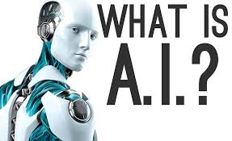
What is Machine Learning and AI
AI refers to the simulation of human intelligence processes by machines exp comp systems
Machine learning is a subset of AI
Enabling computers to perform tasks that require human intelligence.

Slide 3

What is Machine Learning (ML)?
is a branch of Artificial Intelligence that focuses on developing models and algorithms that let computers learn from data without being explicitly programmed for every task
The field of ML stems from research on Artificial Intelligence (AI) in the 1950’s

Slide 4
What is Machine Learning?
Back then the goal was to replicate tedious human tasks using explicit rules (algorithms):
[Data + Rules => Answers],
ML’s goal is to have a computer learn to teach itself an algorithm that produces a useful approximation of data:
[Data + Answers => Rules]
Buzzwords like “Deep Learning,” “Decision Trees,” ”Support Vector Machines,” etc. are subfields of ML.

Slide 5
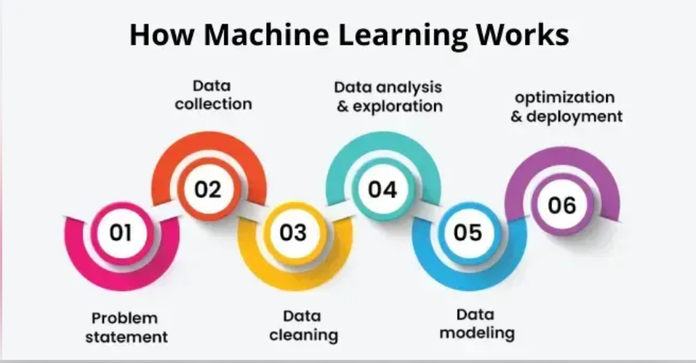

Slide 6
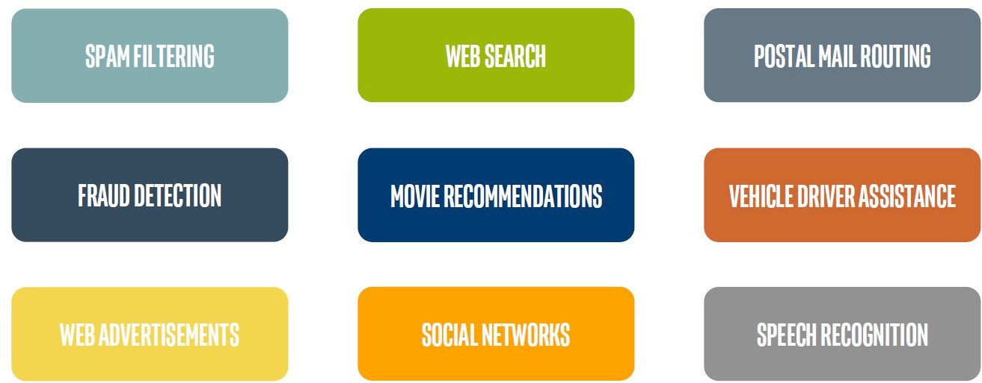
Machine Learning in Our Daily Lives

Slide 7
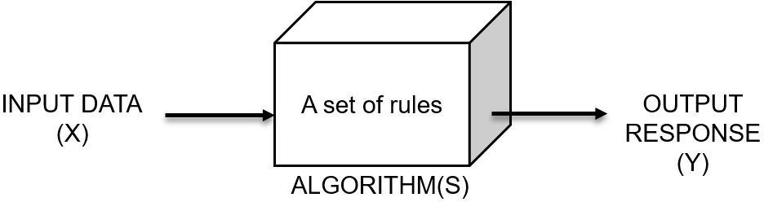
Basic Idea of an Algorithm

Slide 8
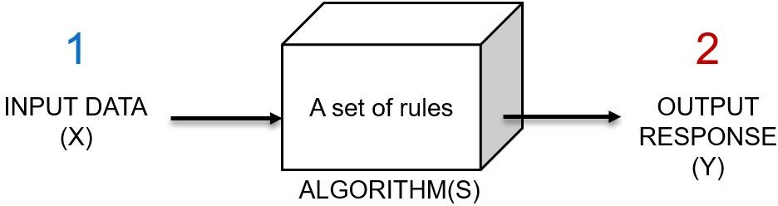
Basic Idea of an Algorithm

Slide 9
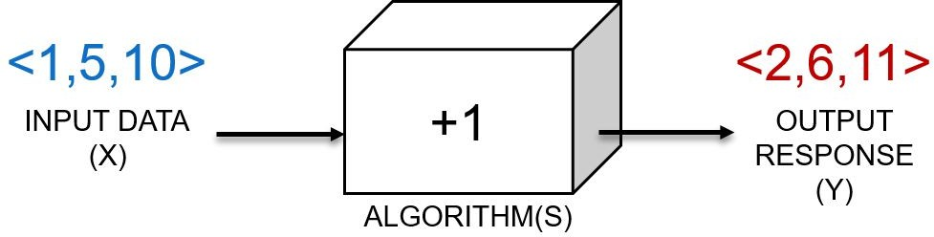
Basic Idea of an Algorithm

Slide 10
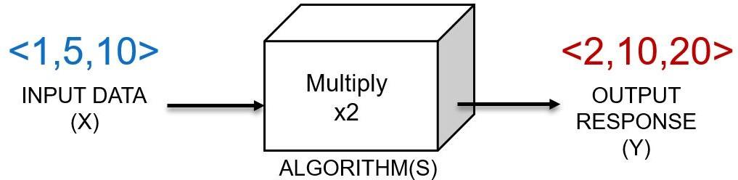
Basic Idea of Learning an Algorithm
This is a basic regression problem!
We’re fitting a function that maps INPUT to OUTPUT y = 2x + 0

Slide 11
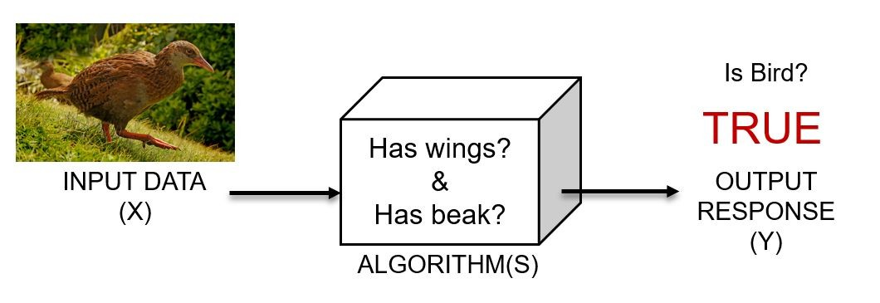
Basic Idea of Learning an Algorithm
This is a classification problem!
Typically these produce binary (limited to 2 topics) or categorical (multi-topic) outputs

Slide 12
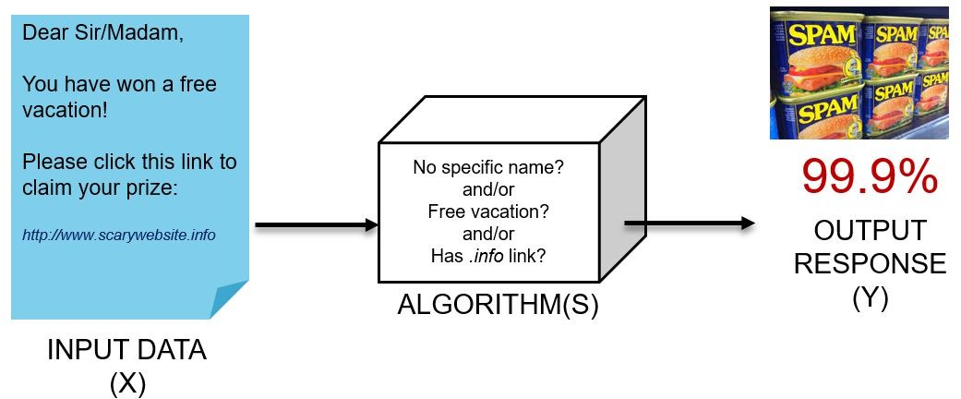
Basic Idea of Learning an Algorithm
This is another classification problem with numerical (prediction probabilities) output

Slide 13
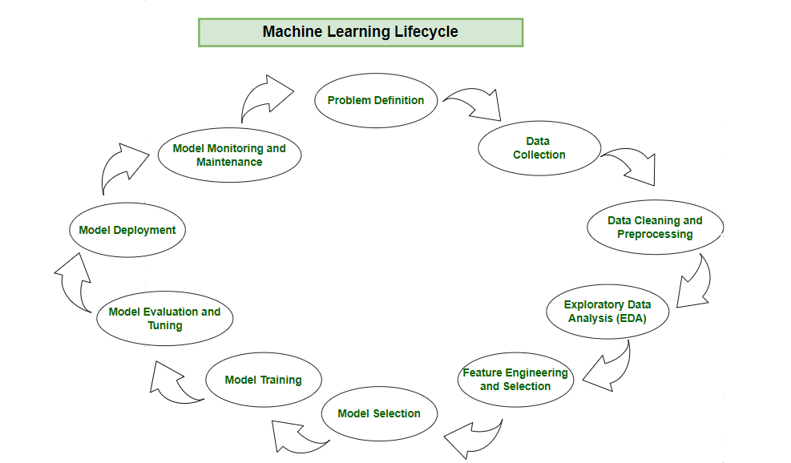

Slide 14
Problem Definition
Collaboration: Work together with stakeholders to understand and define the business problem.
Clarity: Clearly write down the objectives, desired outcomes and scope of the task.
Foundation: Establish a solid foundation for the machine

Slide 15
Data Collection
Relevance: Collect data should be relevant to the defined problem and include necessary features.
Quality: Ensure data quality by considering factors like accuracy and ethical use.
Quantity: Gather sufficient data volume to train a robust model.
Diversity: Include diverse datasets to capture a broad range of scenarios and patterns.

Slide 16
Data Cleaning and Preprocessing
Data Cleaning: Address issues such as missing values, outliers and inconsistencies in the data.
Data Preprocessing: Standardize formats, scale values, and encode categorical variables for consistency. Read about this?
Data Quality: Ensure that the data is well-organized and prepared for meaningful analysis.

Slide 17
Exploratory Data Analysis (EDA)
Exploration: Use statistical and visual tools to explore patterns in data.
Patterns and Trends: Identify underlying patterns, trends and potential challenges within the dataset.
Insights: Gain valuable insights for informed decisions making in later stages.
Decision Making: Use EDA for feature engineering and model selection.

Slide 18
Feature Engineering and Selection
Feature Engineering: Create new features or transform existing ones to capture better patterns and relationships.
Feature Selection: Identify subset of features that most significantly impact the model's performance.
Domain Expertise: Use domain knowledge to engineer features that contribute meaningfully for prediction.
Optimization: Balance set of features for accuracy while minimizing computational complexity.

Slide 19
Model Selection
Alignment: Select a model that aligns with the defined problem and characteristics of the dataset.
Complexity: Consider the complexity of the problem and the nature of the data when choosing a model.
Decision Factors: Evaluate factors like performance, interpretability and scalability when selecting a model.
Experimentation: Experiment with different models to find the best fit for the problem.

Slide 20
Model Training
Training Data: Expose the model to historical data to learn patterns, relationships and dependencies.
Iterative Process: Train the model iteratively, adjusting parameters to minimize errors and enhance accuracy.
Optimization: Fine-tune model to optimize its predictive capabilities.
Validation: Rigorously train model to ensure accuracy to new unseen data.

Slide 21
Model Evaluation and Tuning
Evaluation Metrics: Use metrics like accuracy, precision, recall and F1 score to evaluate model performance.
Strengths and Weaknesses: Identify the strengths and weaknesses of the model through rigorous testing.
Iterative Improvement: Initiate model tuning to adjust hyperparameters and enhance predictive accuracy.
Model Robustness: Iterative tuning to achieve desired levels of model robustness and reliability.

Slide 22
Model Deployment
Integration: Integrate the trained model into existing systems or processes for real-world application.
Decision Making: Use the model's predictions for informed decision.
Practical Solutions: Deploy the model to transform theoretical insights into practical use that address business needs.
Continuous Improvement: Monitor model performance and make adjustments as necessary to maintain effectiveness over time.

Slide 23
Machine Learning Taxonomy
Machine Learning
Supervised
Semi-supervised
Unsupervised
Reinforcement Learning
Regression
Classification
Clustering
Associations

Slide 24
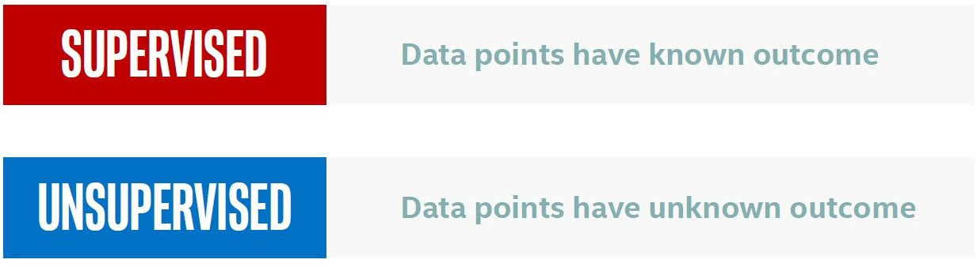
Types of Machine Learning

Slide 25
Supervised Learning
Some of the previous examples of ML algorithms were “supervised learning” – where we train our approach using both example INPUT and example OUTPUT (label or class).
You can now take your trained approach (a “model”) and use it to make predictions on new (unseen) data!
Examples: Classifying

Slide 26
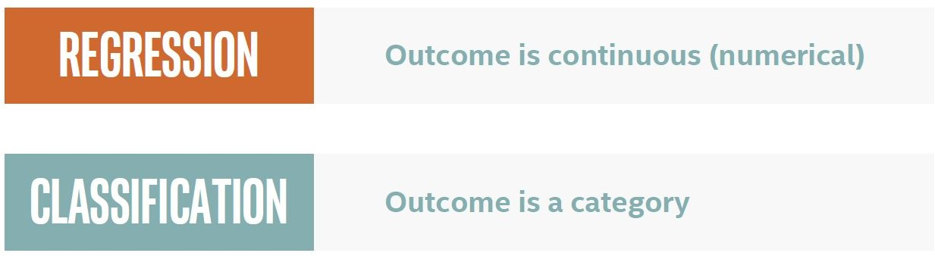
Types of Supervised Learning

Slide 27
Unsupervised Learning
What if we do not know the OUTPUT labels for our data?
In “unsupervised learning” – we apply a specific set of rules to the INPUT to identify trends/patterns in the data.
Examples: Clustering, trend/topic detection, outlier identification, dimensionality reduction

Slide 28
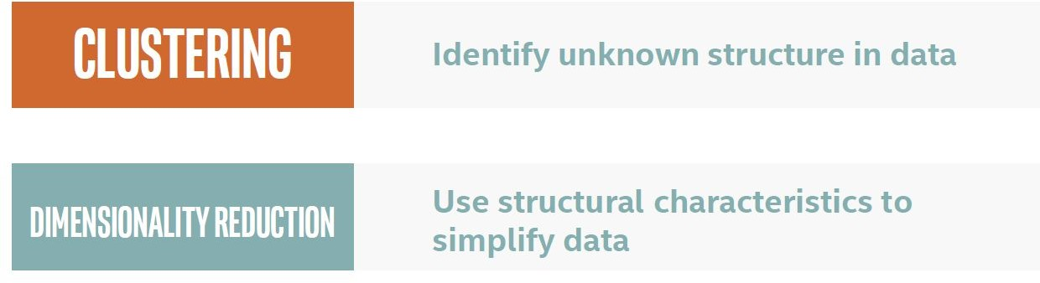
Types of Unsupervised Machine Learning

Slide 29
Classification in Machine Learning
Classification is a predictive modeling problem where a class label is predicted for a given example of input data
Assign input vector to one of two or more classes

Slide 30
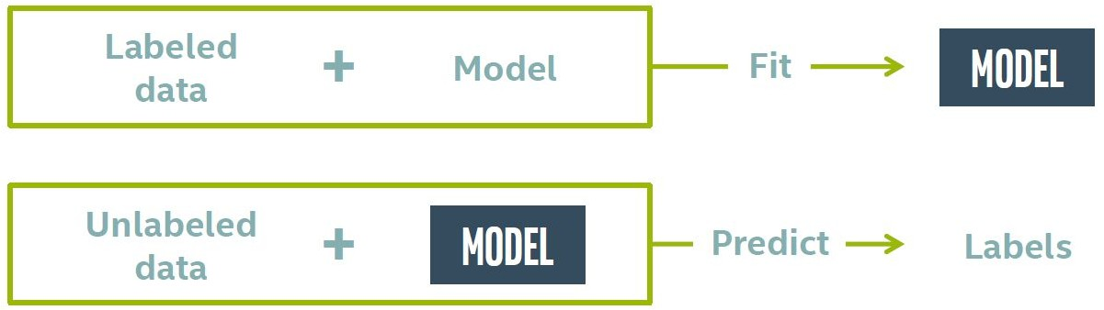
Classification in Machine Learning

Slide 31
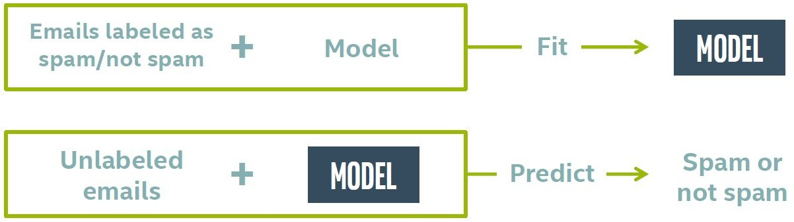
Classification in Machine Learning

Slide 32
Classification : Terminology
Target: predicted category the data (column to predict)
Features: properties of the data used for prediction (non-target columns)
Example: a single data point within the data (one row)
Label: the target value for a single data point

Slide 33
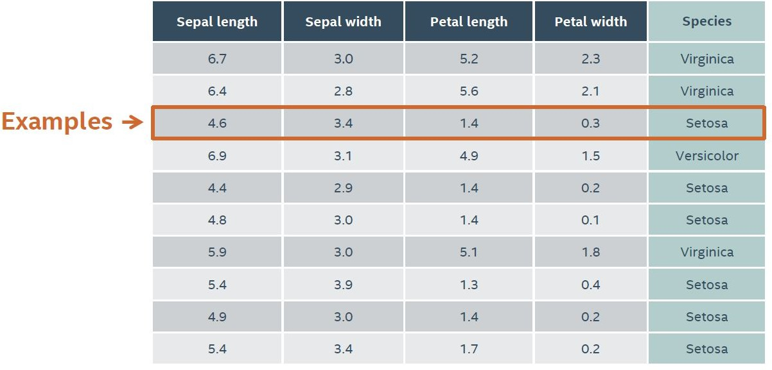
Classification : Terminology
Example using the Iris Dataset

Slide 34
Types of Classification in ML
Binary Classification
Classification tasks that have two class labels
Examples: spam or not, cancer detected/not detected
Multi-Class Classification
Classification tasks that have more than two class labels.
Examples: Plant species classification, Optical character recognition

Slide 35
Types of Classification in ML
Multi-Label Classification
Classification tasks that have two or more class labels, where one or more class labels may be predicted.
Example: photo classification
Imbalanced Classification
Classification tasks where the number of examples in each class is unequally distributed.
Examples: Fraud detection, Medical diagnostic test

Slide 36
Classification Algorithms
Logistic Regression
k-Nearest Neighbors
Decision Trees
Support Vector Machine
Naive Bayes
Gradient Boosting
Neural networks
Others

Slide 37
Setting Up a Supervised ML Experiment
Gather representative data
Split into Training, Tuning and Testing partitions
Train a model and use Tuning partition like “Testing” while adjusting model parameters
Merge Training + Tuning and Train your final model
Run final model on Testing partition and evaluate

Slide 38
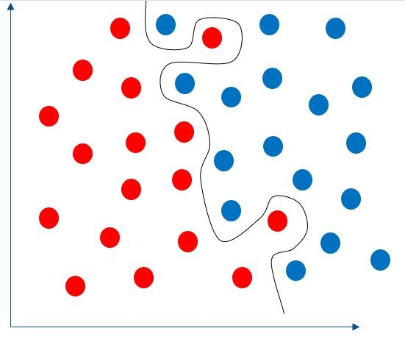
How Much Training is Enough?
Over-fitting: Training our model too much!
We are making it fit the training data so well that it does not generalize well to new (unseen) points

Slide 39
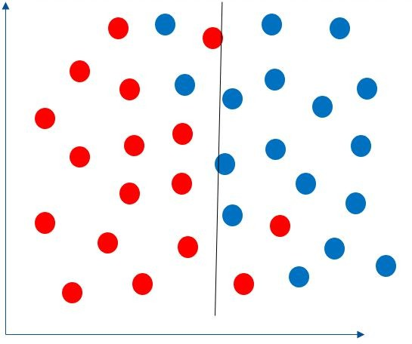
How Much Training is Enough?
Under-fitting: Our model is missing key parameters needed to model the data- typically this means you need to perform more training

Slide 40
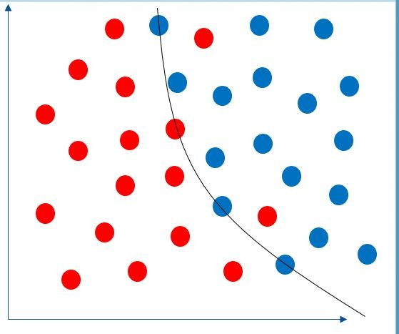
How Much Training is Enough?
Generalization: How well does our model perform on new (unseen) data? Often more training data helps!
Regularization: Adding information (or a penalty) to a score/ loss function to make a model perform better.
For example, if we allow a few misses in training set, we might actually generalize better to the testing set!

Slide 41

Evaluating Model Performance
Choosing the Right Error Measurement is key for machine learning problems
For algorithms that produce real-valued numerical predictions we can calculate the difference between predictions and the actual answers. For example, sum of squares:
Common performance metrics for binary predictions (TRUE/FALSE, 0/1, A/B, etc.) are based on the number of true positives (TP), true negatives (TN), false positives (FP) and false negatives (FN):

Slide 42
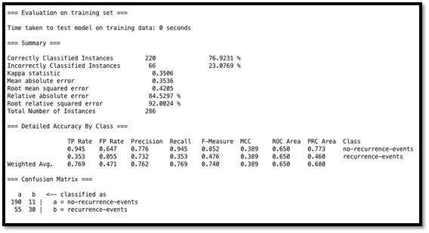
Evaluating Model Performance
WEKA RESULTS

Slide 43
Evaluating Model Performance
You are asked to build a classifier for leukemia
Training data: 1% patients with leukemia, 99% healthy
Measure accuracy: total % of predictions that are correct
Build a simple model that always predicts “healthy”
Accuracy will be 99%…

Slide 44
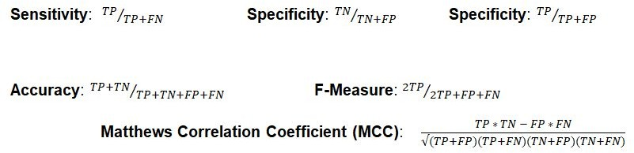
Evaluation Metrics

Slide 45
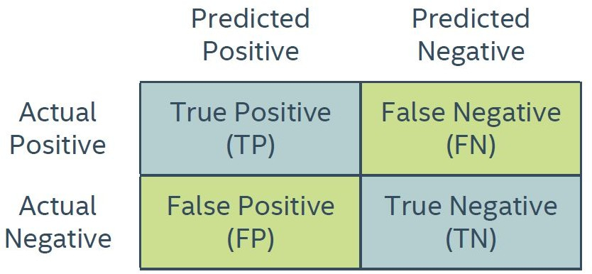
Classification : Error Metrics
Confusion Matrix

Slide 46

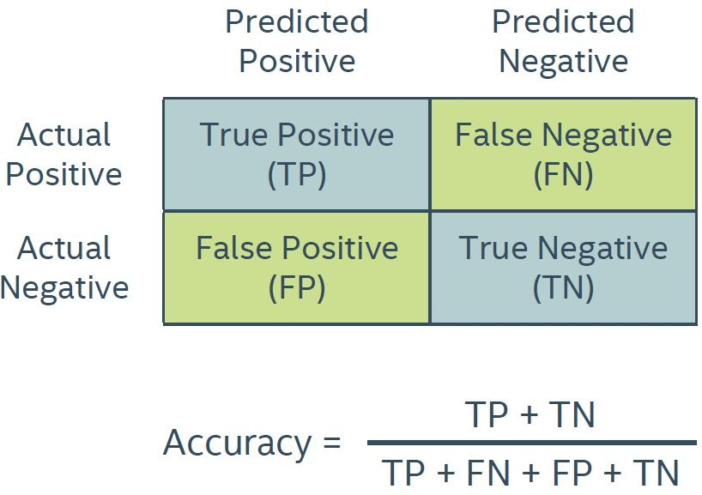
Classification : Error Metrics
Accuracy : Predicting Correctly

Slide 47
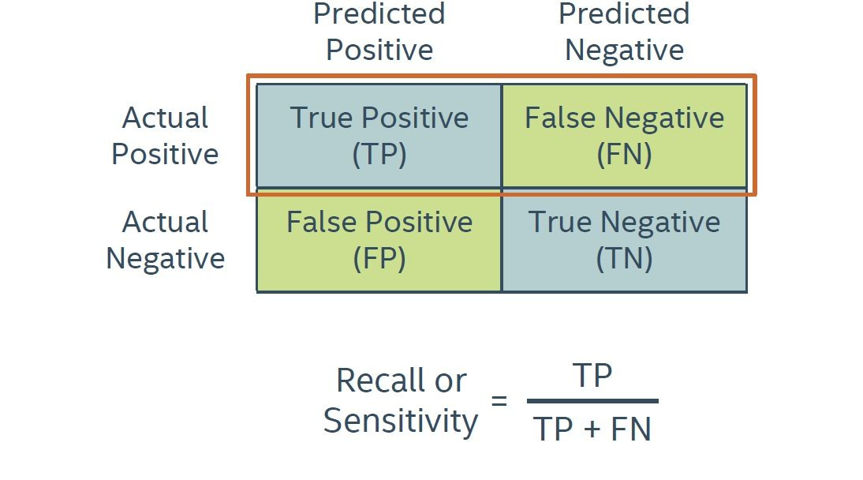
Classification : Error Metrics
Recall /Sensitivity: Identifying All Positive Instances What proportion of actual positives was identified correctly?

Slide 48
Classification : Error Metrics
Others:
Classification Report
Receiver Operator Curve (ROC)

Slide 49
KNeighborsClassifier : The Syntax
Import the class containing the classification method
from sklearn.neighbors import KNeighborsClassifier
Create an instance of the class
KNN= KNeighborsClassifier(n_neighbors=3)
Fit the instance on the data and then predict the expected value
KNN= KNN.fit(X_data, y_data) y_predict = KNN.predict(X_data)

Slide 50
Logistic Regression : The Syntax
Import the class containing the regression method
from sklearn.linear_model import LogisticRegression
Create an instance of the class
LR= LogisticRegression(random_state=0)
Fit the instance on the data and then predict the expected value
LR= LR.fit(X_train, y_train) y_predict= LR.predict(X_test)

Slide 51
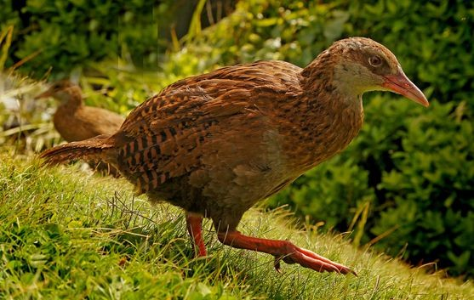
How to Use WEKA
The Weka is a bird native to New Zealand

Slide 52

Some WEKA Features
Ideal starting point to explore data – figure out basic trends, try out different algorithms, etc.
Use this after you have selected and an approach and you need to exhaustively check parameters and consistency of the method
Helpful visual representation of your workflow – can be saved to enable reproducible pipelines
Combined interface that has Explorer and Experimenter options together in one place
Command line interface

Slide 53
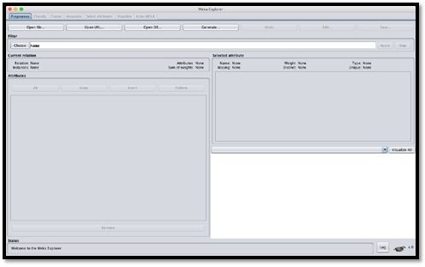
WEKA Explorer Mode - Properties
Both Attributes (X) and Classes (Y) can be of the following Types:
Numerical (numbers)
Nominal (1+ categories)
Date (considered Nominal)
Binary (2 categories only)
Lets all open up the Iris data set!

Slide 54
What to remember about ML Algorithms
No free lunch: machine learning algorithms are tools, not dogmas
Try simple algorithms first
Better to have smart features and simple algorithms than simple features and smart algorithms

Slide 55
References
https://machinelearningmastery.com/types-of-classification-in- machine-learning/
Lecture notes by Dan Veltri
Intel Academy Machine Learning Course
https://developers.google.com/machine-learning/crash-course/
https://developers.google.com/machine-learning/clustering/algo rithm/advantages-disadvantages
https://www.cs.waikato.ac.nz/ml/weka/
https://www.seas.upenn.edu/~cis519/fall2017/lectures/01_intro

Slide 56
Thank you
If you have any questions feel free to email me: mozeyrix@gmail.com

