Slide 1
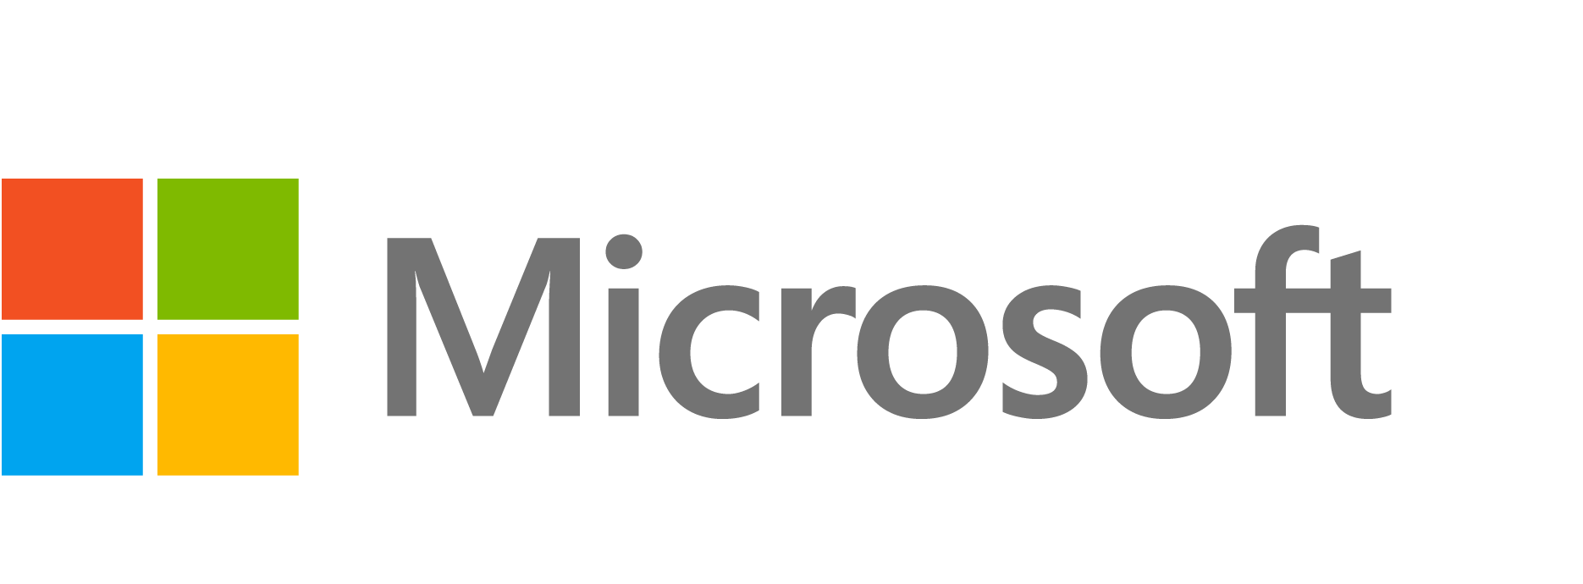
Practical Machine Learning for Cloud Intrusion Detection
Challenges and the Way Forward
Ram Shankar Siva Kumar Andrew Wicker Matt Swann
(@ram_ssk) (@MSwannMSFT)
Machine Learning and Computer Security – NIPS 2017
Notes:
Hello – My name is Ram, and I am a Senior ML Engineer in Azure Security Data Science. This work was done in collaboration with Andrew Wicker and Matt Swann.
This paper draws on our collective knowledge to secure Microsoft’s cloud solution, Azure, focusing more on qualitative experience as opposed to specific algorithms and results.

Slide 2
Plug:
We are hiring!!
Contact: RamK@microsoft.com

Slide 3
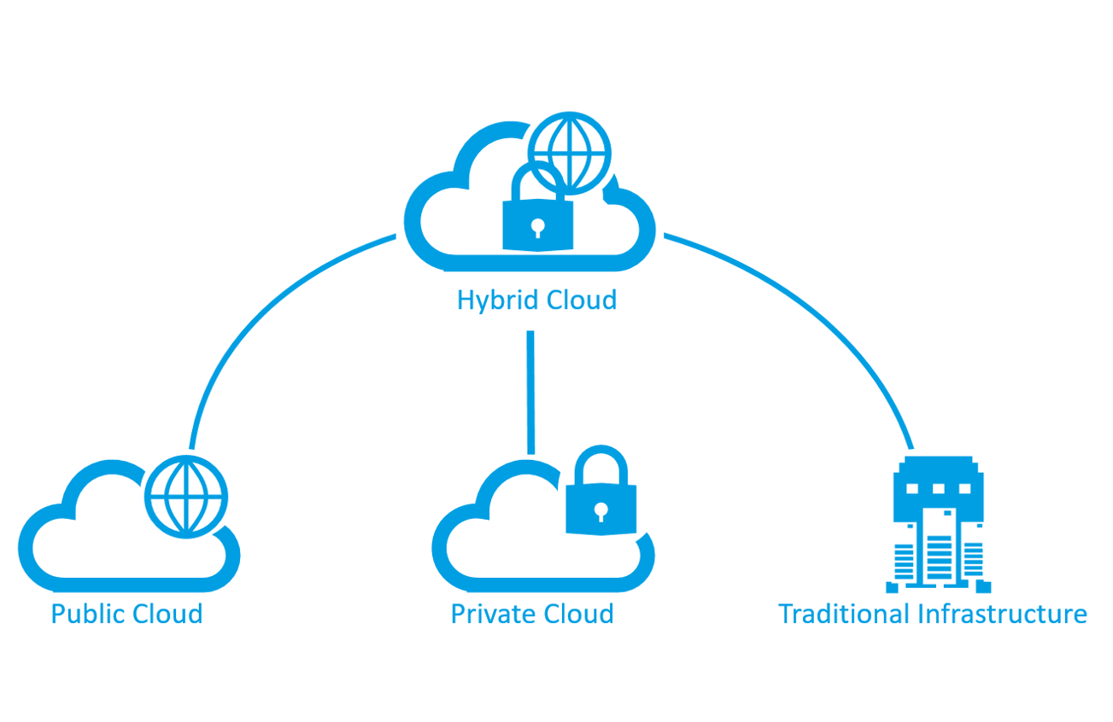






Cloud IDS: Why should you care?
$5.9B
Source
Notes:
85% of Enterprise IT organizations will commit to multicloud architecture by 2018 [IDCFutureScape 2017]
Security is an important competitive Cloud Differentiator [csoonline2016]
Intrusion detection systems are expected to grow to USD 5.93 billion by 2021 at a compound annual growth rate of 12% [Gartner2016]
Net-Net: Important Problem for the Industry

Slide 4


Motivating Example
“Detect anomalous security logons from developers to the infrastructure system”
Anomalous Login Detection System

Slide 5
Motivating Example
“Detect anomalous security logons from developers to the infrastructure system”
Anomalous Login Detection System

Slide 6

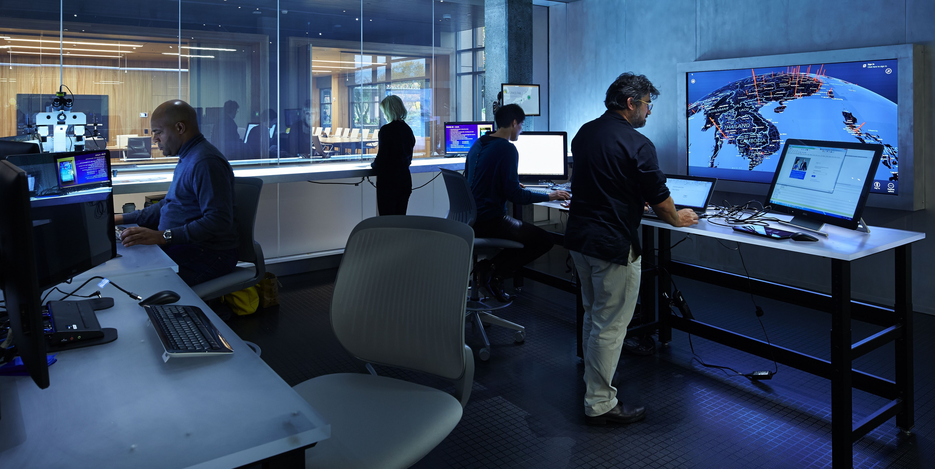
Cloud Setting
Cloud
Azure Developers
Security Analysts
Internal Platform

Slide 7
Cloud Setting
Cloud
Azure Developers
Security Analysts
Internal Platform
Anomalous Login Detection System

Slide 8
Cloud Setting
Cloud
Azure Developers
Security Analysts
Internal Platform
Anomalous Login Detection System

Slide 9
Challenge: The Cloud Infrastructure hosts both platform and customers
Notes:
The first challenge when building cloud IDS systems, is that the infrastructure that keeps the Cloud up and running is massive
Azure is supported by 300+ services – ranging from Resource manager that enables deploying and managing VMs to Storage to Compute. Azure is architected in a way, such that the same backend services support different flavors of the cloud
-> Whether public or private or hybrid, it is the same code
So, net-net: The telemetry generated by these logs are in the order for pBs
To add to the challenge, the cloud is also dynamic – the cloud as it is now, is very different from
-> VMs are constantly deployed
-> Developers constantly push out new features

Slide 10



Customer administrator
Customer Storage Account
Anomalous Login Detection System
Customer logs
External Customers
Central Repository
Anomalous Login Detection System
Azure Developers
Cloud Service logs
Remove any Customer Identifiable Information
Internal Security Analyst + Appropriate Service team
Attacker
Data Center generate logs
Notes:
The data center that supports Azure infrastructure, has two personnas interacting with it:
The External customers who pay Azure, to host services or rent infrastructure.
The Azure Developers who maintain and develop Azure’s infrastructure The logs from the data center, is collected by Azure Monintoring system, and depending on the situation it is piped in one of two ways:
-> Customer’s activity logs goes to their storage account, where detection systems monitor for compromise. The end consumer of this alert, are admin’s of the
-> The internal developer’s activity are collected to a central repository where detection systems monitor for malicious activity. The end consumer of this alert are Microsoft’s Security Analyst

Slide 11




Challenge: The Cloud Backend is built on different, composite services
Microsoft Azure
Microsoft Azure
300+ Services
Storage
Encryption
Storage
Encryption
Identity
Identity
Compute
Compute
….and many many more!
….and many many more!
Notes:
The first challenge when building cloud IDS systems, is that the infrastructure that keeps the Cloud up and running is massive
Azure is supported by 300+ services – ranging from Resource manager that enables deploying and managing VMs to Storage to Compute. Azure is architected in a way, such that the same backend services support different flavors of the cloud
-> Whether public or private or hybrid, it is the same code
So, net-net: The telemetry generated by these logs are in the order for pBs
300+ different backend infrastructure services to ensure correct functionality
Same backend service, supports many “flavors” of cloud
Infrastructure as a Service vs. Platform as a Service
Private Cloud vs. Public Cloud vs. Hybrid Cloud
Each service architected differently
Backend Service for Storage different from Backend service for Compute
Logging for each service is different
To add to the challenge, the cloud is also dynamic – the cloud as it is now, is very different from
-> VMs are constantly deployed
-> Developers constantly push out new features

Slide 12
Data Center 1
Storage Dev
Storage Service Logs
Storage Service Anomalous Login Detection System
Central Repository
Internal Security Analyst + Appropriate Service team
Compute Service Logs
Compute Service Anomalous Login Detection System
Compute Dev
Identity Service Logs
Data Center 2
Identity Service Anomalous Login Detection System
Encryption Service Logs
Identity Dev
Encyption Service Anomalous Login Detection System
Data Center 3
Encryption
Dev
Attacker

Slide 13
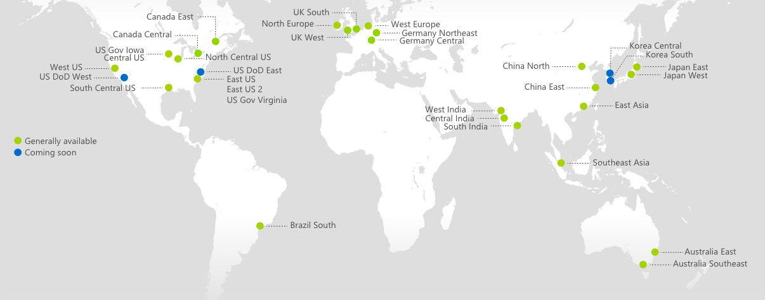
Challenge: The Cloud Backend is Geo-distributed

Slide 14
Geo-distributed = Compliance and Localization
Building Privacy compliant Models has three challenges
Privacy Laws vary across regions
IP address is treated as EII in some regions vs. not EII in other region
Privacy Laws now ask for “retroactive modification”
Privacy laws are not static
Model Localization is important
Weekend in Middle East != Weekend in Americas
Product adoption happens at different rate across different regions
Data distribution is different!

Slide 15
Tiered Modeling
Model - Prime
How:
Federated Models
Each region is modeled separately
Results are scrubbed according to compliance laws and privacy agreements
Scrubbed results are used as input to “Model Prime”
“Model Prime”
Results are collated to search for global trends
Perhaps work such as [Hamm2016] on building differentially private ensemble is relevant?
Pros:
Bespoke modeling for every region
Balance between Micro and Macro modeling
Cons:
Complicated Deployment
Depending on the agreements, model-prime may not be possible
Scrubbed Results
Scrubbed Results
Scrubbed Results
Model 2
Model
3
Model 1
Region1
Region2
Region3

Slide 16
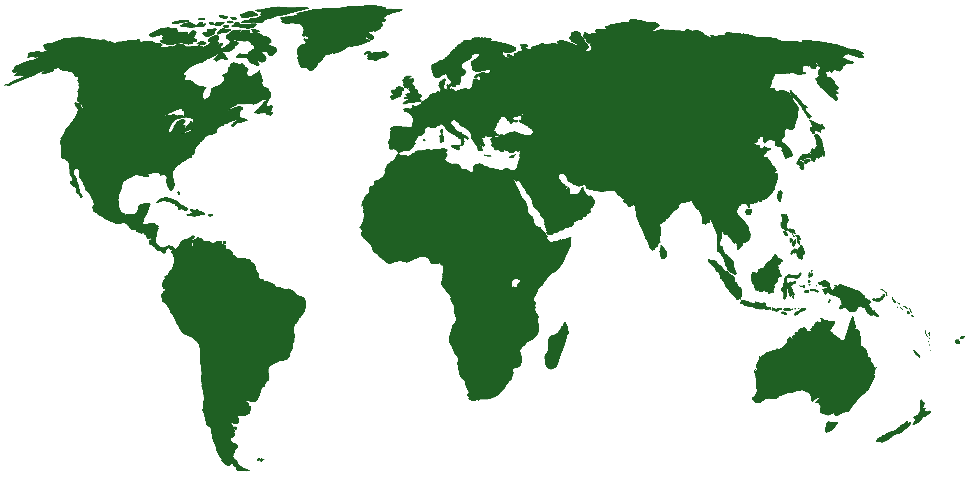
Storage Service Anomalous Login Detection System - AMERICAS
Central Repository
Scrubbed per US Policy
Internal Security Analyst + Storage Service Team
Storage Service Anomalous Login - AUSTRALIA
Scrubbed per EU Policy
Storage Dev
Storage Service Anomalous Login - EUROPE
World Map source: http://upload.wikimedia.org/wikipedia/commons/9/95/World_map_green.png

Slide 17
Other Challenges…
Dynamic Environment
Model Compliance
Vertically and Horizontally Siloed
Tribal/Domain Knowledge Driven
Model Evaluation
Explainability

Slide 18
The Way Forward

Slide 19
Future is Attack Disruption
Notes:
“Compromises are measured in minutes 98% of time…median time for detection is in the order of months” [Verizon2017]
Call to focus from Attack Detection to Attack Disruption
Open Question: Is there a place for intelligence across the blue team kill chain?
Can Machine Learning help towards automatic remediation?
Can Natural Language processing help analysts triage alerts better?
Can recommender engines guide the next steps in investigations?

