Slide 1


Towards Verification of Deep Neural Networks
Clark Barrett
NIPS Workshop on Machine Learning and Computer Security
December 8,$2017$

Slide 2
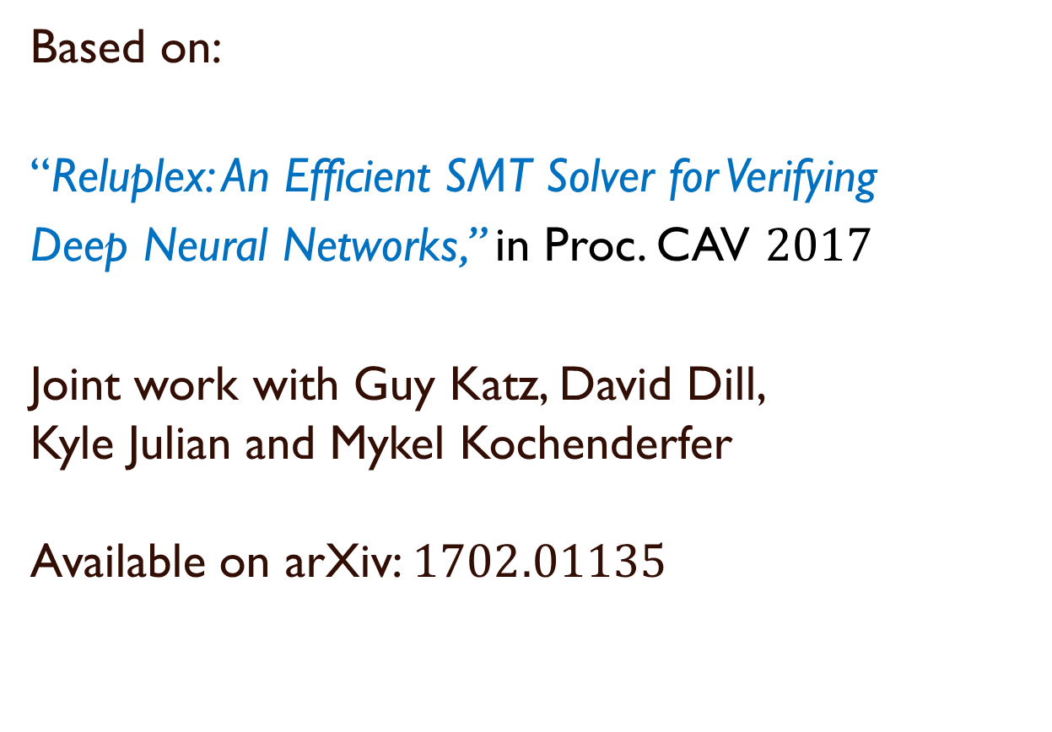
Based on:
“Reluplex: An Efficient SMT Solver for Verifying
Deep Neural Networks,” in Proc. CAV $2017$
Joint work with Guy Katz, David Dill, Kyle Julian and Mykel Kochenderfer Available on arXiv: $1702.01135$

Slide 3
Artificial Neural Networks
An emerging solution to a wide variety of problems
Image recognition, game playing, autonomous driving, etc.
A “black box” solution
An advantage, but also a drawback
Goal: Reason about the inner workings of neural networks

Slide 4
Possible Applications
Transform (simplify) neural networks
While preserving certain properties
Extract properties of networks
Make networks more understandable to humans
Check robustness against adversarial examples
Formally verify safety-critical or security-critical systems that incorporate neural networks

Slide 5
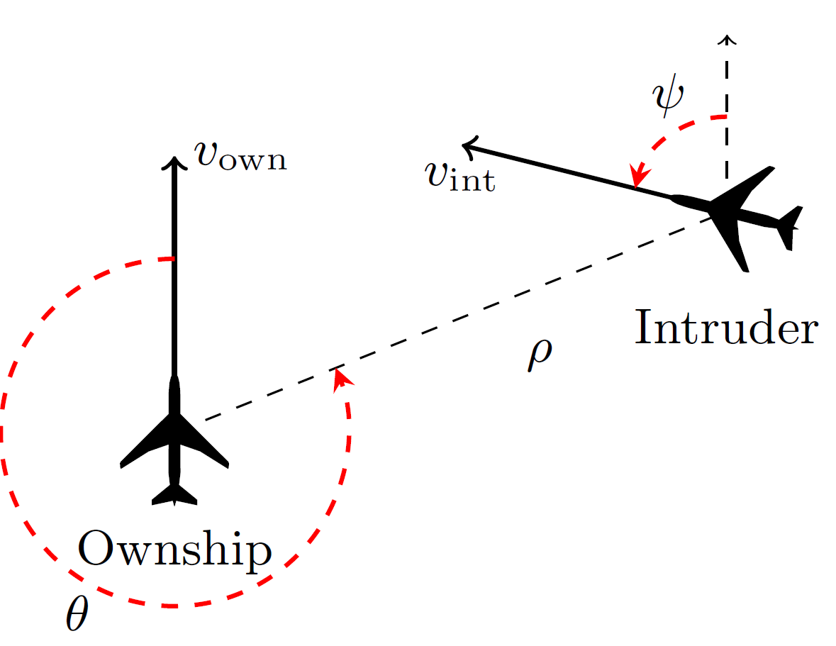
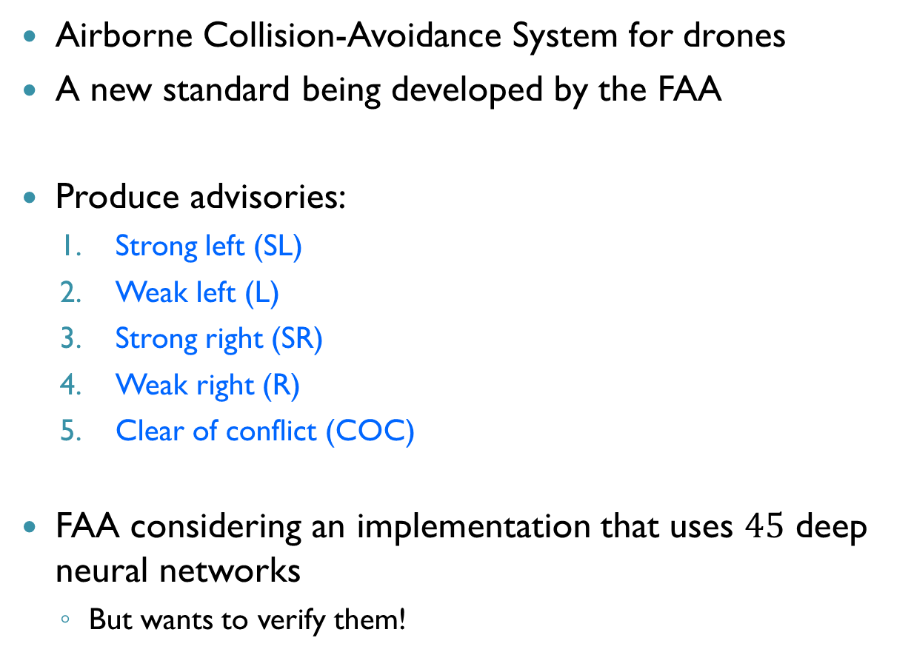
Case Study: ACAS Xu
Airborne Collision-Avoidance System for drones
A new standard being developed by the FAA
Produce advisories:
Strong left (SL)
Weak left (L)
Strong right (SR)
Weak right (R)
Clear of conflict (COC)
FAA considering an implementation that uses $45$ deep neural networks
But wants to verify them!

Slide 6
Certifying ACAS Xu Networks
Neural networks generalize to previously-unseen inputs
Show that certain properties hold for all inputs
Examples:
If intruder is distant, advisory is always COC
If intruder is nearby on the left, advisory is always “strong right”
Crucial for increasing the level of confidence

Slide 7
Agenda
The Reluplex Algorithm
Verifying the ACAS Xu Networks
Conclusion

Slide 8
Agenda
The Reluplex Algorithm
Verifying the ACAS Xu Networks
Conclusion

Slide 9
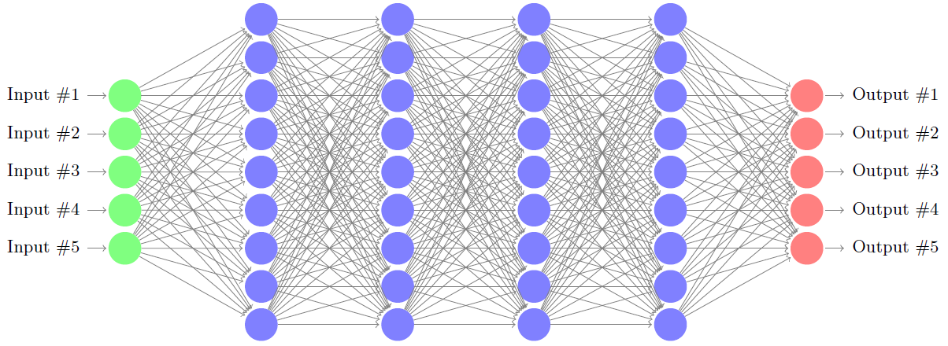

Deep Neural Nets (DNNs)
ACAS Xu networks: $8$ layers, $310$ nodes (x $45$)
State of the art verification: networks with $\sim 20$ nodes
NP-Complete problem!

Slide 10








The Culprits: Activation Functions
Steps:
Weighted sum
Activation function
$$2$$
$$1$$
$$0$$
$$3$$
$$f(4)$$
$$2⋅1+0⋅3+(−1)⋅\left(−2\right)=4$$
$$−1$$
$$−2$$

Slide 11














Rectified Linear Units (ReLUs)
ReLU($x$) = $max⁡(0,x)$
$x≥0$: active case, return $x$
$x<0:$ inactive case, return $0$
$$2$$
$$1$$
$$1$$
$$0$$
$$3$$
$$−2$$
$$0$$
$$4$$
$$1⋅1+\left(−2\right)⋅3+0⋅\left(−2\right)=−5$$
$$2⋅1+0⋅3+(−1)⋅\left(−2\right)=4$$
$$−1$$
$$−2$$
$$0$$

Slide 12
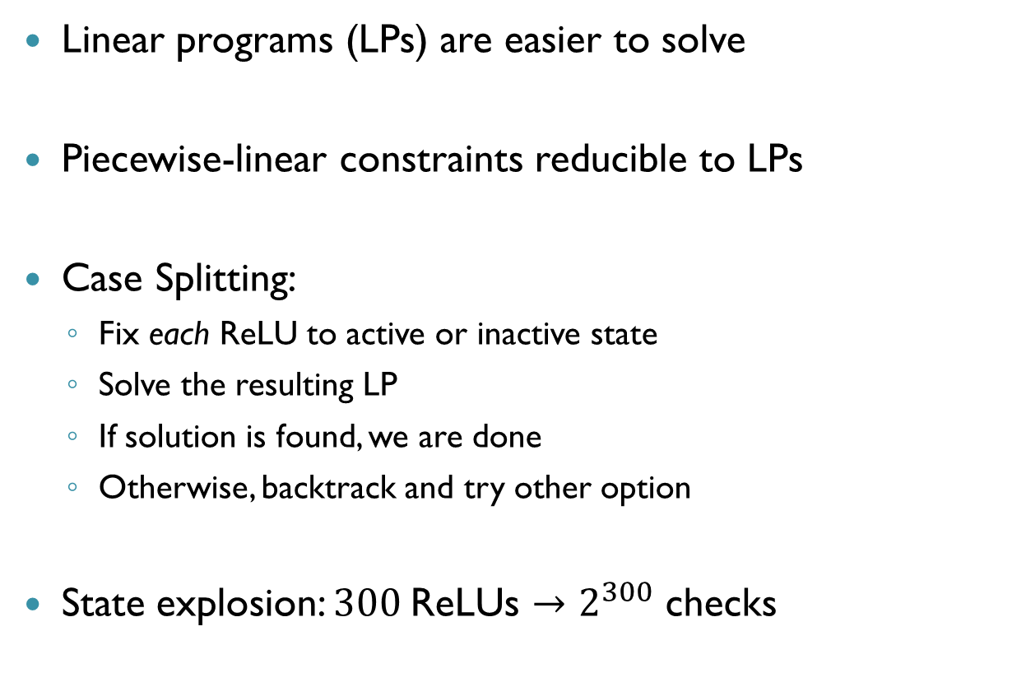
Case Splitting
Linear programs (LPs) are easier to solve
Piecewise-linear constraints reducible to LPs
Case Splitting:
Fix each ReLU to active or inactive state
Solve the resulting LP
If solution is found, we are done
Otherwise, backtrack and try other option
State explosion: $300$ReLUs $→2^{300}$ checks

Slide 13
Reluplex
A technique for solving linear programs with ReLUs
Can encode neural networks as input
Extends the simplex method
Does not require case splitting in advance
ReLU constraints satisfied incrementally
Split only if we must
Scales to the ACAS Xu networks
An order of magnitude larger networks than previously possible

Slide 14









A Simple Example
Property being checked: Is it possible that $x_{1}∈[0,1]$ and $x_{4}∈[0.5,1]$?
$$x_{2}$$
$$1$$
$$1$$
$$x_{1}$$
$$x_{4}$$
$$−1$$
$$x_{3}$$
$$1$$

Slide 15








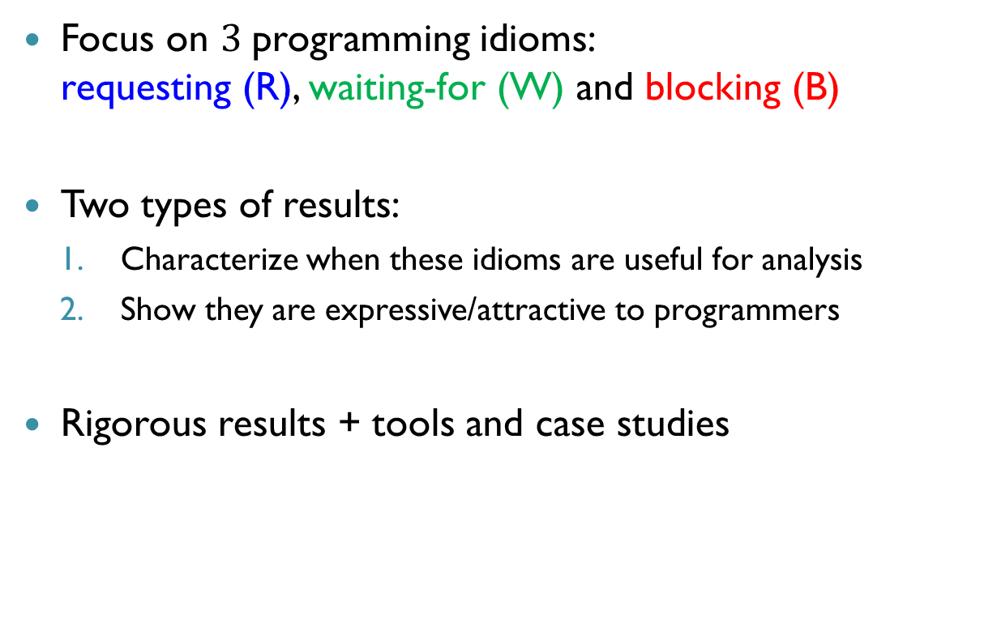
ReLUs As Variable Pairs
Split ReLUs into:
A weighted sum variable
An activation function variable
ReLU
$$x_{2}^{w}$$
$$x_{2}$$
$$x_{2}^{a}$$
$$1$$
$$1$$
$$x_{1}$$
$$x_{4}$$
$$−1$$
ReLU
$$x_{3}^{w}$$
$$x_{3}^{a}$$
$$x_{3}$$
$$1$$

Slide 16

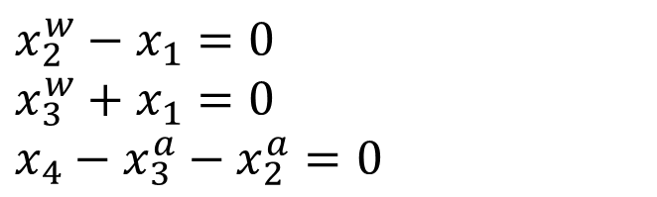





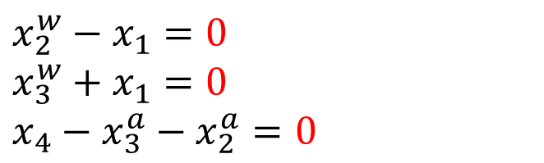


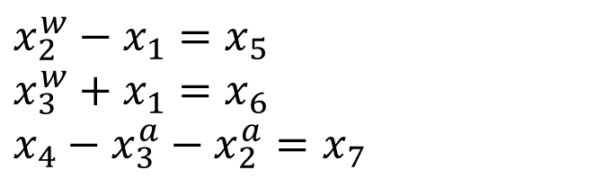


Encoding Networks (cnt’d)
Introduce equalities:
Set bounds: $x_{1}∈[0,1]$ $x_{4}∈\left[0.5,1\right]$ $x_{2}^{w},x_{3}^{w}∈(−∞, ∞)$ $x_{2}^{a},x_{3}^{a}∈\left[0,∞\right)$
Auxiliary variables: $x_{5},x_{6},x_{7}∈[0,0]$
$$x_{2}^{w}$$
ReLU
$$x_{2}^{a}$$
$$1$$
$$1$$
$x_{2}^{w}−x_{1}=0$ $x_{3}^{w}+x_{1}=0$ $x_{4}−x_{3}^{a}−x_{2}^{a}=0$
$x_{2}^{w}−x_{1}=x_{5}$ $x_{3}^{w}+x_{1}=x_{6}$ $x_{4}−x_{3}^{a}−x_{2}^{a}=x_{7}$
$x_{2}^{w}−x_{1}=0$ $x_{3}^{w}+x_{1}=0$ $x_{4}−x_{3}^{a}−x_{2}^{a}=0$
$$x_{1}$$
$$x_{4}$$
$$−1$$
$$x_{3}^{w}$$
ReLU
$$x_{3}^{a}$$
$$1$$

Slide 17


























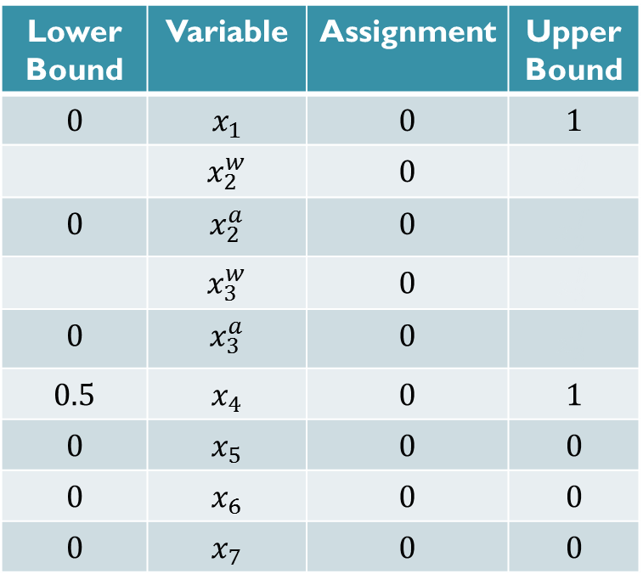









Reluplex: Example
$$x_{1}=x_{2}^{w}−x_{5}$$
$$x_{5}=x_{2}^{w}−x_{1}$$
$$x_{5}=x_{2}^{w}−x_{1}$$
$$x_{6}=x_{3}^{w}+x_{1}$$
$$x_{6}=x_{2}^{w}+x_{3}^{w}−x_{5}$$
$$x_{6}=x_{2}^{w}+x_{3}^{w}−x_{5}$$
$$x_{3}^{w}=x_{5}+x_{6}{−x}_{2}^{w}$$
Lower Bound | Variable | Assignment | Upper Bound
$$0$$ | $$x_{1}$$ | $$0$$ | $$1$$
 | $$x_{2}^{w}$$ | $$0$$ | $$x_{2}^{b}$$
$$0$$ | $$x_{2}^{a}$$ | $$0$$ | $$x_{2}^{f}$$
 | $$x_{3}^{w}$$ | $$0$$ | $$x_{3}^{b}$$
$$0$$ | $$x_{3}^{a}$$ | $$0$$ | $$x_{3}^{f}$$
$$0.5$$ | $$x_{4}$$ | $$0$$ | $$1$$
$$0$$ | $$x_{5}$$ | $$0$$ | $$0$$
$$0$$ | $$x_{6}$$ | $$0$$ | $$0$$
$$0$$ | $$x_{7}$$ | $$0$$ | $$0$$
$$x_{7}=x_{4}−x_{3}^{a}−x_{2}^{a}$$
$$x_{7}=x_{4}−x_{3}^{a}−x_{2}^{a}$$
$$x_{2}^{a}=x_{4}−x_{3}^{a}−x_{7}$$
$$0$$
$$0.5$$
$$0$$
$$0.5$$
Operation:
$$0$$
$$0.5$$
$$x_{5}≔x_{5}−0.5$$
$$x_{6}≔x_{6}−0.5$$
Success
$$x_{4}≔x_{4}+0.5$$
$$x_{7}≔x_{7}−0.5$$
$$x_{2}^{w}≔x_{2}^{w}+0.5$$
$$0$$
$$−0.5$$
$$0$$
$$0.5$$
$$0$$
$$0.5$$
$$0.5$$
$$0$$
$$0.5$$
$$0.5$$
$$0$$
$$0.5$$
$$0.5$$

Slide 18














The Assignment is a Solution
Property being checked: Is it possible that $x_{1}∈[0,1]$ and $x_{4}∈[0.5,1]$?
ReLU
ReLU
$$0.5$$
$$0.5$$
$$0.5$$
$$0.5$$
$$1$$
$$1$$
$$1$$
$$1$$
$$0.5$$
$$0.5$$
$$0.5$$
$$0.5$$
ReLU
ReLU
$$−1$$
$$−1$$
$$−0.5$$
$$−0.5$$
$$0$$
$$0$$
$$1$$
$$1$$

Slide 19
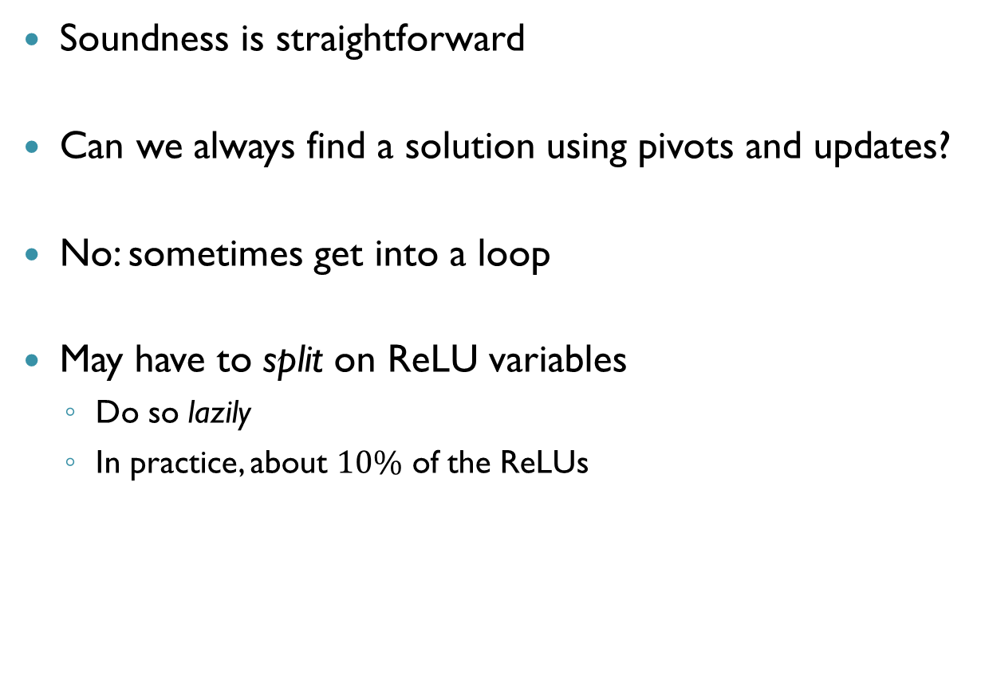
Soundness & Termination
Soundness is straightforward
Can we always find a solution using pivots and updates?
No: sometimes get into a loop
May have to split on ReLU variables
Do so lazily
In practice, about $10\%$ of the ReLUs

Slide 20

Reluplex: Efficient Implementation
Bound tightening
Deriving tighter lower/upper bounds can eliminate ReLUs
Use a Satisfiability Modulo Theories (SMT) framework
Efficiently manage case splits and bound tightening
Use floating point arithmetic
Put bounds on round-off errors
For more details, see paper
$$x=y+z \\ x≥−2 \\ y≥1 \\ z≥1$$
$$x≥2$$

Slide 21
Agenda
The Reluplex Algorithm
Verifying the ACAS Xu Networks
Conclusion

Slide 22
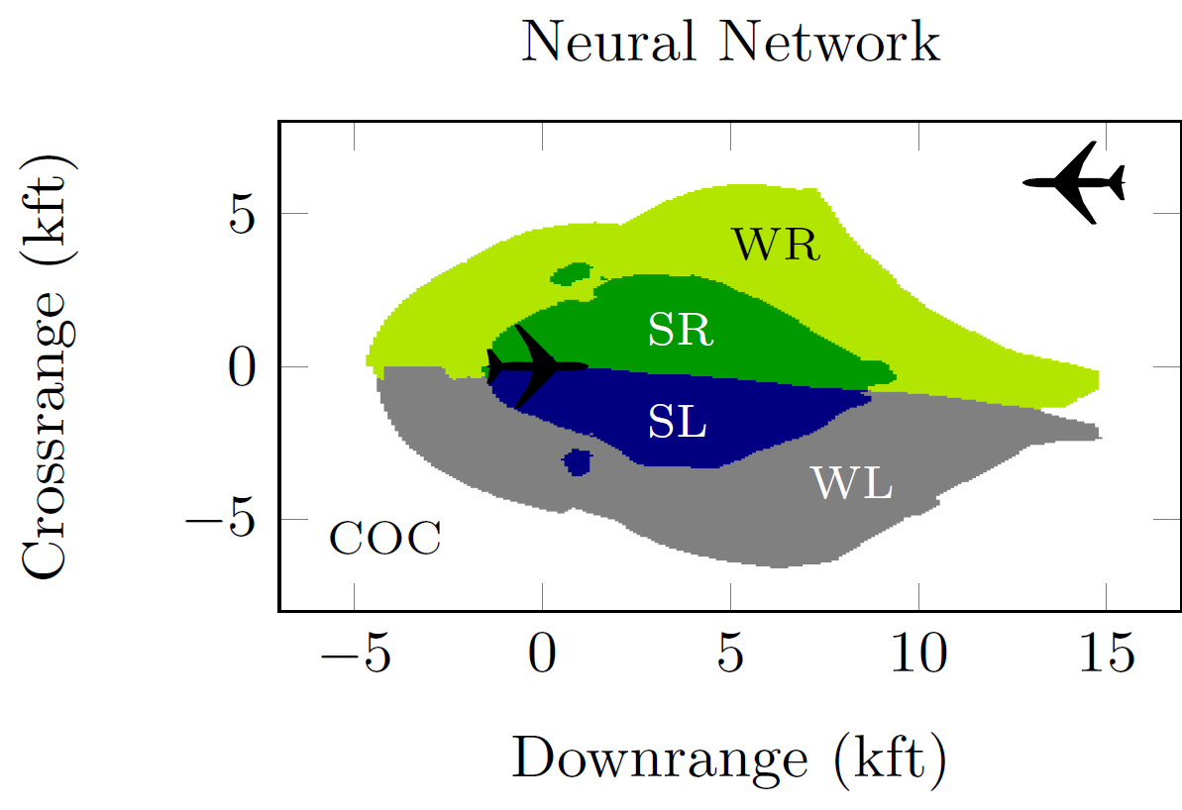
Properties of Interest
No unnecessary turning advisories
Alerting regions are consistent
Strong alerts do not appear when vertical separation is large

Slide 23

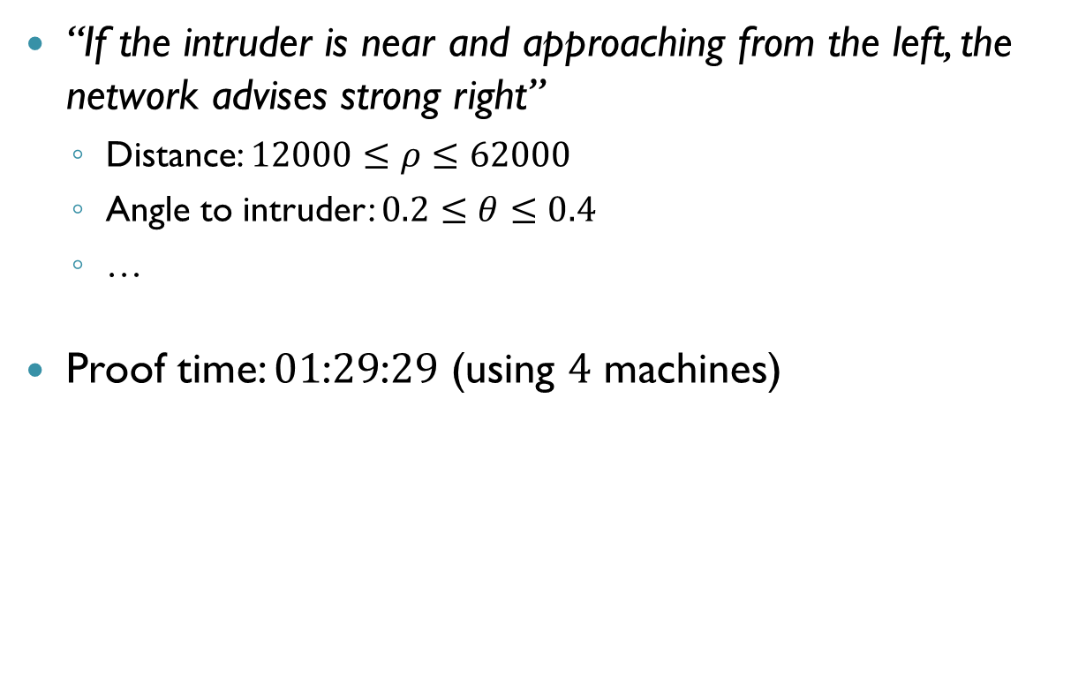
ACAS Xu: Example $1$
“If the intruder is near and approaching from the left, the network advises strong right”
Distance: $12000≤ρ≤62000$
Angle to intruder: $0.2≤θ≤0.4$
…
Proof time: $01$:$29$:$29$ (using $4$ machines)
Notes:
Property 5 in the paper

Slide 24
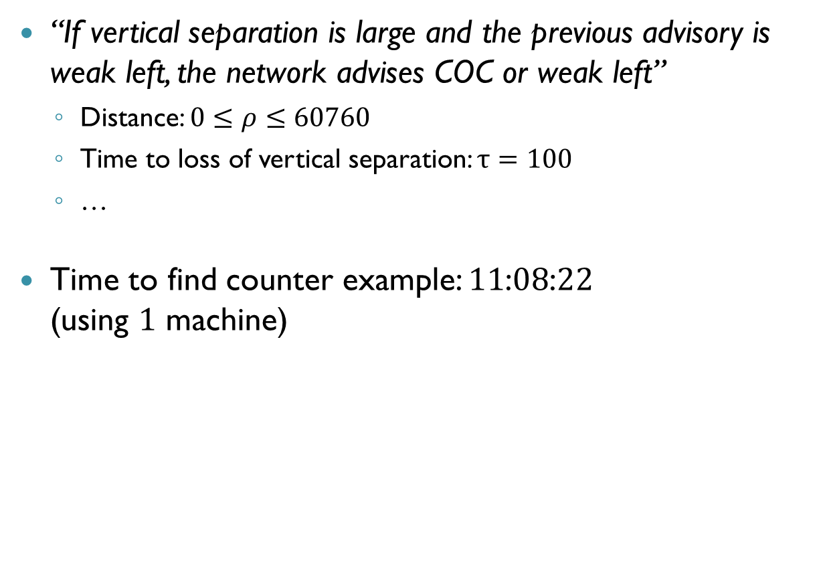
ACAS Xu: Example 2
“If vertical separation is large and the previous advisory is weak left, the network advises COC or weak left”
Distance: $0≤ρ≤60760$
Time to loss of vertical separation: $τ=100$
…
Time to find counter example: $11$:$08$:$22$ (using $1$ machine)
Notes:
Property 8 in the paper

Slide 25
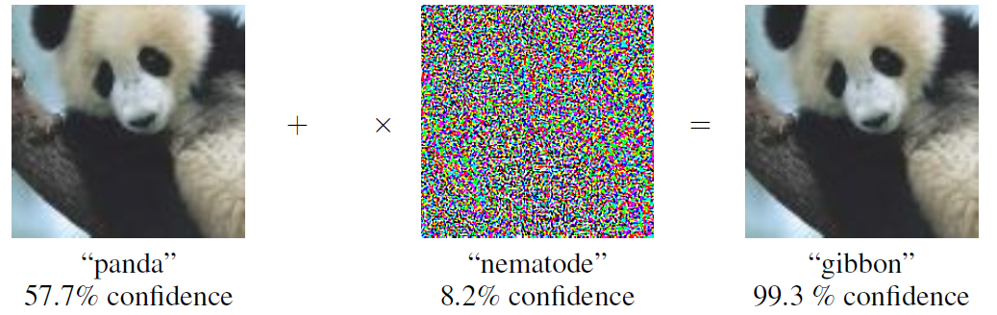


Robustness to Adversarial Inputs
Slight input perturbations cause misclassification
Reluplex can prove that these cannot occur (for given input and amount of noise)
Goodfellow et al., $2015$
$$ε$$

Slide 26

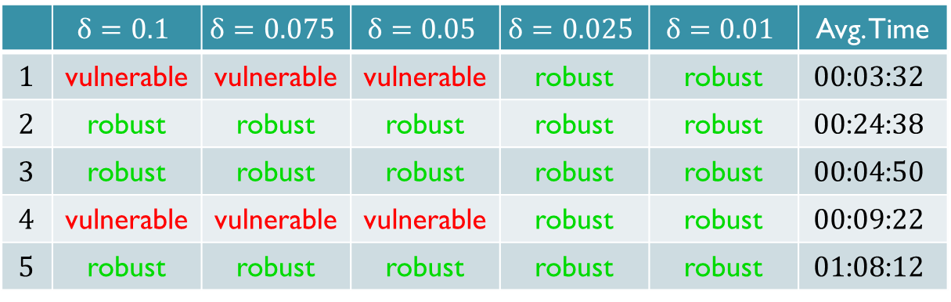
Local Adversarial Robustness
Local robustness at $x$: how far from $x$ is the first adversarial example?
 | $$δ=0.1$$ | $$δ=0.075$$ | $$δ=0.05$$ | $$δ=0.025$$ | $$δ=0.01$$ | Avg. Time
$$1$$ | vulnerable | vulnerable | vulnerable | robust | robust | $$00\text{:}03\text{:}32$$
$$2$$ | robust | robust | robust | robust | robust | $$00\text{:}24\text{:}38$$
$$3$$ | robust | robust | robust | robust | robust | $$00\text{:}04\text{:}50$$
$$4$$ | vulnerable | vulnerable | vulnerable | robust | robust | $$00\text{:}09\text{:}22$$
$$5$$ | robust | robust | robust | robust | robust | $$0\text{1}\text{:}0\text{8}\text{:}12$$
Notes:
Property 10 in the paper

Slide 27
Agenda
The Reluplex Algorithm
Verifying the ACAS Xu Networks
Conclusion

Slide 28
Conclusion
Reluplex: a technique for solving linear programs with ReLUs
Can encode neural networks and properties as Reluplex inputs
Improved scalability over previous techniques
Sound and terminating
Modulo floating point

Slide 29
Next Steps
Further certify the ACAS Xu networks
Scalability: better SMT and LP techniques
Additional activation functions
Additional applications: autonomous driving (Intel)

Slide 30


Questions
Thank You!
Available on arXiv: $1702.01135$

Slide 31

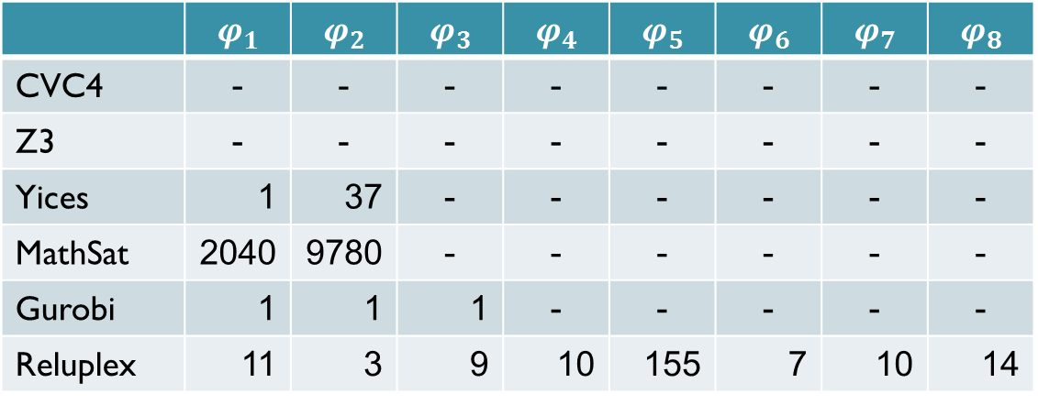
Comparison to SMT/LP Solvers
$φ_{1}…φ_{8}$: Satisfiable properties, find point $x$ for which the output is $y$ with score at least $c$
Times in seconds, - indicates the 4h timeout
 | $$φ_{1}$$ | $$φ_{2}$$ | $$φ_{3}$$ | $$φ_{4}$$ | $$φ_{5}$$ | $$φ_{6}$$ | $$φ_{7}$$ | $$φ_{8}$$
CVC4 | - | - | - | - | - | - | - | -
Z3 | - | - | - | - | - | - | - | -
Yices | 1 | 37 | - | - | - | - | - | -
MathSat | 2040 | 9780 | - | - | - | - | - | -
Gurobi | 1 | 1 | 1 | - | - | - | - | -
Reluplex | 11 | 3 | 9 | 10 | 155 | 7 | 10 | 14

Slide 32



Global Adversarial Robustness
Local robustness: check for fixed $x$
Global robustness: checked for all inputs simultaneously
$$x_{1}$$
$$x_{2}$$
Notes:
Property 10 in the paper

Slide 33
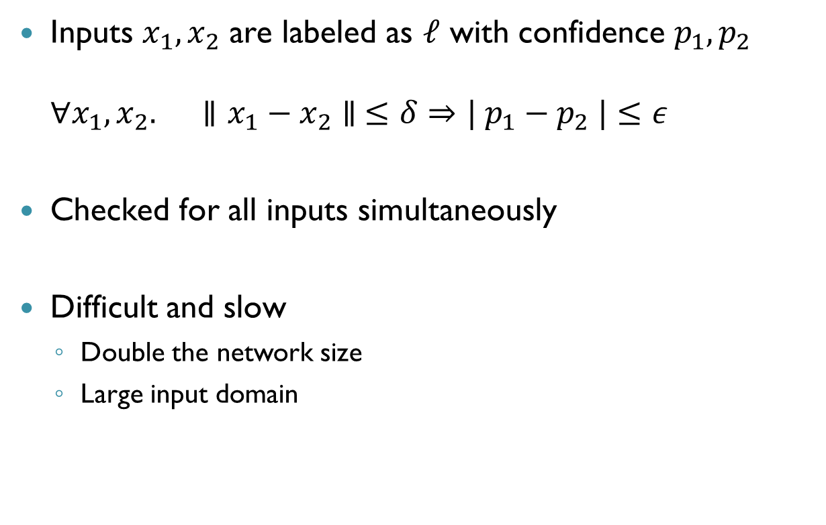
Global Adversarial Robustness
Inputs $x_{1},x_{2}$ are labeled as $ℓ$ with confidence $p_{1},p_{2}$ $∀x_{1},x_{2}.$ $∥x_{1}−x_{2}∥ ≤δ⇒| p_{1}−p_{2} |≤ε$
Checked for all inputs simultaneously
Difficult and slow
Double the network size
Large input domain
Notes:
Property 10 in the paper

