Slide 1
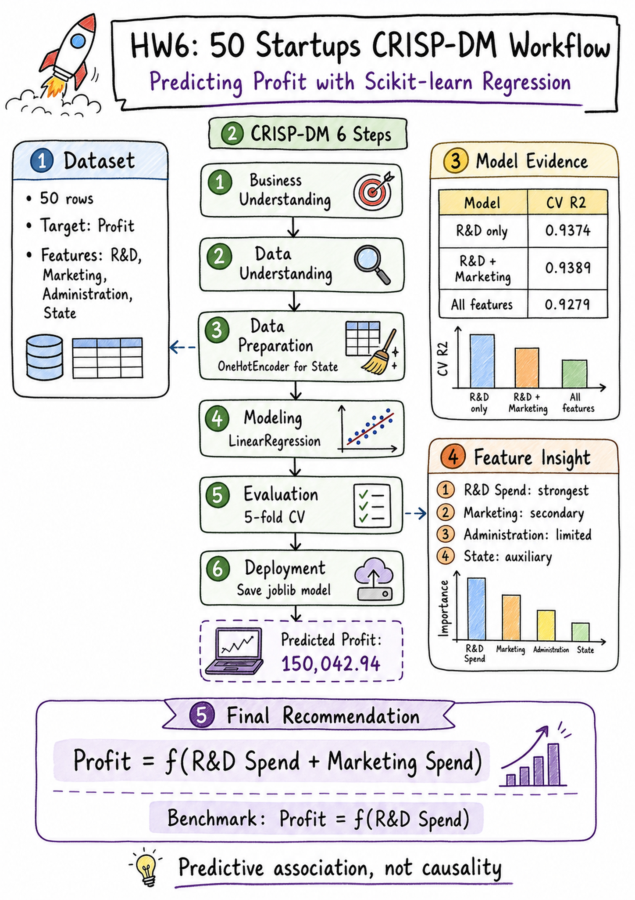
HW6: Kaggle 50 Startups Profit Prediction
CRISP-DM + Scikit-learn Regression Project
Prepared by: James Wang
Target: startup Profit
Final model: R&D Spend + Marketing Spend
Speaker notes included in PowerPoint Notes pane.
HW6 | Kaggle 50 Startups | CRISP-DM
1
Notes:
Welcome to my HW6 project presentation. In this project, I use the Kaggle 50 Startups dataset to predict startup profit. The analysis follows the CRISP-DM process and uses Scikit-learn regression models to compare different feature sets.

Slide 2
Project Objective
Predict startup Profit
Use business spending variables
Build an interpretable regression model
Support business decision-making
Business spending -> predicted Profit
Speaker notes included in PowerPoint Notes pane.
HW6 | Kaggle 50 Startups | CRISP-DM
2
Notes:
The main objective is to predict startup profit based on spending information. The model is designed to be interpretable, so it can support decisions by founders, investors, analysts, and managers.

Slide 3
Dataset Overview
Dataset: 50_Startups_dataset.csv
Records: 50
Target: Profit
Features: R&D Spend, Administration, Marketing Spend, State
Problem type: supervised regression
50 rows | 5 columns | clean dataset
Speaker notes included in PowerPoint Notes pane.
HW6 | Kaggle 50 Startups | CRISP-DM
3
Notes:
The dataset contains 50 startup records. The target variable is Profit. The predictors include R&D spending, administrative spending, marketing spending, and state. Since Profit is a continuous numeric value, this is a supervised regression problem.

Slide 4
CRISP-DM Workflow
1. Business Understanding
2. Data Understanding
3. Data Preparation
4. Modeling
5. Evaluation
6. Deployment
Plan -> Model -> Evaluate -> Deploy
Speaker notes included in PowerPoint Notes pane.
HW6 | Kaggle 50 Startups | CRISP-DM
4
Notes:
This project follows the six steps of CRISP-DM. This structure helps connect the business question, data exploration, model building, evaluation, and final deployment simulation into one complete workflow.

Slide 5
Business Understanding
Business question: which spending patterns are associated with higher profit?
Startup resources are limited
Model supports planning and resource allocation
Important: prediction, not causality
Use association language, not causal claims.
Speaker notes included in PowerPoint Notes pane.
HW6 | Kaggle 50 Startups | CRISP-DM
5
Notes:
The business question is which spending patterns are associated with higher profit. Because the dataset is observational and small, I avoid claiming causality. The model can identify predictive associations, but it cannot prove that one feature directly causes profit to increase.

Slide 6
Expert Panel View
Marketing expert: market expansion
Top CEO: decision usefulness
Governor / policy expert: regional factors
R&D expert: product innovation
Four perspectives, one model decision.
Speaker notes included in PowerPoint Notes pane.
HW6 | Kaggle 50 Startups | CRISP-DM
6
Notes:
To make the interpretation more business-oriented, I use four expert perspectives. The marketing expert focuses on customer acquisition, the CEO focuses on decision usefulness, the policy expert considers regional factors, and the R&D expert focuses on product innovation.

Slide 7
Data Understanding
Shape: 50 rows, 5 useful columns
Missing values: 0
Duplicate rows: 0
States: New York, California, Florida
Data quality check passed.
Speaker notes included in PowerPoint Notes pane.
HW6 | Kaggle 50 Startups | CRISP-DM
7
Notes:
The dataset is clean. It has 50 rows and 5 useful columns after removing the exported index column. There are no missing values and no duplicate rows. The state variable contains New York, California, and Florida.

Slide 8
Feature Meaning
R&D Spend: product innovation and technical capability
Marketing Spend: brand exposure and customer acquisition
Administration: operating scale and management structure
State: regional auxiliary factor
Feature meaning guides interpretation.
Speaker notes included in PowerPoint Notes pane.
HW6 | Kaggle 50 Startups | CRISP-DM
8
Notes:
Each feature has a business meaning. R&D spending reflects product development and innovation. Marketing spending reflects market expansion and customer acquisition. Administration may represent operating scale. State may represent regional conditions, but the sample size is too small for strong regional conclusions.

Slide 9
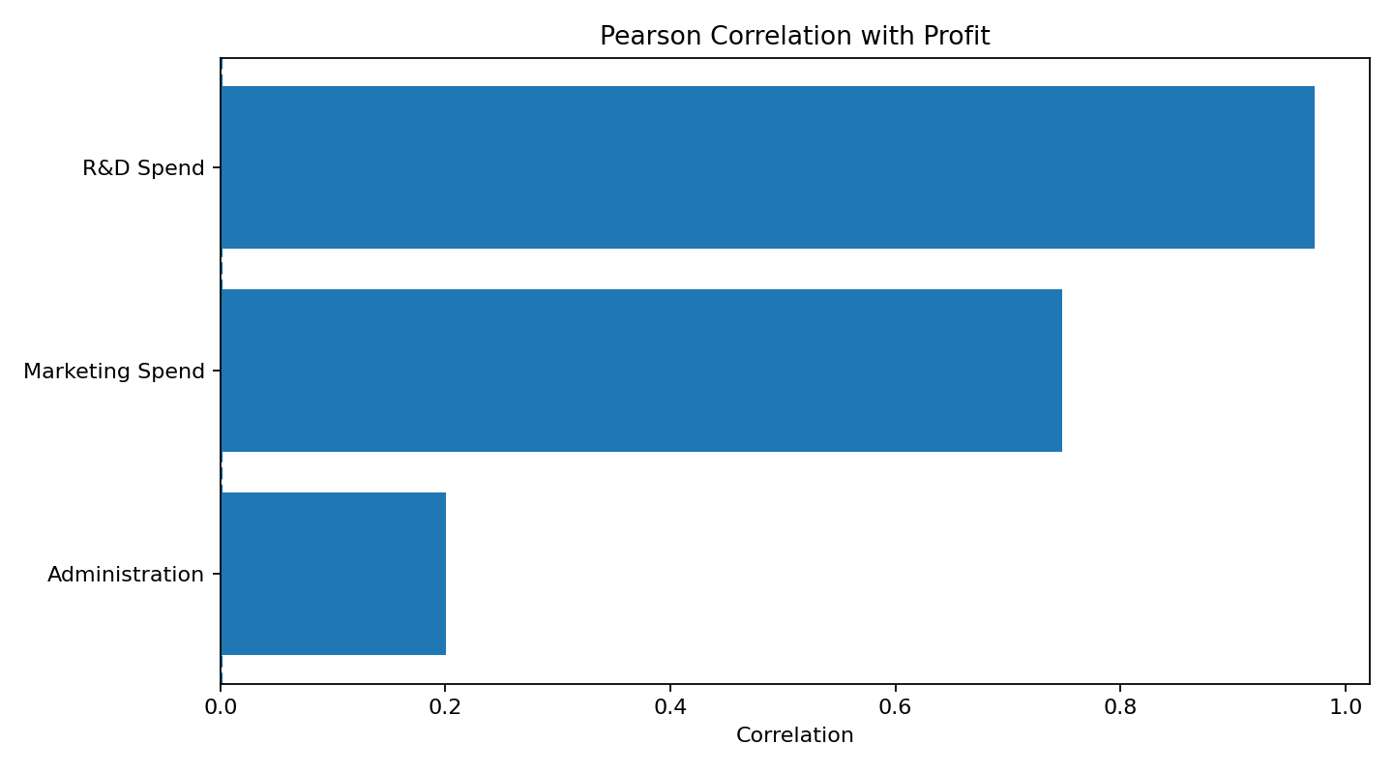
Correlation Results
R&D Spend: 0.9729
Marketing Spend: 0.7478
Administration: 0.2007
R&D is the strongest direct linear signal
Speaker notes included in PowerPoint Notes pane.
HW6 | Kaggle 50 Startups | CRISP-DM
9
Notes:
The correlation results show that R&D Spend has the strongest direct linear relationship with Profit. Marketing Spend is also positively associated with Profit, but it is weaker than R&D. Administration has a much weaker correlation.

Slide 10
Data Preparation
Separate X and y
Use Profit as target
Encode State with OneHotEncoder
Use ColumnTransformer and Pipeline
Train-test split: 80/20 with random_state=42
Reproducible sklearn Pipeline
Speaker notes included in PowerPoint Notes pane.
HW6 | Kaggle 50 Startups | CRISP-DM
10
Notes:
For data preparation, I separate the features and target variable. The categorical State feature is encoded with OneHotEncoder, not label encoding. I use ColumnTransformer and Pipeline to keep preprocessing and modeling in one reproducible workflow.

Slide 11
Modeling Strategy
Primary model: LinearRegression
Target is continuous
Dataset is small
Model is interpretable
Suitable for CRISP-DM teaching and reporting
Simple model, clear explanation.
Speaker notes included in PowerPoint Notes pane.
HW6 | Kaggle 50 Startups | CRISP-DM
11
Notes:
The primary model is Linear Regression. This model is appropriate because the target is continuous, the dataset is small, and the results are easier to explain in a business and educational setting.

Slide 12
Model Experiments
Model 1: R&D only
Model 2: R&D + Marketing
Model 3: Numerical features
Model 4: All features
Test whether more features actually help.
Speaker notes included in PowerPoint Notes pane.
HW6 | Kaggle 50 Startups | CRISP-DM
12
Notes:
I compare four feature sets. First, I test R&D alone. Second, I add Marketing. Third, I include all numerical features. Finally, I include all features, including State. This helps test whether additional variables actually improve prediction.

Slide 13
Evaluation Metrics
R2 Score
MAE
RMSE
CV R2 Mean and Std
CV RMSE Mean and Std
5-fold cross-validation
Small dataset -> use cross-validation.
Speaker notes included in PowerPoint Notes pane.
HW6 | Kaggle 50 Startups | CRISP-DM
13
Notes:
The models are evaluated with R2, MAE, and RMSE on the train-test split. Since the dataset has only 50 rows, I also use 5-fold cross-validation to check model stability and reduce reliance on one split.

Slide 14
Model Comparison
R&D only: Test R2 0.9265 | CV R2 0.9374
R&D + Marketing: Test R2 0.9168 | CV R2 0.9389
Numerical features: Test R2 0.9001 | CV R2 0.9338
All features: Test R2 0.8987 | CV R2 0.9279
Best CV R2 Mean: R&D + Marketing
Speaker notes included in PowerPoint Notes pane.
HW6 | Kaggle 50 Startups | CRISP-DM
14
Notes:
The comparison shows that R&D only performs very strongly. However, R&D plus Marketing has the highest cross-validation R2 mean, at 0.9389. The numerical and all-feature models perform worse, which shows that more features do not automatically improve the model.

Slide 15
Feature Selection Evidence
Pearson correlation
SelectKBest F-regression
Recursive Feature Elimination
LASSO regularization
Random Forest importance
Consensus: R&D Spend dominates.
Speaker notes included in PowerPoint Notes pane.
HW6 | Kaggle 50 Startups | CRISP-DM
15
Notes:
Multiple feature selection methods support the same conclusion. Pearson correlation, SelectKBest, RFE, LASSO, and Random Forest importance all show that R&D Spend is the dominant predictive feature.

Slide 16
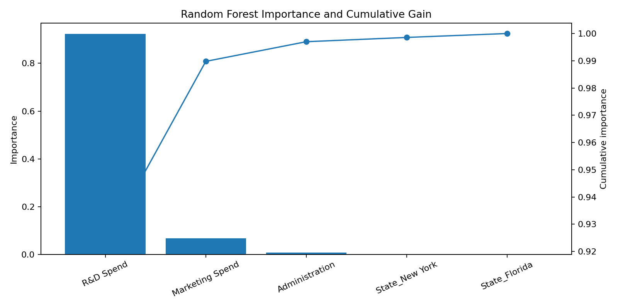
Random Forest Importance
R&D Spend: 0.9228
Marketing Spend: 0.0670
Administration: 0.0072
State total: about 0.0030
Speaker notes included in PowerPoint Notes pane.
HW6 | Kaggle 50 Startups | CRISP-DM
16
Notes:
The Random Forest feature importance result also confirms the same pattern. R&D Spend contributes most of the predictive signal. Marketing is second, while Administration and State contribute very little in this dataset.

Slide 17
Final Model Decision
Main model: Profit = f(R&D Spend, Marketing Spend)
Benchmark: Profit = f(R&D Spend)
Reason: best CV R2 Mean plus business meaning
Avoid selecting the most complex model automatically
Final model: R&D + Marketing
Speaker notes included in PowerPoint Notes pane.
HW6 | Kaggle 50 Startups | CRISP-DM
17
Notes:
The final main model uses R&D Spend and Marketing Spend. R&D alone is kept as the simplest benchmark. This choice balances predictive performance, business meaning, simplicity, and interpretability.

Slide 18
Deployment Simulation
R&D Spend: 120,000
Administration: 130,000
Marketing Spend: 250,000
State: New York
Predicted Profit: 150,042.94
Learning-project deployment, not full production.
Speaker notes included in PowerPoint Notes pane.
HW6 | Kaggle 50 Startups | CRISP-DM
18
Notes:
For deployment simulation, I use a sample startup with R&D Spend of 120,000, Administration of 130,000, Marketing Spend of 250,000, and State as New York. The final model predicts a profit of about 150,042.94.

Slide 19
Business Interpretation
Prioritize product innovation
Use Marketing to support market reach
Administration and State add limited value here
Do not overclaim causality
Product innovation is the core signal.
Speaker notes included in PowerPoint Notes pane.
HW6 | Kaggle 50 Startups | CRISP-DM
19
Notes:
The business interpretation is that product innovation appears to be the strongest signal associated with profit. Marketing can support market reach, but its incremental value is small. Administration and State were tested, but they do not add meaningful predictive value in this small dataset.

Slide 20
Final Conclusion
Use R&D Spend + Marketing Spend as the main explainable model
Keep R&D Spend as the benchmark
Treat results as predictive associations
Dataset is small: 50 observations
Speaker notes included in PowerPoint Notes pane.
HW6 | Kaggle 50 Startups | CRISP-DM
20
Notes:
In conclusion, the recommended model is R&D Spend plus Marketing Spend. R&D Spend remains the strongest predictor, while Marketing provides useful business context. Because the dataset contains only 50 observations, the results should be treated as predictive associations rather than causal conclusions. Thank you.

