Slide 1
Machine Control ready for the Internet of Things
Alexander Rössler, BSc

Slide 2
Overview
About Me
Machinekit
Machinetalk
Live Demo

Slide 3
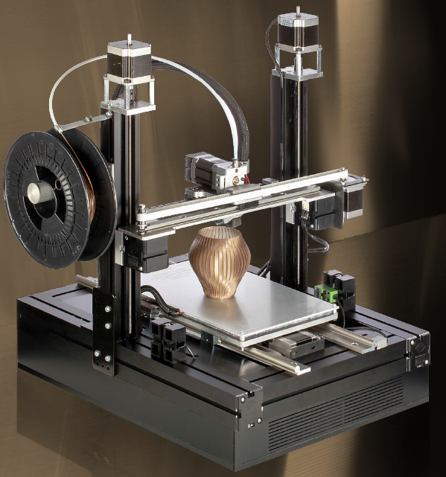
About Me
Alexander Rössler
Embedded Systems
OpenSource community
3D printing
The Cool Tool

Slide 4
What is Machinekit?

Slide 5
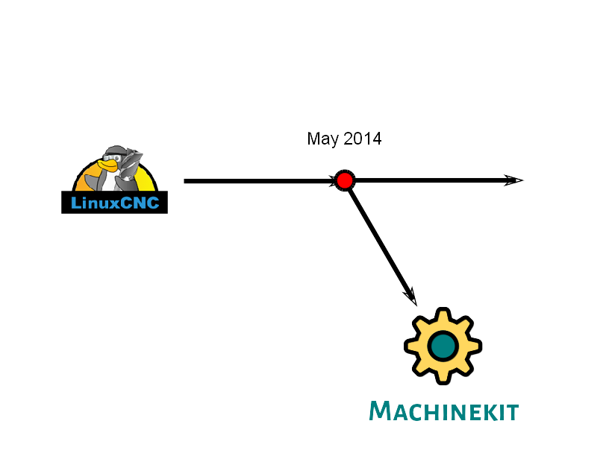
Roots

Slide 6
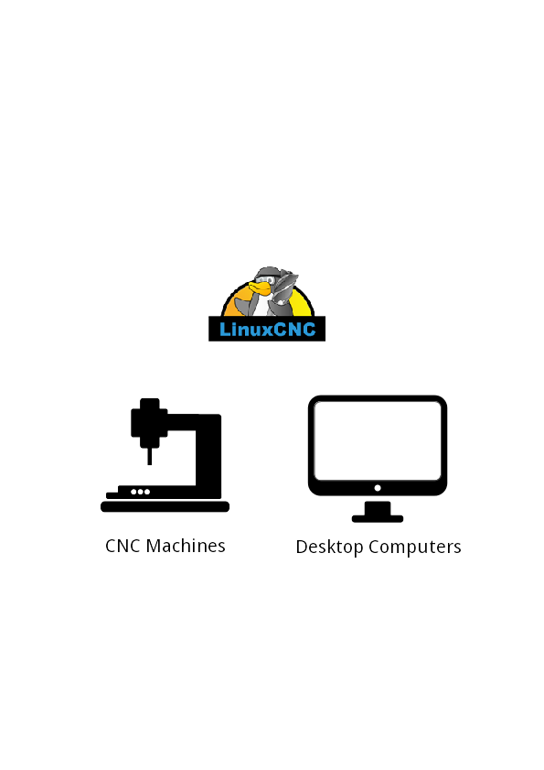
Roots

Slide 7
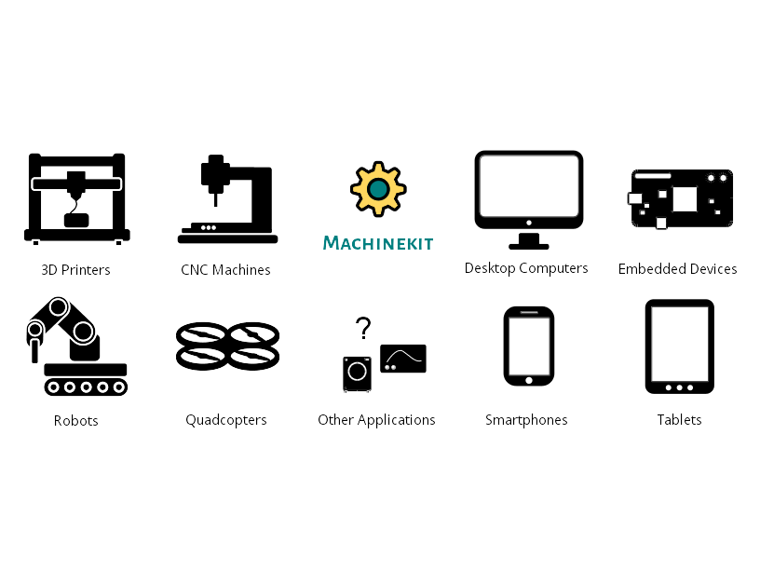
Applications

Slide 8
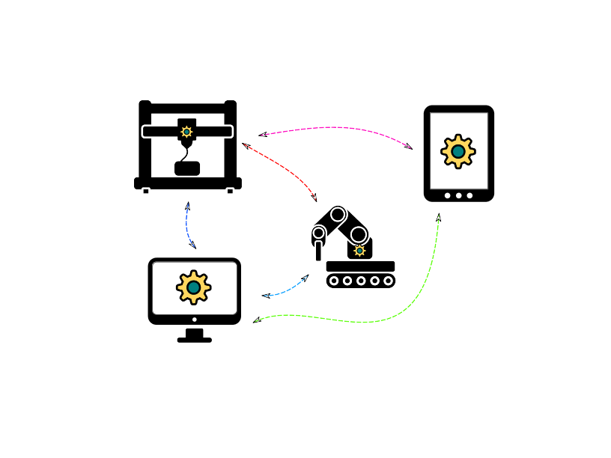
Machinetalk
Middleware
Interaction between RT and non-RT
Distributed setups

Slide 9
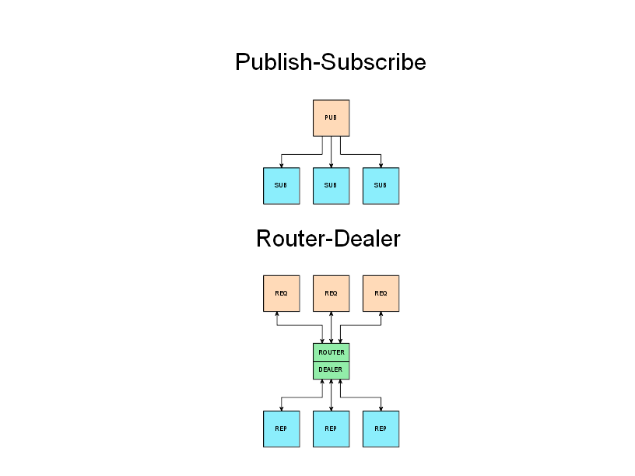
Transport
ZeroMQ
End-to-end
Communication patterns
Several transports (TCP, IPC, …)
No startup order dependency
Automatic reconnect

Slide 10
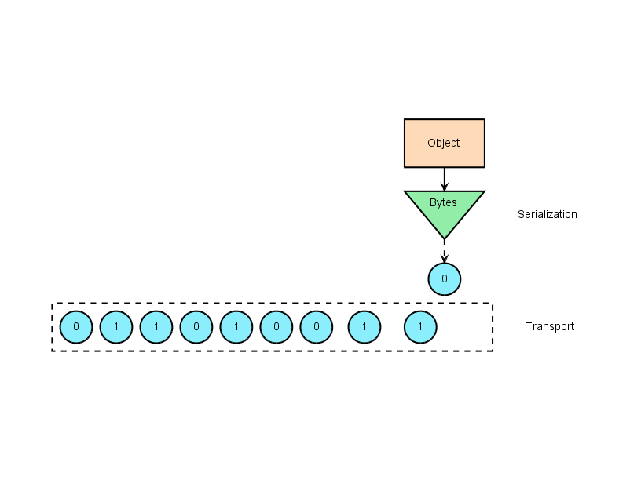
Serialization
Protocol Buffers
Wire format
Binary data
Highly optimized
RT: nanopb

Slide 11
Services
Instances organized in services
Distributed setups
Easy to extend

Slide 12
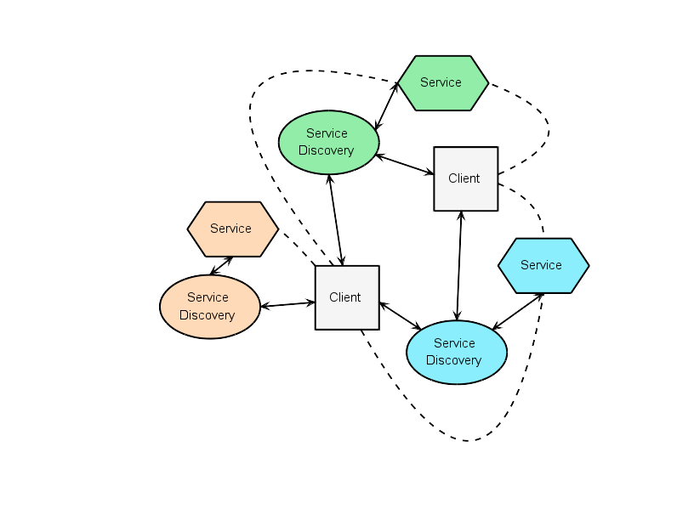
Service Discovery
MDNS/DNS-SD
Auto configuration
No user interaction
Decentralized
Multicast
Unicast

Slide 13

Webtalk
Bridge
Protobuf → JSON
ZeroMQ → websockets

Slide 14
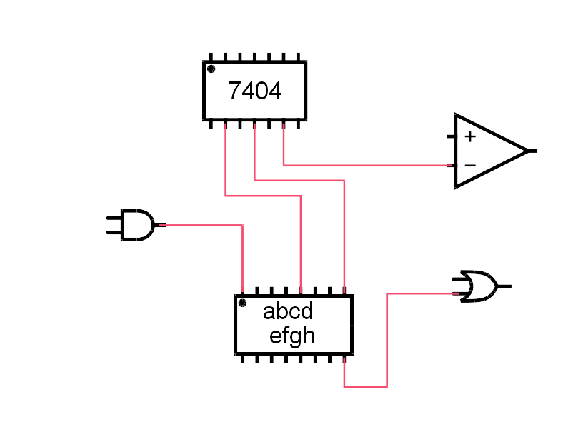
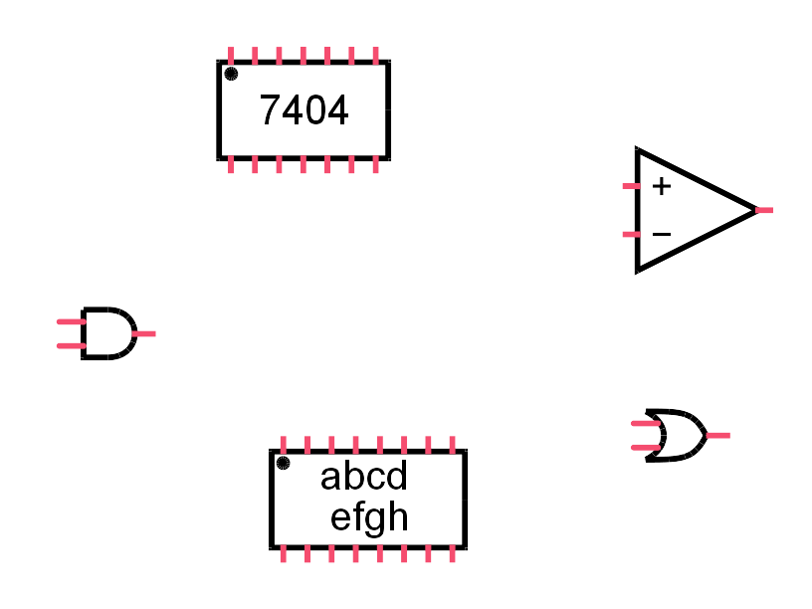
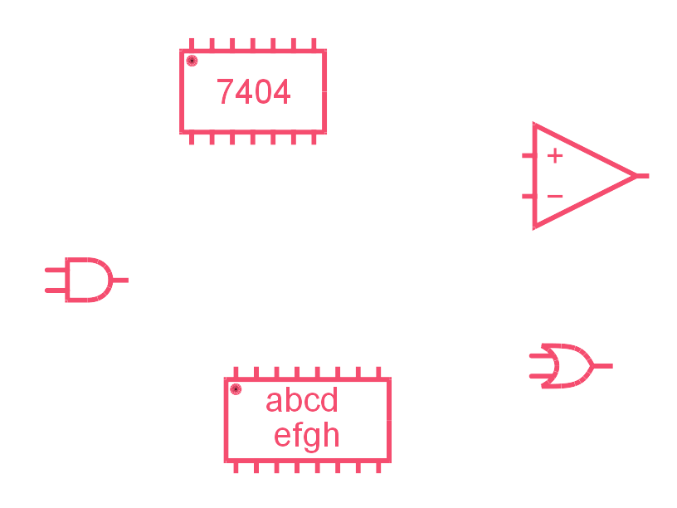
Hardware Abstraction Layer
Configuration
  Components
  Pins
  Signals
Realtime
Userland

Slide 15
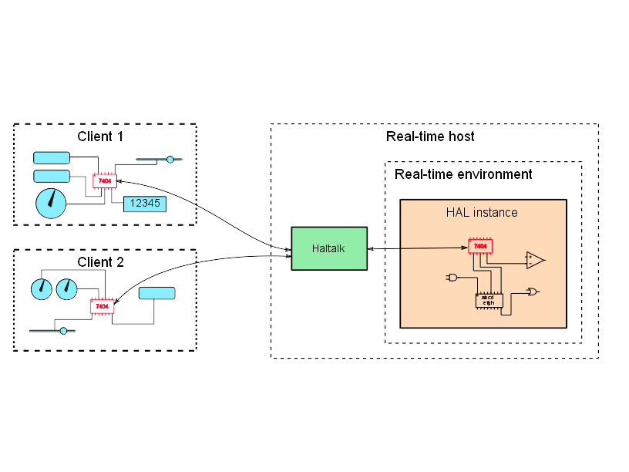
HAL Remote Component
Like normal components
Remote API

Slide 16
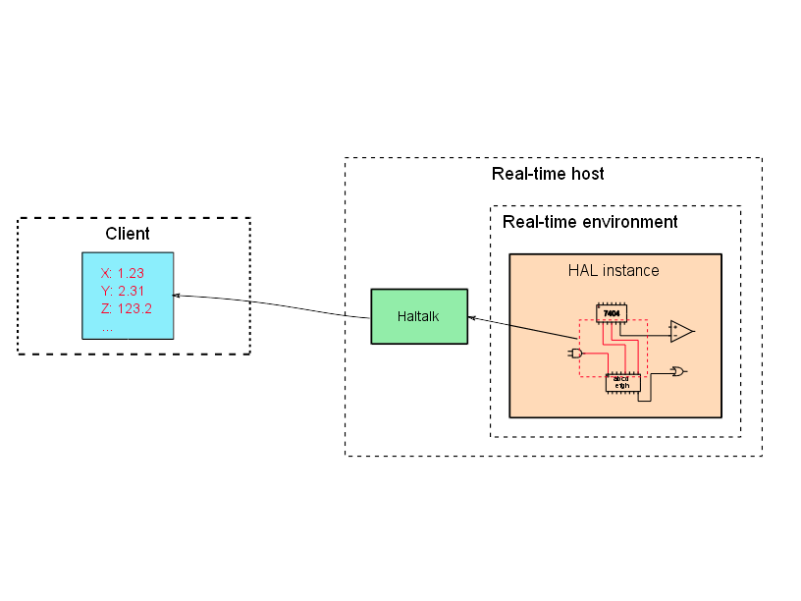
HAL Groups
Grouping signals
Value updates

Slide 17
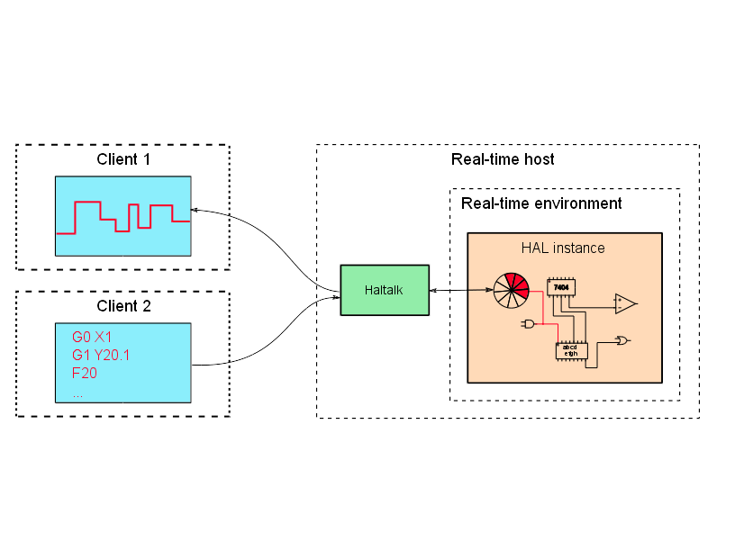
HAL Named Ring Buffers
Queued command and response
RT to non-RT interface

Slide 18
Showtime!

Slide 19
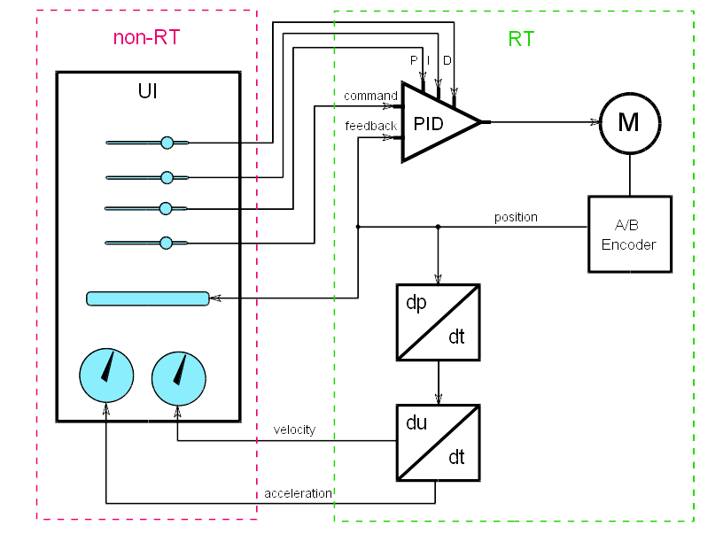
Demo

Slide 20
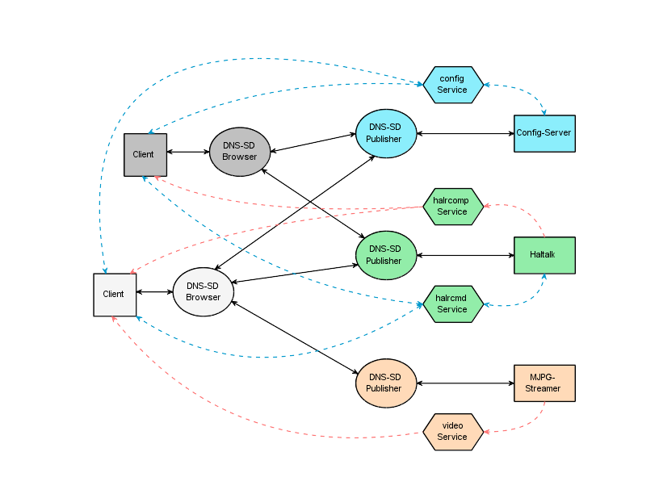
DEMO

Slide 21
More Information
machinekit.io
Machinekit on Google Google Groups

Slide 22
Questions?

