Slide 1

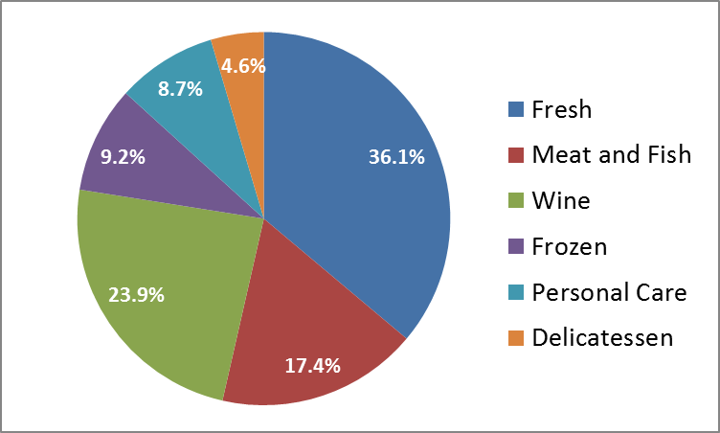

Case Study Food Retailers
segmentation of the customer base
The data set refers to 440 customers of a retailer in the food industry
Customers come from two different channels (Pos 67.7%, Online 32.3%) and are distributed into three regions (North 71.8%, Center 17.5%, South 10.7%).
Data include the annual spending on some product categories:
Fresh
Meat & Fish
Wine
Frozen
Personal Care
Delicatessen

Slide 2
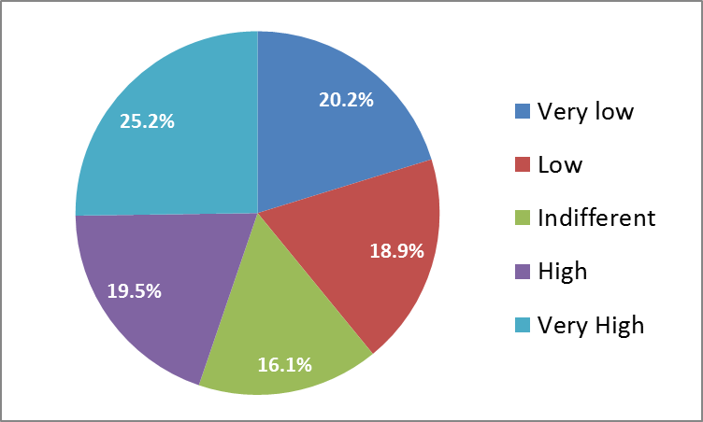
Case Study Food Retailers
segmentation of the customer base
Data also include responses to a questionnaire intended to evaluate managerial actions with potential impact on sales (extending products’ assortment).
Customers were asked: “Would extending products’ assortment have impact on your purchases?”

