Slide 1


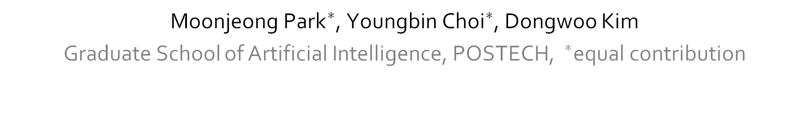
SpReME: Sparse Regression for Multi-Environment Dynamic Systems
${\text{Moon}\text{j}\text{eong} \text{Park}}^{∗}$, ${\text{Youngbin} \text{Choi}}^{∗}$, Dongwoo Kim
Graduate School of Artificial Intelligence, POSTECH, $^{∗}$equal contribution
Notes:
Hi, thank you for attending our presentation.
My name is Youngbin Choi.
Today, I’m going to present our work “SpReME: sparse regression for multi-environment dynamic systems”.
This work has been done with my great co-worker Moonjeong park and professor Dongwoo Kim.

Slide 2
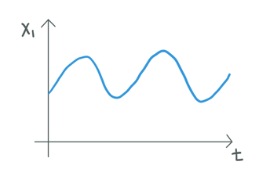
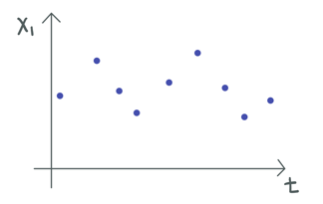

Dynamic System Discovery
Dynamic system discovery means identifying dynamic equation directly from data.
Data
Dynamic equation
Prediction
Notes:
In this slide, I’ll introduce what is dynamic system discovery.
It is identifying dynamic equations from data.
From this, we can make predictions about the future state.
For example, time series data in the left side are given.
Our goal is to find dynamics equation in the middle of the slide from data, which describes the evolution of state with time.
If we find dynamic equation, we can predict the state continuously.

Slide 3
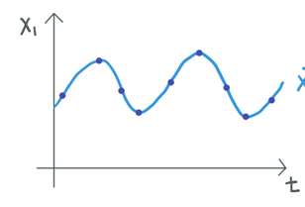

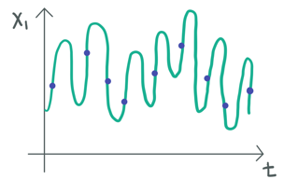

Dynamic System Discovery
The data can be expressed in several differential equations.
Well-known dynamic equations are expressed in the simple form.
Data
Notes:
Time series data can be expressed in several differential equations.
Given data in the left side, the both differential equations can represent the change of data with time, perfectly.
Then, How to select the differential equation from them?
Previous well-known dynamic equations are mostly expressed in the simple forms, even though the data seem to be complex with time.
From this fact, we select the simple form from several differential equations.

Slide 4
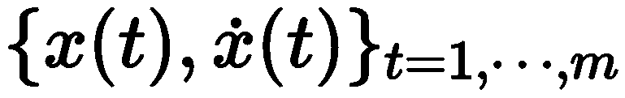
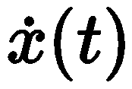
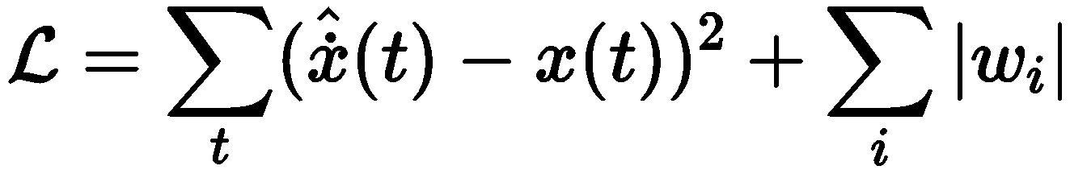
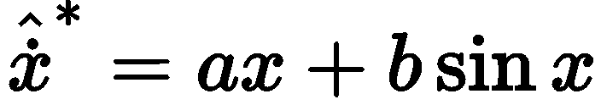
Previous Work; SINDy
Given data , we can model potential dynamic equations with candidate functions.
Candidate functions
sparsity for finding simple form
🤔
Notes:
I’ll introduce the previous work for finding dynamics from data, named SINDy. ​
Given state and derivative of state with time, It frames dynamics discovery as a sparse regression problem with predefined candidate functions. ​
For example, let’s define candidate functions with x, x^2, sin x, and cos^2 x.
Then, we can model following potential dynamic equations, which predicts the derivative of state.
​
Given this data, consider the state at time t.
Then, model predicts the derivative at time t as follows.
We train coefficients of each candidate functions by comparing with the given derivative.
Then, the loss function is the bellow equation of the slide.
The result of optimizing following loss function can be expressed by using many candidate functions.
However, remind the previous slides, which tell the dynamics are prone to have a simple form.
For this, we add the L1 regularization to improve sparse coefficients.
By adding L1 regularization, the result of optimization may have simple form.
In this way, SINDy discover the dynamic equation from data.

Slide 5

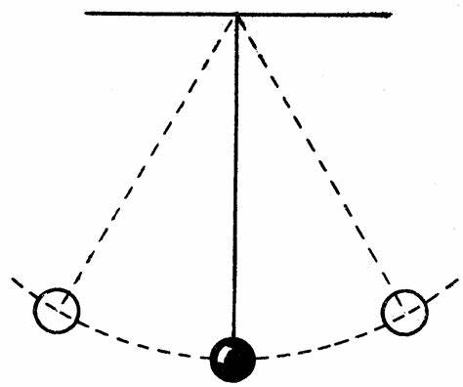
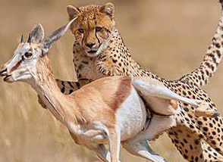
Multiple Environments
Data can be collected from multiple environments.
Predator-prey model in different regions
Pendulum with different length string
Notes:
In this slide, I’ll explain why we consider the multiple environments.
Data under the same dynamic system can be collected in different environments.
For example, consider the predator prey model, which describes the change of the number of predators and prey.
In reality, The number of predators and prey with time can be collected from Asia and South America.
Another example is the pendulum system. The data can be collected with various string length.
In multi environments, dynamics describes identical dynamic systems, but data have different tendencies.

Slide 6
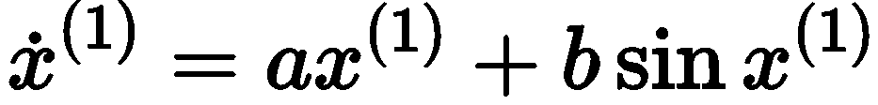
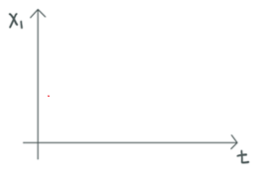

Multiple Environments
In multiple environments, only coefficients of terms are changed, but terms are shared.
SINDy cannot capture shared information across environments.
env1
Shared!
env2
Notes:
Let’s see what is different in dynamics equations in multiple environments.
Show the example.
Here, the super script indicates environment.
In environment 1 and environment 2, only coefficients of each term are changed, but terms are identical.
That is, terms of dynamic equation are shared across all environments.
However, SINDy cannot capture this shared information from multi environment data.

Slide 7

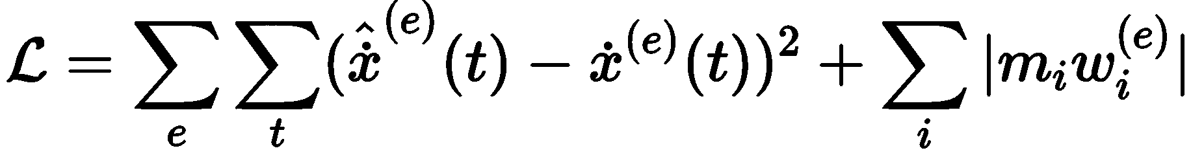
Method; Introduce Binary Mask
We introduce binary mask to capture few necessary candidate functions across all environments.
Mask is trained with all environments data
env1
Shared!
env2
Notes:
In this slide, I’ll introduce our method.
We introduce the binary mask m to capture few necessary terms across all environments.
Consider the state at time t in each environments.
The model predicts the derivative in each environment as follows.
Here, The main idea is the mask is shared across all environments, while enforcing to use same candidates across all environments.
The loss function is equation in the bottom of the slide.
Also, it uses mse loss for regression, and L1 regularization for sparsity.
Only difference with SINDy is the existence of mask.
Mask is trained with all environments data.
That is, mask can capture the necessary candidate terms, using all environments data.

Slide 8
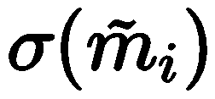
Method; Continuous Mask
Optimization with binary mask is a combinatorial optimization problem.
We relax binary mask into continuous mask
Notes:
To train mask and coefficients, we optimize the loss function in terms of coefficients and mask.
However, optimization with binary mask is a combinatorial optimization problem, which is generally interactable.
So, we relax binary mask m into continuous mask sigmoid tilde m.
Let’s see the derivative prediction with binary mask m in the middle of slide.
It changed into the bellow equation with continuous mask.

Slide 9
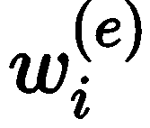



Method; Learning Algorithm
We update coefficients and mask with gradient descent, alternatively.
Update coefficients with binary mask
binarize continuous mask
Update continuous mask with coefficients
Notes:
In this slide, I’ll explain our learning algorithm briefly.
We update coefficients and mask with gradient descent, alternatively.
After optimizing the coefficients with a binary mask, the continuous mask should be updated, utilizing the updated coefficients.
Subsequently, the continuous mask should be binarized, and this process should be repeated in order to train both the coefficients and the mask.
For example, This is the result of optimizing coefficients with binary mask.
In this time, the model with continuous version is as follows.
Update continuous mask and, binarize it.
The results is the equation under blue box.
We repeat this process to train coefficients and mask.

Slide 10
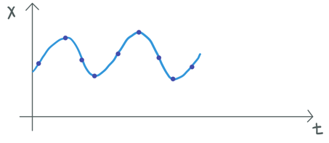

Experimental setting
We use 4 dynamics:
Linear, Lotka-Volterra, Lorenz, Damped pendulum
We test performance in unseen environment after adaptation.
To evaluate extrapolation performance, we set longer time horizon of test data than train data.
interpolation
extrapolation
Notes:
We conduct experiments under four systems, and test the performance in an unseen environment after adaptation.
We set a time horizon of test data longer than train data for evaluating extrapolation performance.
See the picture in the bottom of slide.
Extrapolation means predicting the state outside of the learning range.
And, interpolation means predicting the state inside of the learning range.

Slide 11
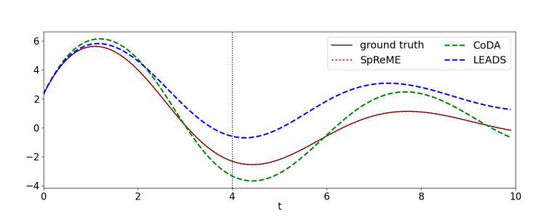
Results; Damped Pendulum
SpReME captures underlying dynamics almost perfectly.
interpolation
extrapolation
Notes:
This is the qualitative results under damped pendulum system, compared with neural network based models.
here, The red dot means prediction with spreme, and black line is ground truth.
As you can see, the two lines overlap.
So, we can infer that spreme predicts the state almost perfectly.

Slide 12
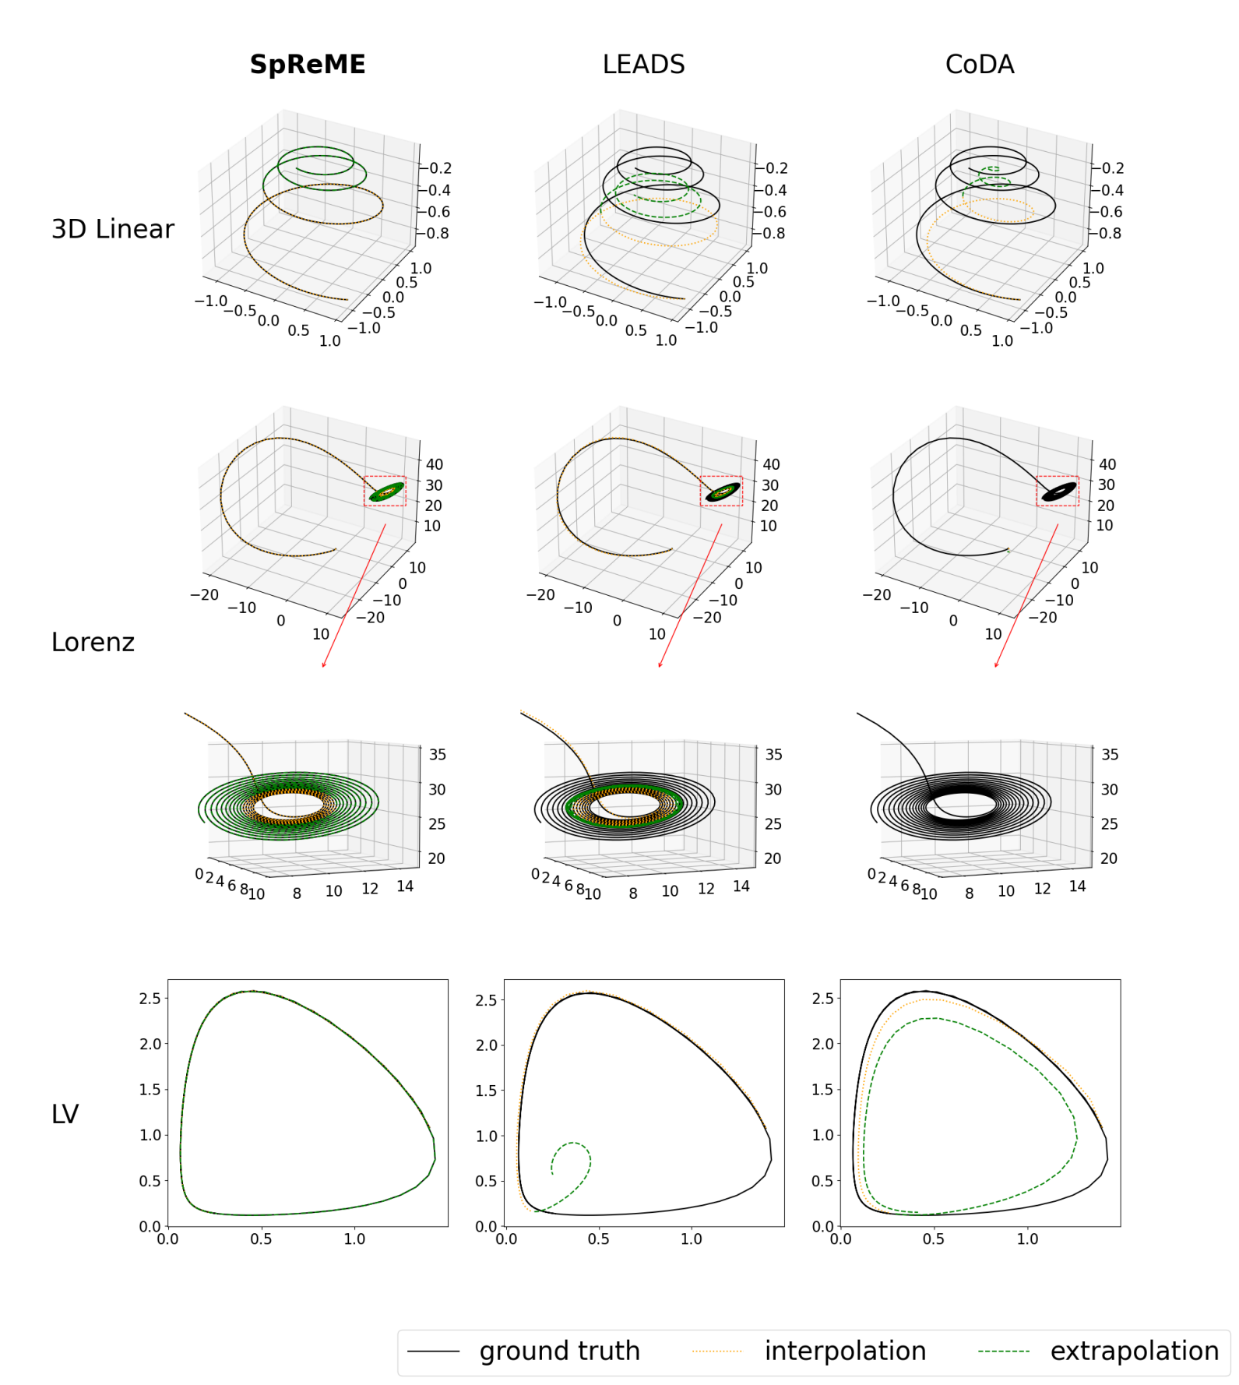
Results; Lorenz
SpReME predicts state better than neural network-based model in the range of extrapolation
Notes:
This is the results under Lorenz system.
In this figure, the yellow dot means interpolation, and the green dot means extrapolation.
The left side of picture is the result of LEADS, which has the best performance among baselines.
It predicts the state well in interpolation, but cannot extrapolate well into the future.
However, SpReME predicts the state in both sides well.

Slide 13
Thank you for listening!
choi.youngbin@postech.ac.kr
Notes:
That’s all for my presentation, and thank you for listening.

Slide 14
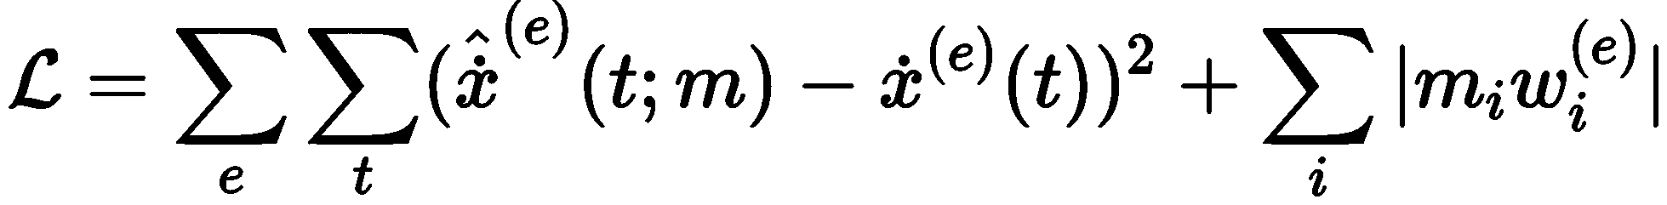
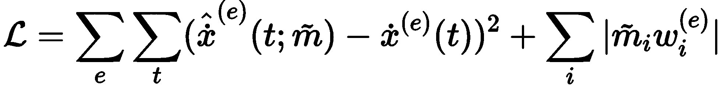
Method; Continuous Mask
Optimization with binary mask is a combinatorial optimization problem.
We relax binary mask into continuous mask
Notes:
In this slide, I’ll introduce what is dynamic system discovery.
It is identifying dynamic equations from data.
From this, we can make predictions about the future state.
For example, this picture illustrates the number of predators and prey with time.
Our goal is to find this dynamics equation from data, which describes the evolution in the number of predators and prey with time.
If we find this equation, we can predict the number of predators and prey in the future.

Slide 15
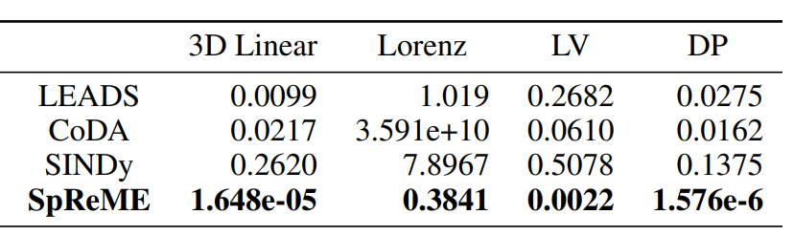
Results
We report adaptation MSE loss.
SpReME outperforms baselines under four systems.
Notes:
In quantitative results, We report mean squared error after adaptation.
As you can see in the table, SpReME outperforms not only neural network based models but SINDy under four systems.
This result shows SpReME can capture dynamics more accurately than SINDy by using the learned sparse structure from multi environments.

